Slide 1
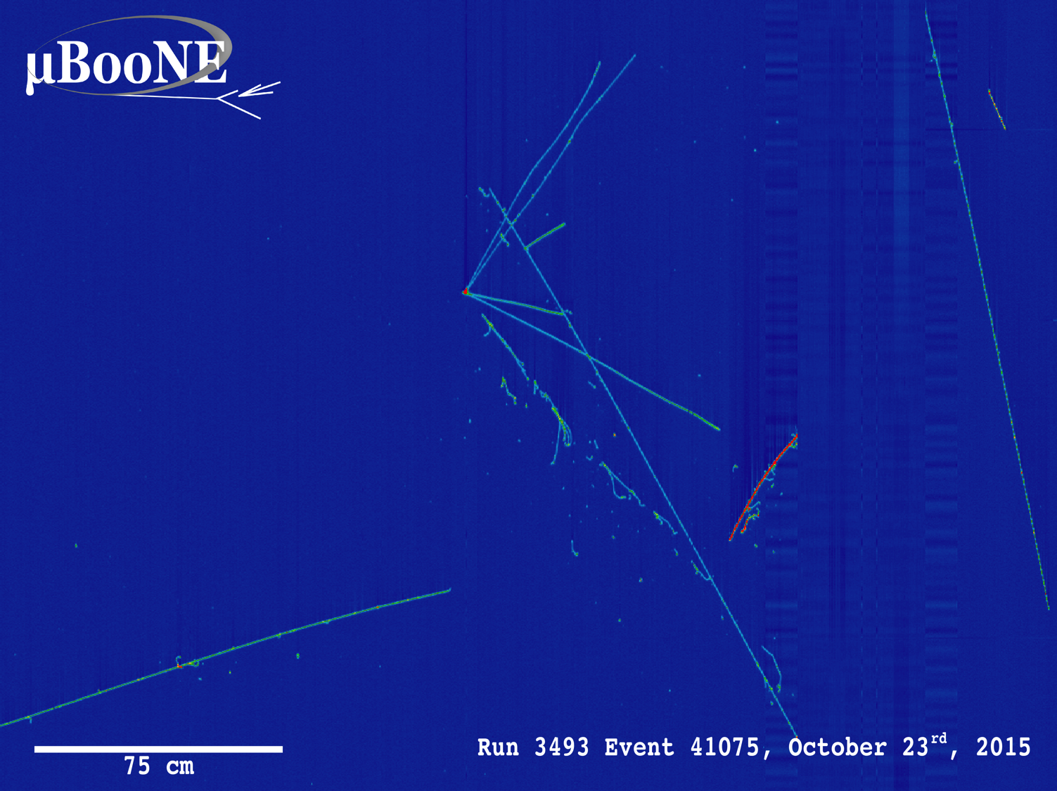
Neutrino Oscillations and Sterile Neutrinos
UChicago SPS
April 17, 2017
David Schmitz

Slide 2

The Standard Model
of Elementary Particles
12 Matter
Particles:
3 “quarks”
3 “leptons”
3 Forces:
electromagnetism
weak nuclear force
strong nuclear forces
(only other force we
know is gravity)

Slide 3
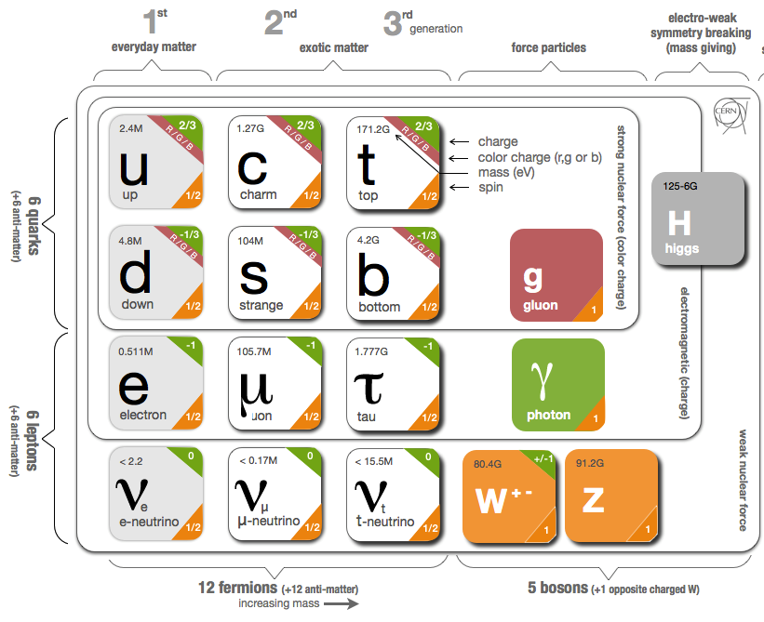

Slide 4
Protons, neutrons, and electrons make up everything we can see in the universe.
For every proton, neutron or electron in the universe there
are 1 BILLION neutrinos

Slide 5
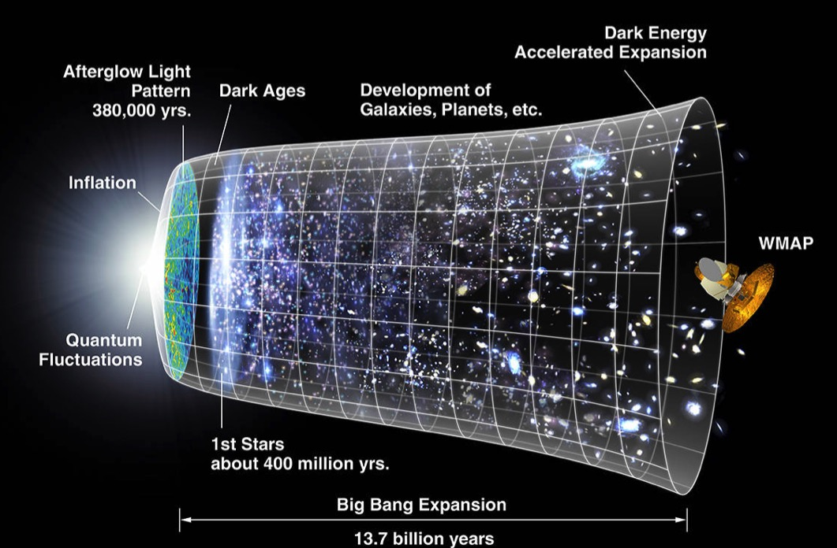
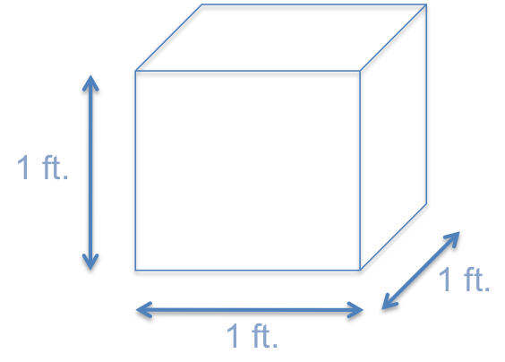
“Relic”
Neutrinos
10,000,000 neutrinos
(or about 400 cm³)
In every cubic foot of space in the Universe,
there are 10,000,000 neutrinos which were created
in the Big Bang and are still flying around

Slide 6
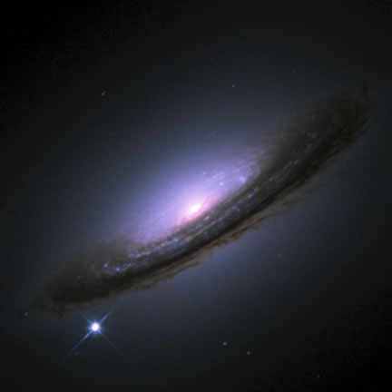
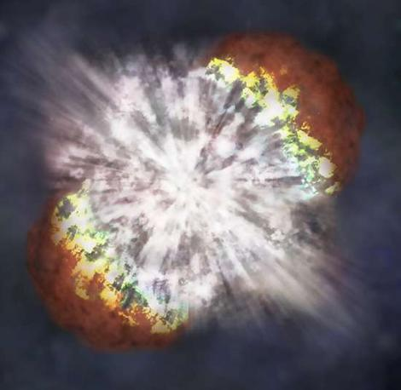
Supernova
Neutrinos
Supernova 1994D
Whenever a star explodes as a Supernova,
the most powerful explosions in the Universe,
99% of the energy is carried off by neutrinos

Slide 7
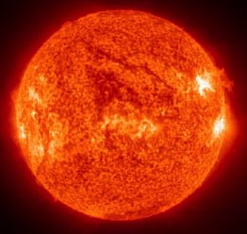
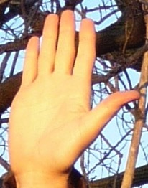
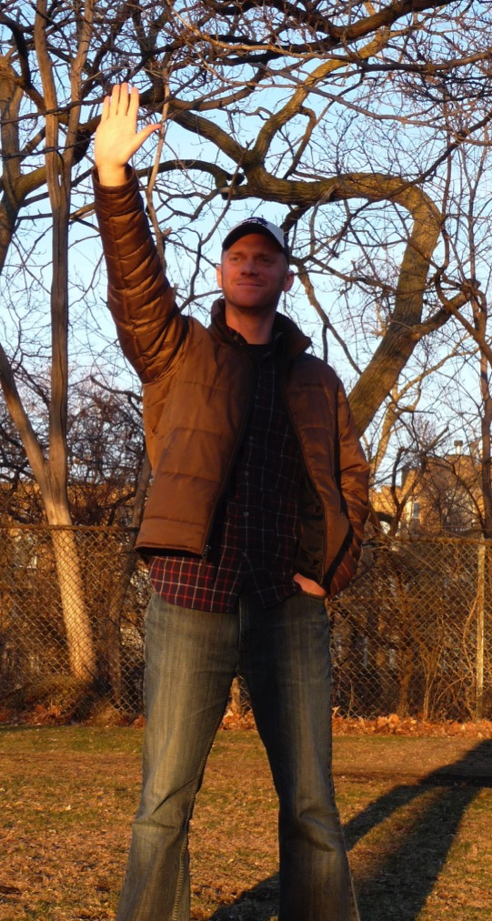
93 million miles
8 minutes
2in x 2in square
How many neutrinos in 10 seconds?
0 sec. 0
2 sec. 3,400,000,000,000
4 sec. 6,800,000,000,000
6 sec. 10,200,000,000,000
8 sec. 13,600,000,000,000
Working on my neutrino tan
10 sec. 17,000,000,000,000

Slide 8
Sphere with a radius of 93,000,000 miles
93 million miles
8 minutes
2in x 2in square
How many neutrinos is the Sun producing per second TOTAL?
≈20,000,000,000,000,000,000,
000,000,000,000,000,000,000
= 2 x 10³⁸ neutrinos/second!!

Slide 9
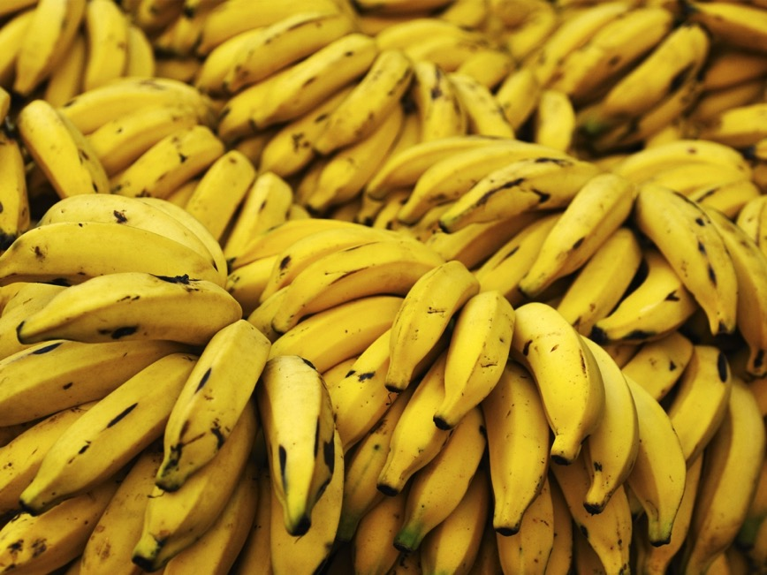
You don’t have to look to the cosmos to find neutrinos. For example:
A banana emits about 1 million neutrinos/day from decays of the small number of naturally occurring radioactive potassium atoms they contain

Slide 10
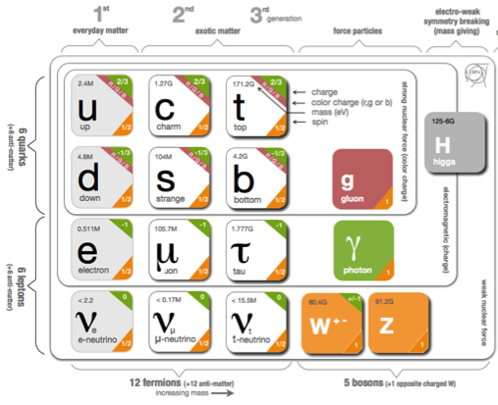
What are Neutrino Oscillations?
Neutrino mass states, m_{i}
(the “mass basis”)
Neutrino Mixing Matrix
Flavor states
participating in
standard weak interactions
(the “flavor basis”)

Slide 11



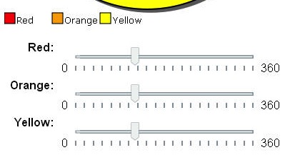
Flavor Mass
ν_{e}, ν_{μ} and ν_{τ} are neutrinos of distinct flavor
but this is not the
only way to think of neutrino ‘particles’
We can also think of neutrinos of definite mass
So which is the right view?Answer: BOTH!
ν_{e}
ν_{μ}
ν_{τ}
ν₁
ν₂
ν₃
ν₁
ν₂
ν₃

Slide 12
What is Neutrino Flavor?
l_{α}
l_{α}
ν_{α}
ν_{α}
The neutrino of flavor α is the one created together with the charged lepton of flavor α
And which creates a charged lepton of flavor α when it undergoes a charged-current interaction
e
μ
τ
ν_{e}
ν_{μ}
ν_{τ}

Slide 13
What is Neutrino Flavor?
l_{α}
l_{α}
ν_{α}
ν_{α}
The neutrino of flavor α is the one created together with the charged lepton of flavor α
And which creates a charged lepton of flavor α when it undergoes a charged-current interaction
e
μ
τ
ν_{e}
ν_{μ}
ν_{τ}

Slide 14
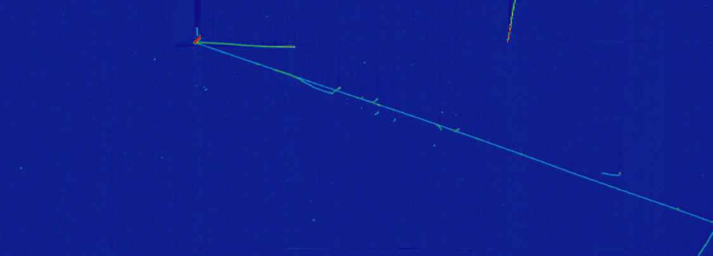
How to Tell Neutrino Flavor?
ν_{μ}
long “minimum ionizing” track
Muon
ν_{e}
electromagnetic shower
Electron

Slide 15
What is Neutrino Flavor Change?
l_{α}
l_{α}
ν_{α}
ν_{α}
l_{α}
l_{β}
ν_{α}
ν_{β}
Neutrinos are created and destroyed as states of definite flavor, but propagate as states of definite mass.

Slide 16
The Amount of Flavor/Mass Mixing is an Experimental Question
Leptonic Mixing Matrix
flavor states
participating in
standard weak interactions
neutrino
mass states
flavor eigenstates == mass eigenstates
flavor eigenstates = equal mix of mass states
neutrino oscillations

Slide 17
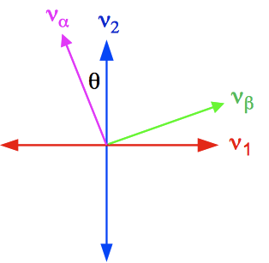
Two Neutrino Mixing
The mixing angle, θ, determines the amplitude of the oscillation
Δm² determines the shape of the oscillation as a function of L (or E)
E = neutrino energy
L = distance traveled

Slide 18


Neutrino Oscillations
401 Hz
Quantum mechanics
particle ⬅➔ wave
mass determines frequency
wave 1
If neutrinos (ν_{e},ν_{μ},ν_{τ}) are actually mixtures of multiple waves with different frequencies different masses)…
+
400 Hz
wave 2
These wave functions can interfere and change the neutrino’s flavor composition
401 Hz
+ 400 Hz
wave 1
+ wave 2
time (distance)
www.scienceclarified.com

Slide 19
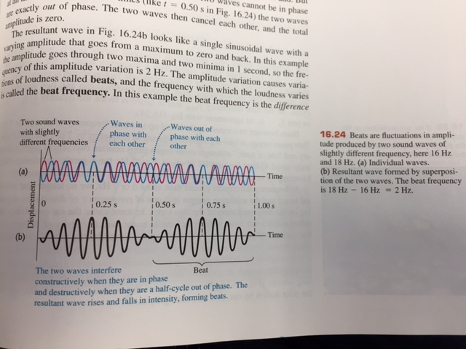
University Physics
Young and Freedman
“Beat” Frequency = f₂ –f₁

Slide 20
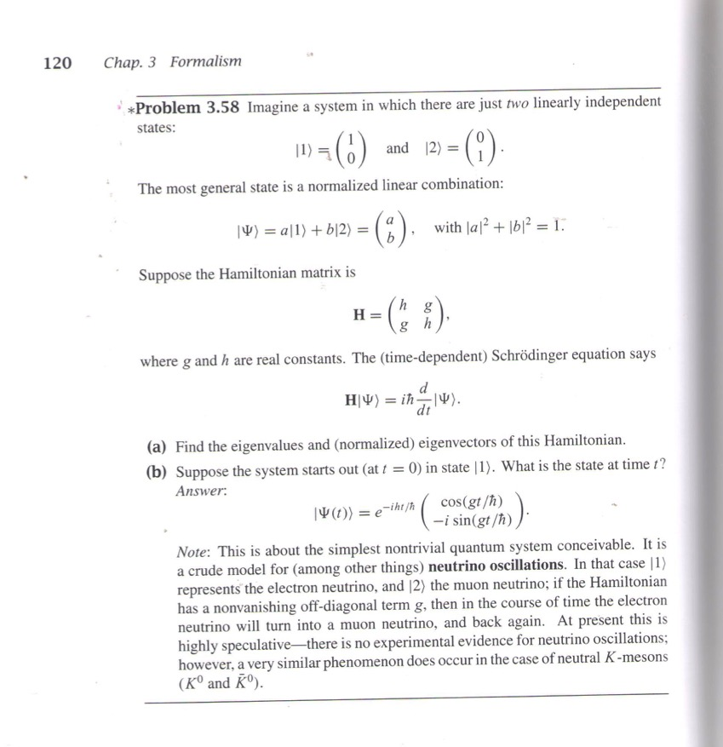
Neutrino oscillations are a relatively recent
discovery in the world of particle physics
my undergraduate textbook
…At present this is highly speculative – there is no experimental evidence for neutrino oscillations…”
Introduction to Quantum Mechanics
David J. Griffiths, 1995
(Problem 3.58)

Slide 21

Neutrino
produced as pure flavor state
Neutrino
detected
P(ν_{e})
ν_{μ}
flavor content evolves
P(ν_{μ})
P(ν_{τ})
ν_{μ}
ν_{e}
ν_{μ}
ν_{e}
ν_{μ}
ν_{e}
ν_{μ}
ν_{τ}
ν_{τ}
ν_{τ}

Slide 22
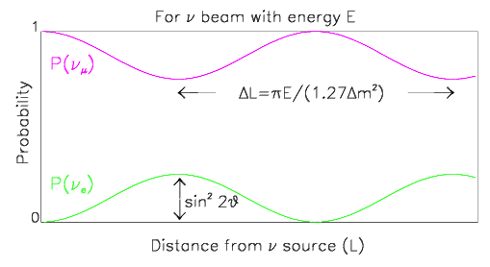
Building a Neutrino Oscillation Experiment
Fixed E
Variable L
A bunch of detectors to measure ν_{α} / ν_{β} content along path
Wouldn’t that be awesome!!
Alas…
Begin with mono-energetic beam of ν_{α}

Slide 23
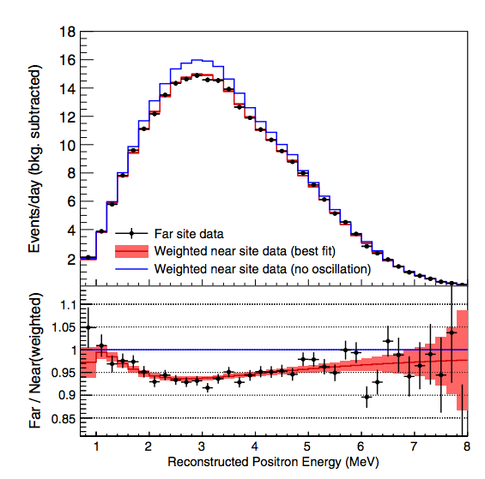
Building a Neutrino Oscillation Experiment
Fixed L
Variable E
Reactor neutrinos at Daya Bay in China
Measure ν_{α} / ν_{β} energy spectrum at origin and again after traveling distance L
Begin with broad energy spectrum beam of ν_{α}
L

Slide 24
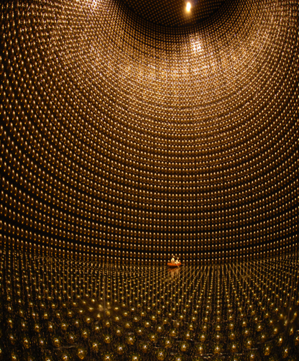

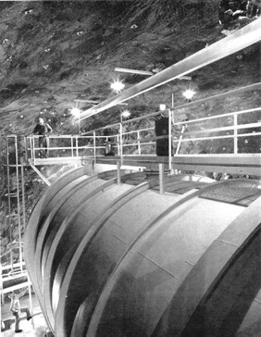
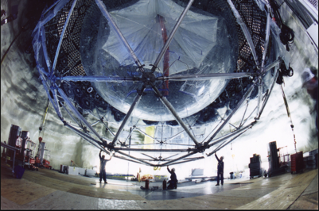
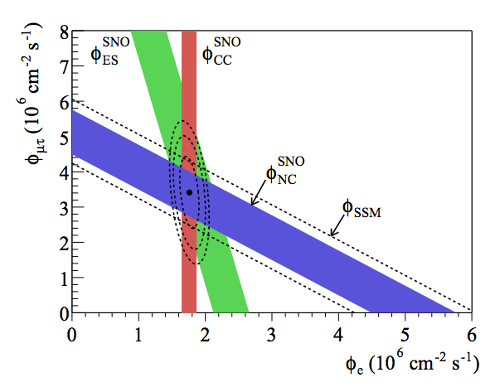
A Really Beautiful Experimental History
Atmospheric neutrinos at Super-Kamiokande
Solar neutrinos at Homestake
2002
Earth
SuperK
…and SNO
2015
2015

Slide 25
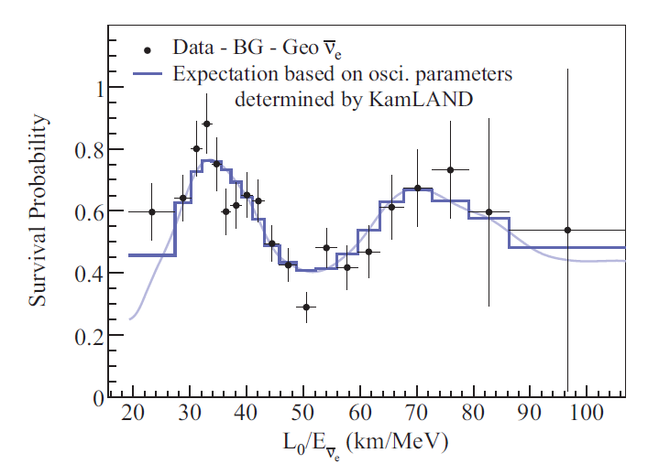
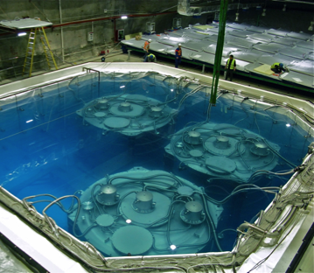
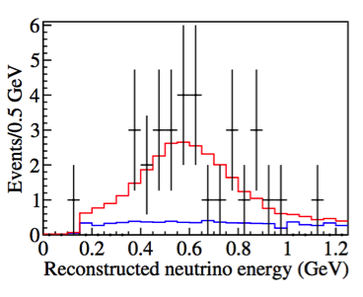
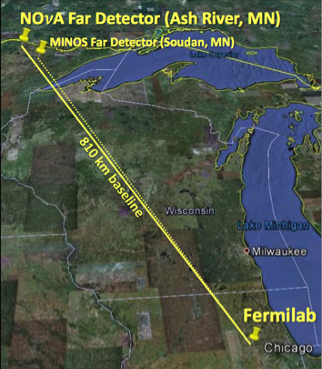
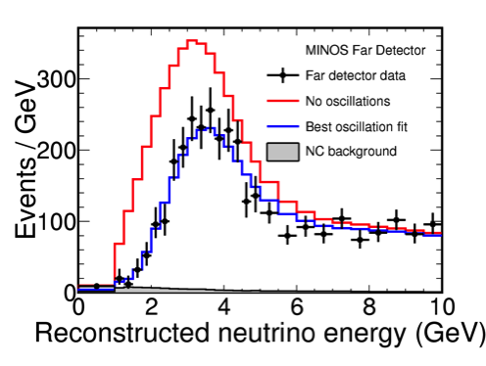
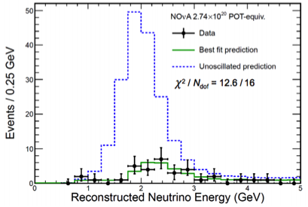
A Really Beautiful Experimental History
Reactor neutrinos at long-baseline in KamLAND
…and at
short-baseline in Daya Bay, Reno, and Double Chooz
ν_{e} disappearance
Accelerator neutrinos at MINOS
…and T2K
ν_{μ} disappearance
…and now at NOvA
ν_{μ} → ν_{e}
appearance!
ν_{μ} disappearance

Slide 26
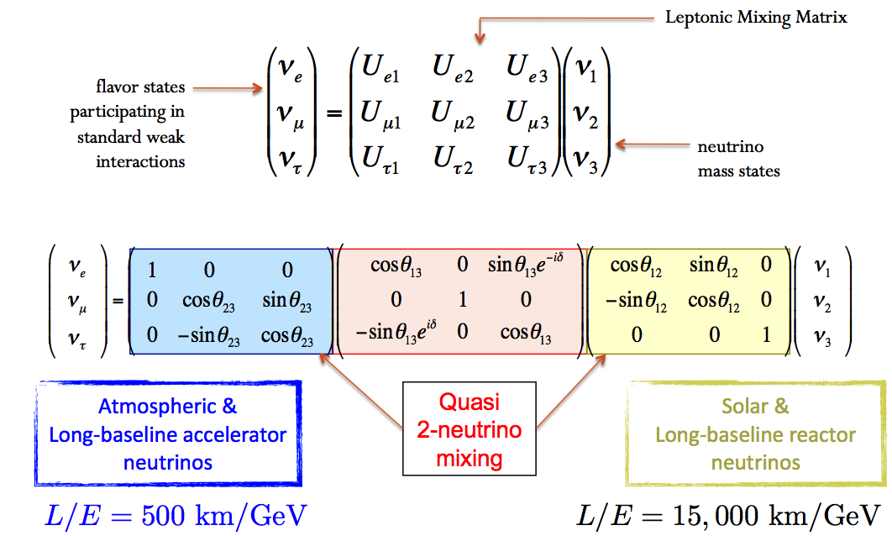

Slide 27
Three vs. Quasi-Two Neutrino Mixing

Slide 28
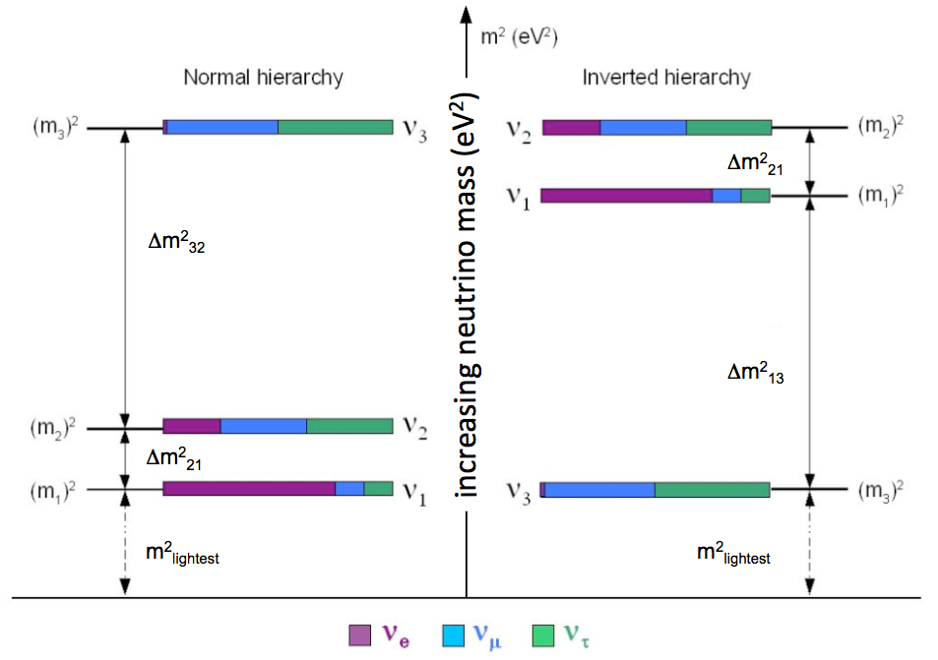
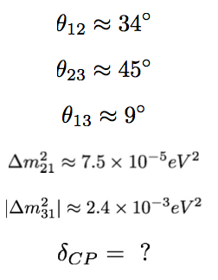
Some Things We Know and Don’t Know
?
?
?

Slide 29
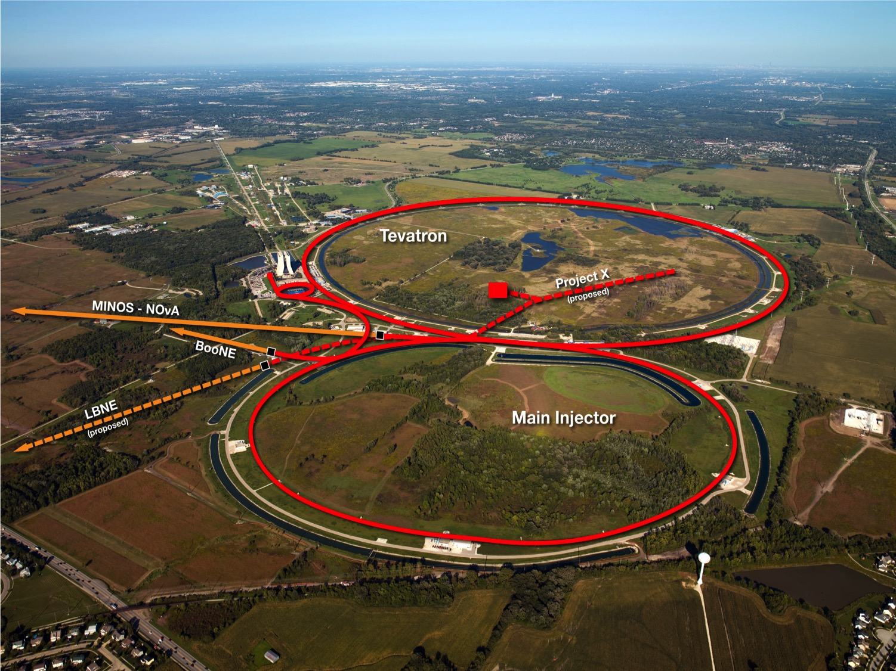
Fermilab is a great place to do neutrino physics

Slide 30
Because you can use an
intense beam of protons
to create an
intense beam of neutrinos
creates short-lived
charged particles
quickly decay into neutrinos
ν_{μ}
impinge upon a
fixed metal target
ν_{μ}
ν_{μ}
ν_{μ}
energetic protons
delivered
by the accelerator
ν_{μ}
ν_{μ}
which are focused forward by a strong magnetic field

Slide 31
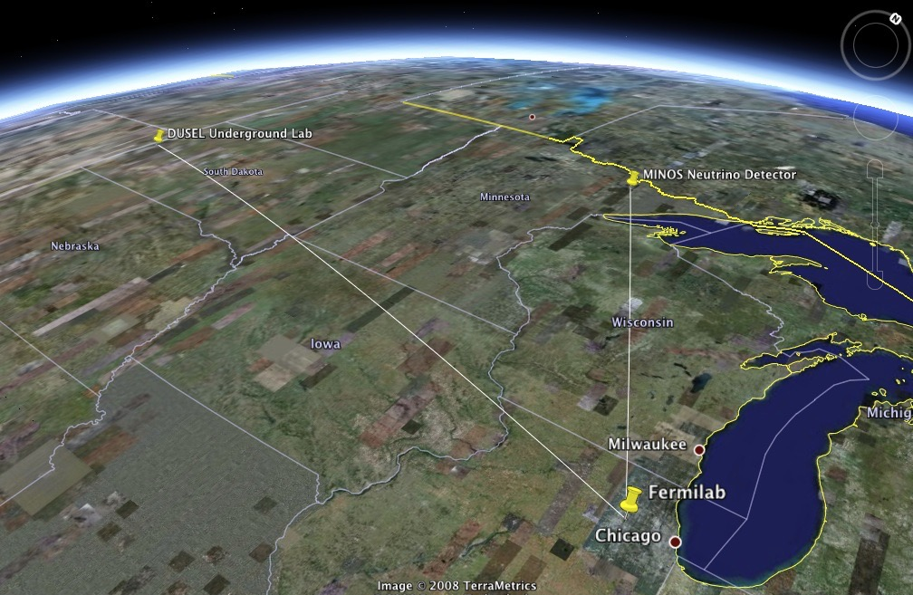

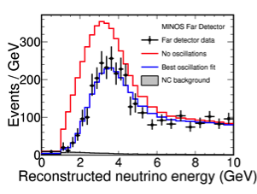
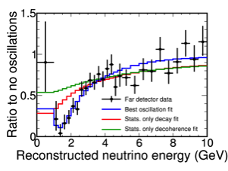

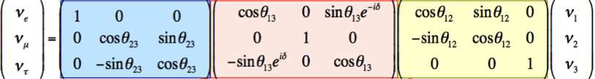
ν_{e}
ν_{μ}
ν_{τ}
MINOS
Muon Neutrino Disappearance

Slide 32


ν_{e}
ν_{μ}
ν_{τ}
Electron Neutrino Appearance

Slide 33
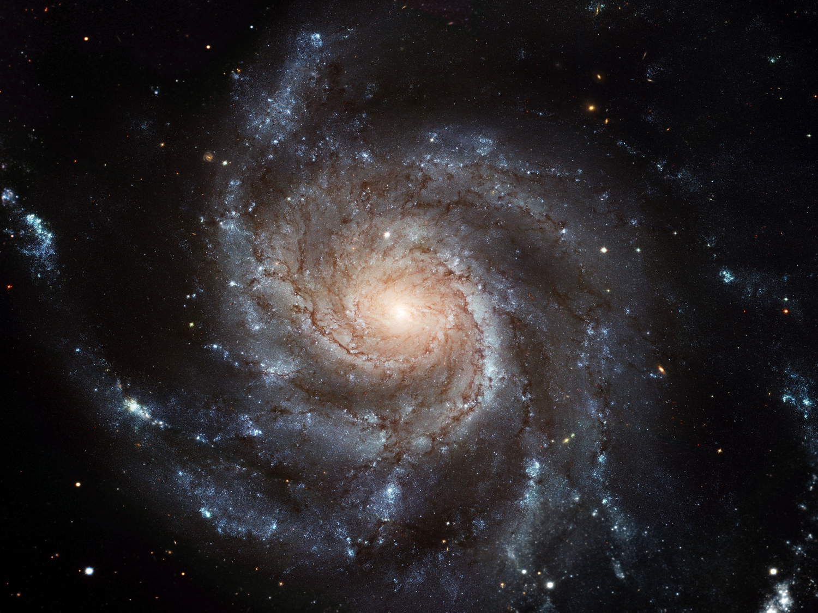
How did this beautiful matter dominated universe evolve from a beginning that all of our laws of physics tell us should have begun in a very matter-antimatter symmetric form?
One requirement: “CP Violation”
Have actually made very precise measurements of CP violation among the quarks – definitely there – but too little of it by about 10 orders of magnitude. Must be more!
Have been unable to look among the leptons… until now

Slide 34

Physics at DUNE
Are neutrinos possibly the reason for the matter-antimatter asymmetry in the universe?
  Measure the charge-parity (CP) violating phase δ
  Fundamental question in the Standard Model, is CP respected by leptons?
Neutrino mass hierarchy
  Another fundamental question about structure of leptons: is lightest charged lepton associated with the heaviest neutrino?
Are protons unstable?
  p → K⁺ν and other modes
  Predicted in many beyond SM theories
Supernova neutrinos
  Measure the ν_{e} flux from a core-collapse supernova within our galaxy
  1000s of events for a SN 10 kpc away

Slide 35
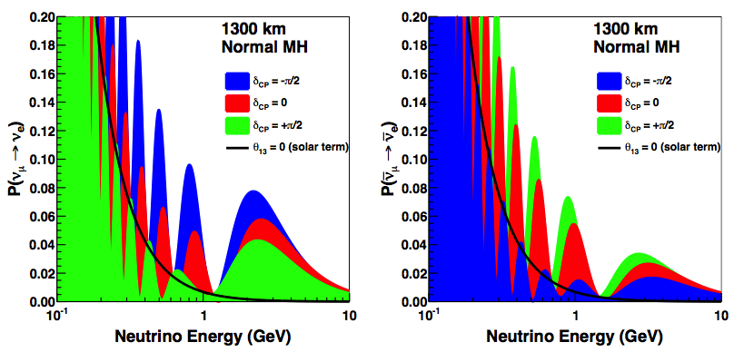
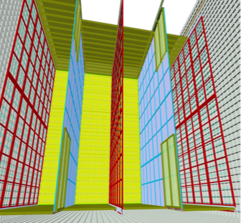
The Challenge Ahead in 3-ν Mixing
neutrinos
antineutrinos
12m
Detector is 1300 km from the source, small event rates (occupational hazard)
Detect muons → detect electrons (it’s just harder)
ν_{μ} disappearance probability is “clean” → ν_{e} appearance involves atmospheric and solar terms, δ-CP, and matter effects
Need neutrinos AND antineutrinos for CP violation
Multiple modules, each one a 10,000 metric ton cryogenic precision imaging detector.
Detectors 4850 ft. underground at Sanford Underground Research Facility in South Dakota

Slide 36
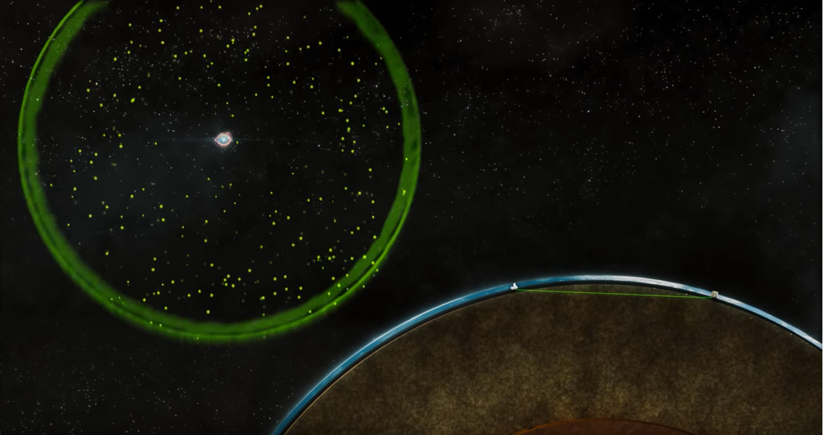
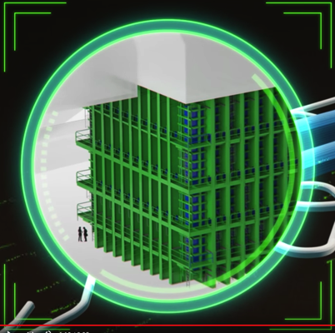
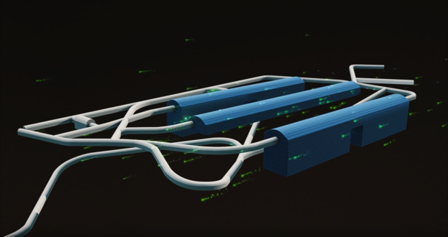
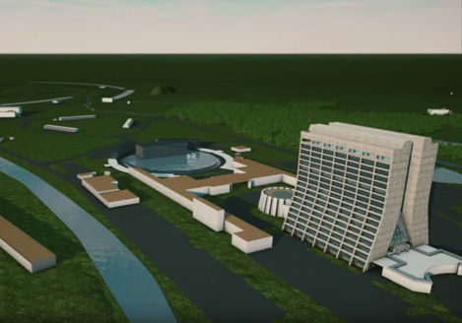
https://www.youtube.com/watch?v=AYtKcZMJ_4c&feature=youtu.be

Slide 37
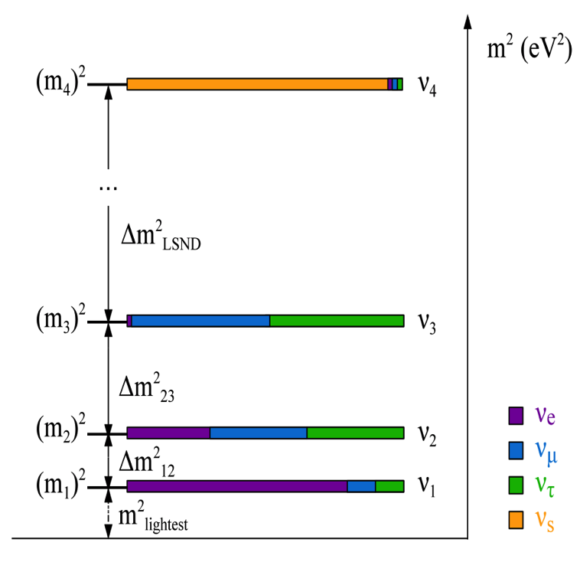
What About Physics Beyond the 3-ν SM?
It’s possible that oscillations can provide a window into particle sectors not accessible through SM interactions
  i.e. no strong, EM, or weak interactions
  e.g. ‘sterile’ neutrinos
What if you bring the detectors much closer, say ~1km instead of 1000 km?
new

Slide 38
?

Slide 39
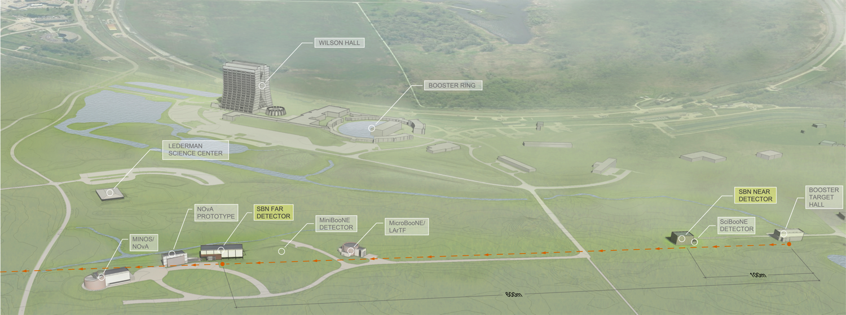
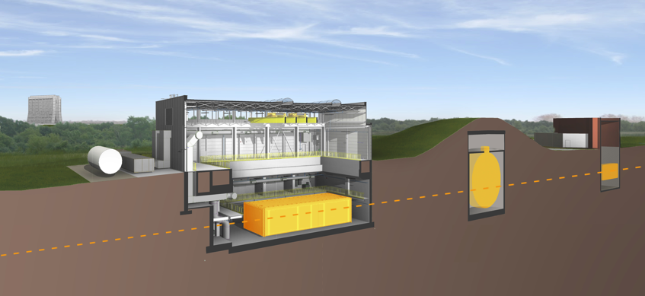
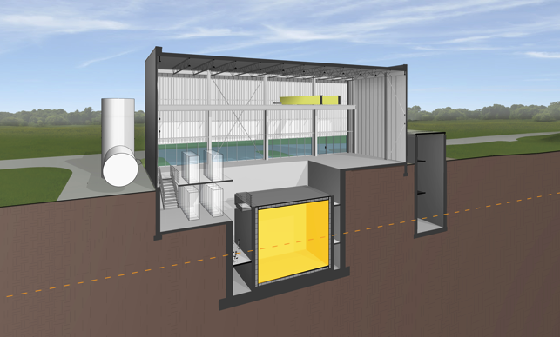
We are currently building a new experimental program at Fermilab to search for an oscillation involving the sterile neutrino.
Using same detector technology as the DUNE experiment.
Detector | Distance from BNB Target | Active LAr Mass
SBND | 110 m | 112 ton
MicroBooNE | 470 m | 87 ton
ICARUS | 600 m | 476 ton
MicroBooNE
MiniBooNE
Near Detector
SBND
Far Detector
ICARUS

Slide 40
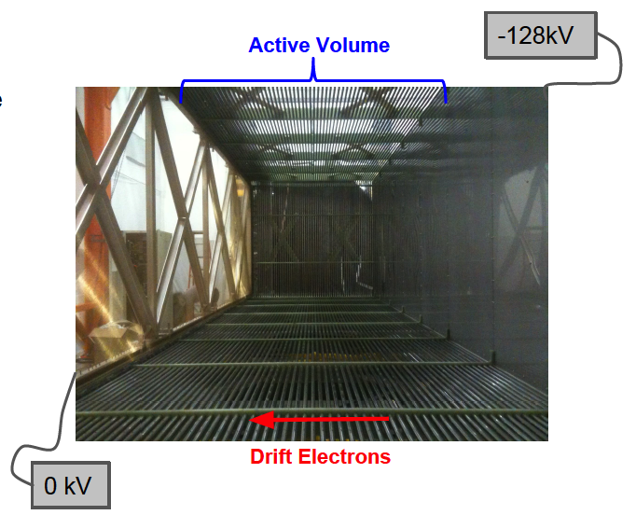
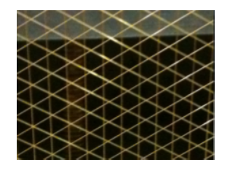
Liquid Argon TPC Neutrino Detector
Around
100 kV
Liquid
Argon
Time
Projection
Chamber

Slide 41
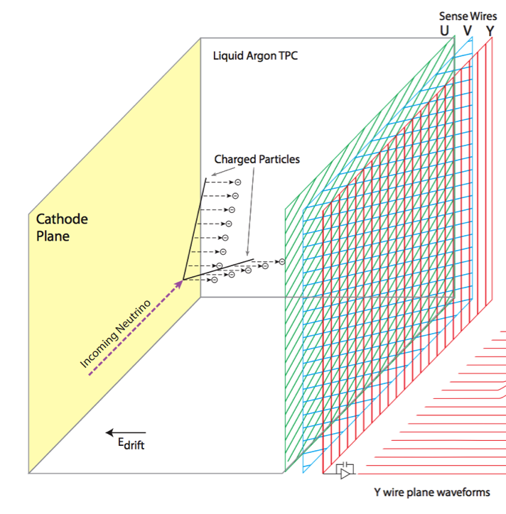




time

Slide 42




Cosmic Tracks
Cosmic muons with delta rays
Electromagnetic
shower
Candidate μ → e decay
UV laser track

Slide 43

Neutrino Interaction

Slide 44




Slide 45


MicroBooNE Installation into Detector Hall (2014)

Slide 46












Slide 47




Both ν_{μ} → ν_{e} Appearance and ν_{μ} Disappearance
Near
Detector
deficit of ν_{μ}?
excess of ν_{e}?
Far
Detector

Slide 48
Summary
Neutrino oscillations are an incredible tool for discovery, and there are several areas where experimental neutrino physics is confronting potentially new physics soon
  Do neutrinos violate CP and help us to understand the universe’s early evolution? The next generation long-baseline experiment, DUNE, will explore this.
  Do sterile neutrinos exist? The on-going Short-Baseline Neutrino Program is exploring this now.

Slide 49
Extras

Slide 50
0.4 eV²
0.4 eV²
1.6 eV²
1.6 eV²

Slide 51

Physics Beyond the 3-ν SM?
Experimental anomalies ranging in significance (2.8-3.8σ) have been reported from a variety of experiments studying neutrinos over baselines less than 1 km.
Most common interpretation is as evidence for high-mass squared neutrino oscillations and the existence of one or more additional, mostly “sterile” neutrino states with masses at or below a few electron volts.
While each of these measurements taken separately lack the significance to claim a discovery, together these signals could be hinting at important new physics

Slide 52



Liquid Scintillator Neutrino Detector (LSND)
blue histogram is oscillation best fit to excess

Slide 53


Liquid Scintillator Neutrino Detector (LSND)
L/E ~ 1 km/GeV
L/E ~ 500 km/GeV
L/E ~ 15,000 km/GeV
…

Slide 54


LSND and MiniBooNE Anomalies
LSND
MiniBooNE was a follow-up experiment at Fermilab starting in 2003
blue is an oscillation best fit
2.8σ
3.8σ
Are these results evidence of new physics or caused by challenging SM backgrounds?
Could be important either way.
3.4σ
Unexplained results also from reactors and radioactive sources

Slide 55

Where to Look: Possible Sterile Neutrino Parameters
Many global analyses that incorporate the positive and null results available
  Kopp et al.
  Conrad et al.
  Giunti et al.
  others
Positive signals in ν_{μ} → ν_{e} appearance and ν_{e} disappearance (neutrinos and antineutrinos)
No evidence for ν_{μ} disappearance
To definitively confirm or refute this 1 eV sterile neutrino interpretation is the primary physics goal of the SBN Program
typical global fit range

Slide 56


LBL & SBL Detector Requirements
Basic detector requirements for the next generation physics
  Excellent muon AND electron identification
  Powerful rejection of NC backgrounds where gammas can fake electron showers
  Excellent energy measurement capabilities
  Good performance from few-MeV (for SN physics) to few-GeV (for beam physics)
  Scalable to tens of thousands of tons
Liquid argon time projection chamber
  Monolithic, totally active calorimeter
  Excellent imaging capability in 3D (mm scale)
  dE/dx sampling enables e/γ separation
e
γ γ γ

Slide 57


The SBN Far Detector – The ICARUS-T600
ICARUS is the largest existing LArTPC in the world
  476 ton active volume
  Three-year physics run in CNGS neutrino beam at Gran Sasso Laboratory
Currently the detector is at CERN being refurbished and prepared for transport to Fermilab in 2017

Slide 58



Far Detector Building Construction
Broke ground on the FD building site end of July ‘15
Will be completed and ready to receive the ICARUS detector end of this year
ND building construction to start next month
Sept 2015
Dec 2015

Slide 59




The Short-Baseline Near Detector
-100 kV
4 m
5 m
4 m
Central cathode
with two 2m drift regions
SBND will be a new 112 ton LArTPC

Slide 60

The Short-Baseline Near Detector
Only 110 m from the source, SBND is designed to characterize the neutrino beam before the onset of any L-dependent new physics
Also an excellent platform for studying ν-Ar interactions and precision testing of TPC reconstruction and analysis techniques
Both valuable inputs to DUNE physics in the future
SBND
cryostat
110m from BNB target
SBND will see more than
1.5 million neutrino interactions per year

Slide 61

SBN Oscillation Sensitivity Analysis
For sensitivity calculations, datasets analyzed in a common framework to properly account for correlations between detectors
  Correlations are the key to systematic uncertainty cancelations in oscillation searches
Take advantage of available simulation tools:
  Applied the full G4 simulation of BNB neutrino fluxes developed over ~10 years by MiniBooNE and based on dedicated hadron production data from HARP
    Phys. Rev. D79, 072002 (2009)
  Used a standard neutrino interaction event generator (GENIE) that several experiments are using to analyze and publish data (MINERvA, T2K, etc.)
    Nucl.Instrum.Meth. A614 (2010) 87-104
  For cosmic backgrounds, compared standard generators like CRY, CORSIKA, FLUKA

Slide 62

Flux and Cross Section Systematics
Using systematics utilities within flux and interaction simulations can quantify the correlations between data samples

Slide 63
Other Beam Related Backgrounds
“Dirt” backgrounds
  Beam-induced backgrounds that sneak into the active volume from outside
Photon
Conversion
Applied a tight 25cm FV buffer to keep this background limited

Slide 64

Cosmogenic Backgrounds
The problem: 1000x longer charge drift time than the beam spill time!
1-2 ms drift time
1.6 μs beam spill
Detector | Neutrino interaction every N spills | Cosmic muon in beam spill time every N spills
SBND | 25 | 300
MicroBooNE | 800 | 200
ICARUS-T300 | 500 | 100

Slide 65


Mitigation of Cosmogenic Backgrounds
3m of concrete overburden removes ν_{e}-like backgrounds induced by cosmic rays other than muons
  Near 100% reduction of primary protons, neutrons, pions, and gammas that enter the TPCs without overburden according to simulations
  Only a few percent increase in secondaries generated in overburden
This leaves photons generated near the TPC by cosmic muons as the primary source of cosmogenic backgrounds in the ν_{e} analysis
  External cosmic ray tracker systems to tag muons near the detectors
T600
SBND

Slide 66

Mitigation of Cosmogenic Backgrounds
External cosmic ray tracker systems
identify potentially contaminated beam spills
Off-beam triggers can be used to measure the cosmic background to high precision
so small systematic uncertainties - all about statistics

Slide 67

SBN ν_{μ} → ν_{e} Oscillation Sensitivity
5σ

Slide 68

SBN ν_{μ} Disappearance

Slide 69

SBN ν_{μ} Disappearance Oscillation Sensitivity
Very little background. Near detector key to controlling flux and cross-section uncertainties.

Slide 70




size
long-baseline neutrino experiment
time
development
short-baseline neutrino experiments
test
beam
experiments
0.25 ton
100s tons
10,000 tons
this
talk

Slide 71



SBND ⟺ DUNE
SBND design based on technologies/solutions similar to those planned for DUNE
Development of photon detection technologies
x150
x4
Similar scale wire planes. Collaboration on engineering, wire stringing, QA procedures, etc.

Slide 72
SBN ⟺ LBN Physics Goals
The physics goals of SBN are complementary to the goals of DUNE and extend the overall reach of the neutrino physics program:
  A major physics goal of DUNE is to “test the 3-ν paradigm”
  SBN will contribute directly to this question through either a major discovery that breaks the paradigm or by ruling out additional light neutrinos in a range hinted at by previous anomalies
  Precision measurements of neutrino+argon cross sections in the relevant energy range are an important component for reaching required systematics level in DUNE
BNB
on-axis @ SBND
DUNE 2nd max
1st max
NuMI
off-axis @ ICARUS
DUNE 2nd max
1st max

Slide 73
The SBN Program @ Fermilab: Summary
The SBN Program of three LArTPC detectors located along the Booster Neutrino Beam at Fermilab will:
  Explore the anomalous hints of new physics in the neutrino sector with coverage of the LSND allowed oscillation parameters in neutrinos at >5σ
  Measure neutrino-argon cross sections with high precision in an important energy range
  Further develop the LArTPC technology for neutrino physics and help build expertise of the global neutrino physics community working toward DUNE
SBN program has made significant technical progress in 2015
  MicroBooNE is running with beam!
  ICARUS-T600 refurbishment is progressing well and on schedule at CERN
  SBND TPC is entering final design phase, construction to begin in early 2016
  Full program should be online by 2018
Well on our way to an exciting SBN physics program!

Slide 74




Electron/Gamma ID in LArTPCs
1 mip
2 mip
1 mip
2 mip

Slide 75

Impact of Three Detectors
Full SBN Program
SBND + T600
SBND + MicroBooNE

Slide 76

Impact of Cosmics
Full SBN Program
SBND + T600
SBND + MicroBooNE

Slide 77

Impact of Additional Beam Statistics

Slide 78



Booster Neutrino Beam Improvements
Far detector statistics are key to ν_{e} appearance sensitivity
  (Detector mass) x (Neutrino flux) x (Time)
Possible BNB upgrade paths:
  Increase focusing efficiency of target/horn system
    Optimize horn length, inner conductor, and current
  Increase rate at which horn system is capable of running
    Booster can operate at 15 Hz, existing horn at 5 Hz (limited by mechanical integrity and power supply)
Detailed study carried out by design team at FNAL; conclusion: gains up to ~1.8× in event rate possible with longer horn design and upgraded power supply
ν_{μ}
ν_{μ}
ν_{μ}
antineutrino mode running

Slide 79
ICARUS Refurbishment Activities
New PMT system deployment
Cathode flattening
Updated TPC electronics
Detector re-cabling
New cold vessel construction
New thermal insulation
Maintenance and partial replacement of cryogenics and purification systems
Construction of Cosmic Ray Tagger
One T-300 in the clean room at CERN

Slide 80


“mobile” cryostat lid plate
insulation
TPC hung from cryostat lid
“fixed” cryostat lid plate
Outer mechanical support. Membrane cryostat built inside.

Slide 81


SBND

Slide 82


A Look at Three Neutrino Mixing
zoom in
zoom out
ν_{μ}
ν_{τ}
ν_{e}
Atmospheric and
long-baseline accelerator disappearance (Δm₂₃²,θ₂₃)
Quasi
2-neutrino
mixing
Solar and
long-baseline reactor disappearance (Δm₁₂²,θ₁₂)

Slide 83

Backgrounds & Oscillation Signals in SBN

