Slide 1
Physics of Neutrinos
Dave Schmitz
February 23, 2015
The Standard Model of Particle Physics to see where neutrinos fit in
Neutrino Discovery and Early History
Neutrino Oscillations
The Next Exciting Discoveries?

Slide 2
Why Neutrinos?
They are the most abundant (known) matter particles in the universe. Important to understand them. Further, they act as messengers from across the cosmos.
Are there new kinds of “sterile” neutrinos? What is there mass? What role do they play in the early and current universe?
Could neutrinos explain the asymmetry between matter and antimatter that has created the universe we live in today?
Neutrinos have surprise us many times before, and we’ve by no means learned all there is to know!

Slide 3

Standard Model of Particle Physics
12 matter particles
  6 quarks
  6 leptons
  these 12 building blocks make up all the varieties of “normal” matter in the Universe
4 forces
  gravitational force
  electromagnetic force
  strong nuclear force
  weak nuclear force
  these 4 ways for particles to interact with each other are the only ones we currently know about
The Standard Model
Elementary Particles

Slide 4
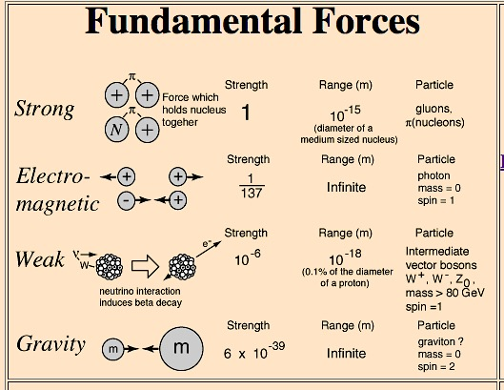
Standard Model of Particle Physics
12 matter particles
  6 quarks
  6 leptons
  these 12 building blocks make up all the varieties of “normal” matter in the Universe
4 forces
  gravitational force
  electromagnetic force
  strong nuclear force
  weak nuclear force
  these 4 ways for particles to interact with each other are the only ones we currently know about

Slide 5
More on Quarks and Leptons
6 Quarks:
  up, down, charm, strange, top, bottom
  fractional electric charge (+2/3 top row, -1/3 bottom)
  interact with other particles via the strong force, the weak force, and the electromagnetic force
  strong force is attractive between quarks and holds them together in pairs or triplets
3 Charged Leptons:
  electron, muon , tau
  unit electric charge (+1 or -1)
  interact with other particles via the weak nuclear force and the electromagnetic force
3 Neutral Leptons (neutrinos):
  electron neutrino, muon neutrino, tau neutrino
  no electric charge
  interact only via the weak nuclear force
  were assumed to be completely massless in the Standard Model
  outnumber other matter particles in the Universe by a factor of a BILLION
The Standard Model
Elementary Particles

Slide 6
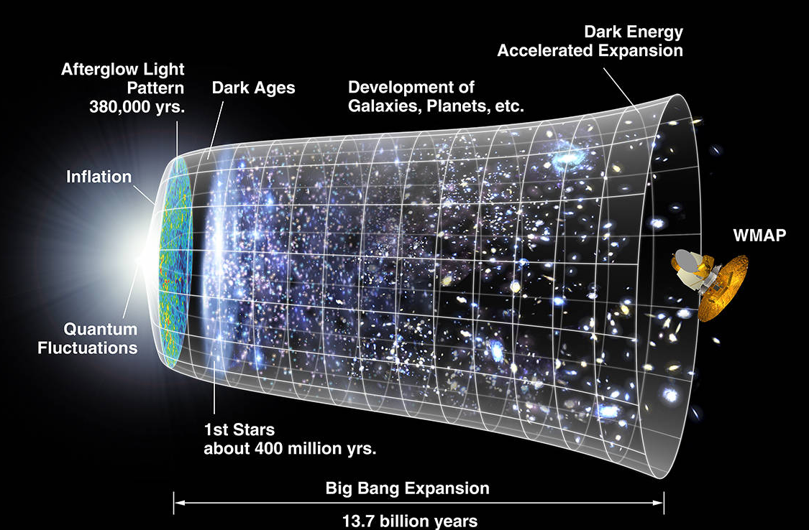
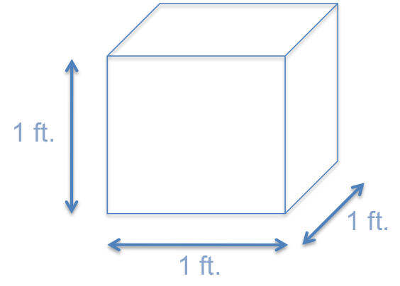
“Relic”
Neutrinos
10,000,000 neutrinos
(or about 400 cm³)
In every cubic foot of space in the Universe,
there are 10,000,000 neutrinos which were created
in the Big Bang and are still flying around

Slide 7
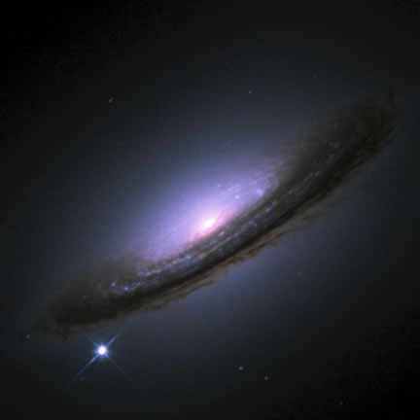
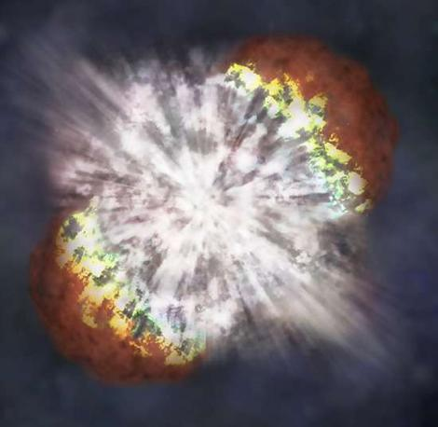
Supernova
Neutrinos
Supernova 1994D
Whenever a star explodes as a Supernova,
the most powerful explosions in the Universe,
99% of the energy is carried off by neutrinos

Slide 8
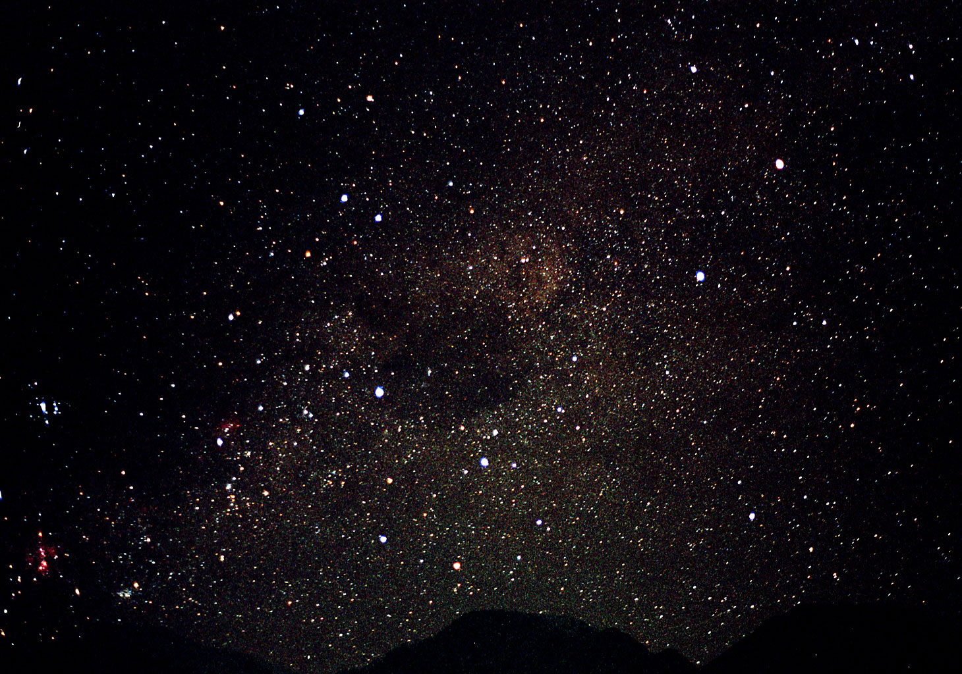
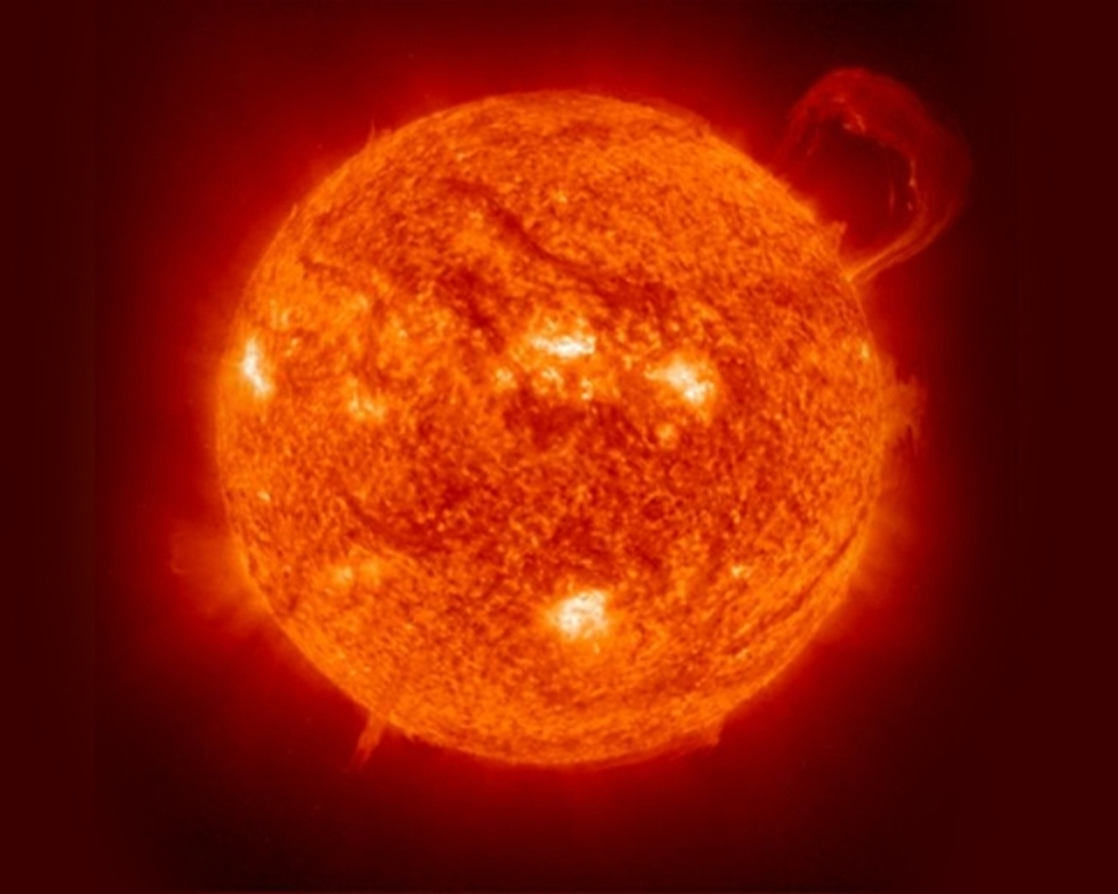
In fact, every star is an incredible
neutrino factory throughout its lifetime,
including our star, the Sun.

Slide 9
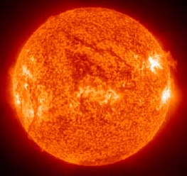

93 million miles
8 minutes
2in x 2in square
How many neutrinos in 10 seconds?
0 sec. 0
2 sec. 3,400,000,000,000
4 sec. 6,800,000,000,000
6 sec. 10,200,000,000,000
8 sec. 13,600,000,000,000
Working on my neutrino tan
10 sec. 17,000,000,000,000

Slide 10
Sphere with a radius of 93,000,000 miles
93 million miles
8 minutes
2in x 2in square
How many neutrinos is the Sun producing per second TOTAL?
≈20,000,000,000,000,000,000,
000,000,000,000,000,000,000
= 2 x 10³⁸ neutrinos/second!!

Slide 11
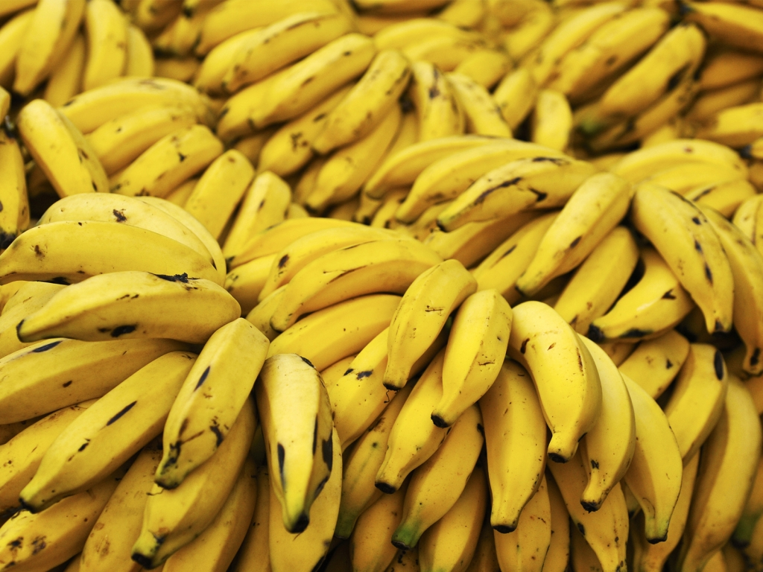
You don’t have to look to the cosmos to find neutrinos. For example:
A banana emits about 1 million neutrinos/day from decays of the small number of naturally occurring radioactive potassium atoms they contain!

Slide 12
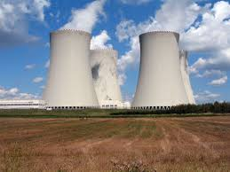
In fact, this is
how the neutrino was realized to exist
(radioactive decay, not bananas)
neutron
electron
proton
ν

Slide 13
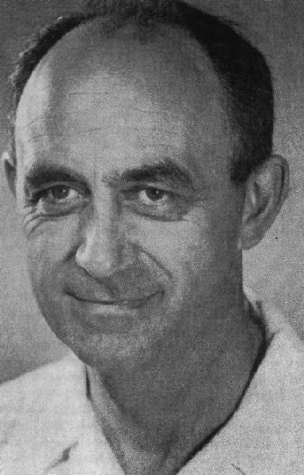
neutrino: ORIGIN mid 20th cent.: from Italian, diminutive of neutro.
Little, neutral object.
It was Enrico Fermi who first calculated the mechanism for detecting a neutrino in 1934
ANSWER: It was going to be hard
Enrico Fermi
Nobel Prize in 1938

Slide 14
Fermi’s Weak Interaction
Bethe-Peierls (1934), using Fermi’s original theory and the experimental value of G_{F}, was able to calculate the expected cross-section for inverse beta decay of few MeV neutrinos:

Slide 15
Fermi’s Weak Interaction
Bethe-Peierls (1934), using Fermi’s original theory and the experimental value of G_{F}, was able to calculate the expected cross-section for inverse beta decay of few MeV neutrinos:
atomic mass unit
Hmmm… that looks small
What’s the mean free path of a neutrino in lead?
1.66x10⁻²⁷ kg
d_{lead} =
(σ_{x-N} m²)(11400 kg/m³)
ν-N cross-section
density of lead

Slide 16
Fermi’s Weak Interaction
A typical neutrino produced in a power reactor or
the core of the sun has 1-10 MeV of energy:
  σ ~ 10⁻⁴⁴ cm², d_{lead} ~ 10¹⁶ m
  over a light year of lead!

Slide 17
Fermi’s Weak Interaction
A typical neutrino produced in a power reactor or
the core of the sun has 1-10 MeV of energy:
  σ ~ 10⁻⁴⁴ cm², d_{lead} ~ 10¹⁶ m
  over a light year of lead!
A typical neutrino produced at a particle accelerator
has between 1-100 GeV of energy:
  σ ~ 10⁻⁴⁰ cm², d_{lead} ~ 10¹² m
  better, but still around a billion miles of solid lead!

Slide 18
Fermi’s Weak Interaction
A typical neutrino produced in a power reactor or
the core of the sun has 1-10 MeV of energy:
  σ ~ 10⁻⁴⁴ cm², d_{lead} ~ 10¹⁶ m
  over a light year of lead!
A typical neutrino produced at a particle accelerator
has between 1-100 GeV of energy:
  σ ~ 10⁻⁴⁰ cm², d_{lead} ~ 10¹² m
  better, but still around a billion miles of solid lead!
What about a proton with ~1 GeV of energy?
  σ ~ 10⁻²⁵ cm², d_{lead} ~ 10 cm!

Slide 19

Pauli’s Despair
The expected huge difficulty in detecting a neutrino led Pauli to famously quip :
Could the tiny cross section be overcome?
“I have done something very bad by proposing a particle that cannot be detected; it is something no theorist should ever do.”
- Wolfgang Pauli (1931)

Slide 20
To overcome the incredibly
FEEBLE interaction of the neutrino with matter,
studying neutrinos requires
very intense neutrino sources
and
special detectors

Slide 21
Project Poltergeist
To detect a neutrino, need an extremely intense source to compensate for the tiny cross section
Straightforward plan
Explode nuclear bomb
Simultaneously drop detector to feather bed
Detect neutrino
Repeat??

Slide 22
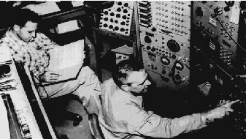
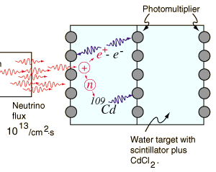
Persistence Pays Off
Finally, confirmation in 1956
  Fred Reines and Clyde Cowan used the nuclear power reactor at Savannah River as an intense source and the inverse β-decay reaction to detect the ν_{e}
Positron annihilates promptly on electron to produce two 0.5 MeV Gamma rays
Neutron gets captured by Cadmium nucleus after a delay of ~5 microseconds

Slide 23
Persistence Pays Off
“[Prof. Pauli], we are happy to inform you that we
have definitely detected neutrinos from fission
fragments by observing inverse beta decay of
protons.”
- Fred Reines and Clyde Cowan (1956)
“Everything comes to him who knows how to wait.”
- Wolfgang Pauli (1956)

Slide 24
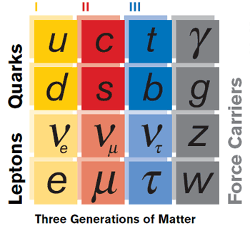
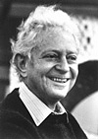
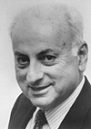
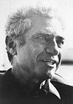
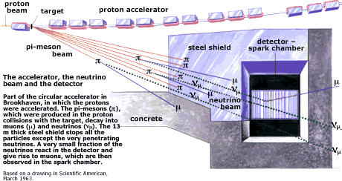
Flavor and Families in the SM
Leon Lederman, Melvin Schwartz and Jack Steinberger made the surprising discovery of a second type of neutrino, the muon neutrino, in 1962
L. Lederman
Nobel Prize in 1988
M. Schwartz
Nobel Prize in 1988
J. Steinberger
Nobel Prize in 1988
Finally, in 2000, 70 years after Pauli’s idea, the Fermilab experiment DONUT directly detected a third kind of neutrino, the tau neutrino

Slide 25
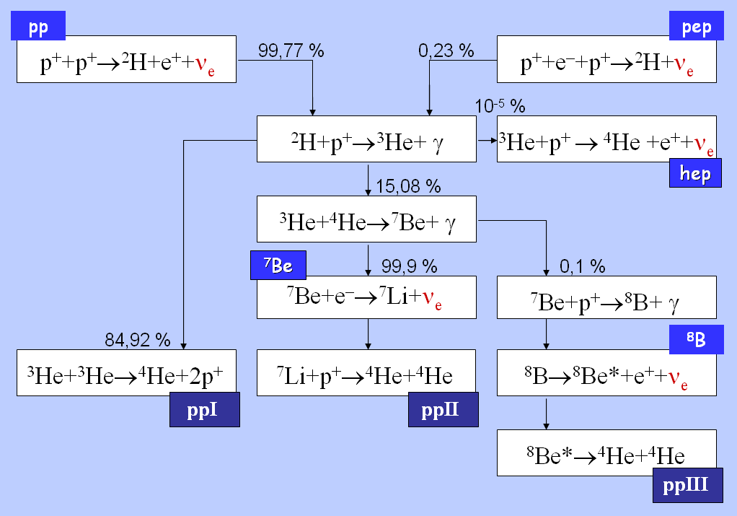
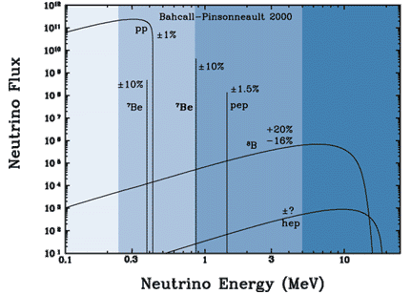
Let’s Give it a Try: ν_{e} from the Sun
Nuclear reactions in the sun produce electron neutrinos ONLY
If can detect them, can test the model of the sun
  Look deep into the sun using neutrinos!
ν_{e}
ν_{e}
ν_{e}
ν_{e}
ν_{e}
ν_{e}
ν_{e}
ν_{e}
ν_{e}
ν_{e}

Slide 26
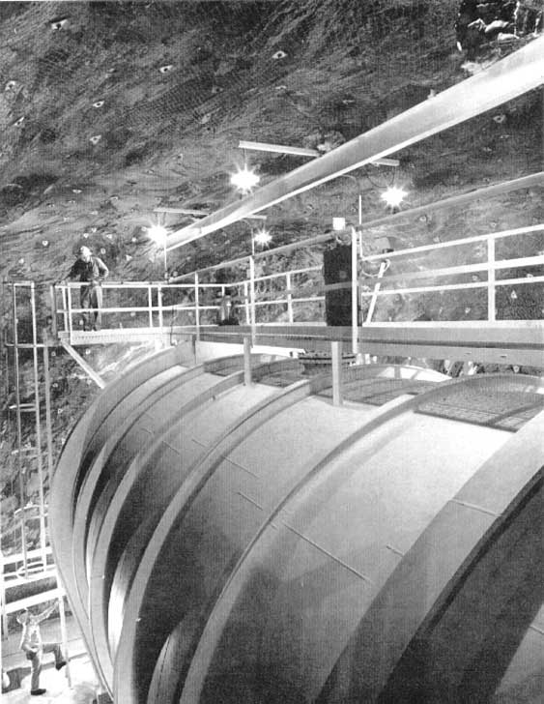
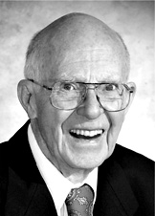
Let’s Give it a Try: ν_{e} from the Sun
Ray Davis set out to detect ν_{e} from the sun using a tank of cleaning fluid buried deep underground
Every once in a while Davis would extract and count the number of argon atoms in the tank
John Bahcall had calculated how many to expect:
R. Davis Jr.
Nobel Prize in 2002
Homestake Mine
Lead, South Dakota
These would need to be extracted from a tank with
10,000,000,000,000,000,000,000,000,000,000 total atoms!!

Slide 27
Let’s Give it a Try: ν_{e} from the Sun
Maybe the theory was wrong?
Maybe the experiment was wrong?
Maybe they were both wrong?

Slide 28
Let’s Give it a Try: ν_{e} from the Sun
Maybe the theory was wrong?
Maybe the experiment was wrong?
Maybe they were both wrong?
Or maybe 2/3 of the solar ν_{e} flux
“disappears” on the way to earth!

Slide 29
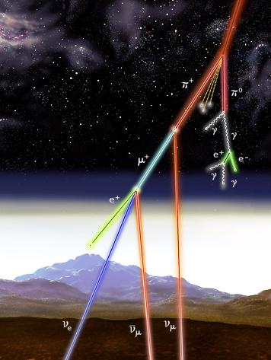
Try Again: ν_{μ} /ν_{e} from Atmosphere
Neutrinos created by decay of pions in particle showers initiated when energetic cosmic rays interact in the atmosphere
Expect:
INFN-Notizie N.1 giugno 1999

Slide 30
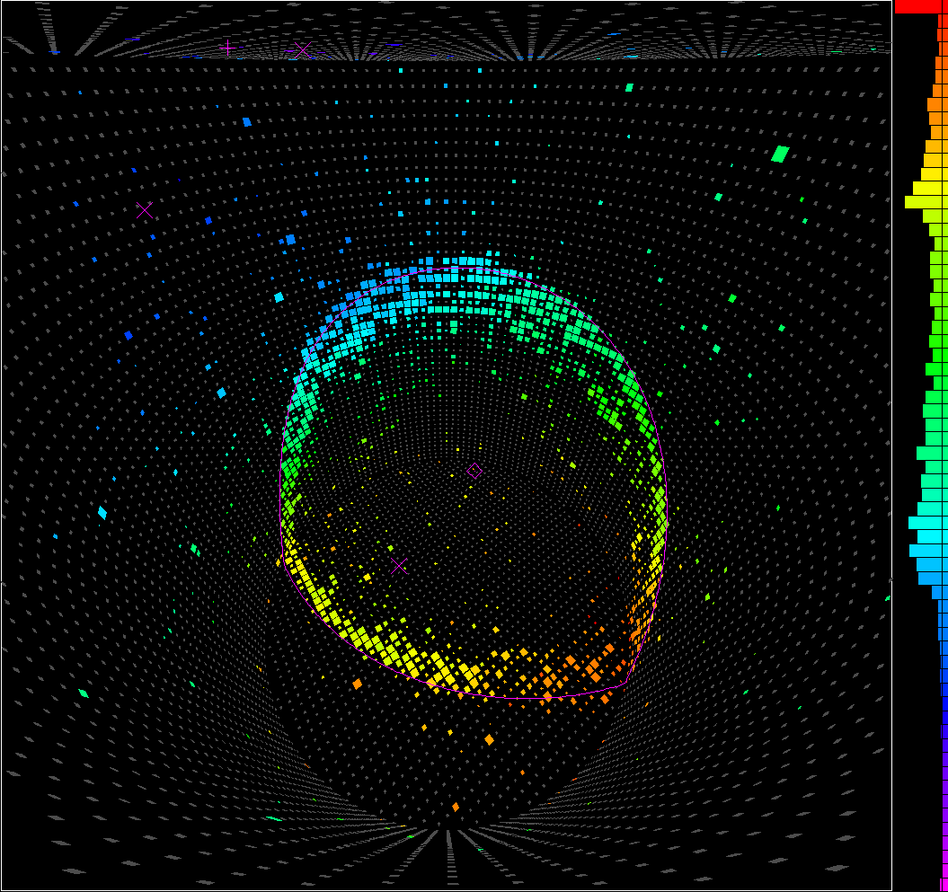
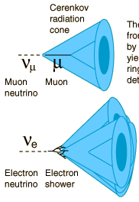
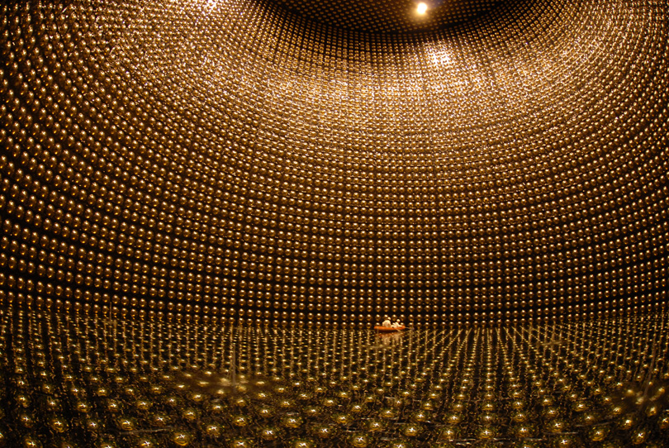
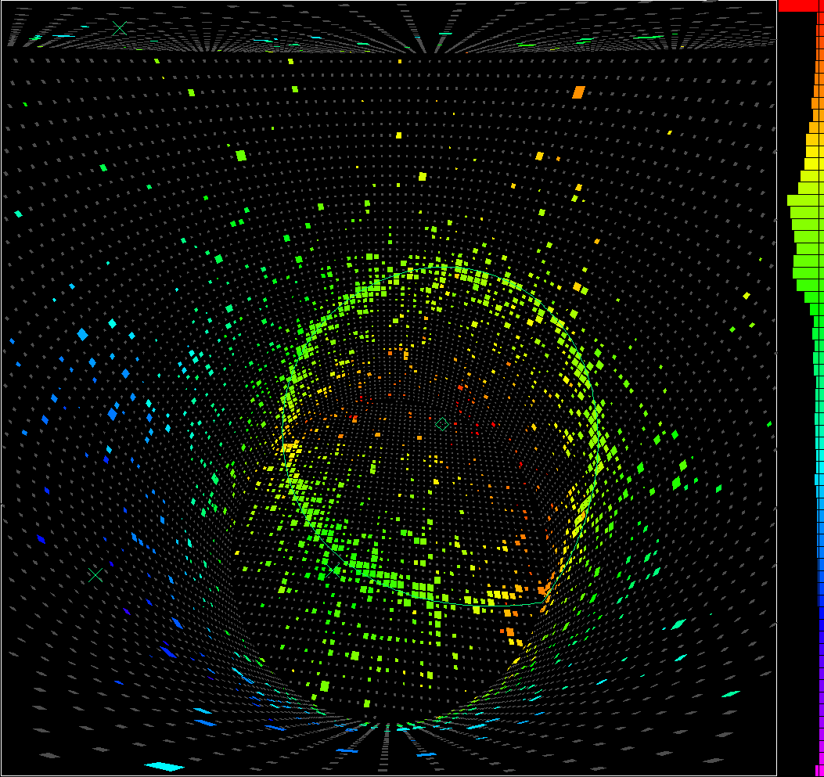
Try Again: ν_{μ} /ν_{e} from Atmosphere
μ
Super-Kamiokande
50kT water Cherenkov detector
e
Originally built to search for proton decay. Still waiting for one of those, but won a Nobel Prize for study of cosmic neutrinos in the mean time.

Slide 31
Try Again: ν_{μ} /ν_{e} from Atmosphere
Expect:
Earth
SuperK
Expect:

Slide 32
Another “Desperate Remedy”
Where are the disappearing neutrinos disappearing to? Another dilema that persisted for more than three decades!
It was realized that if neutrinos indeed have small non-zero masses, then quantum mechanics allows that they could be disappearing into other kinds of neutrinos…
  ν_{e} from the sun ➔ ν_{μ} / ν_{τ}
  ν_{μ} from atmosphere ➔ ν_{τ}
and tiny masses can have HUGE effects

Slide 33
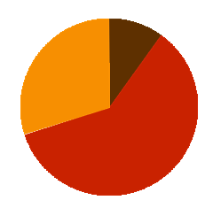
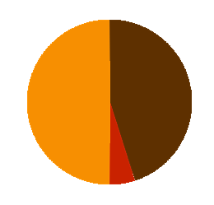
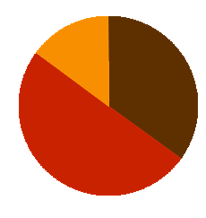
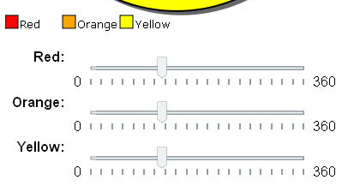
Flavor Mass
ν_{e}, ν_{μ} and ν_{τ} are neutrinos of distinct flavor
but this is not the
only way to think of neutrino ‘particles’
We can also think of neutrinos of definite mass
So which is the right view?Answer: BOTH!
ν_{e}
ν_{μ}
ν_{τ}
ν₁
ν₂
ν₃
ν₁
ν₂
ν₃

Slide 34
What is Neutrino Flavor?
l_{α}
l_{α}
ν_{α}
ν_{α}
The neutrino of flavor α is the one created together with the charged lepton of flavor α
And which creates a charged lepton of flavor α when it undergoes a charged-current interaction

Slide 35
What is Neutrino Flavor Change?
l_{α}
l_{α}
ν_{α}
ν_{α}
l_{α}
l_{β}
ν_{α}
ν_{β}
Which could be possible if
neutrinos have mass and leptons “mix”

Slide 36


neutrino oscillations
401 Hz
Quantum mechanics
particle ⬅➔ wave
mass determines frequency
wave 1
If neutrinos (ν_{e},ν_{μ},ν_{τ}) are actually mixtures of multiple waves with different frequencies (different masses)…
+
400 Hz
wave 2
They can interfere like any waves and change the neutrino’s flavor!
401 Hz
+ 400 Hz
wave 1
+ wave 2
time (distance)
www.scienceclarified.com
“Beat” Frequency = f₂ –f₁

Slide 37
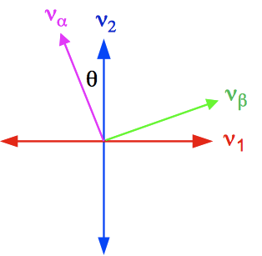
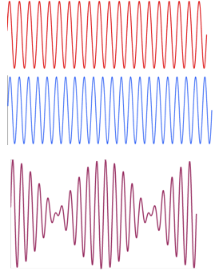
Two Neutrino Mixing
E = neutrino energy
L = distance traveled
The mixing angle, θ, determines the amplitude of the oscillation
Δm² determines the shape of the oscillation as a function of L (or E)
wave-m₁
wave-m₂
m₁+m₂

Slide 38
Neutrino oscillations are a very
recent discovery in the world of
particle physics
my undergraduate textbook
“This is about the simplest nontrivial quantum system conceivable. It is a crude model for neutrino oscillations. . . . . . . . . At present this is highly speculative – there is no experimental evidence for neutrino oscillations”
David J. Griffiths – Introduction to Quantum Mechanics (Problem 3.58) 1995

Slide 39
Neutrino Oscillations
this oscillation affects the probability that a neutrino is of type α as it travels
ν_{μ}
ν_{τ}
ν_{τ}
ν_{μ}
ν_{μ}
ν_{μ}
fraction ν_{μ}
ν_{μ}
ν_{τ}
ν_{μ}
ν_{μ}
ν_{μ}
ν_{μ}
ν_{μ}
ν_{τ}
ν_{μ}
ν_{μ}
ν_{μ}
ν_{μ}
ν_{μ}
ν_{τ}
ν_{τ}
ν_{τ}
ν_{τ}
ν_{μ}
ν_{μ}
ν_{μ}
ν_{μ}
ν_{τ}
ν_{μ}
ν_{μ}
ν_{μ}
ν_{μ}
ν_{τ}
ν_{τ}
ν_{τ}
ν_{τ}
ν_{μ}
ν_{μ}
ν_{μ}
ν_{μ}
ν_{μ}
ν_{μ}
ν_{μ}
ν_{τ}
ν_{μ}
fraction ν_{τ}
L

Slide 40
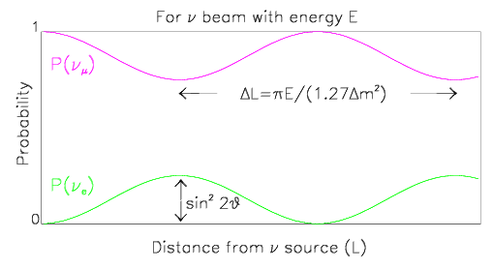
Building a Neutrino Oscillation Experiment
Fixed E
Variable L
A bunch of detectors to measure ν_{α} / ν_{β} content along path
Wouldn’t that be awesome!!
Alas…
Begin with mono-energetic beam of ν_{α}

Slide 41
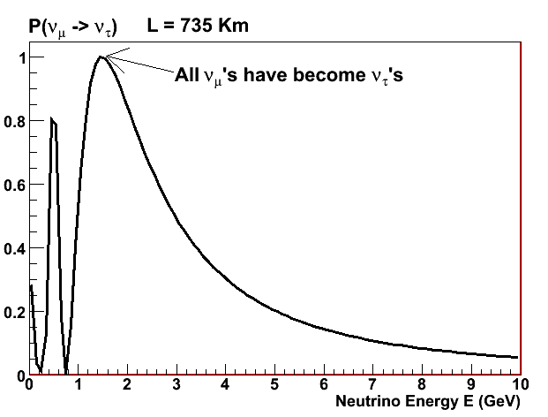
Building a Neutrino Oscillation Experiment
Fixed L
Variable E
Measure ν_{α} / ν_{β} energy spectrum at origin and again after traveling distance L
Begin with broad energy spectrum beam of ν_{α}
L

Slide 42
Turns out that you can use an
intense beam of protons
to create an
intense beam of neutrinos
creates short-lived
charged particles
quickly decay into neutrinos
ν_{μ}
impinge upon a
fixed metal target
ν_{μ}
ν_{μ}
ν_{μ}
energetic protons
delivered
by the accelerator
ν_{μ}
ν_{μ}
which are focused forward by a strong magnetic field

Slide 43
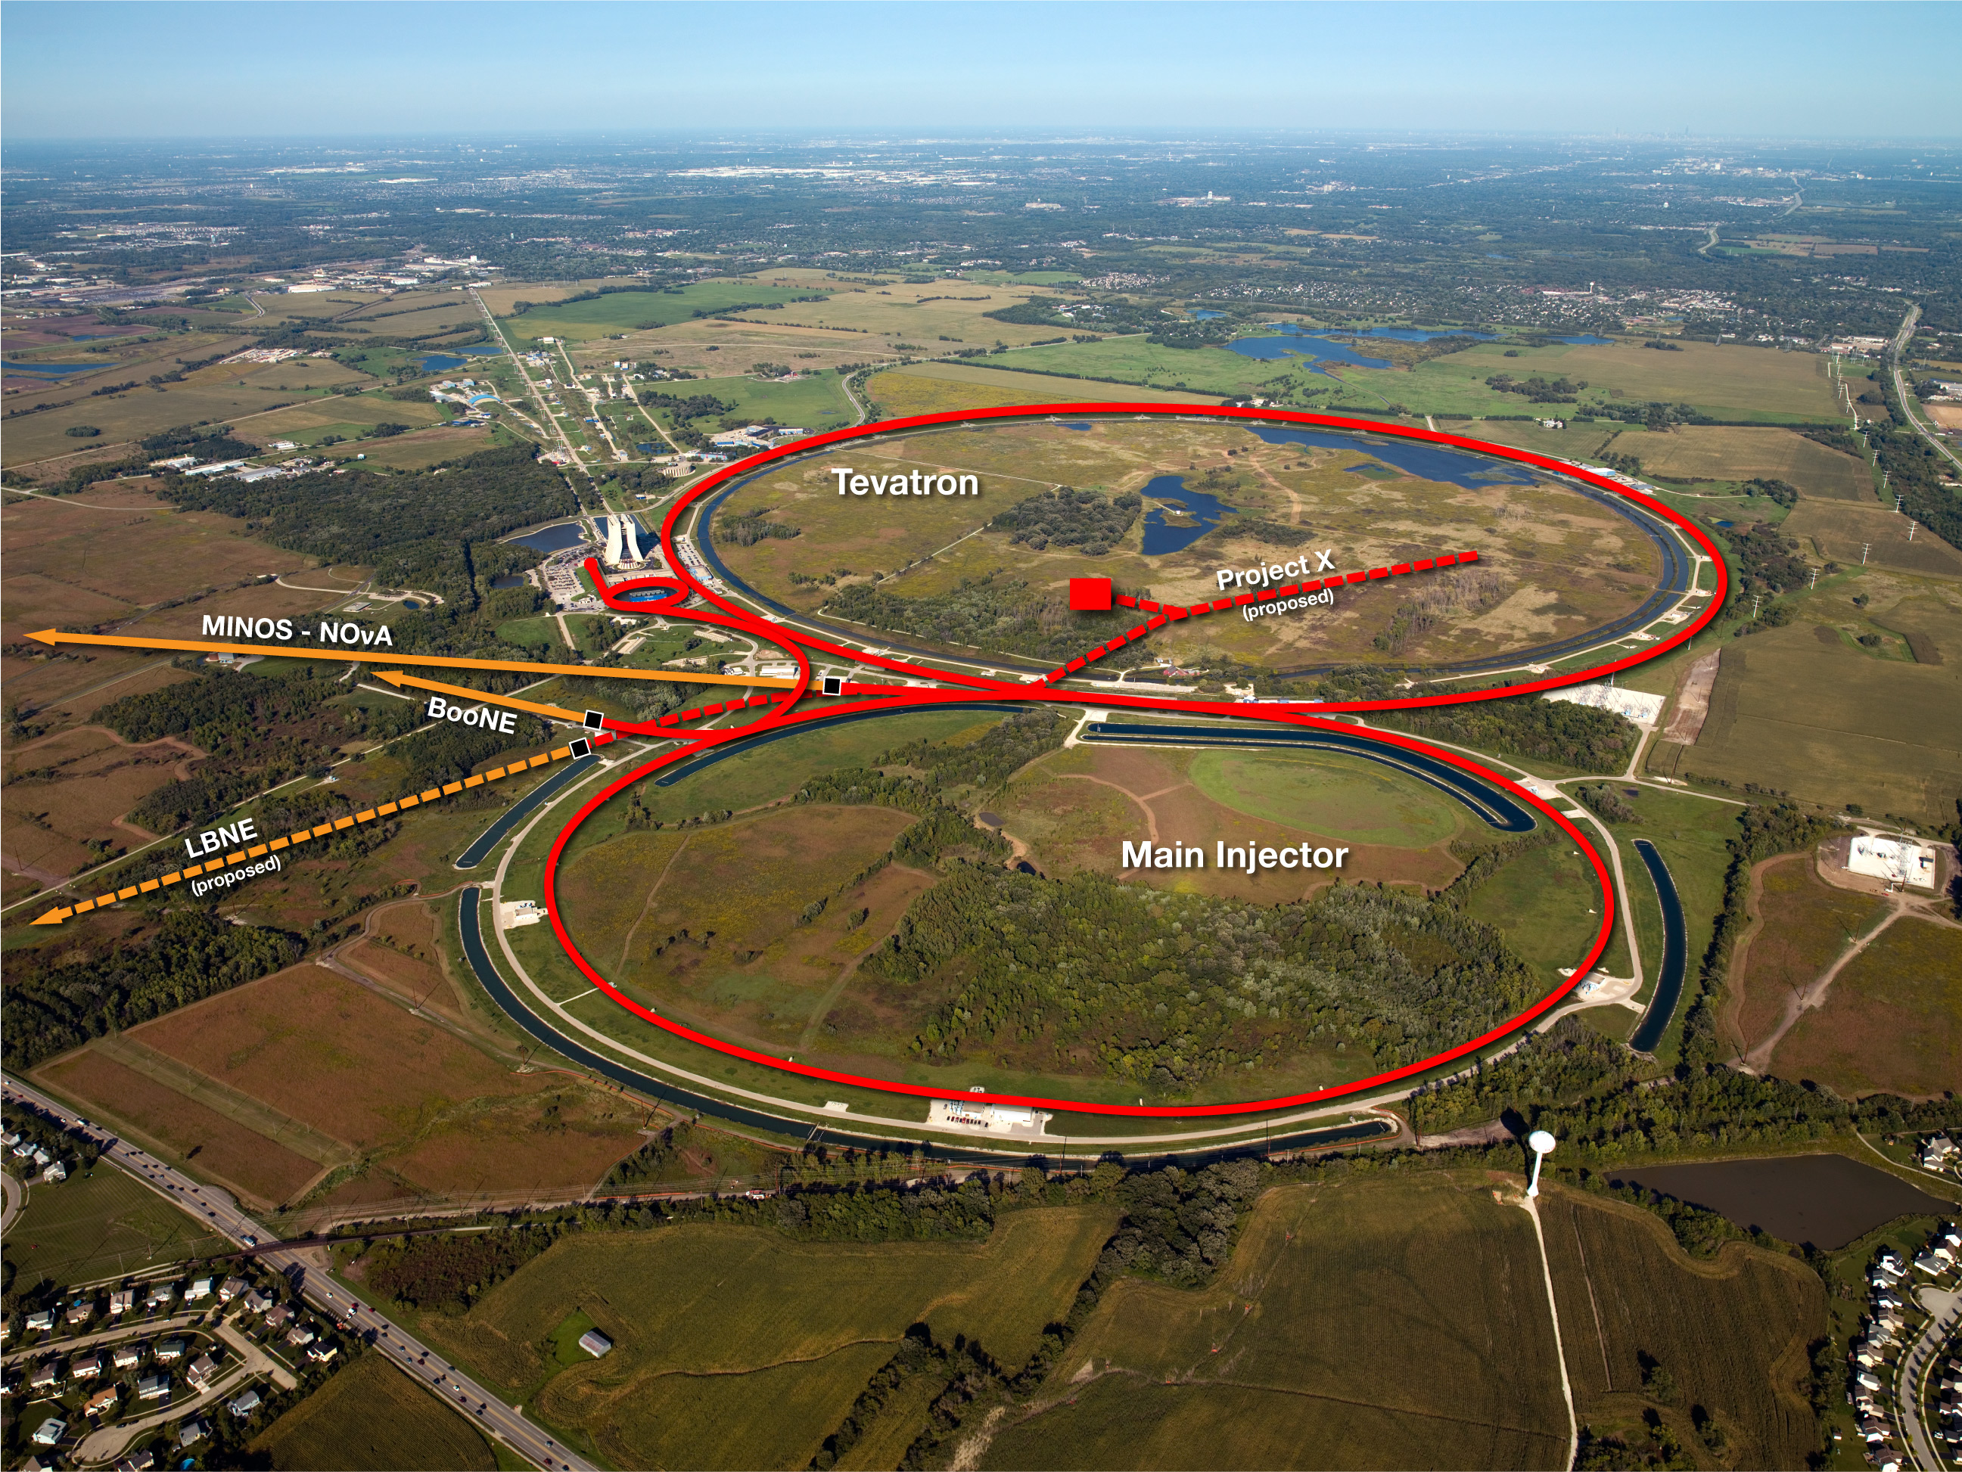
Fermilab has an extremely
intense beam of protons
Making it an excellent place to pursue
neutrino physics

Slide 44
Building a Neutrino Oscillation Experiment
Accelerator generated neutrino beams are in an energy range between
500 MeV – 5 GeV or so
So by moving the detector distance, you tune your sensitivity to different ranges of mass difference, Δm²
To see the first oscillation maximum at this Δm², for example, put your detector about 1000 km away!

Slide 45
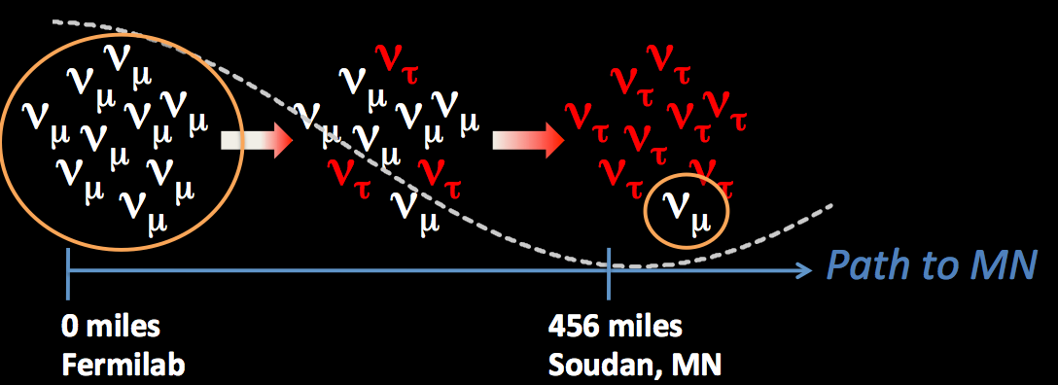
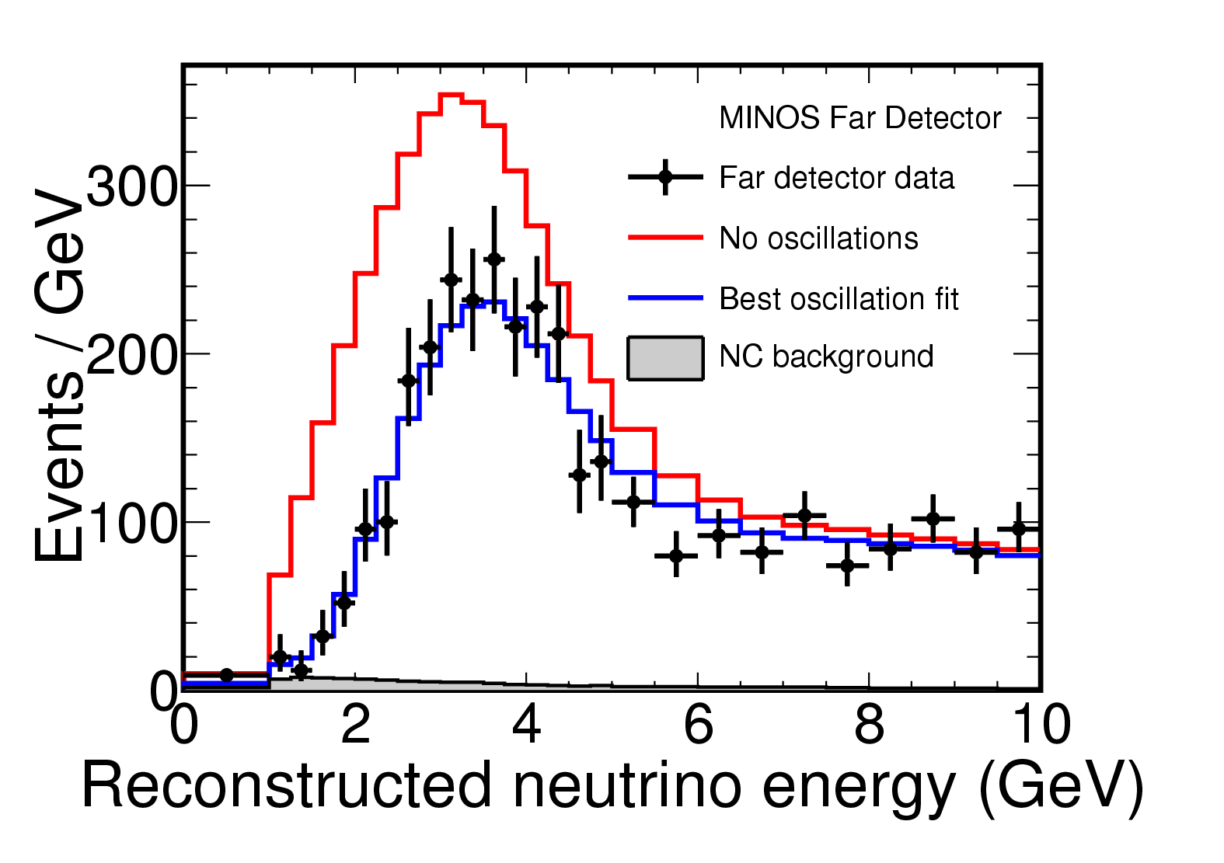
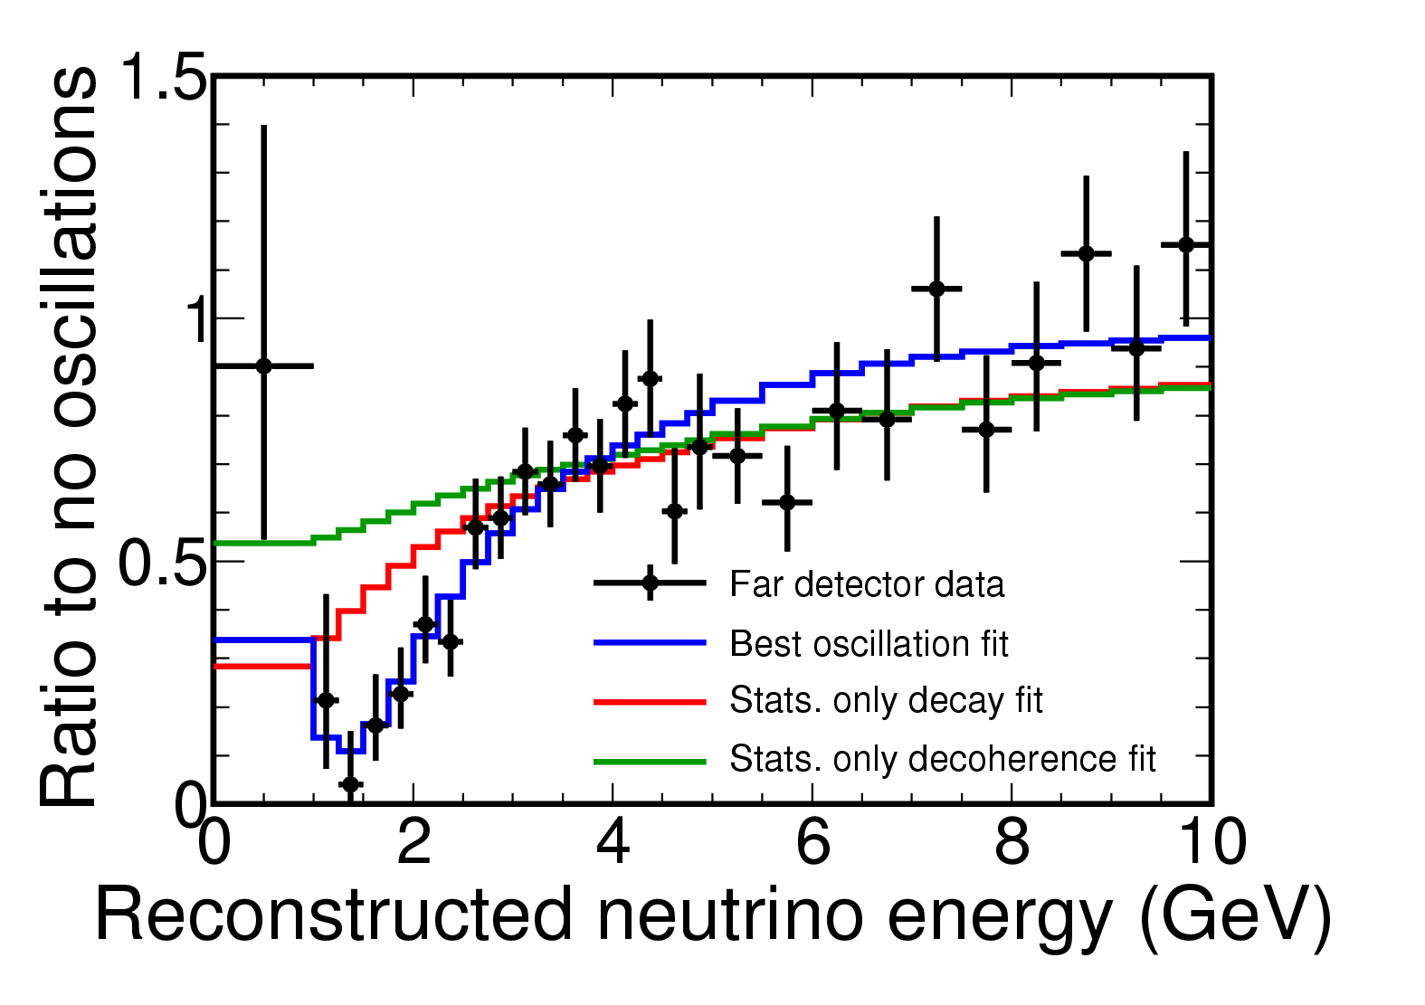
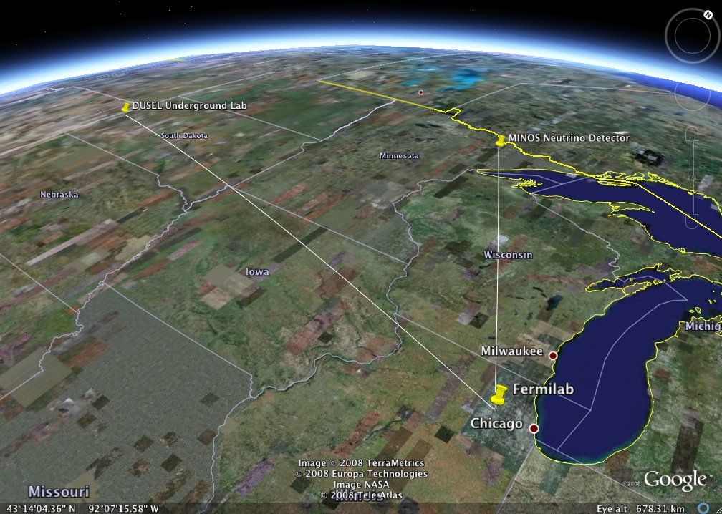
450 miles
800 miles

Slide 46
Are there more neutrinos?!
What if you bring the detectors much closer, say ~1km?

Slide 47
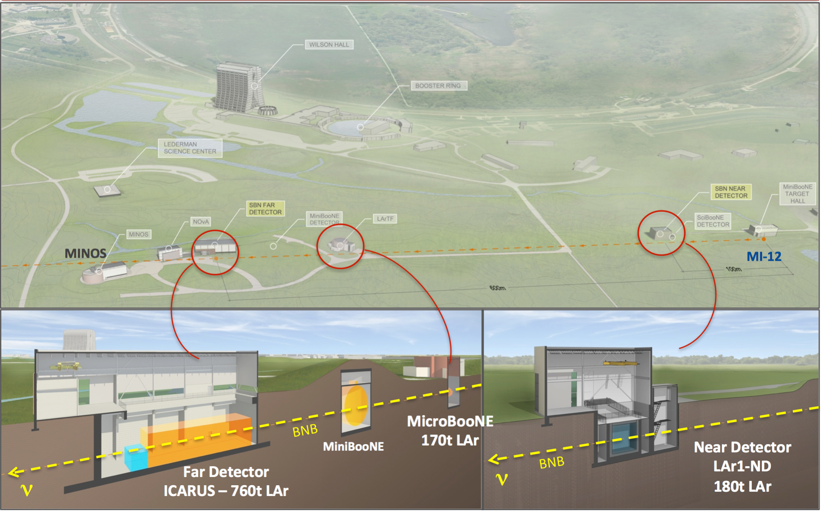

We are currently building a new experimental program at Fermilab to search for a new type of oscillation involving “sterile” neutrinos.
Three new detectors all within 1km of the neutrino source.

Slide 48
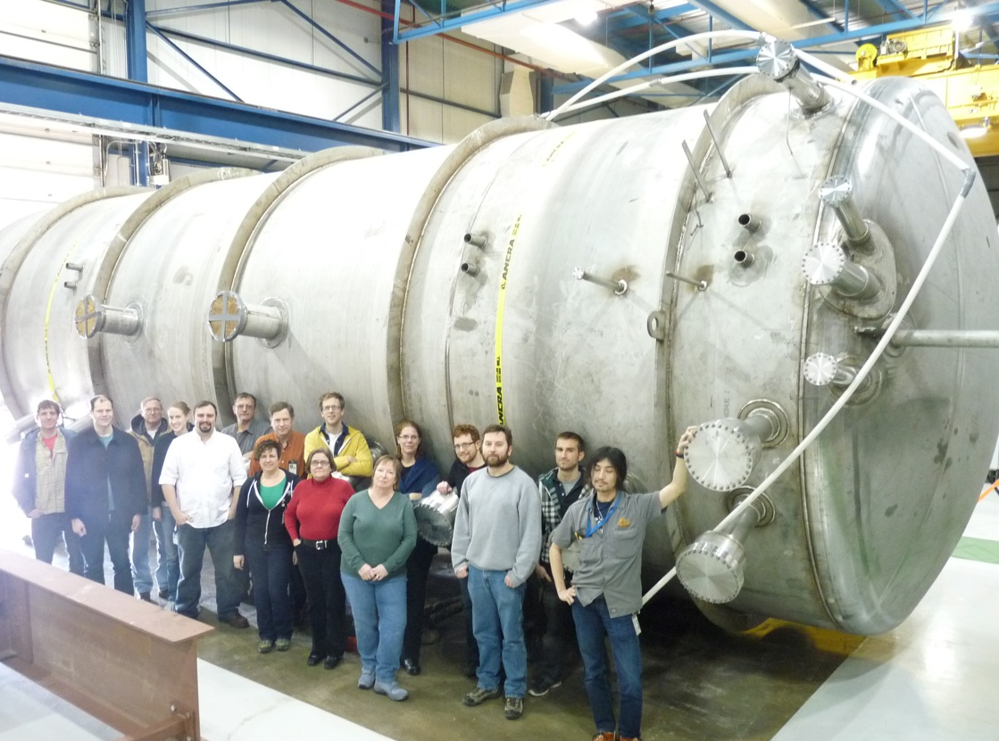
Liquid Argon Time Projection Chambers
April 4, 2013

Slide 49
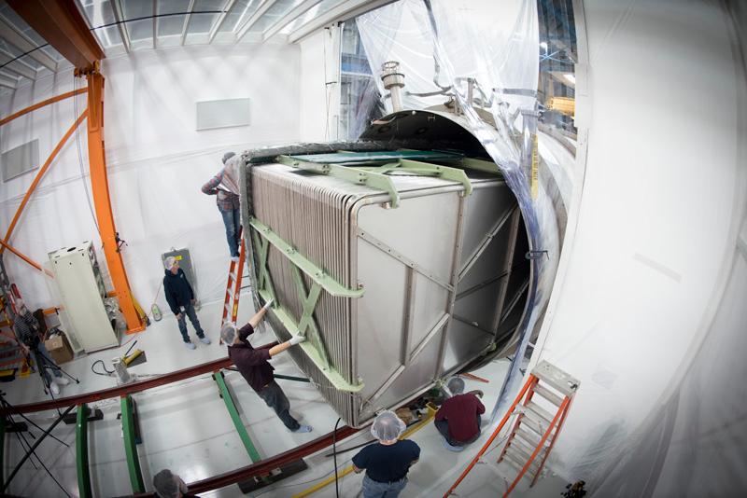
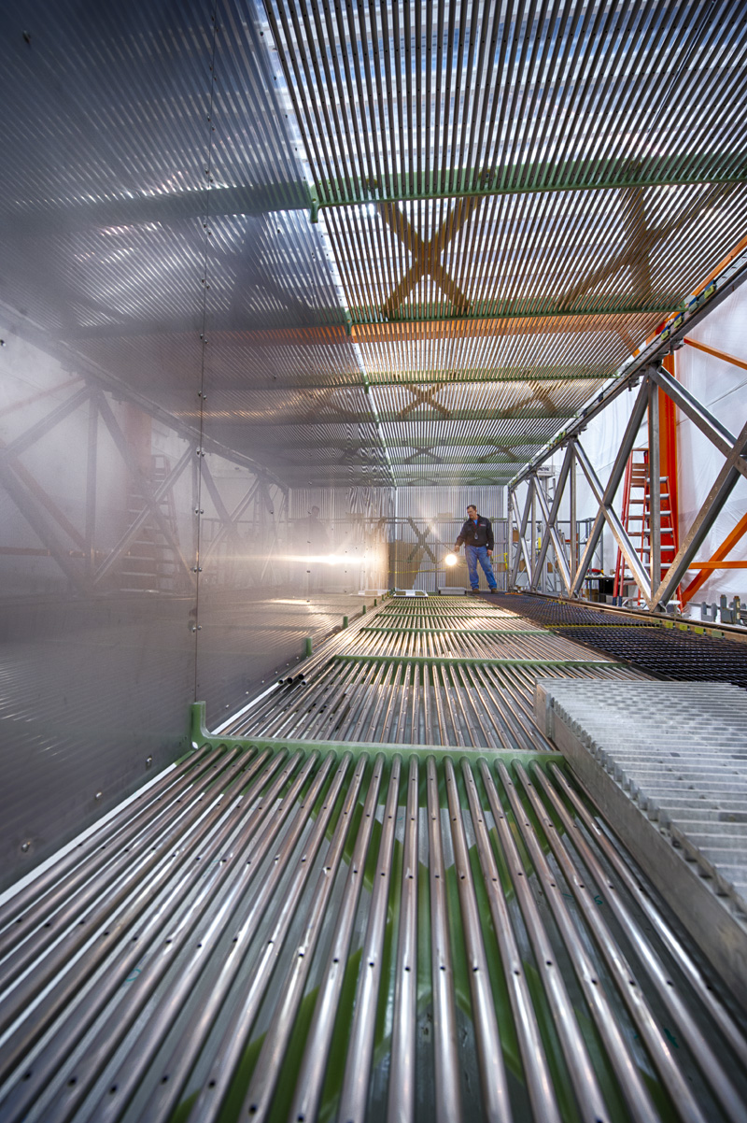
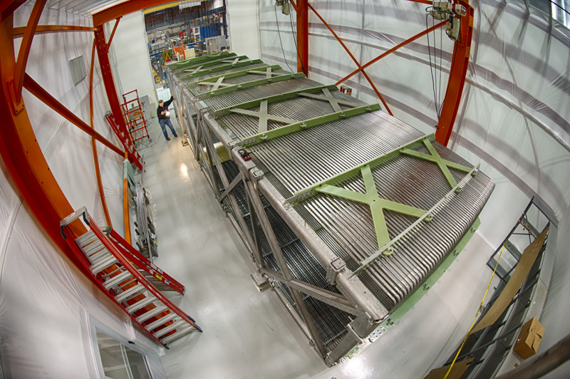

Slide 50

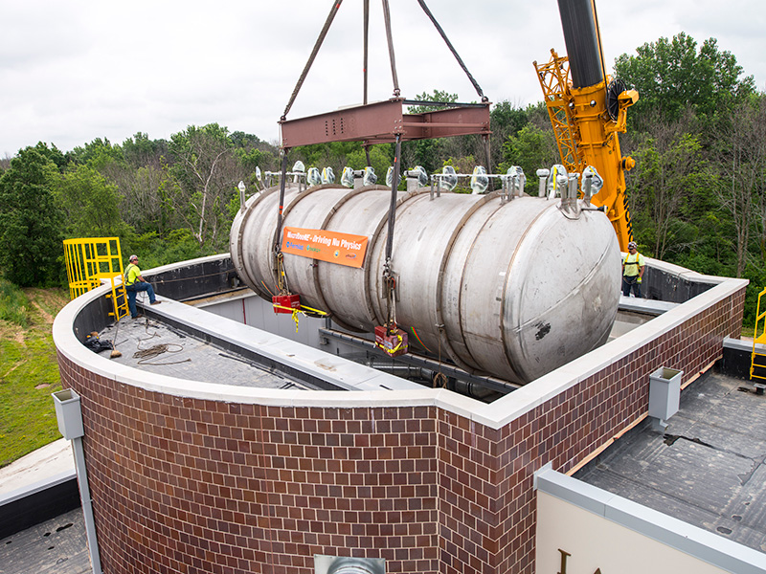

Slide 51
ν_{e}
ν_{μ}
ν_{τ}

Slide 52

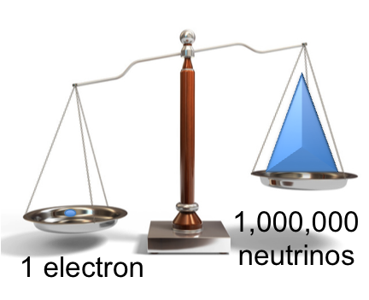
Rich physics in this next stage!!
ν_{e}
ν_{μ}
ν_{τ}
Still many questions to answer
matter/antimatter parts
mass ordering parts

Slide 53
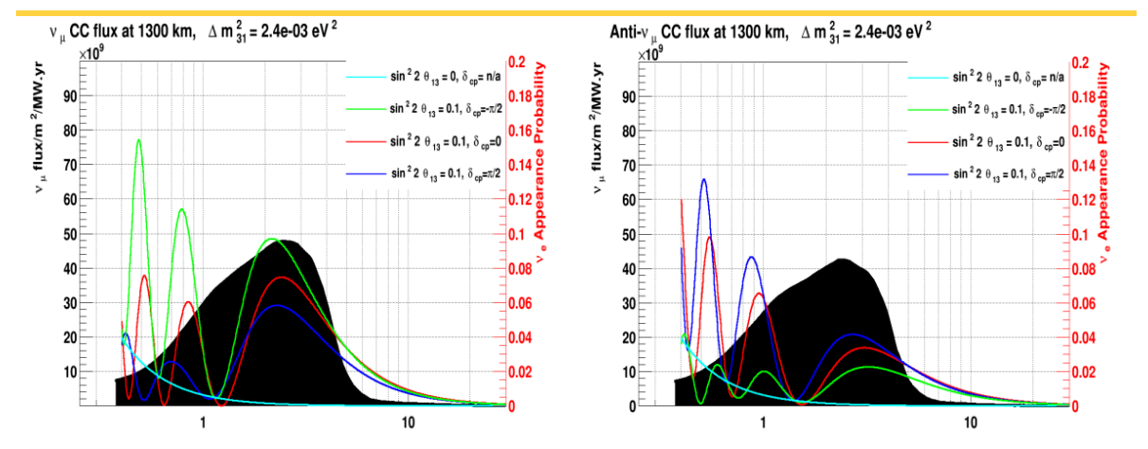
ν_{e}
ν_{μ}
ν_{τ}
ν_{e}
ν_{μ}
ν_{τ}
Could neutrinos explain the asymmetry between matter and antimatter in the Universe?
Next generation oscillation experiments aim to find out.

Slide 54
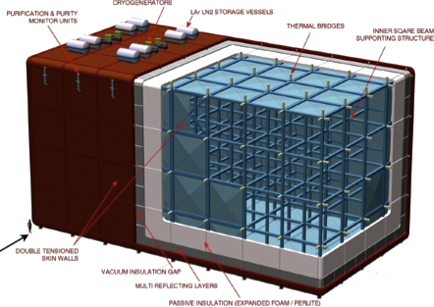
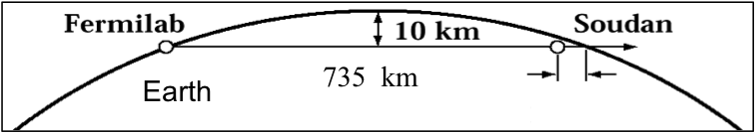
~7 miles
Homestake
800 miles
450 miles
800 miles

Slide 55
450 miles
800 miles
neutrino
physicist

Slide 56
Why Neutrinos?
They are the most abundant (known) matter particles in the universe. Important to understand them. Further, they act as messengers from across the cosmos.
Are there new kinds of “sterile” neutrinos? What is there mass? What role do they play in the early and current universe?
Could neutrinos explain the asymmetry between matter and antimatter that has created the universe we live in today?
Neutrinos have surprise us many times before, and we’ve by no means learned all there is to know!

Slide 57

Upcoming Colloquium
Thursday March 5, 4:00 PM KPTC 206
Sam Zeller, Fermilab Scientist, spokesperson for MicroBooNE

Slide 58
Thanks!

Slide 59

1930s: A Crisis in Particle Physics
By 1931, it was well known that nuclei could change from one variety to another by emitting a “beta particle” (electron)
But a 2-body decay should yield a monochromatic β spectrum
Some even considered abandoning the conservation of energy!
proton
neutron
electron

Slide 60


A “Desperate Remedy”
“wrong statistics” and “exchange theorem” refers to a second problem that:
Wolfgang Pauli
Nobel Prize Winner
Party Man

Slide 61
A “Desperate Remedy”
Of course, we now know Pauli’s “neutron” to be the electron antineutrino
But could it be detected?
neutron
electron
proton
ν

Slide 62
Quarks . . .
We know that like charges repel by the electromagnetic force, so why don’t the positively charged protons in a tiny nucleus push apart from each other?
nucleus
p
p
p
p
p
p
p
p
p
p
p
p
u
u
u
d
d
d
proton
neutron

Slide 63
Quarks . . .
We know that like charges repel by the electromagnetic force, so why don’t the positively charged protons in a tiny nucleus push apart from each other?
Because the attractive strong force is stronger than the repulsive electromagnetic force
Also neutrons help make a nucleus stable since they feel the strong force but are overall electrically neutral
nucleus
nucleus
n
p
p
p
n
p
p
n
p
p
p
p
p
n
n
n
p
p

Slide 64
Flavor Mass
Leptonic Mixing Matrix
flavor states
participating in
standard weak interactions
neutrino
mass states

Slide 65
Flavor Mass
Leptonic Mixing Matrix
flavor states
participating in
standard weak interactions
neutrino
mass states
flavor eigenstates == mass eigenstates
flavor eigenstates = equal mix of mass states

Slide 66





protons from accelerator
1/3 mile decay pipe
neutrino detectors
NuMI Beam Line
target
170 ft
~ 1 mile
350 ft
University of Chicago HEP Seminar – January 31, 2011

