Slide 1
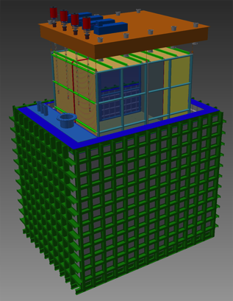
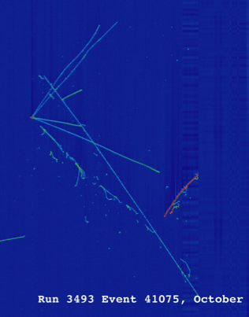


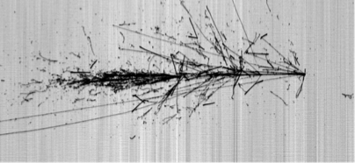

The Short-Baseline Neutrino (SBN) Physics Program at Fermilab
Cornell University, LEPP Journal Club
May 5, 2017
David Schmitz

Slide 2
Outline: The SBN Program
Neutrino Masses and Mixing (10 slides)
  Reminder of what we know and don’t know (yet)
  Physics of DUNE, the Deep Underground Neutrino Experiment
Light (eV-scale) Sterile Neutrinos (9 slides)
  What are they?
  Why bother looking, and where?
The Fermilab SBN Program (35 slides)
  Physics of the SBN Program
  Technology of the SBN Program: Liquid Argon TPC neutrino detector
  Status of SBN Phase I: MicroBooNE running
  Status of SBN Phase II: Preparation of ICARUS and SBND detectors
Conclude (1 slide)

Slide 3
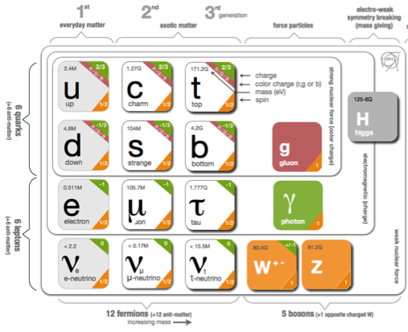
Neutrino Masses and Mixing
Weak flavor α at production point is a superposition of mass eigenstates
for example a ν_{μ}:
After traveling a distance L, the ν_{i} get out of phase with one another, and the sum may no longer correspond to a ν_{α}!
Neutrino Mixing Matrix
Flavor states
participating in
standard weak interactions
Neutrino
mass states of mass m_{i}

Slide 4
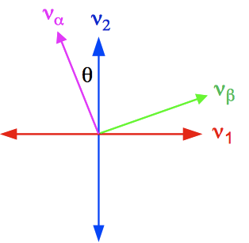
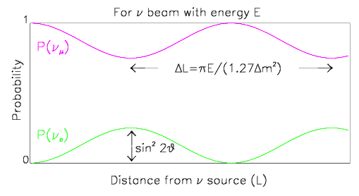
Neutrino Masses and Mixing
Parameterize in a form analogous to the CKM matrix for quarks and factorize:
3 mixing angles and 1 CP-violating phase
2-neutrino mixing oscillation probability:
θ = mixing angle
L = neutrino path length
E = neutrino energy
Amplitude determined
by amount of mixing, θ
Oscillation wavelength determined by mass-splitting and neutrino energy

Slide 5
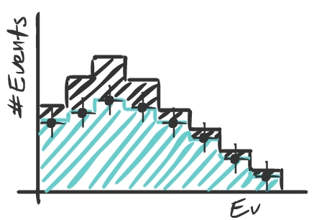
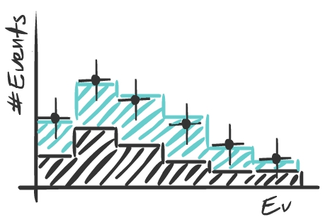
Disappearance vs. Appearance
Begin with broad energy spectrum beam of ν_{α}
ν_{e}
e
L
W
μ
Measure ν_{α} / ν_{β} energy spectrum after traveling distance L
μ
ν_{μ}
ν_{μ}
W
W
ν_{α} “disappearance”
ν_{β} “appearance”
Image credit: Georgia Karagiorgi
No oscillations
Oscillations
No oscillations
Oscillations
(look for deficit of ν_{α} events)
(look for excess of ν_{β} events)

Slide 6
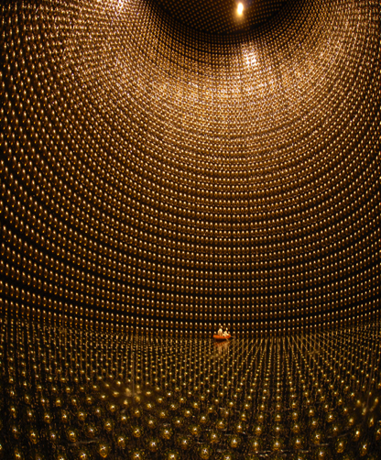

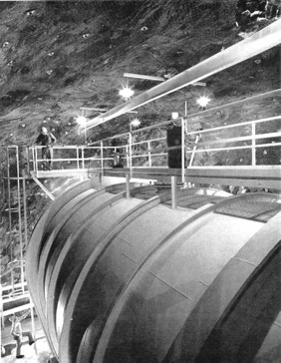
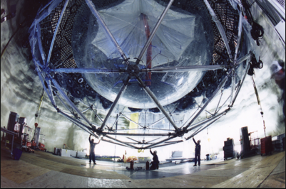
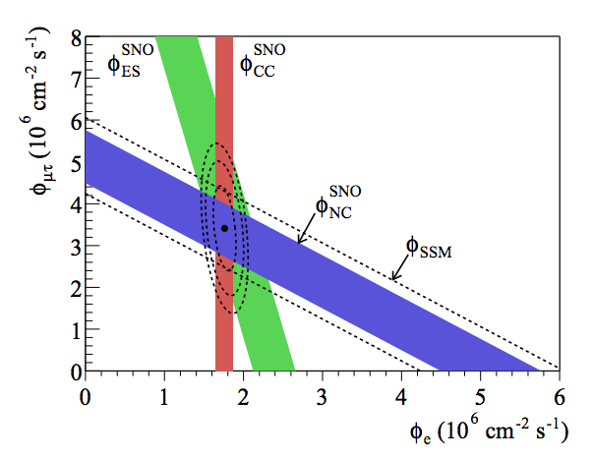
A Really Beautiful Experimental History
Atmospheric neutrinos at Super-Kamiokande
Solar neutrinos at Homestake
2002
Earth
SuperK
…and SNO
2015
2015

Slide 7
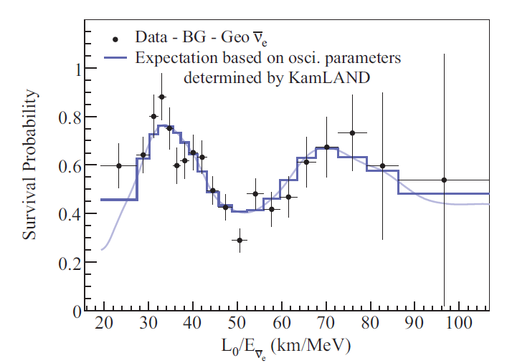
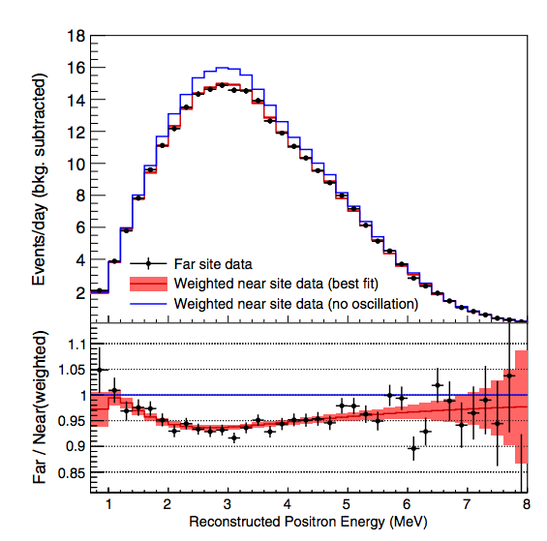
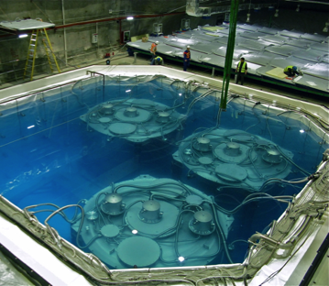
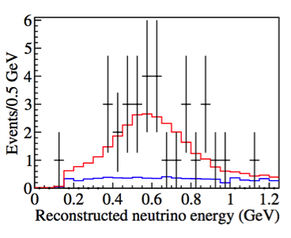
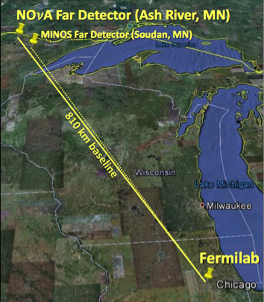
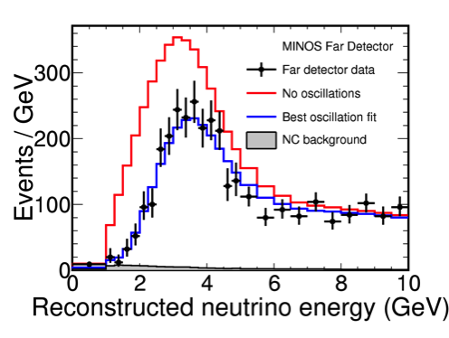
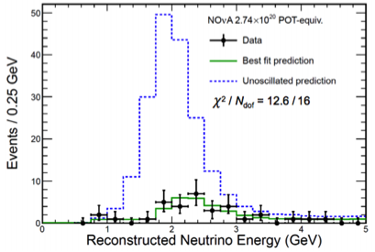
A Really Beautiful Experimental History
Reactor neutrinos at long-baseline in KamLAND
…and at
short-baseline in Daya Bay, Reno, and Double Chooz
ν_{e} disappearance
Accelerator neutrinos at MINOS
…and T2K
( )
ν_{μ} disappearance
…and now at NOvA
( )
( )
ν_{μ} → ν_{e}
appearance!
( )
ν_{μ} disappearance

Slide 8
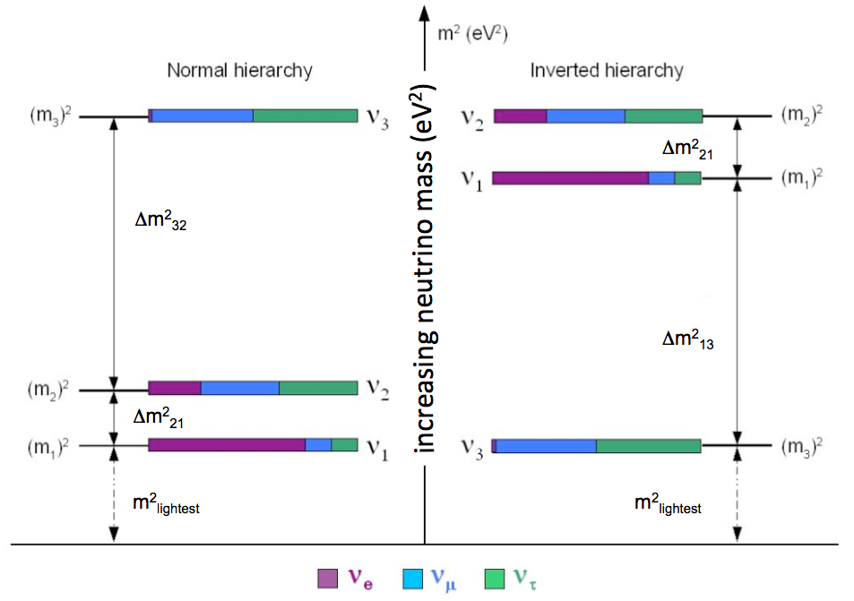
The Things We Know and Don’t Know
?
mass hierarchy
“atmospheric mass-splitting”
“solar mass-splitting”
?
Do neutrinos violate CP symmetry?
?
?
absolute mass scale
why such large mixing? unitarity?

Slide 9
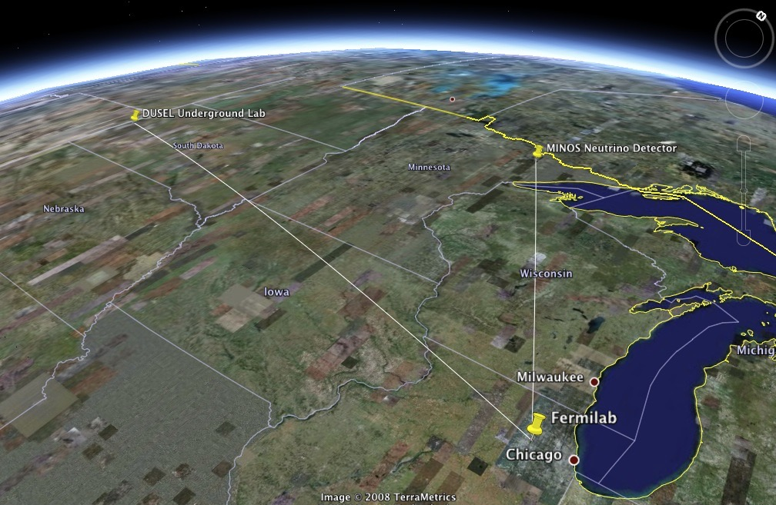


ν_{e}
ν_{μ}
ν_{τ}
L = 1300 km

Slide 10

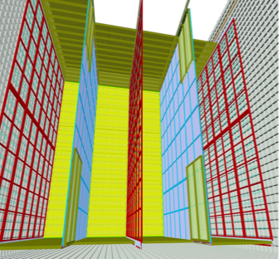
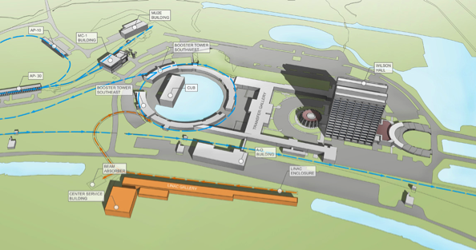
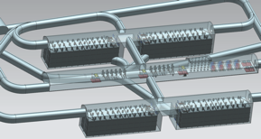
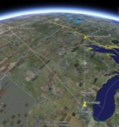
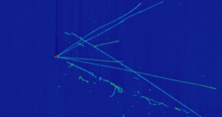
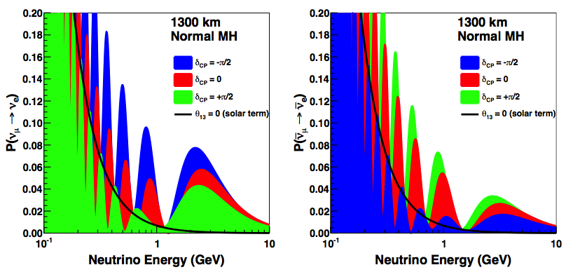
The Deep Underground Neutrino Experiment
12 m
LBNF
x4
1300 km
DUNE
New 800 MeV superconducting linac (PIP-II) and new neutrino beam facility (LBNF) at Fermilab to deliver MW scale neutrino beam
Multiple modules, each a 10,000 metric ton neutrino detector (40kT total), 4800 ft. underground at Sanford Underground Research Facility in South Dakota
neutrinos
antineutrinos
Electron Neutrino Appearance

Slide 11

The Deep Underground Neutrino Experiment
neutrinos
antineutrinos
2nd
1st
2nd
1st
0.8 GeV
2.6 GeV
0.8 GeV
2.6 GeV

Slide 12
Physics of DUNE
Measure the charge-parity (CP) violating phase δ
  Fundamental question in the Standard Model, is CP respected by leptons?
  Is see-saw/leptogenesis a possible explanation of the baryon asymmetry?
Neutrino mass hierarchy
  Another fundamental question about structure of fermions: is lightest charged lepton associated with the heaviest neutrino?
  Implications for other open questions, such as 0νββ data and Majorana nature of ν
Precision tests of three-flavor neutrino oscillation paradigm
  Disappearance and appearance; neutrinos and antineutrinos
Baryon number non-conservation
  proton decay: p → K⁺ν and other modes
  neutron-antineutron oscillations
  Predicted in many beyond SM theories
Supernova neutrinos
  Measure the ν_{e} flux from a core-collapse supernova within our galaxy
  1000s of events for a SN 10 kpc away

Slide 13
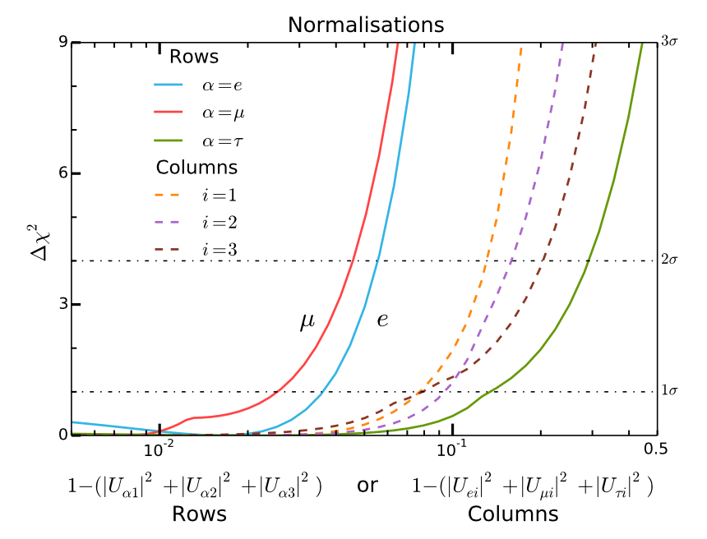
What About Physics Beyond the 3-ν SM?
In principle, neutrino oscillations can provide a window onto particle sectors not accessible through SM interactions
Neutrino mixing framework can be n x n provided
  the total number of (light) weakly interacting neutrinos is 3 (Z measurements at LEP)
  n x n mixing matrix is unitary
Unitarity Constraints on 3x3 part
(and more CP-violating phases…)
~4%
~15%
~3%
[S. Parke, M. Ross-Lonergan, hep-ph/1508.05095]

Slide 14
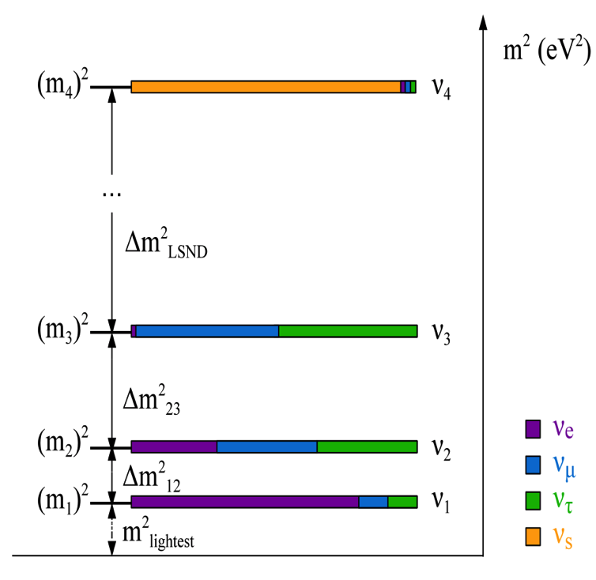
What About Physics Beyond the 3-ν SM?
Additional flavor states which do not couple to Standard Model forces, i.e. ‘sterile’ neutrinos
A simple “3+1” Model*
a mostly sterile mass state
4l
*For discussion of more complex models at SBN,
see Cianci, et al. arXiv:1702.01758 [hep-ph]

Slide 15
What About Physics Beyond the 3-ν SM?
Additional flavor states which do not couple to Standard Model forces, i.e. ‘sterile’ neutrinos
A simple “3+1” Model
ν_{e} disappearance:
a mostly sterile mass state
4l

Slide 16
What About Physics Beyond the 3-ν SM?
Additional flavor states which do not couple to Standard Model forces, i.e. ‘sterile’ neutrinos
A simple “3+1” Model
ν_{e} disappearance:
a mostly sterile mass state
ν_{μ} disappearance:
4l

Slide 17
What About Physics Beyond the 3-ν SM?
Additional flavor states which do not couple to Standard Model forces, i.e. ‘sterile’ neutrinos
A simple “3+1” Model
ν_{e} disappearance:
a mostly sterile mass state
ν_{μ} disappearance:
4l
ν_{e} → ν_{μ} appearance:

Slide 18
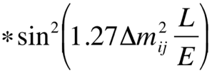
The Oscillation Picture
x30
…
?
L/E ~ 500 km/GeV
L/E ~ 15,000 km/GeV
Extremely sensitive experiments needed.
Oscillation probabilities at least 10x smaller than for atmospheric (θ₁₃)
L/E ~ 1 km/GeV

Slide 19
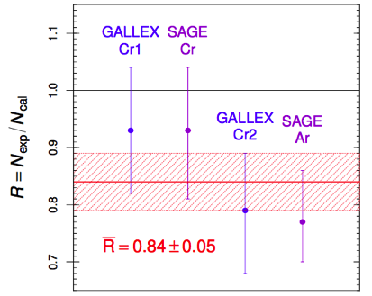
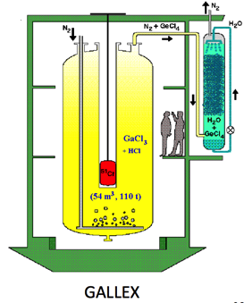
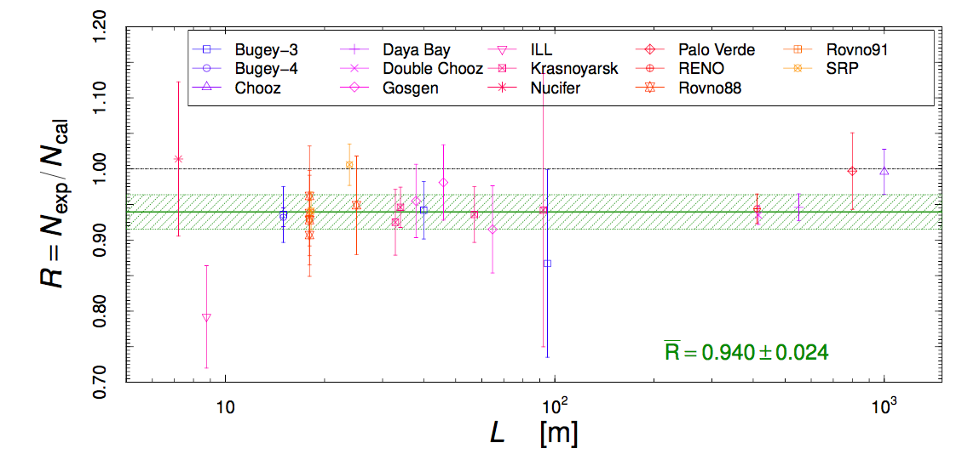
Hints of Physics Beyond the 3-ν SM?
Experimental anomalies ranging in significance have been reported from a variety of experiments studying neutrinos over baselines less than 1 km (L/E order 1 km/GeV)
Experiment | Neutrino Source | Search Channel | Significance
LSND | π/μ decay-at-rest | appearance | 3.8σ
MiniBooNE | accelerator decay-in-flight | appearance | 3.4σ / 2.8σ
GALLEX/SAGE | Source, e-capture | disappearance | 3σ
Reactors | Beta decay | disappearance | ≤ 2.5σ

Slide 20
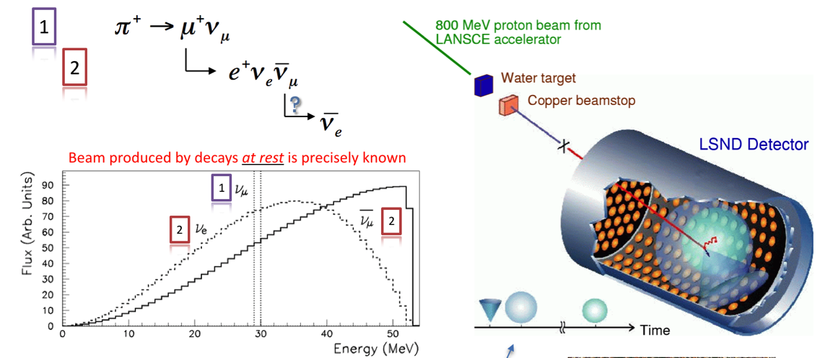
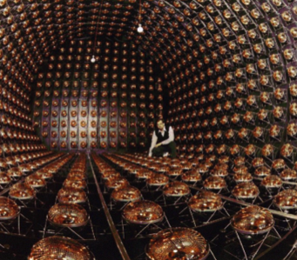
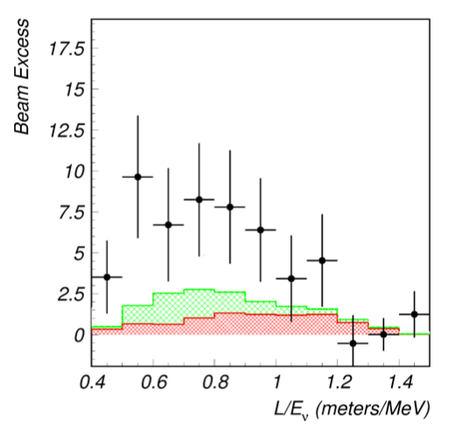

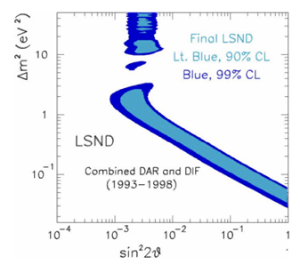
The LSND Appearance Signal
30 m
inverse beta decay detection of electron antineutrinos
if interpreted as an oscillation:
?
but not much Δm₂ resolution,
~0.01 – 100 eV₂
Phys. Rev. D64, 112007(2001)

Slide 21
The MiniBooNE Appearance Signals
Designed to follow up on LSND result as oscillations, but with different source (accelerator DIF), different detection (ν_{e} and ν_{μ} CC), thus different systematics
different L
different E
same L/E ~ 1 km/GeV
BNB fluxes

Slide 22
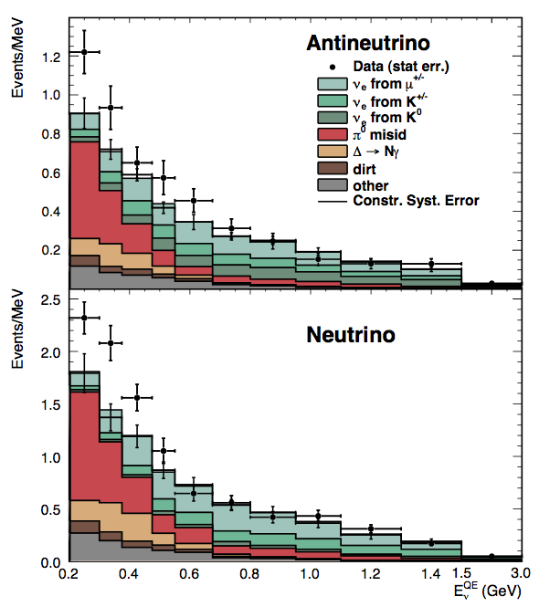
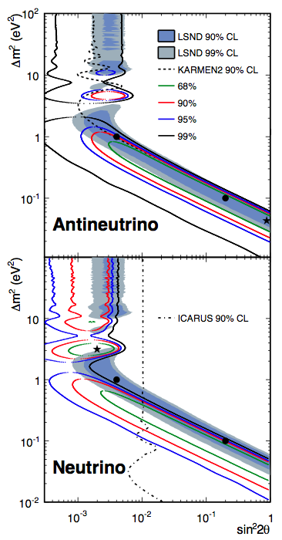
The MiniBooNE Appearance Signals
2.8σ
Phys.Rev.Lett.110.161801,2013
3.4σ
e
Both consistent with (3+1) oscillations, in general. Antineutrino allowed parameters in better agreement with LSND parameters.
γ γ γ

Slide 23
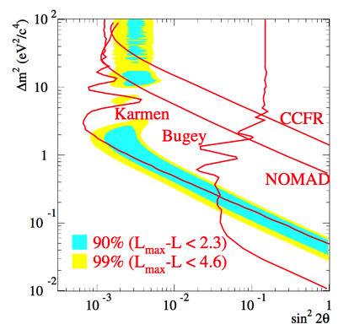
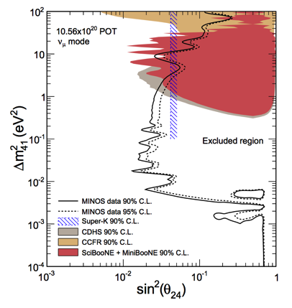
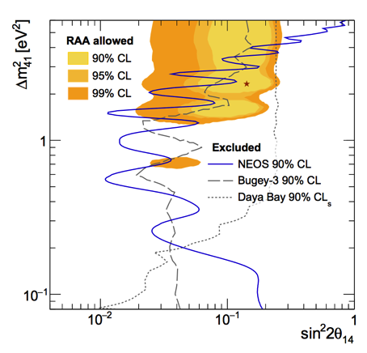
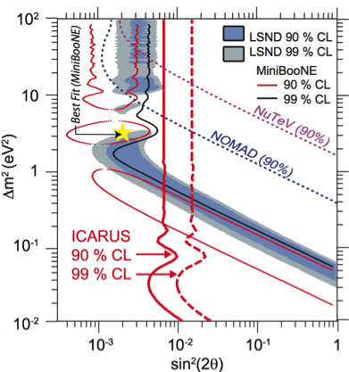
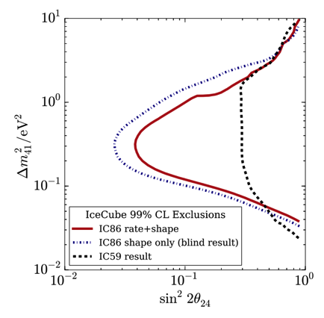
A Multi-Faceted Attack!
ν_{e} appearance
ν_{μ} disappearance
ν_{e} disappearance
SciBooNE
MINOS
NEOS
IceCube
gallium + reactor signals
new generation of SBL reactor experiments underway
LSND + MiniBooNE signals
rest null results
only null results

Slide 24
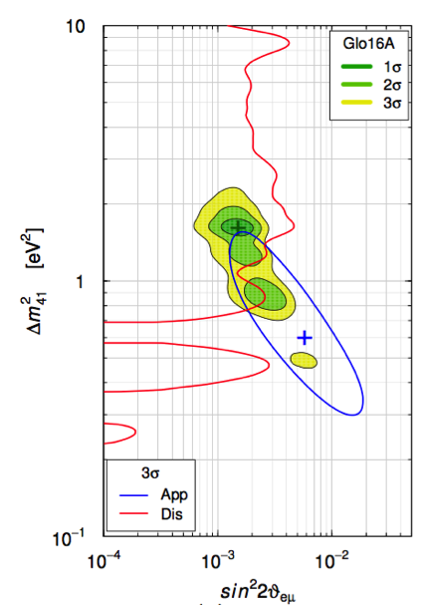
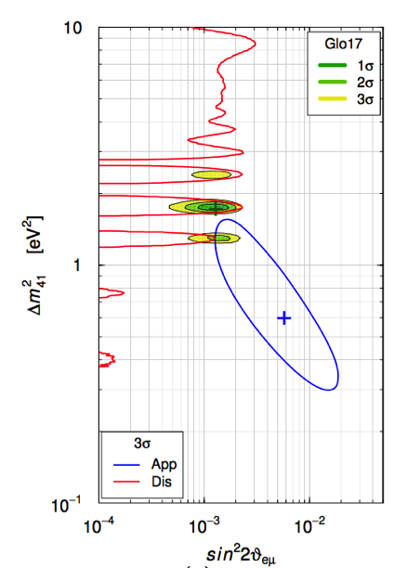
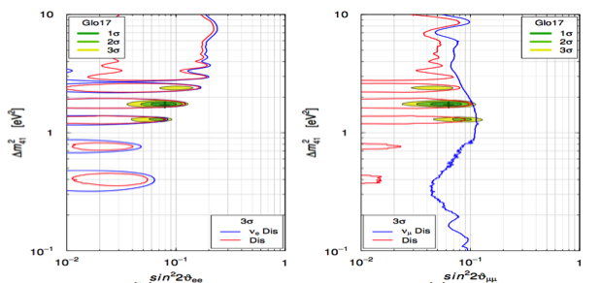
Global Data Analysis
2000
+ many exps
2016
+MINOS+IceCube+NEOS
2017
ν_{e} appearance
1-3 eV²
S. Gariazzo et al. arXiv:1703.00860 [hep-ph]
4 orders of magnitude
bf~0.15%
To definitively rule on the LSND/MiniBooNE anomalies and the ~1 eV sterile neutrino interpretation is the primary physics goal of the SBN Program
ν_{e} disappearance
ν_{μ} disappearance
See also: G.H. Collin et al. arXiv:1607.00011 [hep-ph]
bf~8%
bf~6%

Slide 25
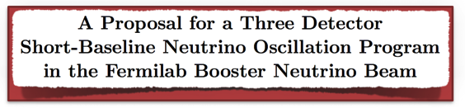
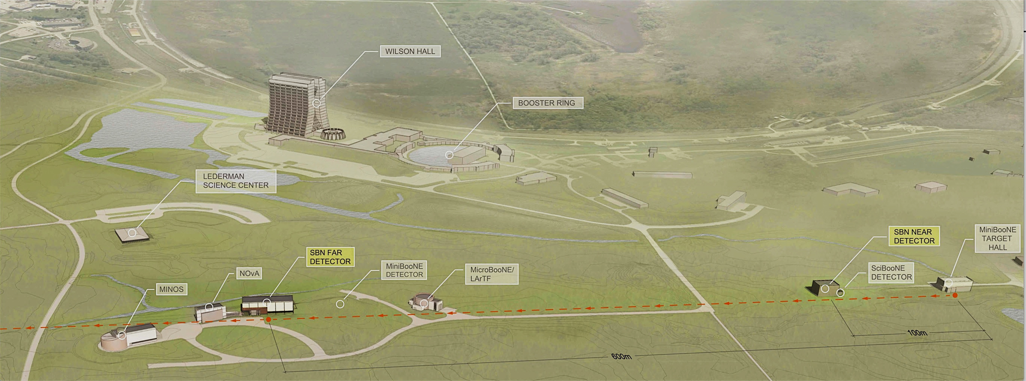
The Three Detector SBN Program
Three liquid argon time projection chamber detectors (LArTPC) along the Booster Neutrino Beam (BNB) at Fermilab
  Same beam, neutrino target, detector technology → minimize systematics
MicroBooNE operational with beam since Oct 2015
Full SBN program approved in Feb 2015
arXiv:1503.01520
SBND
110m
112 tons
ICARUS
600m
476 tons
MicroBooNE
470m
89 tons
Booster Neutrino Beam
25

Slide 26
The Three Detector SBN Program
increase statistics of oscillation signal by adding ICARUS
~global
best fit Δm²
control systematics
with near detector
BNB fluxes
ICARUS
600m
476 tons
MicroBooNE
470m
89 tons
Booster Neutrino Beam
26

Slide 27
The Three Detector SBN Program
ν_{μ} → ν_{e} appearance
ν_{μ} disappearance
5σ
SBND
110m
112 tons
ICARUS
600m
476 tons
MicroBooNE
470m
89 tons
Booster Neutrino Beam
27

Slide 28
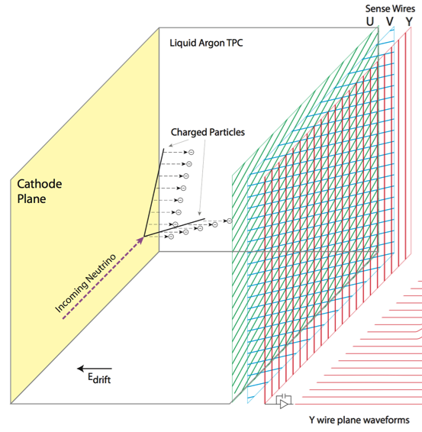


Liquid Argon TPCs: Operating Principle
Neutrino+Ar → final state charged particles ionize the argon, produce scintillation photons
Electric field drifts free electrons to wire chamber planes (~1.6 mm/μs at 500 V/cm)
Induction/Collection planes image charge, record dE/dx
so drift time is few milliseconds
scintillation light
ionization charge
PMTs
SCINTILLATION LIGHT
SIGNALS ARRIVE FIRST
time
time
RELATIVE ARRIVAL TIME OF CHARGE GIVES X-COORDINATE

Slide 29





HV ~ -100 kV
HV ~ -100 kV

Slide 30

Liquid Argon TPCs: The Real Thing
bubble chamber like imaging
fine sampling calorimetry
electronic readout
scalable to large volumes

Slide 31



LArTPC Development for Particle Physics
slide credit: Mike Mooney
ICARUS
2000s

Slide 32





Cherenkov Detector vs. LArTPC → e/γ ID
MiniBooNE
Cherenkov Detector
gaps from vertex
Electron
Photon
e
γ γ γ

Slide 33



The SBN LArTPCs
ICARUS
600 m from ν production
476 ton active volume
4x 1.5m drift
0.95 ms drift time (500V/cm)
75 kV
3 wire planes: 0, +/-60 deg, 3mm
53246 wires x 2 MHz
Warm analog and digital electronics
360 8” PMTs x 500 MHz
Single readout stream:
Continuous
MicroBooNE
470 m from ν production
89 ton active volume
2.5m drift
1.6 ms drift time (500V/cm)
128 kV
3 wire planes: 0, +/-60 deg, 3mm
8256 wires x 2 MHz
Cold analog/warm digital electronics
32 8” PMTs x 64 MHz
Two parallel readout streams:
Triggered and continuous
SBND
110 m from ν production
112 ton active volume
2x 2m drift
1.28ms drift time (500V/cm)
100 kV
3 wire planes: 0, +/-60 deg, 3mm
11264 wires x 2 MHz
Cold analog and digital electronics
120 8” PMTs x 500 MHz & scint. bars
Two parallel readout streams:
Triggered and continuous

Slide 34


SBN Oscillation Sensitivity Analysis
Correlations between detectors (same beam and detection technique) allow for cancelations in systematic uncertainties on backgrounds
3 Detector ν_{e} Backgrounds Correlation Matrix
(flux and cross section systematics)
Large uncertainties come from predicting fluxes and neutrino interaction rates, but event rates strongly correlated between detectors

Slide 35

Cosmogenic Backgrounds
The challenge at the surface: 1000x longer charge drift time than the beam spill time!
1-2 ms drift time
Wire cell reconstruction

Slide 36

Cosmogenic Backgrounds
The challenge at the surface: 1000x longer charge drift time than the beam spill time!
Detector | Neutrino interaction every N spills | Cosmic muon in beam spill time every N spills
SBND | 25 | 300
MicroBooNE | 800 | 200
ICARUS-T300 | 500 | 100

Slide 37


Mitigation of Cosmogenic Backgrounds
3m of concrete overburden → Near 100% reduction of non-muon primaries with only few percent increase in secondaries.
This leaves photons generated near the TPC by cosmic μ as the main cosmogenic background for ν_{e} appearance search
Multi-step mitigation strategy:
  External cosmic ray tracker systems to tag cosmic muons near the detectors
  Internal photon detection systems with good time and spatial resolution for 1-to-1 matching of scintillation and ionization signals in the detectors
μ
Cosmic Ray Tracker
OVERBURDEN
TPC

Slide 38

SBN ν_{μ} → ν_{e} Oscillation Sensitivity
example signal

Slide 39

SBN ν_{μ} → ν_{x} Oscillation Sensitivity
example signal
ν_{e} appearance cannot occur without ν_{μ} disappearance
Critical aspect of SBN that is ONLY enabled with multiple detectors

Slide 40





ν-N Cross-Sections in Neutrino Physics
2nd
1st
Accelerator-based experiments carried out in a sweet spot of maximally complicated nuclear effects in neutrino interactions!
neutrino-nucleus interaction modeling is a leading source of systematic uncertainty in oscillation measurements
NEED DATA!

Slide 41
ν-N Cross-Sections in Neutrino Physics
A broad program of neutrino-argon cross-section measurements at SBN will have direct impact for controlling systematic uncertainties in oscillation measurements at DUNE
  Large statistics at both the 1st and 2nd DUNE oscillation peaks
  MicroBooNE is blazing this trail, but SBND will record the full 3 years of MicroBooNE stats every 2 months of running!
2nd
1st
SBND
ICARUS
BNB
on-axis
Some SBND stats:
1.5M ν_{μ} CC/year
12k ν_{e} CC/year
also low rate channels, like:
  coherent (10⁴/yr)
  strange prod (10³/yr)
  neutrino-electron (10²/yr)
2nd
1st
1st
2nd
NuMI
off-axis

Slide 42



Present Status of the SBN Program
Detector | Distance from BNB Target | Active LAr Mass
SBND | 110 m | 112 ton
MicroBooNE | 470 m | 87 ton
ICARUS | 600 m | 476 ton
MicroBooNE
MiniBooNE
Near Detector
SBND
Far Detector
ICARUS

Slide 43
Phase I: MicroBooNE

Slide 44


MicroBooNE Installation at LArTF (June 2014)

Slide 45




MicroBooNE LAr Fill (June 2015)
CMOS Analog Front End ASIC in LAr @ 87K
Front-end
electronics
noise
impurities absorb drifting electrons
drift times 1-2 ms
Argon purity
τ_{e} > 6 ms

Slide 46

Neutrino ID and Reconstruction
cosmic
cosmic
ν_{μ}
p
π
μ
cosmic
more images here: http://www-microboone.fnal.gov/first-neutrinos/index.html

Slide 47


Data Analysis at MicroBooNE
The beam has performed beyond expectation, and MicroBooNE has a large neutrino dataset already (~6e20 POT)
Many ongoing physics analyses – including neutrino interactions and direct follow-up to the MiniBooNE observed excess in the same beam at similar distance
  pre-cursor for full SBN oscillation analysis to come
Public results (including 4 publications and 16 pubic notes available from the website) so far focus on understanding the detector, calibrations, reconstruction development
  laying the foundations for physics results to come from MicroBooNE
  valuable “lessons learned” for SBND and DUNE regarding LArTPC design and operations

Slide 48


TPC Noise Studies and Mitigation
More noise “out of the box”, especially on induction planes, than anticipated.
Software noise filtering to recover performance (S/N > 12)
Lessons learned about grounding schemes and pickup sources within electronics systems applied to SBND and DUNE
ENC < 400 e⁻
MICROBOONE-NOTE-1016-PUB

Slide 49


Michel Electrons in MicroBooNE
Analysis of Michel electrons from cosmic muon decay valuable for understanding EM shower reconstruction and determining energy scale calibration – important check of Monte Carlo
https://arxiv.org/abs/1704.02927

Slide 50



Michel Electrons in MicroBooNE
https://arxiv.org/abs/1704.02927

Slide 51

Deep Learning Algorithms for TPCs
Convolutional Neural Networks (CNN) produce high-level objects by learning and utilizing low-level “features”
LArTPC basic raw product is an image
Efforts ongoing within MicroBooNE to use these cutting-edge computer vision techniques to characterize interactions in a LArTPC

Slide 52



Deep Learning Algorithms for TPCs
use simulated events injected into cosmic trigger data to train algorithm to find triggers that contain neutrino interactions
Does the trigger contain a neutrino?

Slide 53


Deep Learning Algorithms for TPCs
Once you have an interaction, build particles, vertices
CNNs also being explored for particle ID in events
Machine learning techniques require excellent agreement between simulation and data, so emphasis on validation and data-based techniques (like MC-cosmic data overlays, etc.)
By no means the only reconstruction and ID development going on in MicroBooNE!
More publications forthcoming

Slide 54
Phase II: ICARUS & SBND

Slide 55




SBN Far Detector Ready for Transport
Just completed a ~2 year program of upgrades at CERN in preparation for operation at Fermilab
  updated electronics
  10x more light collection for surface operation
Leaving CERN any day for 5-week journey to Fermilab!
½ ICARUS LArTPC in cleanroom @ CERN
x2
360 PMTs installed

Slide 56



Far Detector Building @ Fermilab
Sept 2015
Building ready to receive the detector this summer
Bottom Cosmic Ray Tracker panel installations beginning now
Dec 2015

Slide 57



Short-Baseline Near Detector
-100 kV
4 m
5 m
4 m
Central cathode
with two 2m drift regions
Two 4m x 2.5m
Anode Plane Assemblies (APAs) per side (drift region)
Membrane cryostat constructed inside an outer warm steel structure

Slide 58







SBND: TPC Construction Is Ongoing
Wiring procedures prototyping
Wire plane frames in production
HV feed-through prototype
Cathode plane mesh prototype

Slide 59

Near Detector Building @ Fermilab
Cryostat constructed in the building pit. Detector to be assembled at Fermilab during 2018.
Bottom Cosmic Ray Tracker panel installations beginning soon.

Slide 60



SBN Detectors ⟺ DUNE, Is it really helpful?
modular design and monolithic nature of LArTPC technology means many commonalities in design and lessons learned are valuable… despite massive scale difference
100 tons
10,000 tons
wire plane design
HV system
QA/QC methods
readout electronics
signal processing
photon detection
analysis methods
etc.

Slide 61
The SBN Program @ Fermilab: Summary
The SBN Program will:
  Explore the anomalous hints of new physics in neutrinos
  Measure neutrino-argon cross sections with high precision
  Further develop the LArTPC technology for neutrino physics
MicroBooNE is running smoothly and analyzing a large data set
ICARUS and SBND will be operational in 2018 and 2019, respectively, completing the program
Do light sterile neutrinos exist? I don’t know!
But SBN will provide critical new information, resulting in either an exciting discovery in particle physics or the welcome resolution of a long-standing unresolved puzzle in neutrino physics.

Slide 62
Extras

Slide 63



The SBN Collaborations
Proposal submitted jointly by ICARUS-WA104, MicroBooNE and LAr1-ND (now SBND) Collaborations
218 authors from 22 US and 23 non-US institutions
Argonne National Lab, USA
University of Bern, Switzerland
Brookhaven National Lab, USA
University of Cambridge, UK
University of Campinas – UNICAMP, Brazil
CERN, Switzerland
University of Chicago, USA
Columbia University, USA
Federal University of ABC – UFABC, Brazil
Federal University of Alfenas – UFAL, Brazil
Fermi National Laboratory, USA
Illinois Institute of Technology, USA
Indiana University, USA
Kansas State University, USA
Lancaster University, UK
University of Liverpool, UK
Los Alamos National Lab, USA
University of Manchester, UK
University of Michigan, USA
MIT, USA
University of Oxford, UKS
Pacific Northwest National Lab, USA
University of Pennsylvania, USA
University of Puerto Rico
University of Sheffield, UK
Syracuse University, USA
University of Texas, Arlington, USA
University College London, UK
Virginia Tech, USA
Yale University, USA
University of Bern, Switzerland
Brookhaven National Lab, USA
University of Cambridge, UK
University of Chicago, USA
University of Cincinnati, USA
Columbia University, USA
Fermi National Lab, USA
Illinois Institute of Technology, USA
Kansas State University, USA
Lancaster University, UK
Los Alamos National Lab, USA
University of Manchester, UK
MIT, USA
University of Michigan, USA
New Mexico State University, USA
Oregon State University, USA
Otterbein University, USA
University of Oxford, USA
University of Pittsburgh, USA
Pacific Northwest National Laboratory, USA
Princeton University, USA
Saint Mary’s University of Minnesota, USA
SLAC, USA
Syracuse University, USA
University of Texas at Arlington, USA
Tubitak Space Tech. Research Inst., Turkey
Virginia Tech, USA
Yale University, USA
Argonne National Lab, USA
Brookhaven National Lab, USA
CERN, Switzerland
Colorado State University, USA
Fermi National Lab, USA
INFN Sez. di Catania and University, Catania, Italy
INFN GSSI, L’Aquila, Italy
INFN LNGS, Assergi (AQ), Italy
INFN Sez. di Milano Bicocca, Milano, Italy
INFN Sez. di Napoli, Napoli, Italy
INFN Sez. di Padova and University, Padova, Italy
INFN Sez. di Pavia and University, Pavia, Italy
H. Niewodniczanski Inst. of Nucl. Phys.,
Polish Academy of Science, Krakow, Poland
Institute for Nuclear Research (INR),
Institute of Physics, University of Silesia,
Katowice, Poland
Inst. for Radio-Electronics,
Warsaw University of Technology, Warsaw, Poland
Los Alamos National Lab, USA
National Centre for Nuclear Research, Warsaw, Poland
University of Pittsburgh, USA
Russian Academy of Science, Moscow, Russia
SLAC, USA
Texas University at Arlington, USA
SBN Program has continued to grow: now 27 US and
26 non-US institutions

Slide 64
Full SBN Program, A Brief History
At the January 2014 meeting of the Fermilab Physics Advisory Committee (PAC), two new proposals were put forward:
P-1052: ICARUS@FNAL
  Proposal to relocate the existing ICARUS-T600 LArTPC detector to the BNB and to construct a new one-fourth scale detector based on the same design to serve as a near detector for oscillation searches
P-1053: LAr1-ND
  Realizing the physics program enabled in a first phase with a near detector in combination with MicroBooNE, LAr1-ND was proposed as the next phase in the BNB program (to possibly be followed by 1kton scale far detector later, LAr1).
Soon after, proponents of the LAr1-ND and ICARUS proposals, members of the MicroBooNE collaboration, as well as representatives from Fermilab, INFN, and CERN started working together to develop a plan for a coherent SBN physics program
“The PAC encourages the [groups] to formulate a common
Short-Baseline Neutrino Experimental program for FNAL.”

Slide 65



US Particle Physics Prioritization Report
P5 Report, May 2014

Slide 66

The SBN Proposal
Coordinated effort between three collaborations took more than nine months. Resulting scientific proposal and conceptual design report was submitted to the Fermilab PAC in January 2015
Submitted jointly by ICARUS, MicroBooNE and SBND (LAr1-ND)
http://arxiv.org/abs/1503.01520
Part I: SBN Physics Program
Part II: Near Detector Conceptual Design
Part III: T600 Design and Refurbishing
Part IV: Infrastructure and Civil Construction
Part V: Booster Neutrino Beam
Part VI: Coordination and Schedule
218 authors from
22 US and 23 non-US institutions
Collaborations have continued to grow through 2015

Slide 67

The Challenge Ahead in 3-ν Mixing
Always small rates (occupational hazard)
Detect muons → detect electrons (at GeV energy scales)
ν_{μ} disappearance probability is “clean” → ν_{e} appearance involves atmospheric and solar terms, δ-CP, and matter effects
Neutrinos → neutrinos AND antineutrinos for CP violation

Slide 68

Impact of Three Detectors
Full SBN Program
SBND + T600
SBND + MicroBooNE

Slide 69

Impact of Cosmics
Full SBN Program
SBND + T600
SBND + MicroBooNE

Slide 70

Impact of Additional Beam Statistics

Slide 71



Booster Neutrino Beam Improvements
Far detector statistics are key to ν_{e} appearance sensitivity
  (Detector mass) x (Neutrino flux) x (Time)
Possible BNB upgrade paths:
  Increase focusing efficiency of target/horn system
    Optimize horn length, inner conductor, and current
  Increase rate at which horn system is capable of running
    Booster can operate at 15 Hz, existing horn at 5 Hz (limited by mechanical integrity and power supply)
Detailed study carried out by design team at FNAL; conclusion: gains up to ~1.8× in event rate possible with longer horn design and upgraded power supply
ν_{μ}
ν_{μ}
ν_{μ}
antineutrino mode running

Slide 72
ICARUS Refurbishment Activities
New PMT system deployment
Cathode flattening
Updated TPC electronics
Detector re-cabling
New cold vessel construction
New thermal insulation
Maintenance and partial replacement of cryogenics and purification systems
Construction of Cosmic Ray Tagger
One T-300 in the clean room at CERN

Slide 73

Scintillation Light in LArTPCs
Ionized LAr creates large amounts of scintillation light as well
  ~40k photons/MeV at 0 electric field
Valuable for fast-timing information
The problem is that the light is at 128 nm (VUV)
  Shift the light from UV to Visible, typically using Tetraphenyl Butadiene (TPB)
TPB absorption
Transmission of glass
Arbitrary Units
TPB emission
LAr
emission
128 nm
Photocathode efficiencies

Slide 74


MicroBooNE Photon Detection
450 nm light
128 nm light
8” PMT
TPB-coated acrylic

Slide 75

Backgrounds & Oscillation Signals in SBN

Slide 76
SBN Oscillation Sensitivity Analysis
For sensitivity calculations, datasets analyzed in a common framework to properly account for correlations between detectors
  Correlations are the key to systematic uncertainty cancelations in oscillation searches
Take advantage of available simulation tools:
  Applied the full G4 simulation of BNB neutrino fluxes developed over ~10 years by MiniBooNE and based on dedicated hadron production data from HARP
    Phys. Rev. D79, 072002 (2009)
  Used a standard neutrino interaction event generator (GENIE) that several experiments are using to analyze and publish data (MINERvA, T2K, etc.)
    Nucl.Instrum.Meth. A614 (2010) 87-104
  For cosmic backgrounds, compared standard generators like CRY, CORSIKA, FLUKA

Slide 77
Other Beam Related Backgrounds
“Dirt” backgrounds
  Beam-induced backgrounds that sneak into the active volume from outside
Photon
Conversion
Applied a tight 25cm FV buffer to keep this background limited

Slide 78

SBN ν_{μ} → ν_{e} Oscillation Sensitivity
5σ

Slide 79

SBN ν_{μ} Disappearance Oscillation Sensitivity
Very little background. Near detector key to controlling flux and cross-section uncertainties.

Slide 80



The Booster Neutrino Beam
beam near the surface, parallel
700 MeV peak energy
0.5% ν_{e} content

Slide 81




First Cosmic Tracks (August 2015)
Cosmic muons with delta rays
Electromagnetic
shower
Candidate μ → e decay
UV laser track

