Slide 1
LAr1-ND: Testing Neutrino Anomalies with Multiple LAr TPC Detectors at Fermilab
(P-1053)
Fermilab PAC Meeting
22-24 January 2013
Ornella Palamara, Yale University
David Schmitz, University of Chicago
for the LAr1-ND Collaboration

Slide 2
Outline
Motivations for this Proposal
A Fermilab Short-Baseline Neutrino Program
Physics Reach of LAr1-ND
The LAr1-ND Detector
Cost and Schedule Estimates
LAr1-ND Collaboration
Conclusions

Slide 3
The LAr1-ND Proposal
Our approach has been to consider a staged short-baseline neutrino program that builds upon the existing FNAL Booster Neutrino Beam and the MicroBooNE detector
  There are important physics questions to be answered, and Fermilab can be the first in the world to address them
  A SBL program builds upon existing infrastructure, investments, expertise, and physics interests within the Fermilab community
  A SBL program offers an ideal opportunity for continued development of the liquid argon TPC technology, combining timely neutrino physics measurements with vital experience in detector development for a community working toward LBNE
In this proposal, we present the next stage, the Liquid Argon Near Detector, or LAr1-ND
  This phase (LAr1-ND + MicroBooNE) enables a compelling and important physics program
  A detector design that is time- and cost-effective could allow LAr1-ND to run near the end of the already approved MicroBooNE neutrino-mode run of 6.6 x 10²⁰ POT
  LAr1-ND can also serve as a near detector in future phases of the program that include a larger-scale far detector at longer baseline

Slide 4

Existing Anomalies in Neutrino Physics @ SBL
Experimental anomalies ranging in significance (2.8–3.8σ) have been reported from a variety of experiments studying neutrinos over baselines less than 1 km.
Most common interpretation is as evidence for high mass-squared neutrino oscillations and the existence of one or more additional, mostly “sterile” neutrino states with masses at or below a few eV
While each of these measurements taken separately lack the significance to claim a discovery, together these signals could be hinting at important new physics that requires further exploration
Current anomalies from:
accelerator beams
radioactive sources
reactor neutrinos
K. N. Abazajian et al. "Light Sterile Neutrinos: A Whitepaper", arXiv:1204.5379 [hep-ph], (2012)

Slide 5


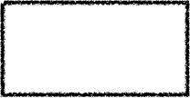

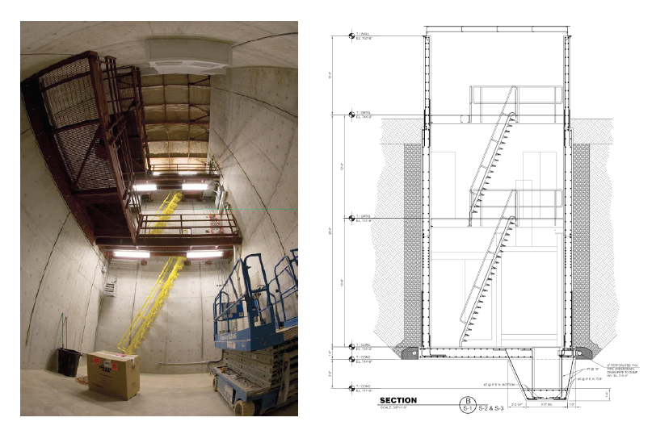
A Staged Multi-LAr TPC
Short-Baseline Neutrino Program
MINOS/MINERvA
surface building
Phase 0: MicroBooNE
86 t active volume TPC
L = 470 m
start in 2014
Phase 1: LAr1-ND
82 t active volume TPC
L = 100 m
2017-2018
Phase 2: LAr1-FD
1000 t active volume TPC
L = 700 m
2020+
BNB Source
Existing enclosure vacated by SciBooNE detector

Slide 6
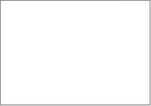

ν_{μ} disappearance probability at E_{ν} = 700 MeV
as a function of distance in a sterile neutrino
model with Δm² = 1.0 eV²
LAr1-ND
location
uBooNE
location
LAr1-FD
location
A Near Detector close to the BNB source is a key element in each phase
  Sample the beam before the onset of L/E dependent physics
  Provide a high statistics constraint on intrinsic event rates
oscillation probability
νμ source
Distance (meters)

Slide 7
LAr1-ND Physics Goals
MiniBooNE low-energy excess
  Directly test the anomalous excess of electron neutrino events reported by MiniBooNE
Oscillations: νμ → νe appearance
  In combination with MicroBooNE, much improved sensitivity with a near detector (ND)
Oscillations: νμ disappearance
  Only possible with a ND
Oscillations: Neutral-current disappearance
  Direct test for sterile neutrino content. Only possible with a ND
Neutrino-argon interactions
  15x the rate compared to MicroBooNE. ~1M events per year.
  If low-energy excess determined to be a Standard Model photon production mechanism, LAr1-ND can make measurements of the rate and kinematics with 100s of events per year
Dark matter search with beam off-target running
  Requires future beam off-target running. See talk by B. Batell & R. Van de Water

Slide 8
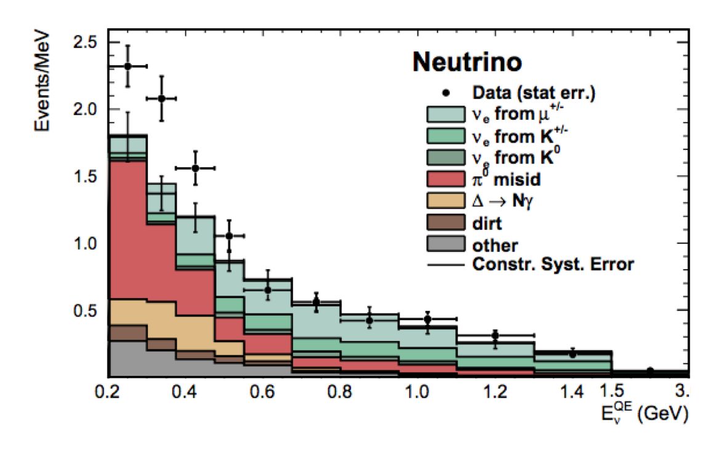

Sensitivity to MiniBooNE Low-Energy νe Excess
A. A. Aguilar-Arevalo et al., Phys. Rev. Lett. 110 161801 (2013)
Is the excess of electromagnetic events observed in MiniBooNE due to νe or photon final states?
MiniBooNE
MicroBooNE will determine the nature of the MiniBooNE excess reported at ~500 m.
In either scenario (electrons or photons) LAr1-ND can address the obvious next question:
Does the excess appear over a distance or is it intrinsic to the beam?

Slide 9


Sensitivity to MiniBooNE Low-Energy νe Excess
A. A. Aguilar-Arevalo et al., Phys. Rev. Lett. 110 161801 (2013)
MiniBooNE
By scaling directly from observed rates in MiniBooNE, MicroBooNE expects to see ~50 background and 50 excess events in 6.6x10²⁰ POT run

Slide 10

Sensitivity to MiniBooNE Low-Energy νe Excess
A. A. Aguilar-Arevalo et al., Phys. Rev. Lett. 110 161801 (2013)
MiniBooNE
Assuming NO L/E dependence LAr1-ND would expect to see ~320 background and 300 excess events in 2.2x10²⁰ POT run
By scaling directly from observed rates in MiniBooNE, MicroBooNE expects to see ~50 background and 50 excess events in 6.6x10²⁰ POT run
An estimate of systematics based on MiniBooNE analysis indicates a >6.5σ observation of a MiniBooNE-like excess

Slide 11
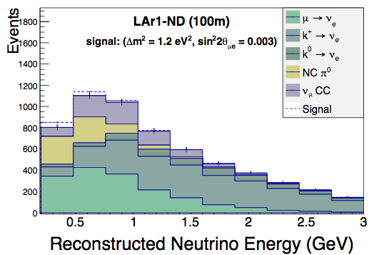
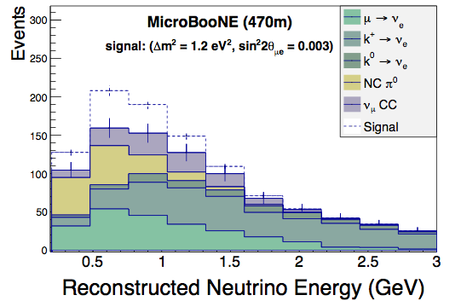
νμ → νe Appearance
Testing νμ → νe appearance in the context of a 3 active + 1 sterile neutrino model (3+1)
Predicted event rates come from full Geant4 Monte Carlo and expected e/γ shower separation in a LAr TPC, not flat scaling of generator level event topologies
Produce realistic reconstructed neutrino energy spectrum using calorimetric reconstruction
The observed electron candidate event rate in LAr1-ND at 100m is used to constrain the expected rate (in the absence of oscillations) in MicroBooNE at 470m
2.2x10²⁰ POT exposure for LAr1-ND
6.6x10²⁰ POT exposure for MicroBooNE

Slide 12
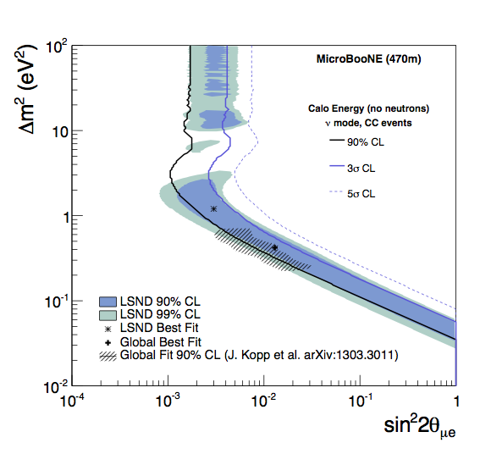
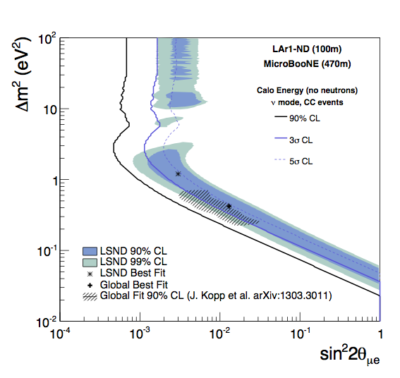
νμ → νe Appearance
6.6x10²⁰ POT exposure for MicroBooNE alone, assuming 20% systematic uncertainties
on ν_{e} background prediction
Same MicroBooNE exposure +
2.2x10²⁰ POT exposure for LAr1-ND
to constrain background prediction
+ND

Slide 13
νμ Disappearance
Testing νμ disappearance only enabled with near detector constraint
  Flux and cross section errors of 15-20% conceal a disappearance signal in MicroBooNE alone, but using an observed LAr1-ND spectrum to normalize the expected rate at MicroBooNE makes it observable
unoscillated spectrum
oscillated spectrum
unoscillated spectrum
oscillated spectrum

Slide 14
νμ Disappearance
6.6x10²⁰ POT exposure for MicroBooNE alone, assuming 15% systematic uncertainties
on the absolute ν_{μ} event rate
Same MicroBooNE exposure +
2.2x10²⁰ POT exposure for LAr1-ND
to measure unoscillated νμ
+ND
Previous result from MiniBooNE+SciBooNE (red dashed contour) - unlike here, detectors were different technologies, and detector related uncertainties did NOT cancel

Slide 15
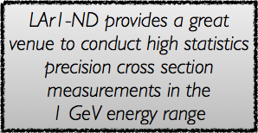
Neutrino-Argon Interactions
GENIE estimated event rates
2.2x10²⁰ POT exposure for LAr1-ND
Event rates based on categorization
in terms of exclusive experimental
topologies
Energy threshold on protons: 21 MeV.
The 0π topologies include any number
of neutrons in the event.
total events per ∼year
Event rates based on classification
by physical process from GENIE Monte Carlo truth information.

Slide 16
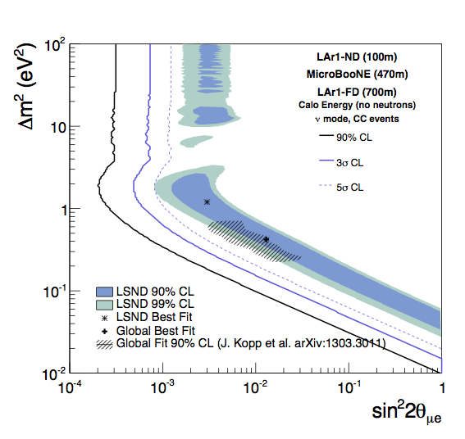
The Full LAr1 Short-Baseline Neutrino Program
LAr1-ND + MicroBooNE already presents a significant extension of the physics program, but LAr1-ND can also be thought of as the next step in the development of a world-class program of short-baseline accelerator-based neutrino physics at Fermilab
The addition of a large (kiloton-scale) detector at longer baseline (∼700 m) could address oscillations in anti-neutrino mode and make precision measurements of sterile neutrino oscillations if they are discovered
5σ level coverage of the null hypothesis for the oscillation parameter space indicated by existing experimental anomalies
Three detector configuration provides a powerful confirmation of the interpretation of any results as an oscillation signal
Have calculated sensitivities, more available in backup slides

Slide 17
The SciBooNE experimental hall
The enclosure formerly used by the SciBooNE experiment (located on-axis at 100 m from the Booster Neutrino Beam target) is currently empty and provides an ideal location, readily usable for the LAr1-ND detector
The SciBooNE enclosure is a below grade rectangular concrete structure with interior dimensions:
Length (beam direction) = 4.9 m
Width = 7.0 m
Depth: floor-grade = 8.5 m,
floor-ceiling = 11.6 m

Slide 18
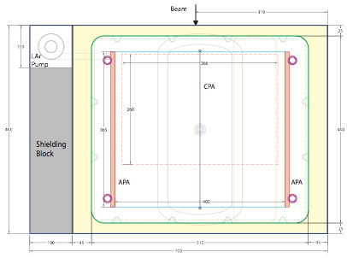
LAr1-ND Detector Design (I)
A foam insulated, corrugated stainless steel membrane cryostat is constructed in the pit, supported by the outer concrete walls of the enclosure, and filling the entire length in the beam direction.
The interior dimensions of the rectangular cryostat are:
      4.4 m long in the neutrino beam direction, 5.1 m wide and 4.8 m tall,
      amounting to 150 tons total of liquid argon
A Time Projection Chamber (TPC), located inside the cryostat vessel, consists of two APAs (Anode Plane Assemblies - to read out ionization electron signals) near the walls of the cryostat, and one CPA (Cathode Plane Assembly) centered between the two APAs
Top view schematic drawing
  The TPC active volume:
  3.65 m (beam direction) x
  4.0 m (wide) x
  4.0 m (tall)
  = 58.4 m³ (82 tons of argon)
*
* Shielding blocks are used to narrow the hall by 1 m, to approximately center the detector on the beam axis

Slide 19

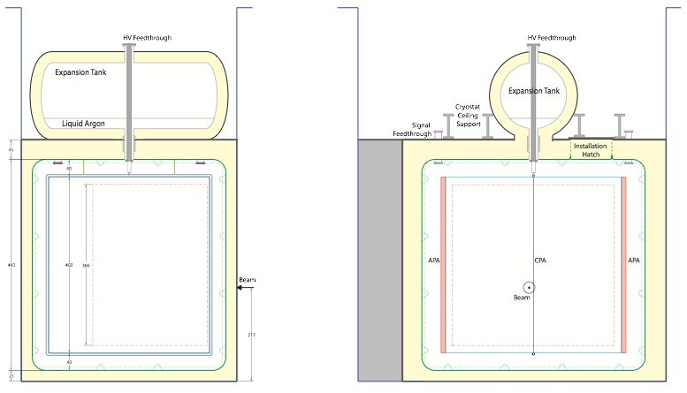

LAr1-ND Detector Design (II)
Side view schematic drawing
Expansion tank
Lateral view
Front
view
The cryostat is designed so that the bulk of the cryostat surface is wetted with liquid (signal feedthrough immersed in liquid, to limit outgassing from signal cables). Only a small volume of gas is contained in an insulated “expansion” tank, sitting on the top of the cryostat
From the information provided by the Fermilab Facilities Engineering Services Section, the walls and
floor of the SciBooNE enclosure are capable of withstanding the hydrostatic pressures of
the LAr1-ND cryostat

Slide 20
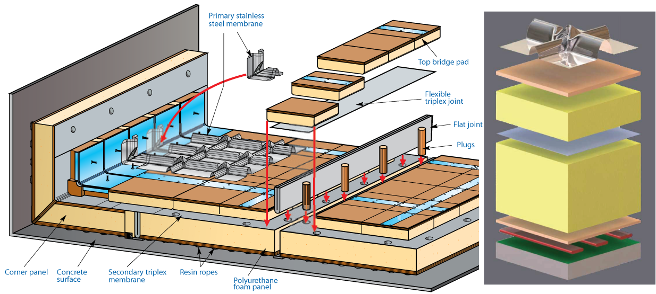
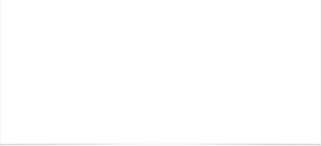
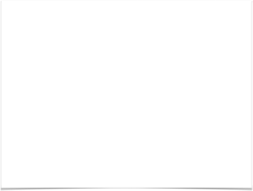
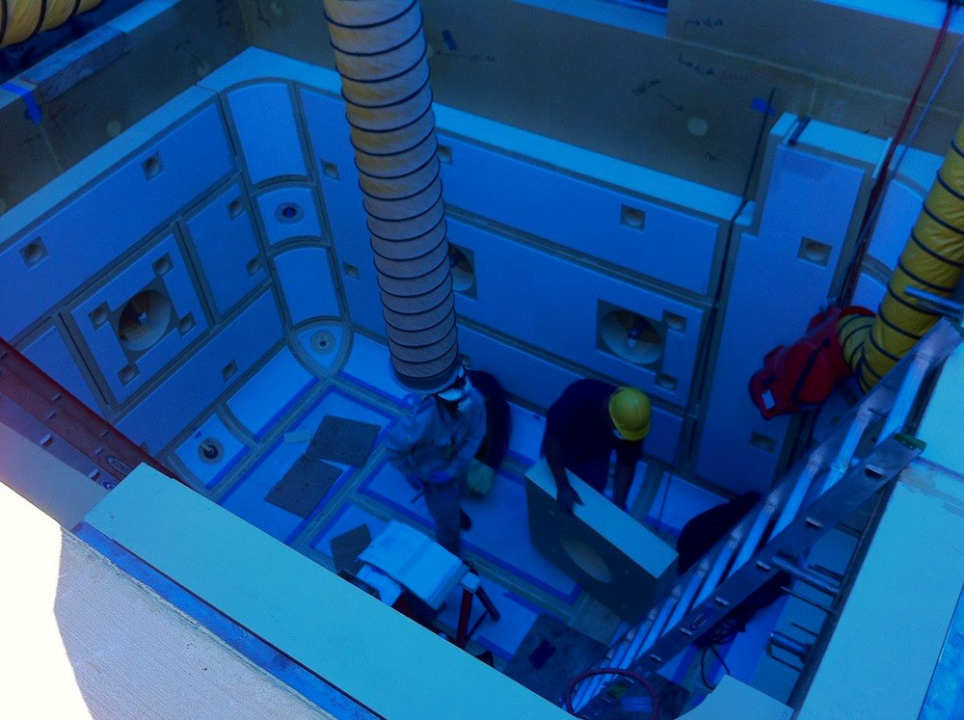

The Membrane Cryostat
Cross Sectional view of the layers in a Membrane Cryostat
35 ton membrane cryostat prototype constructed and successfully filled and operated* at Fermilab
*December 20, 2013
(see Fermilab Today article, Jan 21)
The interior of the 35 ton prototype membrane cryostat
during construction at Fermilab

Slide 21
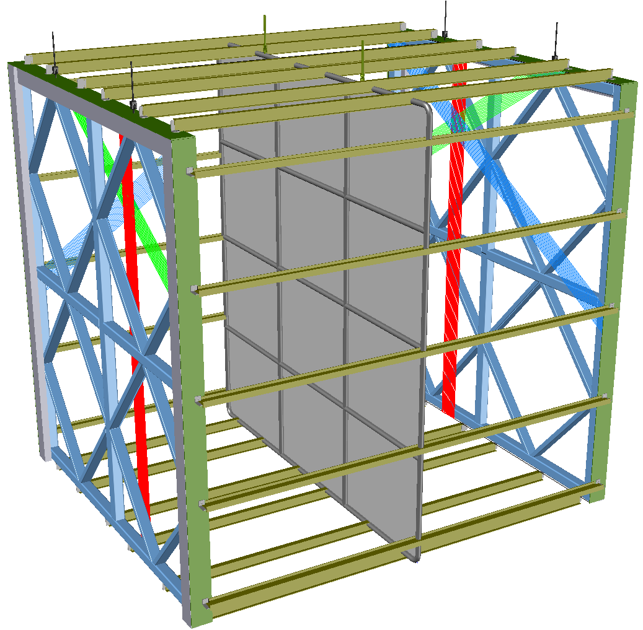

Time Projection Chamber
The entire TPC structure is suspended under the cryostat roof via integrated attachment points.
APA
APA
active area:
3.65 m wide and 4 m tall
Conceptual design of the LAr1-ND TPC
Each pair of facing CPA and APA forms an electron-drift region
CPA
Open sides between each APA and the CPA are surrounded by 4 FCA (Field Cage Assemblies) modules, constructed from FR4 printed circuit panels with parallel copper strips to create a uniform drift field
CPA is made of a stainless-steel framework, with an array of stainless-steel sheets mounted over the frame openings
drift distance - 2 m
At a 500 V/cm drift field and 2 m drift distance, the cathode plane is biased at -100 kV (< than MicroBooNE HV)

Slide 22
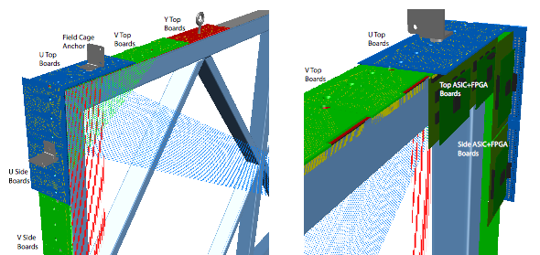
Anode Plane Assembly
Each APA holds three planes of wires (U, V and Y) on one side. The wire pitch (3 mm) and angles (0⁰ and ±60⁰ from vertical) are identical to that of MicroBooNE
Single sided APA: uses the same wire bonding method developed for the LBNE APAs, but without the continuous helical wrapping, to minimize ambiguities in track reconstruction.
Each wire is connected to a front-end readout channel. The wire readout arrangement is also identical to MicroBooNE, with cold electronics boards at the top and vertical sides of each APA
The total number of readout channels is 4736 per APA (9472 in the entire detector)
Readout boards
Each APA has
55 front end
mother boards
(19 on top - 128 channels, 18 on each side - 64 channels)
Corner view of an APA. Wires at 0⁰ (collection plane) and ±60⁰ from vertical (2 induction planes) are attached to wire bonding boards at the sides and ends of the APA.

Slide 23
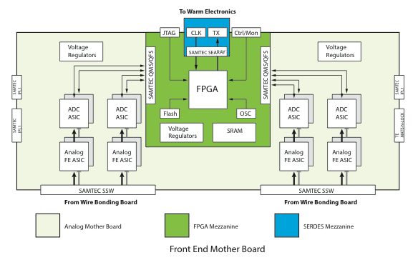
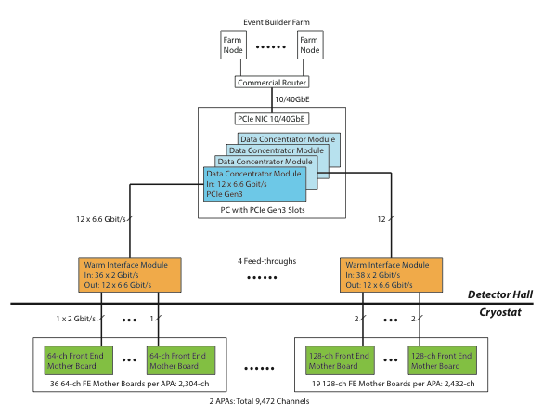
Readout Electronics & DAQ
The electronic readout chain is implemented as CMOS ASICs designed for operation in LAr, and commercial FPGAs (multiplexing). Both analog Front End (FE) ASIC and ADC ASIC have already been developed for LBNE, and analog FE ASIC is being used in MicroBooNE
  8 FE, 8 ADC plus a FPGA comprise a single 128-channel front end mother board
DAQ block diagram
Front End Mother board
The FPGA on each motherboard transmit data out of the cryostat through a feedthrough to the DAQ system.
The DAQ system is located external to the cryostat vessel, with components in the detector hall and in an on-site control room. It consists of the Warm Interface Module (WIM), timing system, and commodity Data Concentrator Modules (DCM), network switch and computing farm

Slide 24
Trigger - Light Collection
Detection of scintillation light plays several important roles in LAr TPCs:
  For a surface detector in a beam, like LAr1-ND, the scintillation light provides a tag of events in-time with the beam pulse, allowing rejection of cosmic rays;
  The light also provides the T0 for non-accelerator events (such as supernova events);
  If a suitable high efficiency light collection system is in use, energy deposited into light can be related to energy deposited into charge for an improved calorimetric reconstruction.
    A compact light-guide-based system has been proposed as Photon Detector (PD) for LBNE (acrylic bars read out by silicon photomultipliers, SiPMs). The results of an R&D program show that, while more development is still necessary, the system works properly and is proposed as the basic design for light collection in the LAr1-ND detector
However, the relatively small volume of LAr1-ND provides an excellent test-bed for light collection systems being designed and optimized for LBNE and for studies of the light collection efficiency as a function of the photocathode coverage

Slide 25
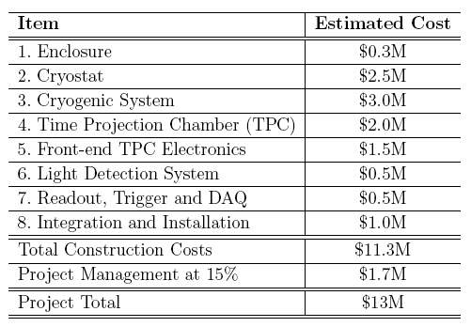
Estimation of Costs
The construction costs for LAr1-ND are estimated based on recent experience at Fermilab from building related LAr projects including MicroBooNE, the LBNE 35 ton membrane cryostat, and the Liquid Argon Purity Demonstrator (LAPD)
The total project cost for the detector, modifications to the conventional facilities, and project management is estimated at $13M
*
*not including contingency

Slide 26
LAr1-ND Timeline
Based on experience from MicroBooNE, the LAr1-ND detector construction could be completed in about two years
2014 | 2015 | 2016 | 2017 | 2018
Develop full technical design & project schedule | Procurement and fabrication of detector sub-components (wire planes, photon detectors, etc) | TPC component assembly (APAs, CPA, FCA) Cryostat and cryogenic system construction | Install TPC components in cryostat Liquid Ar fill Commissioning
LAr1-ND running
A construction start on the 2015 time scale
maximizes the physics potential within the existing Fermilab program,
making it possible to run the LAr1-ND detector concurrently with MicroBooNE
toward the end of the already planned neutrino-mode running
MicroBooNE running

Slide 27

The LAr1-ND Collaboration
10 US institutions
3 DOE National Laboratories
6 NSF institutions
7 European institutions
CERN
1 Swiss institution
5 UK institutions
11 institutions also on MicroBooNE
Nearly all interested in longer term
long-baseline FNAL program
Possibility for NSF contributions and significant in-kind hardware contributions from non-US institutions currently being explored

Slide 28
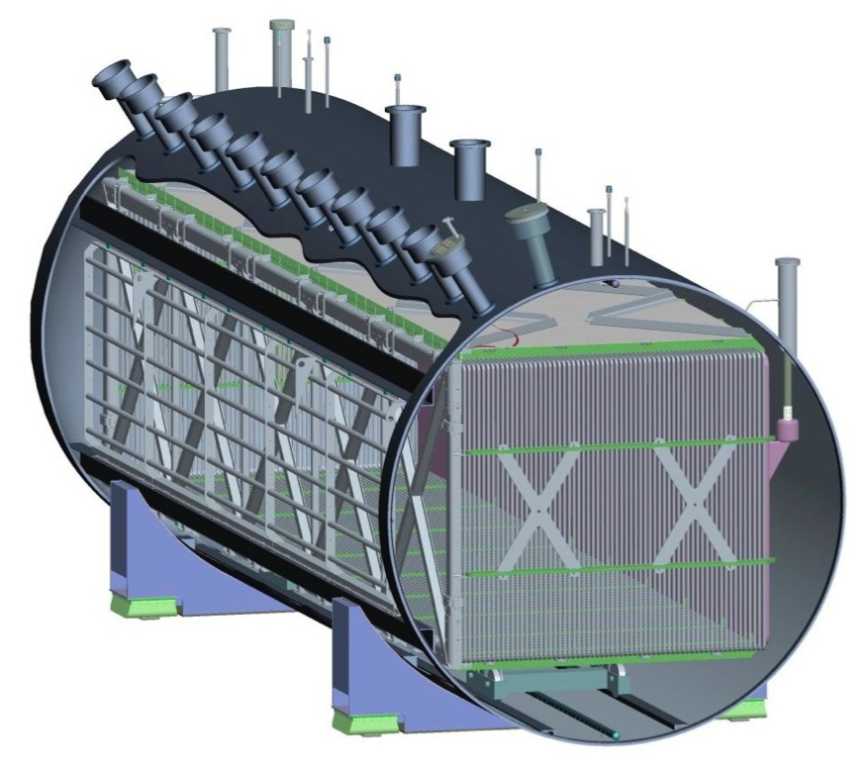

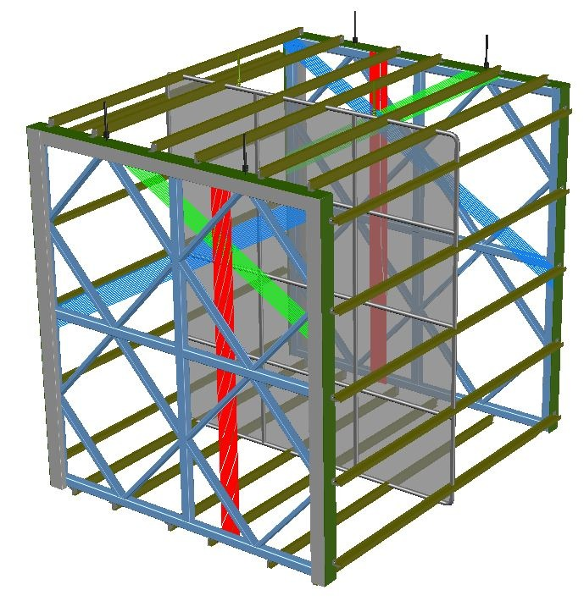

Summary of the LAr1-ND proposal
A LArTPC Near Detector
(82 t active mass) in the SciBooNE hall,
to run in conjunction with MicroBooNE on the BNB, for an exposure of 2.2x10²⁰ POT
(in the last year of the MicroBooNE run)
LAr1-ND
at 100 m
MicroBooNE
at 470 m

Slide 29
Conclusions
Fermilab is well positioned to play a key role in resolving the existing hints for new physics happening at short-baseline
LAr1-ND enables the full interpretation of a MicroBooNE signal, be it electrons or photons, by providing a high statistics measurement at nearer baseline on a rapid time scale
LAr1-ND combines timely neutrino physics with experience in LArTPC detector development for teams working toward LBNE
LAr1-ND would also be an important element for measurements in anti-neutrino mode by serving as a near detector in a possible future phase of the Fermilab short-baseline neutrino program

Slide 30
Overflow

Slide 31
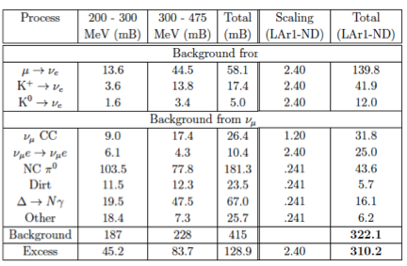


Sensitivity to MiniBooNE Low-Energy νe Excess
Estimated event rates by direct scaling of MiniBooNE event rates* and accounting for differences in fiducial masses, beam exposures and selection efficiencies between detector technologies
*A. A. Aguilar-Arevalo et al. (MiniBooNE Collaboration), “Unexplained Excess of Electron-Like Events
From a 1 GeV Neutrino Beam." Phys. Rev. Lett. 102 101802 (2009)
Backgrounds (including
both intrinsic sources of ν_{e}
and
single photon
final state ν_{μ} interactions)
MicroBooNE expects ~50 signal and 50 background events in 6.6x10²⁰ POT
LAr1-ND: 2.2x10²⁰ POT exposure
Estimate >6.5σ observation of
MiniBooNE-like excess
“Signal”: scale the excess event counts
reported by MiniBooNE as if they are electrons

Slide 32
MiniBooNE Excesses
A. A. Aguilar-Arevalo et al., Phys. Rev. Lett. 110 161801 (2013)

Slide 34
Appearance Global Fit
J. Kopp et al., “Sterile Neutrino Oscillations: The Global Picture”. hep-ph/1303.3011 (2013).

Slide 35
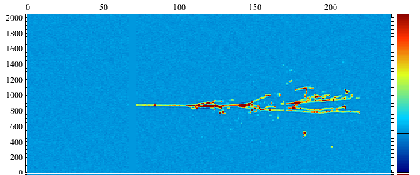
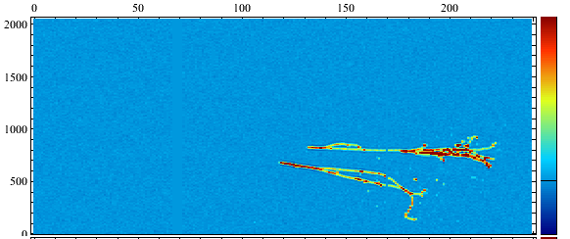
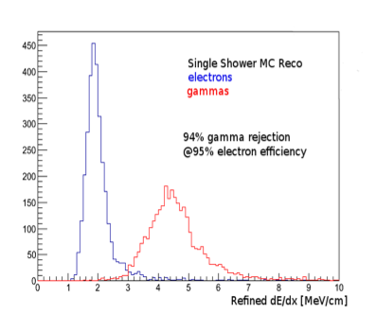
Electron/photon Separation
1 GeV electron shower
Decay of a 1 GeV π⁰ to two photons.
The double mip deposition of converted photons allows even single photons to be identified, significantly reducing backgrounds in searches for νε appearance

Slide 36
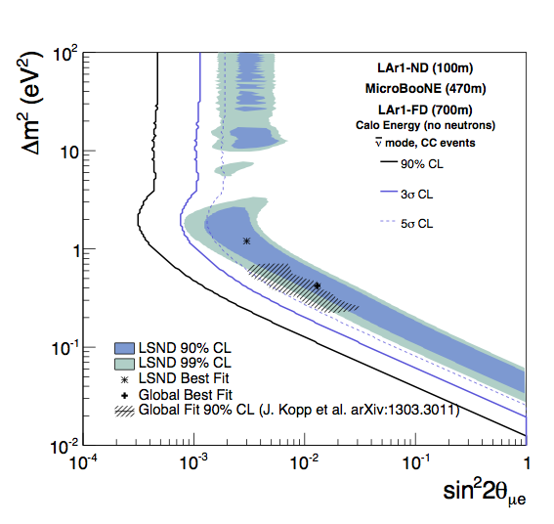
νμ → νe Appearance (3-det)
LAr1-ND + MicroBooNE + 1 kiloton Far Detector at 700m
6.6x10²⁰ POT exposure
neutrino mode
10x10²⁰ POT exposure
anti-neutrino mode
(assumes both neutrinos and anti-neutrinos oscillate)

Slide 37
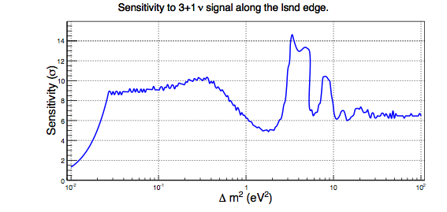
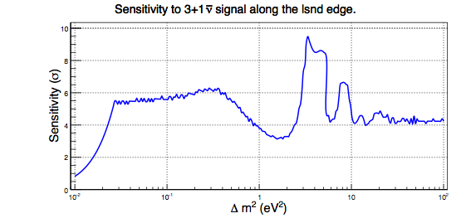
νμ → νe Appearance (3-det)
neutrino mode
anti-neutrino mode

Slide 38
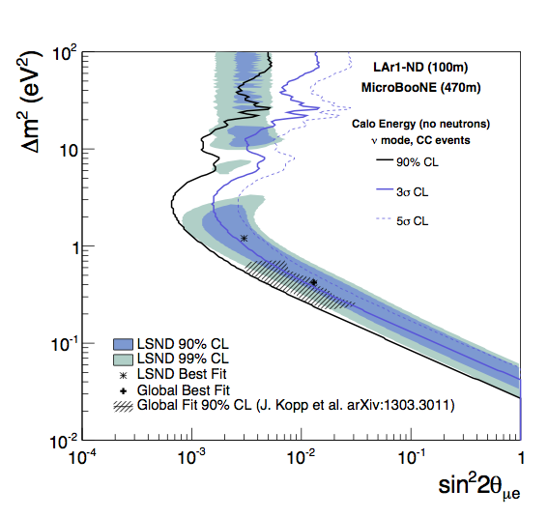
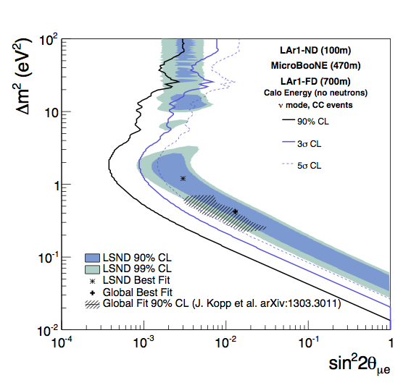
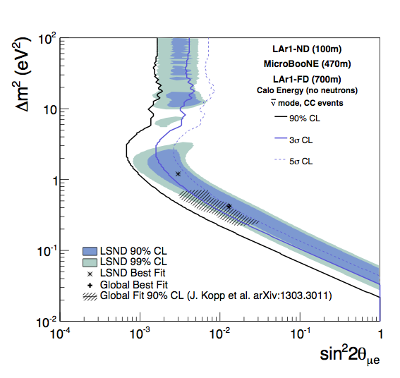
νμ → νe Appearance
(shape only)

Slide 39
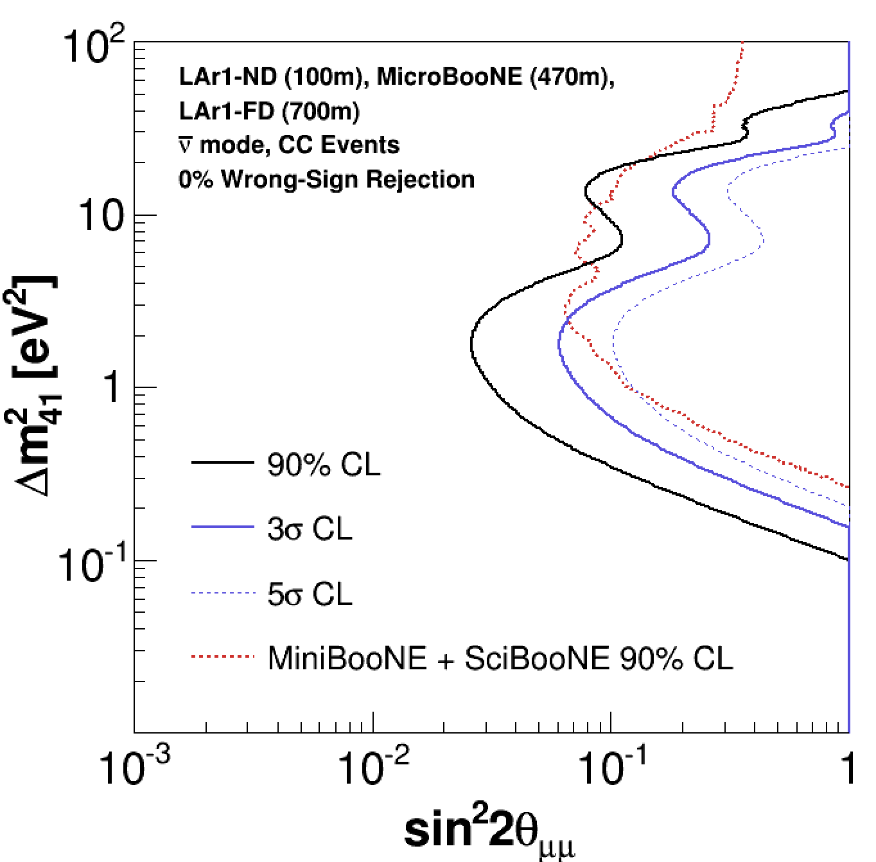
νμ Disappearance (3-det)
LAr1-ND + MicroBooNE + 1 kiloton Far Detector at 700m
6.6x10²⁰ POT exposure
neutrino mode
10x10²⁰ POT exposure
anti-neutrino mode
(assumes only anti-neutrinos oscillate with WS background)

Slide 40
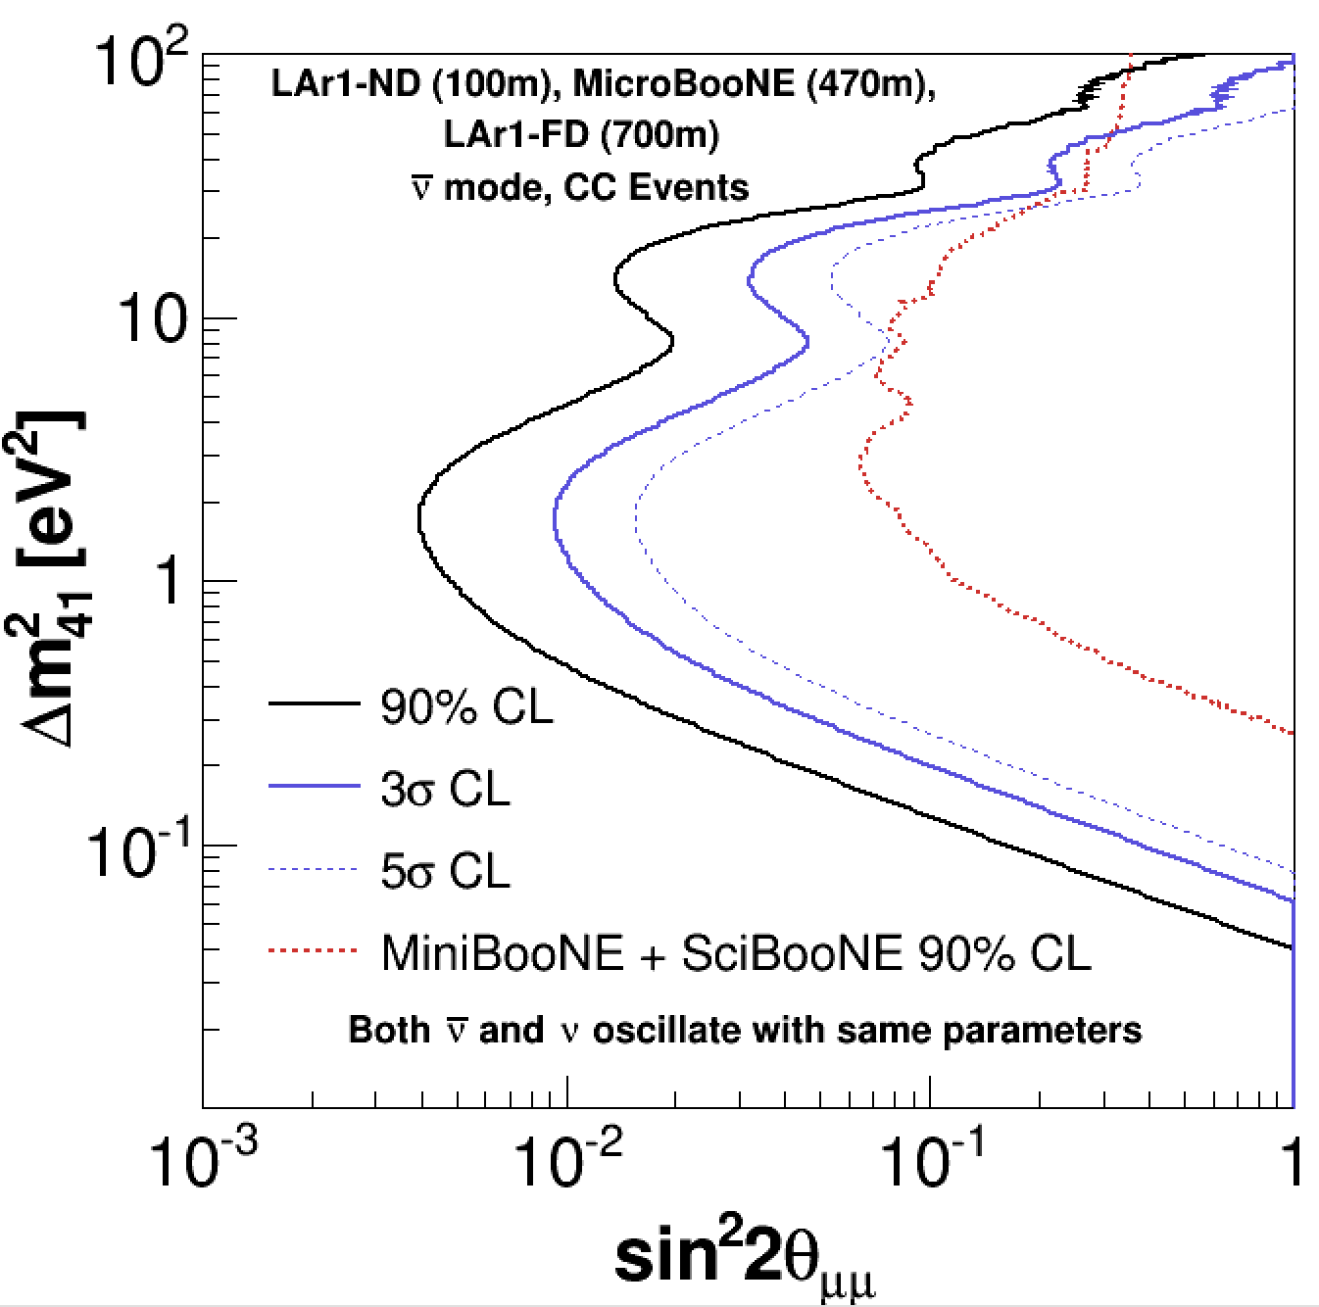
νμ Disappearance (3-det)
LAr1-ND + MicroBooNE + 1 kiloton Far Detector at 700m
6.6x10²⁰ POT exposure
neutrino mode
10x10²⁰ POT exposure
anti-neutrino mode
(assumes both neutrinos and anti-neutrinos oscillate)

Slide 41
νμ Disappearance: Neutral Current Backgrounds
Charged pions and muons which exit the detector cannot be distinguished
Contained tracks may be distinguishable, but the precise efficiency/purity is an area of active study
Plots show total CC and NC-charged-pion rates predicted by simulation

Slide 42
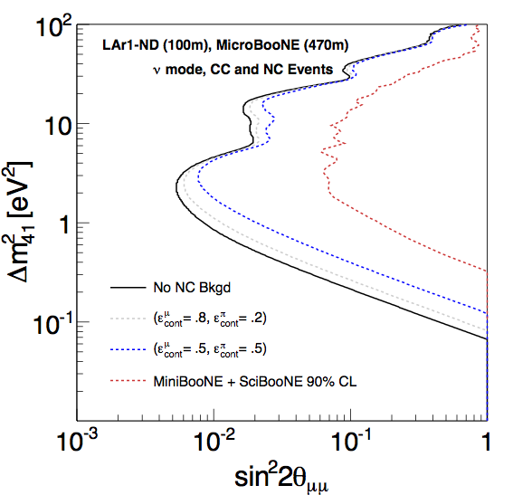
νμ Disappearance: Neutral Current Backgrounds
Plot shows sensitivity for two different efficiency/purity assumptions
When determining the sensitivity we assume that the NC events do not oscillate
The uncertainty on the fraction of NC events is set at 30%

Slide 43
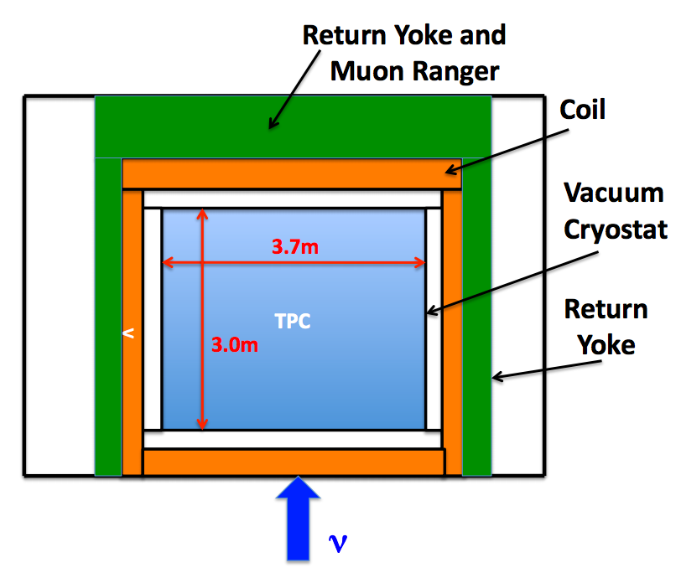
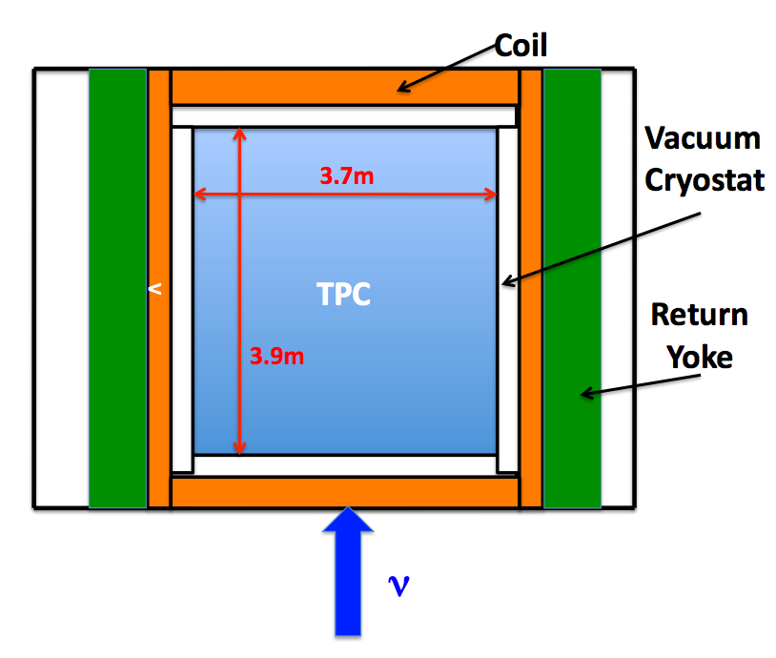
Magnetized LAr1-ND
Two possible detector designs
  Configuration A: The return yoke downstream of the neutrino beam and be instrumented with scintillator modules to form a muon spectrometer increasing the detector acceptance and allowing for particle ID for escaping charged pions
  Configuration B: Compared to (A) there is an extended detector volume but contains no downstream spectrometer
Configuration A
Configuration B

Slide 44
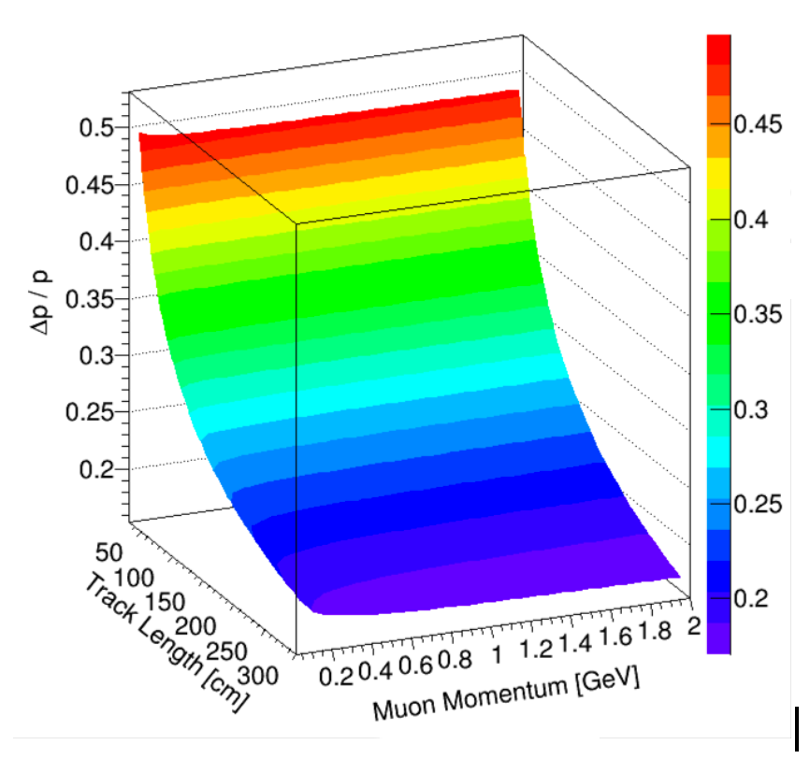
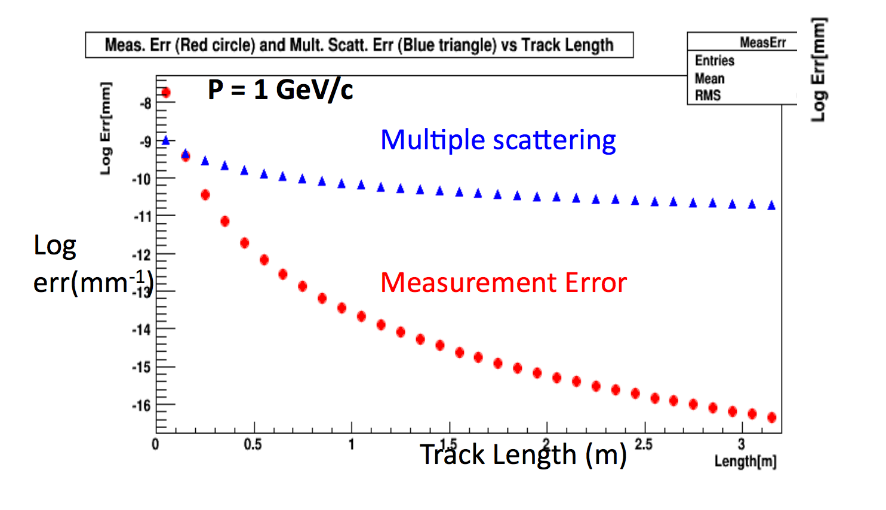
Resolution of Magnetized LAr1-ND
Use curvature of the track to determine momentum
Bending in a magnetic field is also a powerful instrument for rejecting wrong-sign backgrounds in antineutrino running

Slide 45
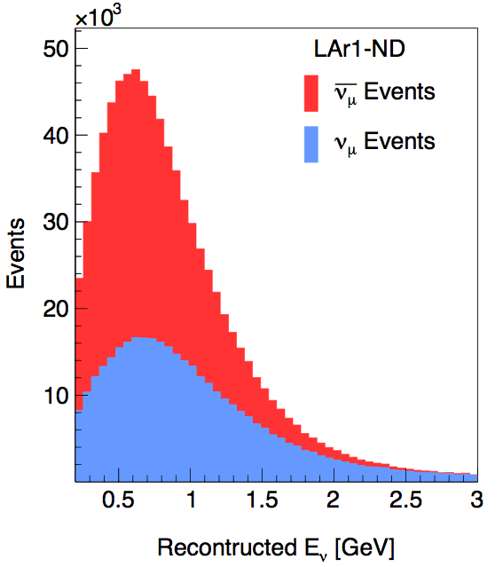
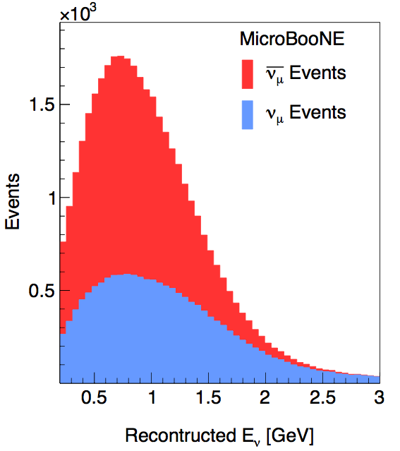
Wrong Sign Contamination
Charge selection (in antineutrino mode) is one of the main motivating factors for a magnetized detector
  Neutrino background in the antineutrino beam

Slide 46
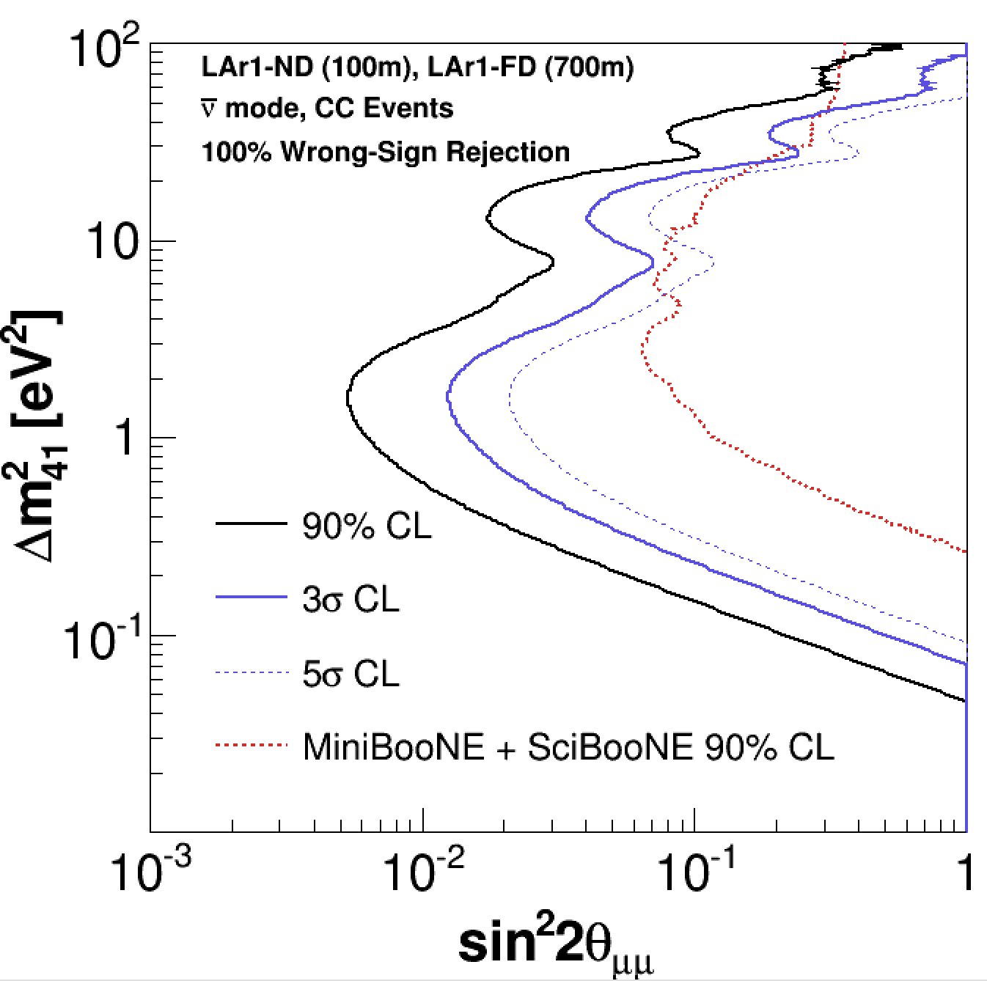
νμ Disappearance (3-det)
LAr1-ND + MicroBooNE + 1 kiloton Far Detector at 700m
6.6x10²⁰ POT exposure
neutrino mode
10x10²⁰ POT exposure
anti-neutrino mode
(magnetized detectors)

Slide 47
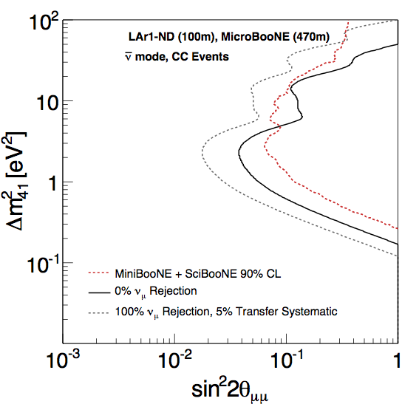
Sensitivity: Antineutrino Disappearance with Magnetized LAr1-ND + MicroBooNE
non-magnetized LAr1-ND
magnetized ND constrains
neutrino content in uBooNE to 5%

Slide 48
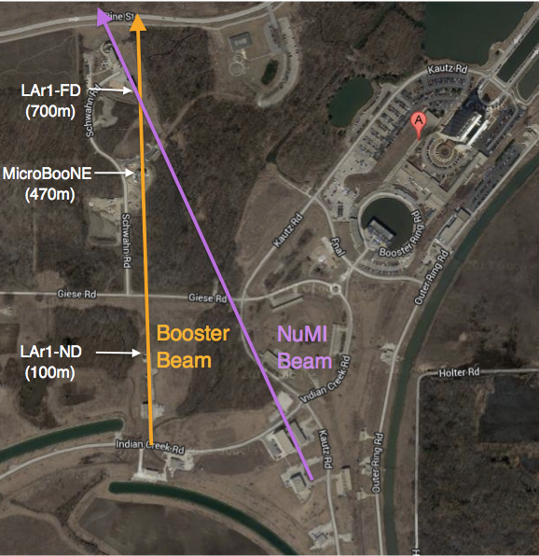
Neutrino beams (I)
The Booster Neutrino Beam @ different detector locations
Ratios of the fluxes at different detector locations.
Flux at MicroBooNE vs.
flux at LAr1-ND
Flux at MicroBooNE
vs. flux at LAr1-FD

Slide 49
Neutrino beams (II)
Off-axis NuMI fluxes @ different detector locations

Slide 50
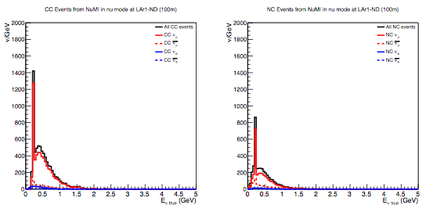
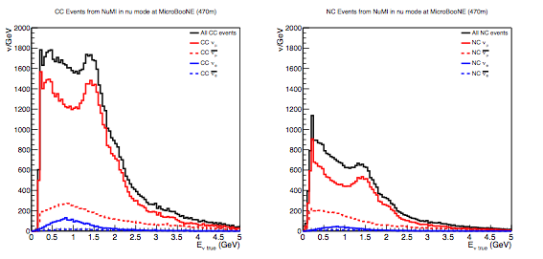
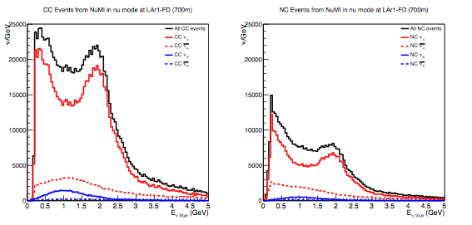
NuMI beam events (I)
Neutrino events from NuMI beam in neutrino mode 9x10²⁰POT*
LAr1-ND
MicroBooNE
LAr1-FD
* it is expected that during the NOvA era the NuMI beam could generate up to 6x10²⁰ POT/year

Slide 51
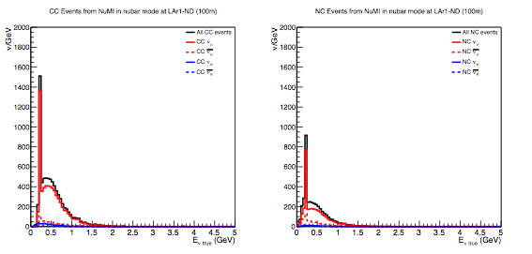
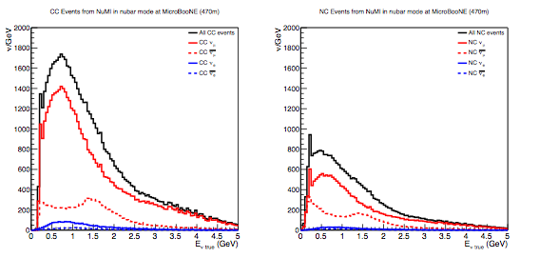

NuMI beam events (II)
Neutrino events from NuMI beam in antineutrino mode 9x10²⁰POT
LAr1-ND
MicroBooNE
LAr1-FD

Slide 52

Probing Active to Sterile Oscillations with Neutral-Currents
A unique probe of sterile neutrino oscillations, directly sensitive to any “sterile" flavor content, is available through neutral-current (NC) neutrino interactions. In this type of search, one looks for an overall depletion of the flavor-summed event rate.
We have considered the NC π⁰ channel, due to its characteristic event topology and kinematics. Unlike other NC channels, the presence of the two photons from the π⁰ decay pointing back to a common vertex, with an invariant mass corresponding to mπ0, provides a powerful discriminant against potential backgrounds.

Slide 53


Dark Matter Searches with Booster
Beam Off-Target Running

Slide 54
Cryogenic system
The cryogenic system design is based on experience with the designs and operation of the systems for LAPD, MicroBooNE and 35 ton.
The choice of the cryogenic systems layout and location is intended to optimize safety and efficiency. It will:
  Minimize the risk of personnel injury to any Oxygen Deficiency Hazard (ODH)
  Minimize heat ingress to the cryogenic system (by minimizing piping length and pump power)
  Minimize the volume of the argon system external to the cryostat and hence minimize the potential for argon escape or contamination
  Provide safe access to refrigeration equipment that requires periodic maintenance
The LN2 cooling system, argon re-condensers, and gas/liquid purifiers will be located in a surface building immediately adjacent to the cryostat pit. The surface facility will include a LAr and LN2 receiving dewars. The cryostat will hold an inventory of 155 tons of liquid argon. The liquid argon purification system will be required only to achieve the initial liquid argon purity. After that the circulation of the argon gas in the expansion tank will maintain the high purity. The purification plant will consist of duty and standby molecular-sieve columns to remove water and an activated copper column to remove oxygen.

Slide 55
The Readout electronics
The electronic readout chain is implemented as CMOS ASICs designed for operation in LAr, and commercial FPGAs tested for cryogenic operation. Both analog Front End (FE) ASIC and ADC ASIC have already been developed for LBNE, and analog FE ASIC is being used in MicroBooNE.
The Front End electronics chain is composed of:
  a 16-channel analog FE ASIC providing amplification and shaping,
  a 16-channel ADC ASIC implemented as a mixed-signal design providing digitization, buffering and the first stage of multiplexing,
  a FPGA providing the second multiplexing stage, and voltage regulators.
  8 FE, 8 ADC plus a FPGA comprise a single 128-channel front end mother board.

Slide 56

Cold signal feedthroughs
“Double feedthrough” are used:
  a cold flange, with all connections to the cold cable inside of the cryostat, is welded to one end of a stainless pipe, and
  a warm flange, with connections to the warm cables to the DAQ, is welded on the other end of the stainless st. pipe.
  A set of cables interconnects the two flanges. The space between the two flanges is evacuated. This technique ensures all cables inside the cryostat are at the LAr temperature to minimize outgassing, and the other side of the feedthrough can be exposed to air without worrying about condensation (can be heated if necessary).
The ATLAS LAr calorimeters used such feedthroughs, with the same pin carriers as the ones on MicroBooNE signal feedthroughs.

Slide 57

Calibration Laser System

Slide 58
Cost and Schedule
Estimates construction costs for LAr1-ND are based on recent experience at Fermilab building related LAr projects including MicroBooNE, the LBNE 35 ton membrane cryostat, and the Liquid Argon Purity Demonstrator (LAPD).
The total project cost for the detector, modifications to the conventional facilities, and project management is estimated at $13M.
Enclosure: Tasks and costs include what is needed to prepare the enclosure to accommodate a cryogenic detector, including some structural work for an interior wall, mechanical support structures above the detector and an upgrade to the electrical service to the building to support operation of the cryogenics.
Cryostat: Costs are based on scaling from the LBNE 35 ton prototype recently built at Fermilab.
Cryogenic System: The cryogenic system design is based on experience with the designs and operation of the systems for LAPD, MicroBooNE and 35 ton. Lessons learned and improvements for cost and performance have been incorporated into the estimate.
TPC: The design and fabrication of the parts of the TPC, including installation fixtures and all hardware are based on the experience from construction of the MicroBooNE TPC. The estimate includes on-site assembly and installation labor costs.
Front-end Electronics: The front-end electronics includes charge collection, amplification and digitization of signals from the TPC. The M&S and design costs are based on experience from the MicroBooNE system.
Light Detection System: LAr1-ND will develop an innovative approach to light detection using new ideas that have been initiated in the context of R&D for the LBNE far detector.
Readout, Trigger and DAQ: The Readout and Trigger requirements for LAr1-ND are under development. The DAQ system will be based on the system that has been developed for MicroBooNE. Costs are estimated from the M&S and labor costs for the development of the similar systems in MicroBooNE.
Integration and Installation: Cost and schedule for assembly and installation are estimated based on experience to date in MicroBooNE.
Based on experience from MicroBooNE, the LAr1-ND detector construction could be completed in two years.
A construction start on the 2015 time scale maximizes the physics potential in Phase-I within the existing Fermilab program by making it possible to run the LAr1-ND detector concurrently with MicroBooNE toward the end of the already planned neutrino-mode running.

