Slide 1
LAr1-ND: Testing Neutrino Anomalies with Multiple LAr TPC Detectors at Fermilab
(P-1053)
LBNE R&D Workshop
Argonne National Lab, March 20-21, 2014
David Schmitz, University of Chicago
for the LAr1-ND Collaboration

Slide 2
Outline
LAr1-ND, a Neutrino Oscillation Experiment
The LAr1-ND Detector
Schedule Estimate
Summary

Slide 3
The LAr1-ND Experiment
The aim of the LAr1-ND experiment is to provide a high-statistics measurement of the intrinsic muon and electron neutrino content in the Booster Neutrino Beam. This will allow for a near-to-far extrapolation between LAr1-ND and downstream detectors and thus a precision search for high mass-squared neutrino oscillations through both appearance and disappearance channels.
A detector design that is time- and cost-effective would allow LAr1-ND to run near the end of the already approved MicroBooNE neutrino-mode run of 6.6 x 10²⁰ POT
The LAr1-ND detector, an 82 ton active volume liquid argon TPC, provides an opportunity for combining timely physics measurements with additional experience in use of LArTPC technology for a neutrino experiment

Slide 4
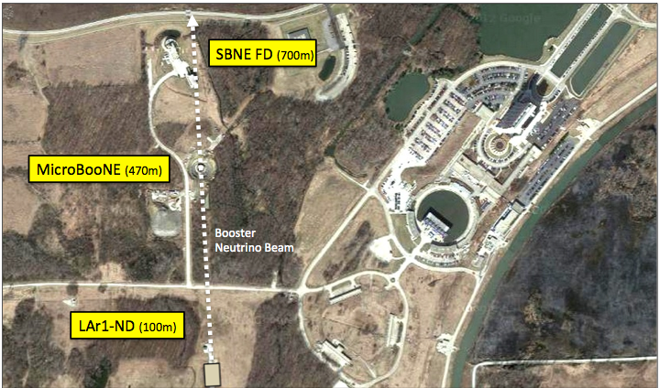
Fermilab Short-Baseline Neutrino Program
MINOS/MINERvA
surface building
100m
BNB Source
LAr1-ND
82 t active volume TPC
L = 100 m
2017-2018

Slide 5
ν_{μ} disappearance probability at E_{ν} = 700 MeV
as a function of distance in a sterile neutrino
model with Δm² = 1.0 eV²
LAr1-ND
location
uBooNE
location
LAr1-FD
location
A Near Detector close to the BNB source is a key element
Samples the beam before the onset of L/E dependent physics
Provide a high statistics constraint on intrinsic event rates
oscillation probability
νμ source
Distance (meters)

Slide 6
LAr1-ND Detector Overview
The LAr1-ND detector design is based on:
Implementing technology that builds upon the current experience from the T600, MicroBooNE and the 35 ton prototype
Utilizing as many of the design elements developed for the LBNE Far Detector as feasible
Brief overview of the design:
A foam insulated, corrugated stainless steel membrane cryostat supported by outer concrete walls of the existing SciBooNE enclosure.
The interior dimensions of the cryostat (slide 13) are 4.4 m long in the neutrino beam direction, 6.1 m wide and 4.8 m tall, amounting to 180 tons total of liquid argon
The TPC consists of two APAs (Anode Plane Assemblies) near the walls of the cryostat (beam left and beam right), and one CPA (Cathode Plane Assembly) centered between the two APAs
Analog front-end, analog-to-digital conversion, and FPGA for multiplexing performed with cold electronics

Slide 7
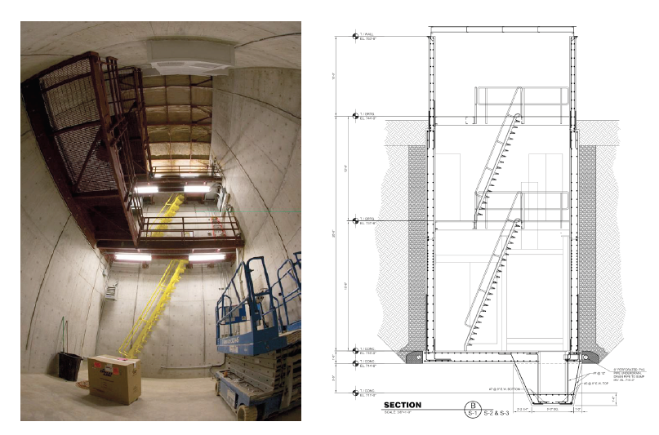
The SciBooNE Experimental Hall
The SciBooNE enclosure is a below grade rectangular concrete structure 100m from the Booster Neutrino Beam target, 50m from the end of the decay region:
Length (beam direction) = 4.9 m; Width = 7.0 m; Depth: floor-grade = 8.5 m, floor-ceiling = 11.6 m
ground
level

Slide 8
The SciBooNE Experimental Hall

Slide 9
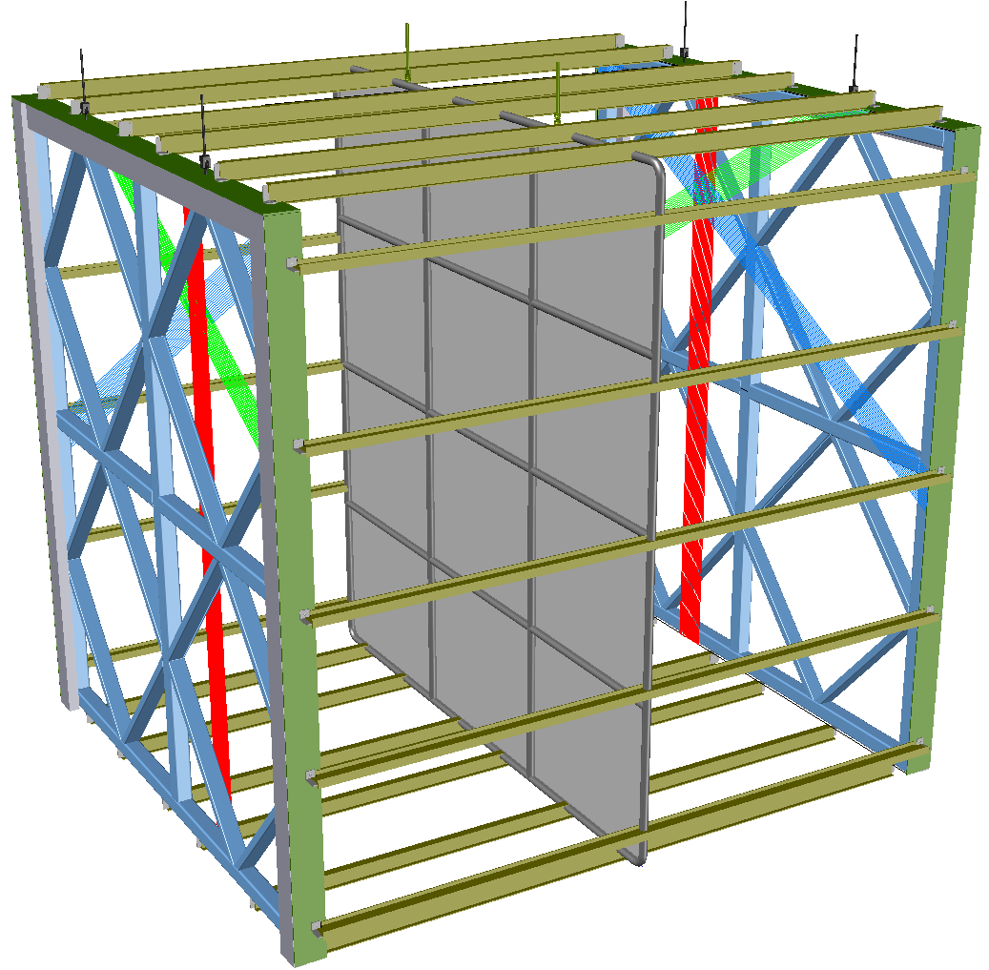
LAr1-ND: Time Projection Chamber Layout
APA
APA active area:
3.65 m wide x 4.0 m tall
Each pair of facing CPA and APA forms a 2.0 m electron-drift region
3.65 m (beam) x
4.0 m (wide) x
4.0 m (tall) =
58.4 m³
(82 tons of argon
in active volume)
For 500 V/cm drift field, cathode plane biased at -100 kV
Open sides between each APA and the CPA are surrounded by 4 FCA (Field Cage Assemblies) modules, constructed from FR4 printed circuit panels with parallel copper strips to create a uniform drift field
drift distance - 2 m
CPA made of a stainless-steel framework, with an array of stainless-steel sheets mounted over the frame openings

Slide 10
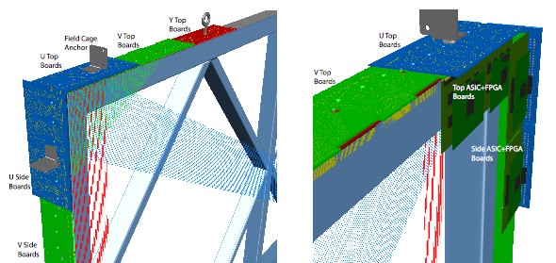
LAr1-ND: Anode Plane Assemblies
Each APA holds three planes of wires on one side
Wire pitch = 3 mm
Wire angles = 0⁰ and ±60⁰ from vertical
Cold readout boards at the top and vertical sides of each APA. Total 4736 channels per APA.
Readout boards
Each APA has
55 front end
mother boards
(19 on top - 128 channels,
18 on each side - 64 channels)
Corner view of an APA. Wires at 0⁰ (collection plane) and ±60⁰ from vertical (2 induction planes) are attached to wire bonding boards at the sides and ends of the APA.

Slide 11
LAr1-ND vs LBNE Design: TPC
TPC | LAr1-ND | LBNE | Comparison
Construction | Pre-fabricated/tested modules assembled in cryostat | Pre-fabricated/tested modules assembled in cryostat | Same concept, different implementation
TPC Support | Suspended under cryostat roof | Suspended under cryostat roof | Same concept, different implementation
TPC configuration | CPA in the middle, single sided APAs against the walls | CPAs against the walls, double sided APAs in the middle | LAr1-ND's TPC configuration avoids a costly fiducial cut around the non-active thickness of the APA in the center of the active region. The APAs can be placed closer to the cryostat walls to maximize active region in the limited available space. For LBNE, it is cheaper to build fewer APAs if they are double sided and in the middle.
APA configuration | single sided, no helical wire wrapping, readout on 3 edges | double sided, helical wire wrapping on two induction planes, readout on one edge | LBNE's wire wrapping design allows the APAs to be tiled on 3 sides, but raised concerns about the reconstruction efficiency. LAr1-ND's APA design avoids the wire wrapping, while allowing APA tiling on all 4 sides. If the LBNE 35 ton TPC shows that the wrapped wires do not work well, the LAr1-ND design provides a verified alternative to the LBNE APAs.
APA wire configuration | 3 sense wire planes, +/- 60 degree, 3mm wire pitch, identical to MicroBooNE | 3 sense wire planes, +/- 45 degrees, 4.5-5mm wire pitch | LAr1-ND's wire configuration is set to be identical to MicroBooNE to avoid additional systematic errors when running together. LBNE's wire angles are supposed to be better suited for beam neutrino events. The large wire pitch is compatible with the larger diffusion over longer drift.
APA wire bonding | CuBe wires epoxyed and soldeded to PCB with notched edges | CuBe wires epoxyed and soldeded to PCB with notched edges | Same design
CPA design | stainless steel frame + conductive sheet | stainless steel frame + conductive sheet | Same design concept, light transmission TBD.
Field cage design | Cu strips on FR4 panels | Cu strips on FR4 panels | Similar design.

Slide 12
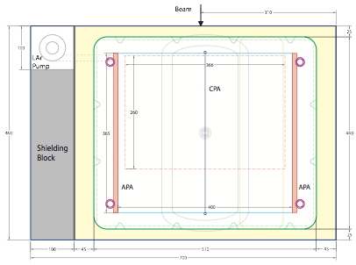
LAr1-ND: Membrane Cryostat
Original design from Proposal submitted in December, 2013 shown here
Cylindrical expansion tank on top allows all surfaces to be wetted in main cryostat volume, reducing contamination of the argon
Purification of GAr in expansion tank sufficient during normal operation due to low outgassing rate in main volume
“Cold” signal feed-throughs required (from LAr to outside air)
High voltage FT passes through expansion tank
Side view
Top view
5.5 m
82 t active volume TPC
(~50 t FV)
7.0 m
4.4 m
Shielding blocks used to narrow the hall by 1 m, to approximately center the detector on the beam axis

Slide 13
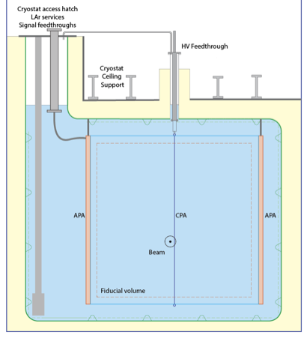
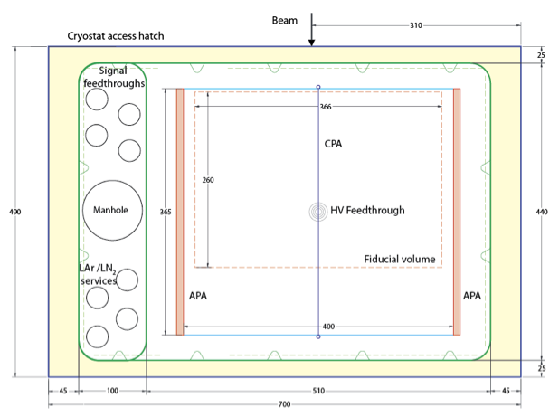
LAr1-ND: Membrane Cryostat
Recent design concept shown here
Main volume still wetted on top
LAr pump in non-active volume allows LAr circulation when necessary
Long “cold” signal feed-throughs still an option
High voltage FT does not pass through expansion tank
Similar to 35 ton configuration
Back view
(looking at the beam)
Top view
7.0 m
7.0 m
Shielding blocks removed in favor of an access region over LAr but not the active area

Slide 14
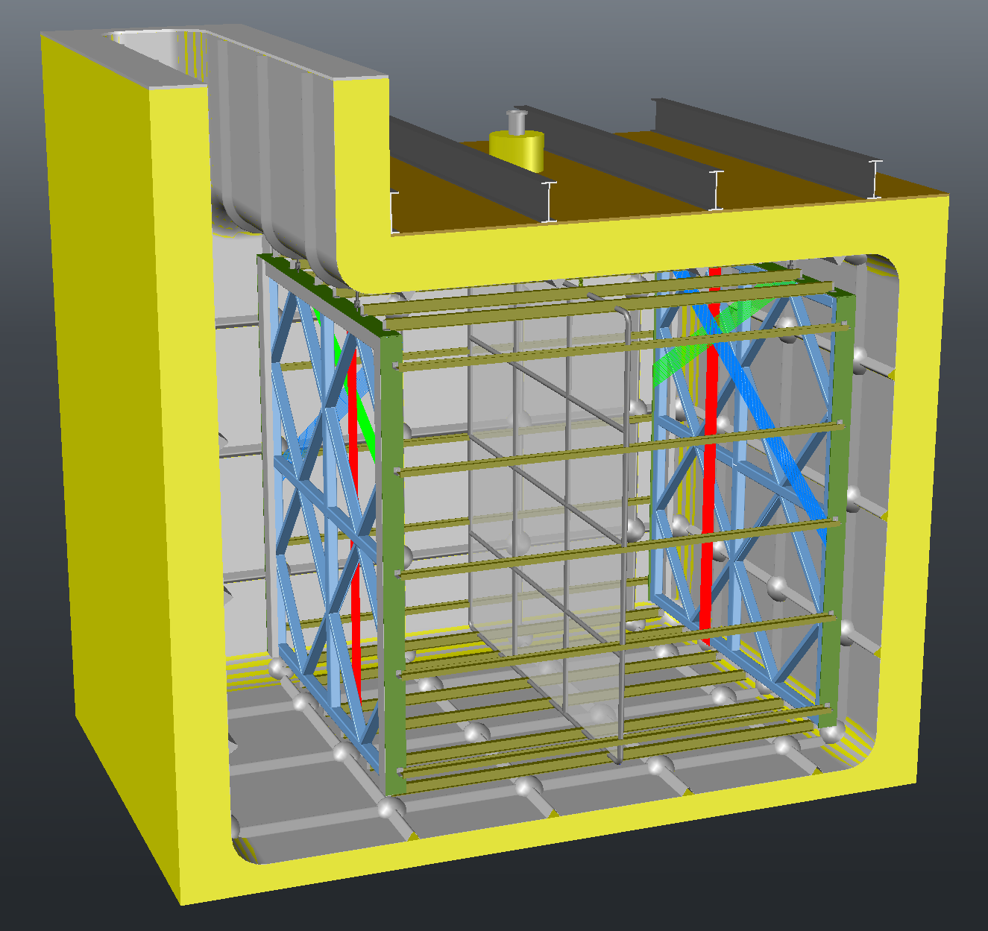
LAr1-ND
neutrino beam coming out of the page

Slide 15
LAr1-ND vs LBNE Design: Cryostat
Cryostat/Cryogenic | LAr1-ND | LBNE | Comparison
Cryostat Technology | Membrane | Membrane | Similar commercial technology using passive foam insulation
LAr pump | Inside cryostat | Inside cryostat | Similar design. May not pump LAr continuously in LAr1-ND.
Ullage space | Confined to a region over inactive region | In the cryostat | An isolated expansion region in LAr1-ND allows the main cryostat to be completely filled with LAr, eliminates outgassing from warm surfaces inside the cryostat
Purification | Dual phase during filling, gas phase thereafter | Dual phase throughout | With the warm ullage in a separate area in LAr1-ND, a much smaller scale purification system can be used in the small gas volume during the normal operation of the TPC
Cooling | Heat exchanger inside cryostat | Heat exchanger outside cryostat | LAr1-ND uses cooling panels inside the cryostat, results in better stability in LAr temperature and convection. The lower convection simplifies the prediction and correction of the positive ion distribution on a surface detector.

Slide 16
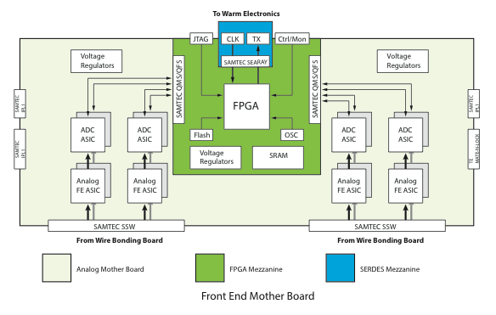
Readout Electronics
Analog Front End ASIC and ADC ASIC have been developed for LBNE; Analog Front End ASIC is being used in MicroBooNE; Commercial FPGAs for multiplexing in the cold; similar to that used in 35 ton, with opportunity for longer term running and large data samples.
After on-board multiplexing, 4 cold cable bundles to 4 signal feed-throughs

Slide 17
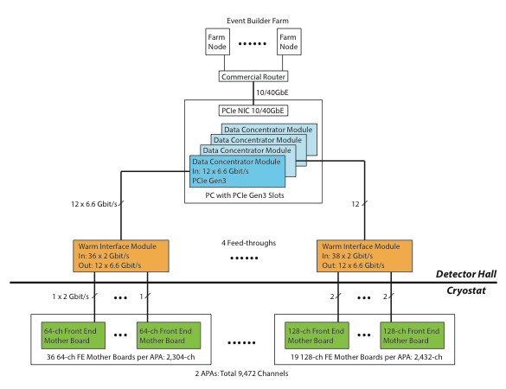
Signal Feed-throughs, warm Electronics & DAQ
Considering long “cold” feed-throughs that dip into the liquid.
Eliminates exposed cables in the gas region
Reliability and hermetic seals are concerns
ATLAS has developed such a FT designed for both warm and cold flanges. MicroBooNE used for warm FTs.
External to the cryostat is the Warm Interface Module (WIM), timing system, and commodity Data Concentrator Modules (DCM), network switch and computing farm

Slide 18
LAr1-ND vs LBNE Design: Electronics
Electronics Elements | LAr1-ND | LBNE | Comparison
Analog Front-End | ASIC | ASIC | Same design
ADC | ASIC | ASIC | Same design
FE Digital Processing | FPGA | FPGA or ASIC | LAr1-ND will use FPGA to meet fast schedule; LBNE will make decision later, with inputs and experience from LAr1-ND
Front End Board | Analog Mother Board + Digital Mezzanine | Analog Mother Board + Digital Mezzanine | Similar design, different mechanical dimension and channel density
Cold Cable | Twinaxial Cable | Twinaxial Cable | Same design
Signal Feed-through | ATLAS Pin Carrier | Flange Board or ATLAS Pin Carrier | LAr1-ND will use already developed technology ATLAS pin carrier; LBNE will make decision later, with inputs and experience from LAr1-ND. LAr1-ND will use a double feedthrough configuration to accommodate both the cold cables inside the cryostat and the warm cables outside.
Warm Interface Board | FPGA + Optical Transceiver | Optical Transceiver and/or FPGA | LAr1-ND will use FPGA to study data compression and trigger algorithm, and keep the capability to stream all data out; LBNE will make decision later, with inputs and experience from LAr1-ND.
Data Concentrator Board | Commercial PCIe Card | SLAC RCE | LAr1-ND will use commodity hardware in DAQ system, focus efforts on algorithm, firmware and software development

Slide 19
LAr1-ND vs. LBNE Design: Light Collection System
A compact light-guide-based system like what has been proposed for LBNE (acrylic bars read out by silicon photomultipliers, SiPMs) is the starting design concept for LAr1-ND.
However, the relatively small volume of LAr1-ND provides an excellent test-bed for light collection systems being designed and optimized for LBNE as well as for studies of the light collection efficiency as a function of photocathode coverage
Photodetection System | LAr1-ND | LBNE | Comparison
Construction | Extruded light guides coated with wavelength-shifter assembled into "paddles" inserted behind APAs | Extruded light guides coated with wavelength-shifter assembled into "paddles" inserted between APAs | Same design
Photodetector | SiPM | SiPM | Same design

Slide 20
“Physics R&D” Neutrino-Argon Interactions,
LArTPC Reconstruction, Oscillation Analysis
GENIE estimated event rates
2.2x10²⁰ POT exposure for LAr1-ND
almost 6,000 νe events
1M total events per ∼year

Slide 21
The LAr1-ND Collaboration
Short-Baseline Neutrino Experiments play a role in the development of international collaboration in the US neutrino program as well as enable valuable and relevant experience for young people in the field that will be PIs on LBNE in the future.
10 US institutions
3 DOE National Laboratories
6 NSF institutions
7 European institutions
CERN
1 Swiss institution
5 UK institutions
11 institutions also on MicroBooNE.
Most also LBNE collaborators.
*Spokespersons

Slide 22
LAr1-ND Timeline
Based on experience in constructing other LArTPC detectors,
the LAr1-ND detector construction could be completed in about two years
2014 | 2015 | 2016 | 2017 | 2018
Develop full technical design & project schedule | Procurement and fabrication of detector sub-components (wire planes, photon detectors, etc) | TPC component assembly (APAs, CPA, FCA) Cryostat and cryogenic system construction | Install TPC components in cryostat Liquid Ar fill Commissioning
LAr1-ND running
MicroBooNE running

Slide 23
Summary
LAr1-ND will be a running LArTPC neutrino experiment collecting millions of neutrino interactions, measuring neutrino-argon cross sections, and enabling two detector oscillation analyses in combination with other detectors on the BNB.
LAr1-ND presents an opportunity to utilize “beyond MicroBooNE” designs of every major LArTPC detector system including cold electronics, TPC construction, use of a membrane cryostat, and the photon detection system.
We will be wise to maximize on that opportunity by incorporating LBNE designs where sensible and testing new ideas where useful.

Slide 24
Overflow

Slide 25
Additional Comments

Slide 26
Additional Comments

Slide 27
LAr1-ND Physics Goals
MiniBooNE low-energy excess
Directly test the anomalous excess of electron neutrino events reported by MiniBooNE
Oscillations: νμ → νe appearance
In combination with MicroBooNE, much improved sensitivity with a near detector (ND)
Oscillations: νμ disappearance
Only possible with a ND
Oscillations: Neutral-current disappearance
Direct test for sterile neutrino content. Only possible with a ND
Neutrino-argon interactions
15x the rate compared to MicroBooNE. ~1M events per year.
If low-energy excess determined to be a Standard Model photon production mechanism, LAr1-ND can make measurements of the rate and kinematics with 100s of events per year
Dark matter search with beam off-target running
Requires future beam off-target running.

Slide 28
Existing Anomalies in Neutrino Physics @ SBL
Experimental anomalies ranging in significance (2.8–3.8σ) have been reported from a variety of experiments studying neutrinos over baselines less than 1 km.
Most common interpretation is as evidence for high mass-squared neutrino oscillations and the existence of one or more additional, mostly “sterile” neutrino states with masses at or below a few eV
While each of these measurements taken separately lack the significance to claim a discovery, together these signals could be hinting at important new physics that requires further exploration
Current anomalies from:
accelerator beams
radioactive sources
reactor neutrinos
K. N. Abazajian et al. "Light Sterile Neutrinos: A Whitepaper", arXiv:1204.5379 [hep-ph], (2012)

Slide 29
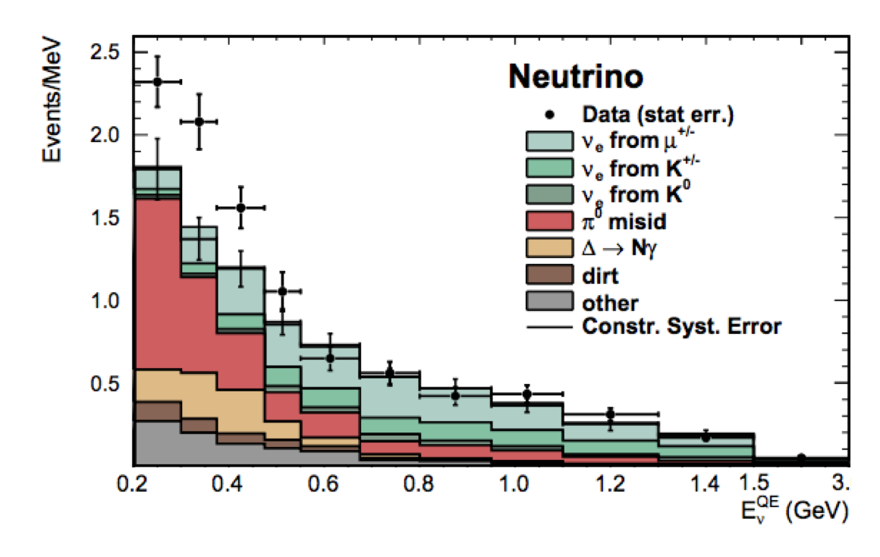
Sensitivity to MiniBooNE Low-Energy νe Excess
A. A. Aguilar-Arevalo et al., Phys. Rev. Lett. 110 161801 (2013)
MiniBooNE
Assuming NO L/E dependence LAr1-ND would expect to see ~320 background and 300 excess events in 2.2x10²⁰ POT run
By scaling directly from observed rates in MiniBooNE, MicroBooNE expects to see ~50 background and 50 excess events in 6.6x10²⁰ POT run
An estimate of systematics based on MiniBooNE analysis indicates a >6.5σ observation of a MiniBooNE-like excess

Slide 30
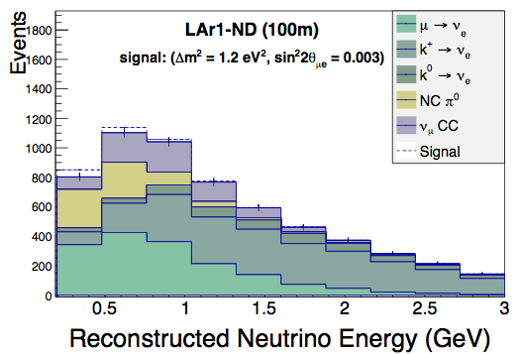
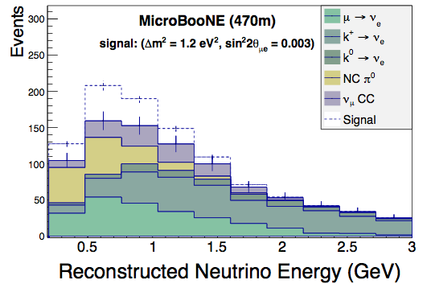
νμ → νe Appearance
Testing νμ → νe appearance in the context of a 3 active + 1 sterile neutrino model (3+1)
The observed electron candidate event rate in LAr1-ND at 100m is used to constrain the expected rate (in the absence of oscillations) in MicroBooNE at 470m
2.2x10²⁰ POT exposure for LAr1-ND
6.6x10²⁰ POT exposure for MicroBooNE

Slide 31
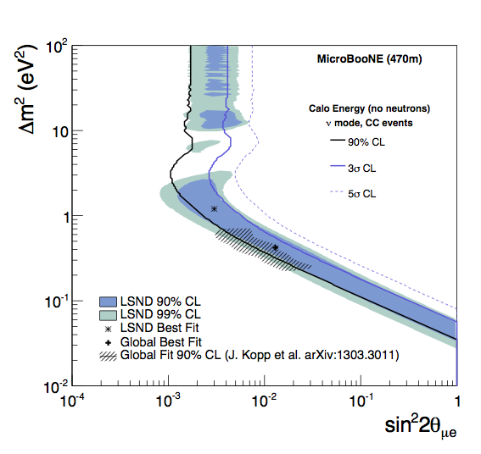
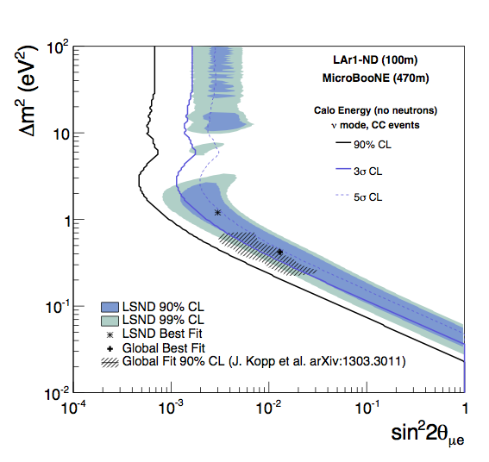
νμ → νe Appearance
6.6x10²⁰ POT exposure for MicroBooNE alone, assuming 20% systematic uncertainties
on ν_{e} background prediction
Same MicroBooNE exposure +
2.2x10²⁰ POT exposure for LAr1-ND
to constrain background prediction
+ND

Slide 32
νμ Disappearance
Testing νμ disappearance only enabled with near detector constraint
Flux and cross section errors of 15-20% conceal a disappearance signal in MicroBooNE alone, but using an observed LAr1-ND spectrum to normalize the expected rate at MicroBooNE makes it observable
unoscillated spectrum
oscillated spectrum
unoscillated spectrum
oscillated spectrum

Slide 33
νμ Disappearance
6.6x10²⁰ POT exposure for MicroBooNE alone, assuming 15% systematic uncertainties
on the absolute ν_{μ} event rate
Same MicroBooNE exposure +
2.2x10²⁰ POT exposure for LAr1-ND
to measure unoscillated νμ
+ND
Previous result from MiniBooNE+SciBooNE (red dashed contour) - unlike here, detectors were different technologies, and detector related uncertainties did NOT cancel

Slide 34
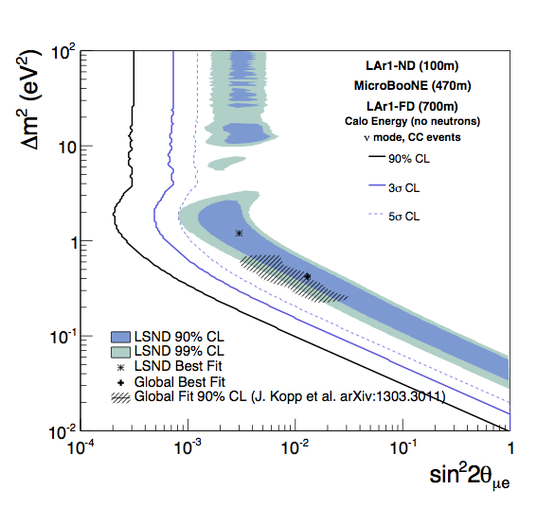
Phase-2 Short-Baseline Neutrino Program at FNAL
LAr1-ND + MicroBooNE already presents a significant extension of the physics program, but LAr1-ND can also be thought of as the next step in the development of a program of short-baseline accelerator-based neutrino physics at Fermilab
The addition of a large (kiloton-scale) detector at longer baseline (∼700 m) could address oscillations in anti-neutrino mode and make precision measurements of sterile neutrino oscillations if they are discovered
5σ level coverage of the null hypothesis for the oscillation parameter space indicated by existing experimental anomalies
Three detector configuration provides a powerful confirmation of the interpretation of any results as an oscillation signal
Have calculated sensitivities, more available in backup slides
About 3 yrs neutrino-mode data

Slide 35
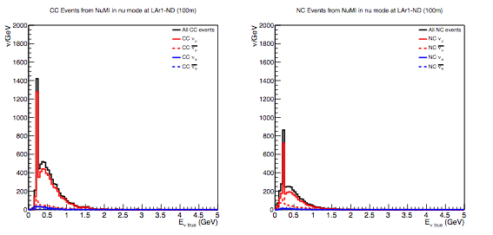
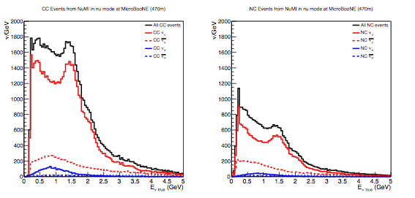
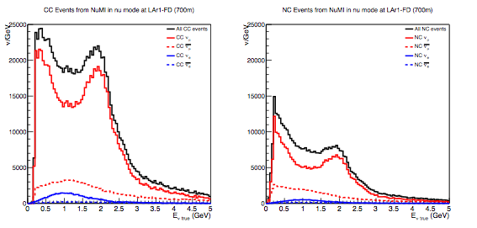
NuMI beam events (I)
Neutrino events from NuMI beam in neutrino mode 9x10²⁰POT*
LAr1-ND
MicroBooNE
LAr1-FD
* it is expected that during the NOvA era the NuMI beam could generate up to 6x10²⁰ POT/year

