Slide 1

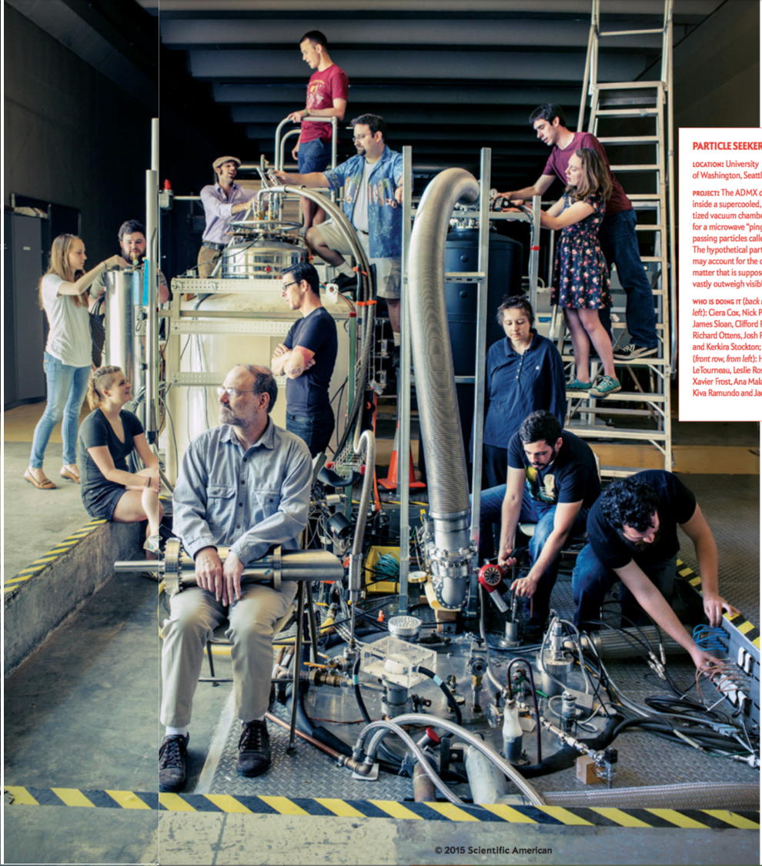
Early Results From ADMX-G2 Axion Dark Matter Search
HEP Seminar at U. Chicago
February 11, 2019
Andrew Sonnenschein
Fermilab

Slide 2
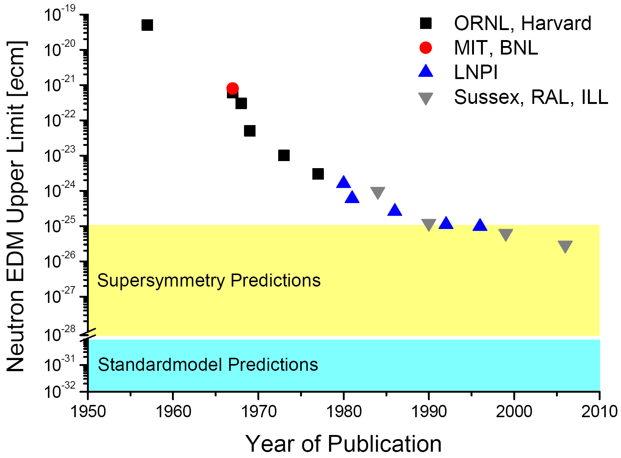
Axions-- Motivation
Protons and neutrons have a charged substructure (quarks)
Naïve expectation: they should have electric dipole moment of order 10⁻¹⁶ e-m ?

Slide 3
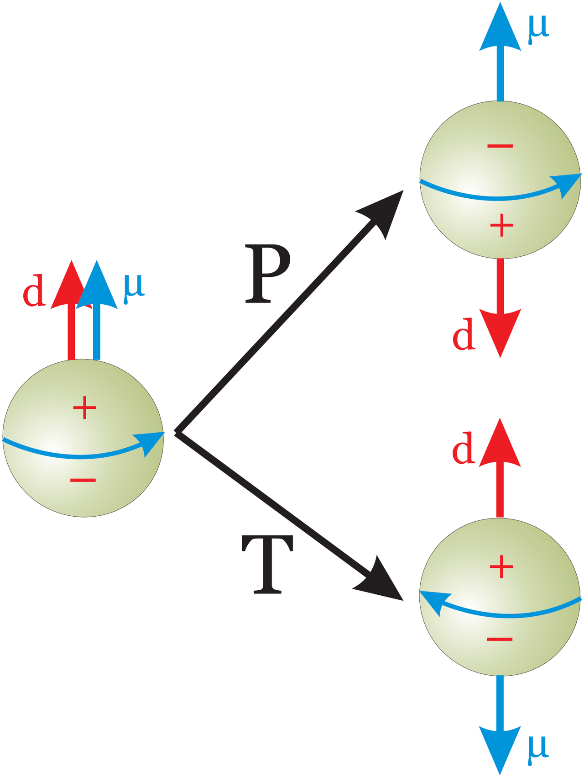
Electric Dipole Moments Violate CP (or T) Symmetry
Small electric dipole moment of neutron could be explained by approximate CP symmetry of strong interaction.
But the strong interaction Lagrangian appears to have CP- violating terms that don’t need to be small.

Slide 4
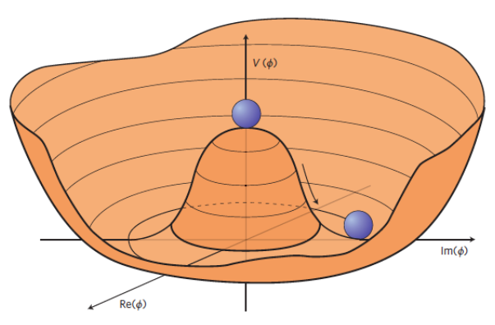
Peccei Quinn Solution to Strong CP Problem
QCD Lagrangian appears to violate CP due to GG term.
Introduce a new field φ coupled to GG with a spontaneously broken symmetry.
To minimize vacuum energy, radial part of φ takes on a vacuum expectation value (VEV).
CP violating term in QCD Lagrangian is cancelled out by the VEV of φ.
φ can still move in the axial direction– the axion!
CP violating term
0 in vacuum state

Slide 5
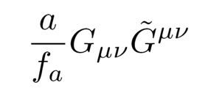
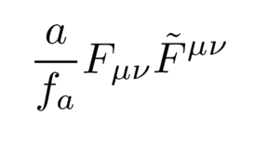
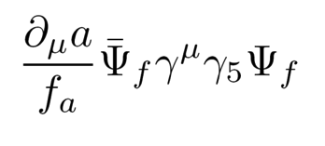
f_{A} : One Parameter Controls Everything
f_{A} is the “axion decay constant”, an unknown energy scale in the theory.
Determines axion mass and all couplings
Coupling to gluon field
Coupling to electromagnetic field
Coupling to fermions
f_{A} Originally identified with the electroweak symmetry breaking scale by Peccei and Quinn (~100 GeV), predicting axion mass to be ~ 100 keV.

Slide 6
Predictions Vs. Previous Experiment Constraints
Astrophysical bounds
Classical “post inflation” axion window: fine tuning not required for axions to make up 100% of observed dark matter
Rochester Brookhaven
Fermilab
U Florida (1990s)
Yale
HAYSTAC
ADMX
(2013)

Slide 7
WIMPs Vs. Axions
WIMPs
  Dramatic progress in attempted WIMP detection over last decade- many models previously considered promising are now excluded.
  Direct searches will become background limited by neutrinos over next 10 years.
Axions
  Previous experiments not sensitive enough to test most important models.
  Emerging techniques likely to reach required sensitivity.

Slide 8
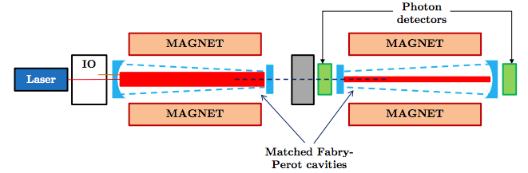
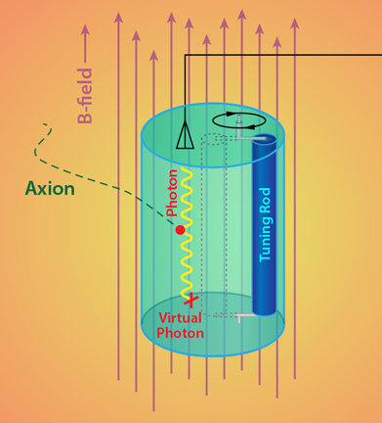
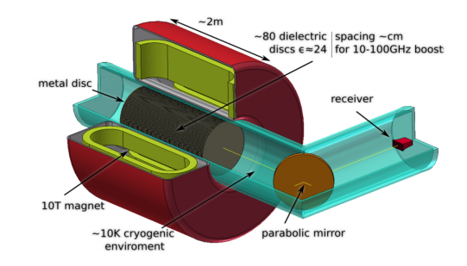
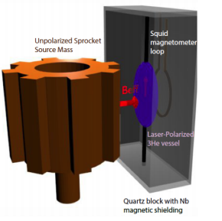
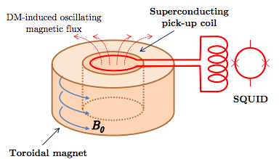
Diversity of Techniques
Resonant Cavity (ADMX, HAYSTAC, CAPP)
“Light Shining Through Walls” (ALPS)
Dielectric Radiators (MADMAX, ORPHEUS)
Solar Axions (CAST, IAXO)
Sun
NMR (ARIADNE, CASPER)
magnet
Photo detector
axion
LC Circuit (DMRADIO, ABRACADABRA)

Slide 9
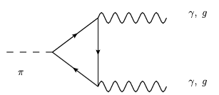
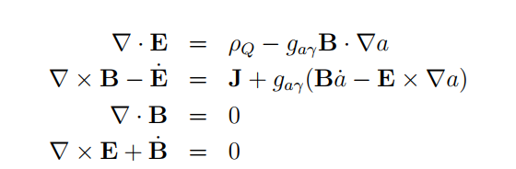
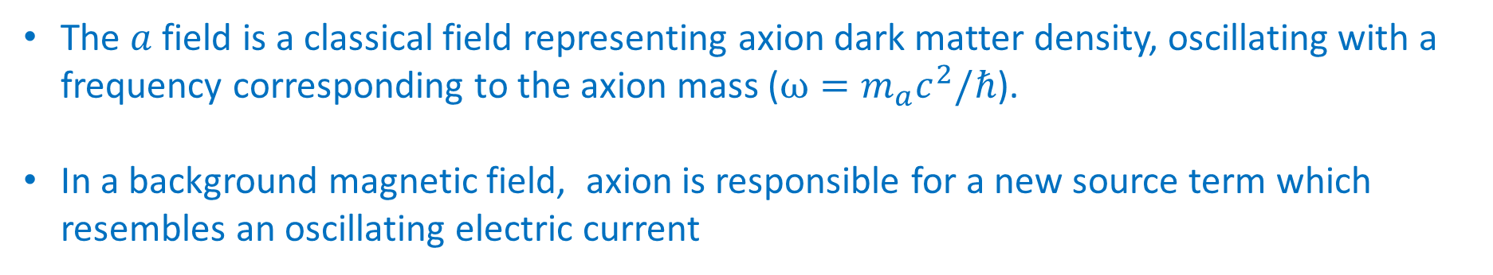


Maxwell’s Equations with an Axion
γ
a
g_{aγγ}
γ
$$≈J+J_{a}(t)$$
Fictitious electric current
The $a$field is a classical field representing axion dark matter density, oscillating with a frequency corresponding to the axion mass ($ω=m_{a}c^{2}/ℏ$).
In a background magnetic field, axion is responsible for a new source term which resembles an oscillating electric current
$$J_{a}(t)=g_{aγ}Ba_{0}e^{−iωt}$$
Irastorza & Redondo 2006

Slide 10

Magnetic Field (e.g. from a solenoid)
Magnet
$${\overset{⃑}{B}}_{0}$$

Slide 11


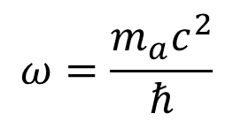

Oscillating Fictitious Current Produced by Axions in Magnetic Field
$$J_{a}(t)=g_{aγ}B_{0}a_{0}e^{−iωt}$$
$${\overset{⃑}{J}}_{a}(t)$$
Magnet
$${\overset{⃑}{B}}_{0}$$
$$ω=\frac{m_{a}c^{2}}{ℏ}$$

Slide 12





Magnetic Field Response to Axion Current
The current $J_{a}\left(t\right)$ sources a magnetic field.
$${\overset{⃑}{B}}_{a}(t)$$
$${\overset{⃑}{J}}_{a}(t)$$
$$∇×B−\dot{E}=J_{a}(t)$$
Magnet
$${\overset{⃑}{B}}_{0}$$

Slide 13




Electric Field Response to Oscillating Magnetic Field
Small electric response field appears parallel to imposed magnetic field.
Electric and magnetic field amplitudes proportional to g_{aγγ}
$${\overset{⃑}{B}}_{a}(t)$$
$$E_{a}(t)$$
$$∇×E−\dot{B}=0$$
Magnet
$${\overset{⃑}{B}}_{0}$$

Slide 14

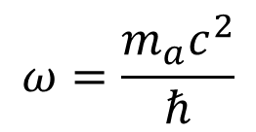


Sikivie Axion Haloscope Detector (ADMX and others)
Put a metal cavity (box) in the magnet bore.
Static B field will permeate the (non superconducting) cavity.
Tune the cavity to resonate at axion frequency .
$$ω=\frac{m_{a}c^{2}}{ℏ}$$
$$E_{a}(t)$$
Magnet
$${\overset{⃑}{B}}_{a}(t)$$
$${\overset{⃑}{B}}_{0}$$
See Pierre Sikivie, “Experimental Tests of the Invisible Axion” 1983 PRL

Slide 15
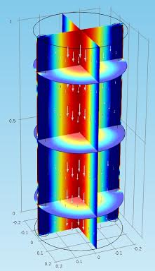

Pumped Cavity Mode
TM₀₁₀ Mode
Power buildup occurs when cavity resonance frequency is matched to axion mass.
Electric field strength enhanced by a factor of Q ∼ 10⁵ at 1 GHz for copper cavity.
Signal
antenna
Magnet
$${\overset{⃑}{B}}_{0}$$

Slide 16
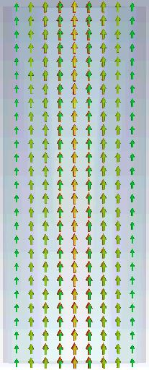
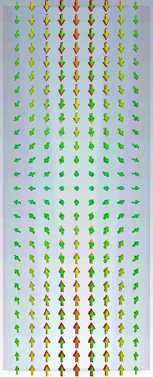
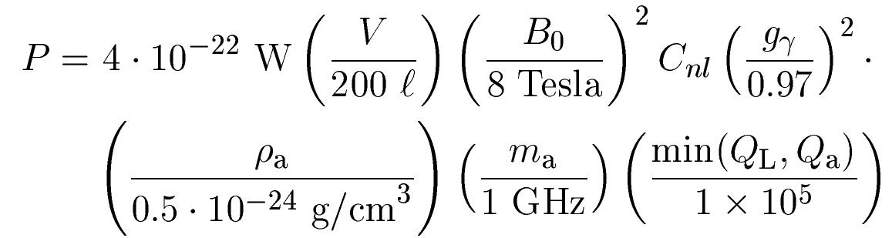

Signal Power
TM₀₁₀ mode
C₀₁₀ ~ 0.69
TM₀₁₁ mode
C₀₁₁ ~ 0.0
Signal power:
Form Factor C_{nl} overlap of cavity mode $E∙B_{0}$
Dark Matter Density ρ_{a}
Axion Mass m_{a}
Resonator Quality Factor Q_{L} $\sim {10}^{5}$
Axion velocity dispersion Q_{a} $\sim {10}^{6}$
Couplings to Photon g_{γ} ~ 0.97 for KSVZ model
g_{γ} ~ 0.36 for DFSZ
B-field

Slide 17
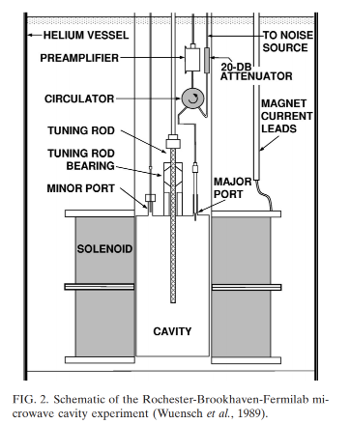
History
Pierre Sikivie, “Experimental Tests of the Invisible Axion”, PRL 1983
First and second generation haloscope experiments (1980s-90s) :
Cooled to 4 K w/FET transistor amplifiers, noise temperature range 3 - 20 K.
  BNL, University of Florida, Rochester/ Brookhaven/ Fermilab (RBF)
  ADMX- achieved KFVZ sensitivity
3rd generation (current):
Superconducting amplifiers <100 mK approaching standard quantum limit of noise.
  ADMX-G2. This talk
  Haystac– focus on higher frequencies than ADMX. Josephson Parametric Amplifiers, Squeezed states.
  CAPP. Korea Center for Axion and Precision Physics Research- ambitious program with several simultaneous searches planned.
Future: Bigger/ stronger magnets. More cavities, Beyond standard quantum noise limit?
Rochester-Brookhaven-Fermilab experiment, 1989

Slide 18
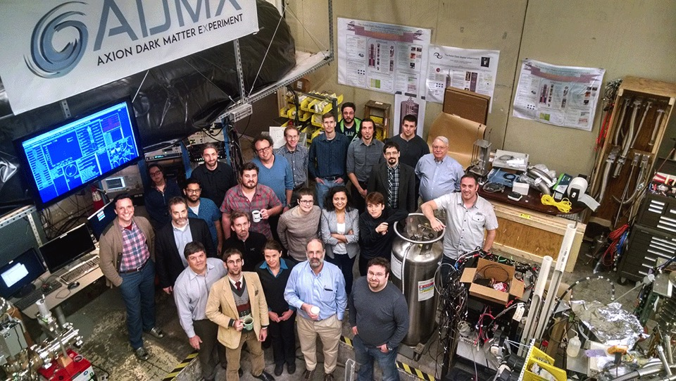
ADMX Collaboration
Collaborating Institutions:
University of Washington
University of Florida
University of California, Berkeley
Washington University St. Louis
Sheffield University
Pacific Northwest National Lab
Lawrence Livermore National Lab
Los Alamos National Lab
National Radio Astronomy Observatory (NRAO)
Fermilab
The ADMX collaboration gratefully acknowledges support from the US Dept. of Energy, High Energy Physics DE-SC0011665 & DE-SC0010280 & DE-AC52-07NA27344
Also support from LLNL and PNNL LDRD programs and R&D support the Heising-Simons institute
18

Slide 19
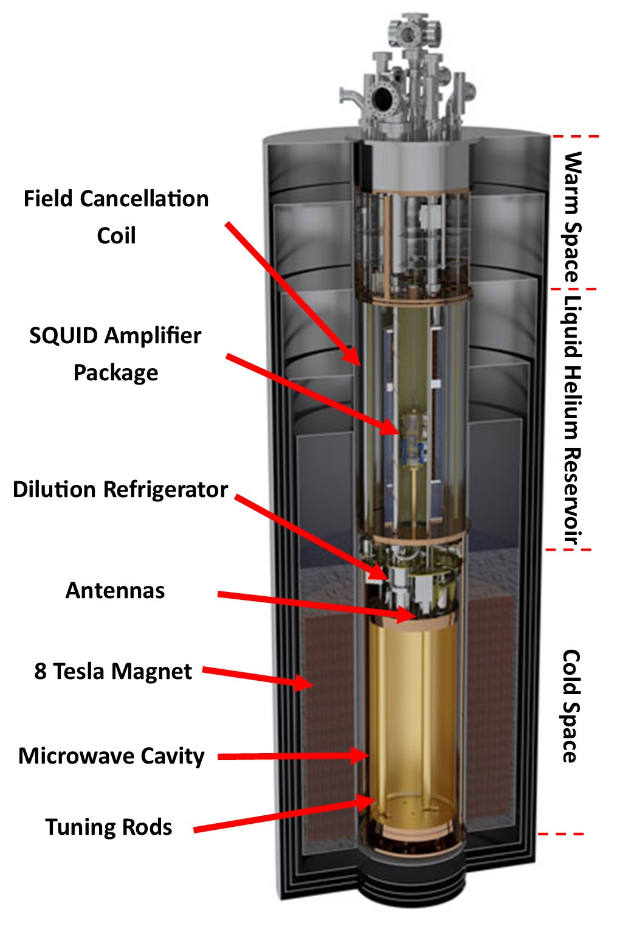
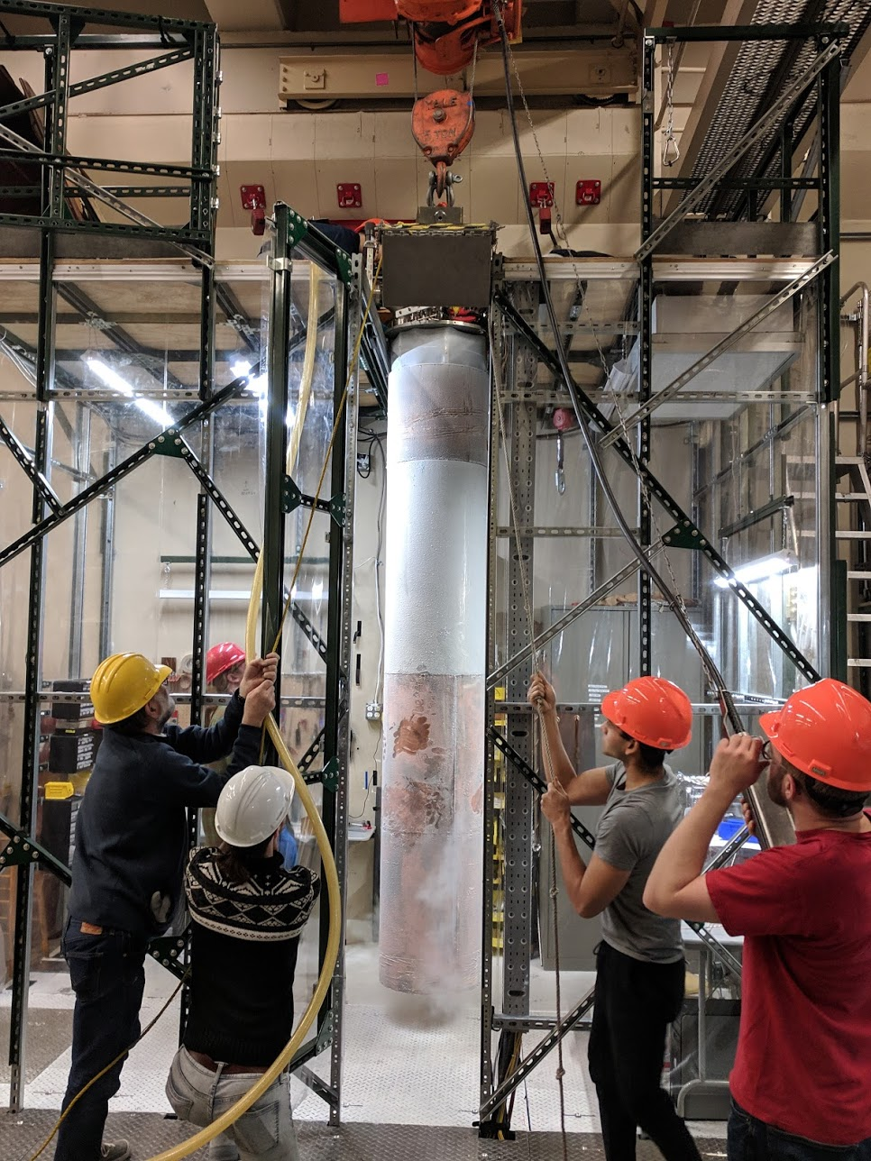
ADMX

Slide 20
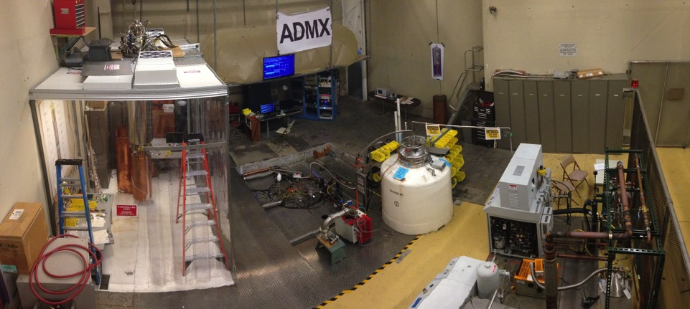
ADMX site: University of Washington
Center for Experimental Nuclear Physics and Astrophysics (CENPA)
DAQ & Controls
Helium liquefier
Cleanroom
(with insert hanging)
Magnet in pit

Slide 21
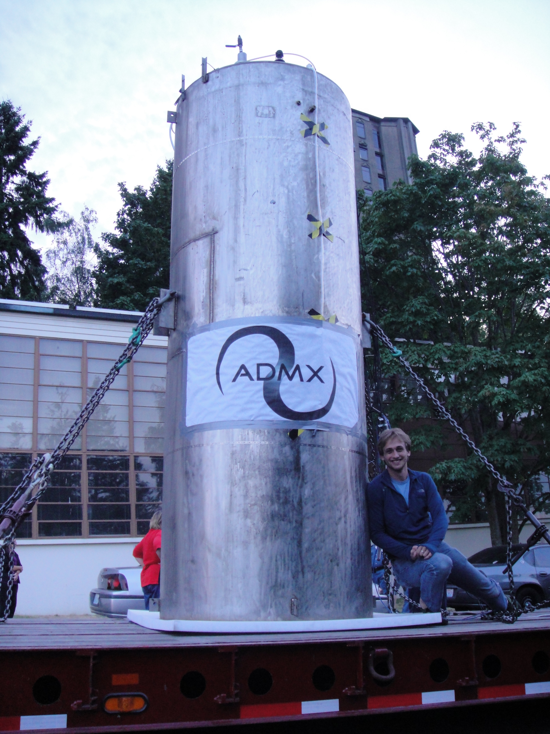
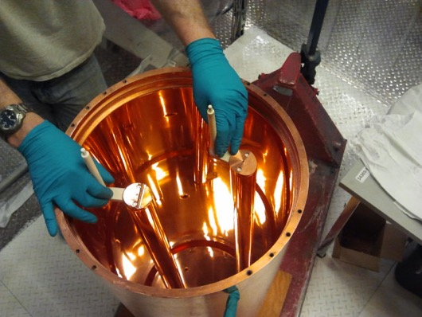
Magnet: 8- Tesla Solenoid with 60 cm bore
Resonant Cavity with Tuning Rod

Slide 22
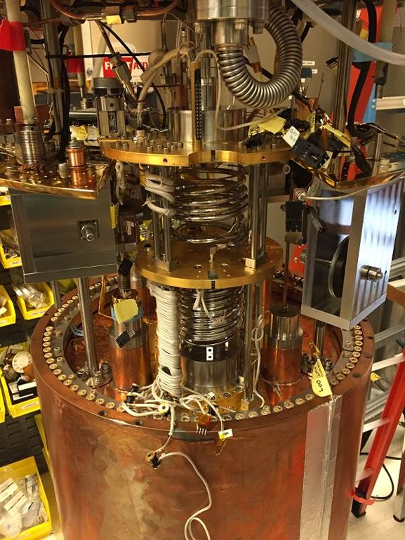
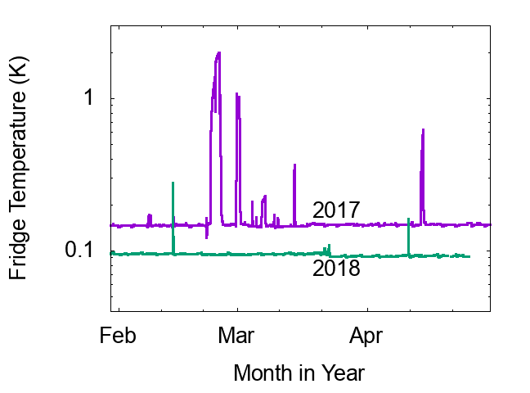
Cryogenics
Significant cooling power required:
  Large cold mass in a magnetic field
  Friction in tuning rod system
  Electromechanical switches.
Dilution refrigerator (Janis Research) supplies 1 mW cooling at 100 mK.
Temperatures in 2016-2017 ranged from 150 mK (cavity) to 300 mK (electronics package)
Reduced temperatures in 2018 run.
Mixing Chamber installed above ADMX Cavity

Slide 23
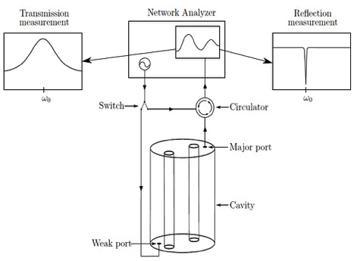
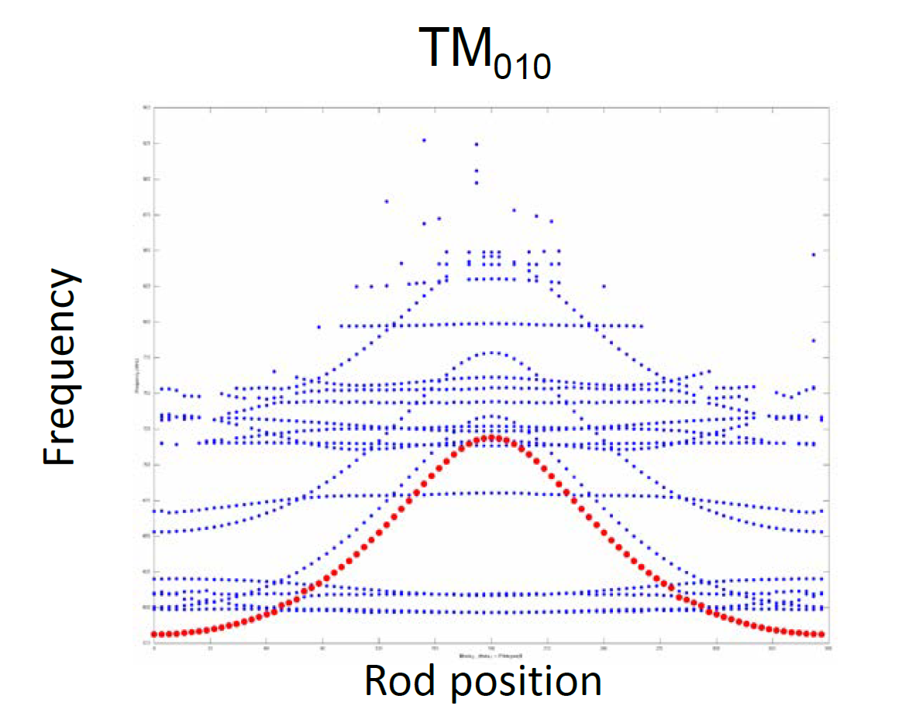
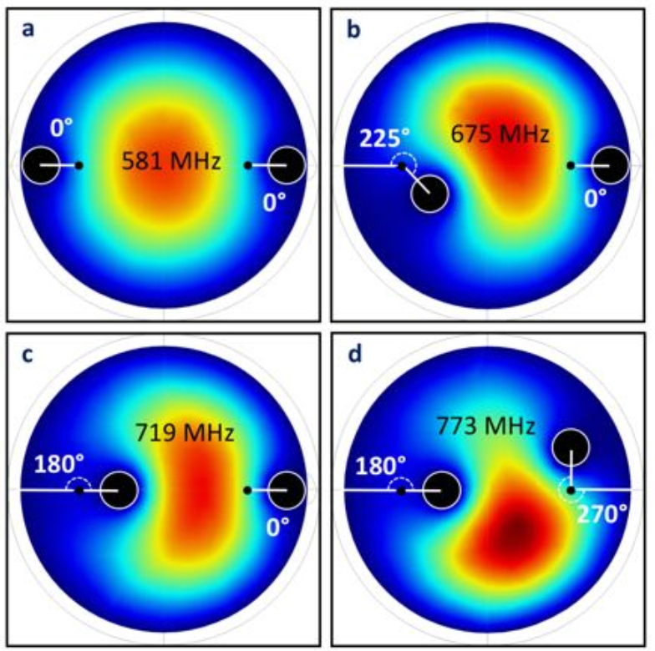
Tuning The Resonator
Tuning Rods
Frequency steps typically 1/10 cavity line width ~ 2 KHz

Slide 24
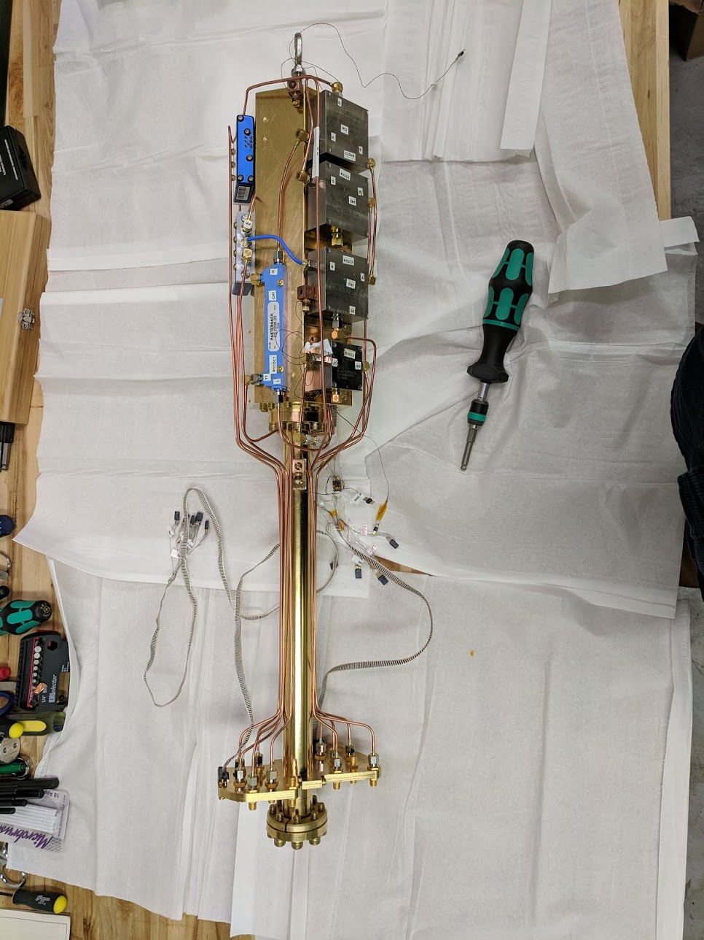
Low Noise Electronics
Noise
calibration
Test Ports
Signal
To reach sensitivity of DFSZ axion models requires noise levels that were beyond state-of-the-art a few years ago.
Possible because of developments in Quantum Information Science community for applications such as Qubit readout:
  Microstrip Squid Amplifiers (Clarke group @ UC Berkeley)
  Josephson Parametric Amplifiers (Siddiqi group @ UC Berkeley).
  Traveling Wave Parametric Amplifiers (MIT Lincoln Labs). Wide instantaneous bandwidth.
Post amplification at 4 Kelvin using commercially available HFET technology.
Cold RF system needs capability for in-situ calibration and diagnostic functions.

Slide 25
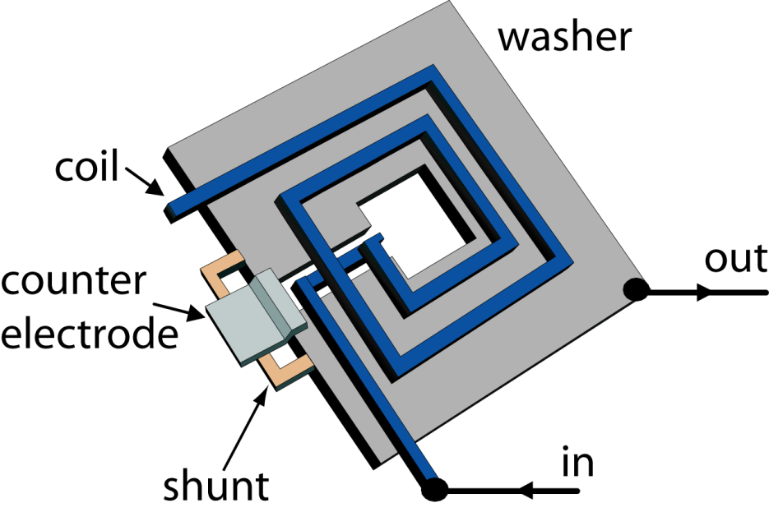
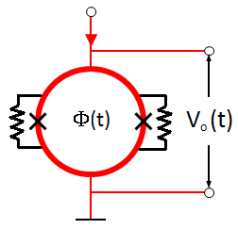
DC SQUID as an RF amplifier (MSA)
Principle of SQUIDs as microwave amplifiers
Microstrip Squid Amplifier
Microstrip Squid Amplifier (MSA)
Very similar to conventional DC Squid.
Flux to voltage converter sensitive to a fraction of a flux quantum.
Adapted for high frequency use.
Supplied to ADMX by Clarke group at UC Berkeley.
Microstrip SQUID Amplifier (MSA):
Nb washer (ground)
Nb coil, isolated from washer
(input)
Nb Counter electrode (output)
V
Nb-AlOx-Nb
junctions
δV
Resistive shunts
δΦ
Φ
Φ
0
1
2
0
Φ₀ = h/2e ∼ 10⁻¹⁵ Tesla m²

Slide 26
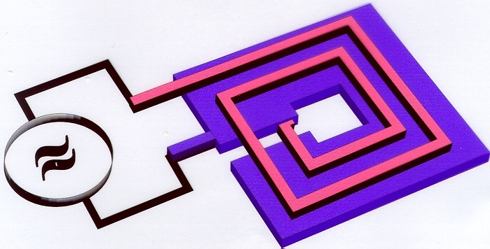
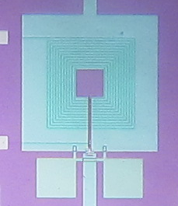
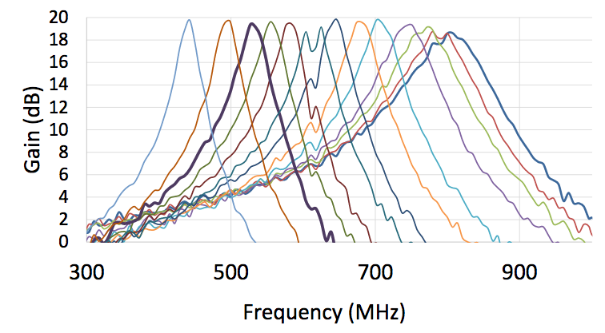
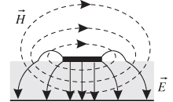
DC SQUID as an RF amplifier (MSA)
Principle of SQUIDs as microwave amplifiers
Microstrip Squid Amplifier
Microstrip Squid Amplifier (MSA)
To couple a microwave signal into the SQUID:
  Cover the washer with an insulating layer (350nm of SiO₂)
  Add a spiral path of conductor around central hole
  This creates a microstrip transmission line resonator between the input coil and SQUID washer.
GaAs varactor used to tune the microstrip resonator.
MSA Varactor Tunability
Stripline Field Geometry

Slide 27
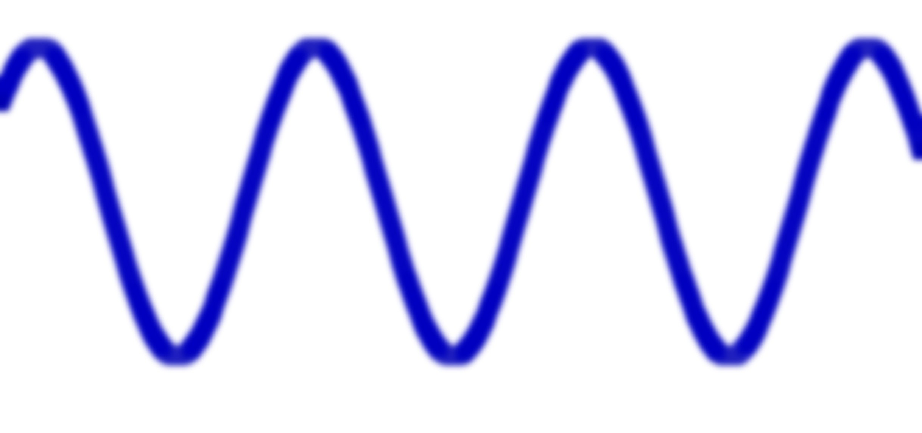
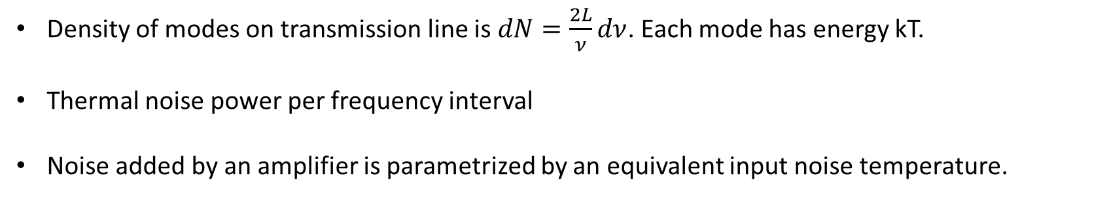
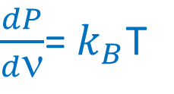
Thermal Noise and Equivalent Noise Temperature
Thermal noise on a transmission line.
Amplifier
“Detector”
Temperature T
T
Signal
Thermal noise
Impedance Match
L
Nyquist, 1928
Density of modes on transmission line is $dN=\frac{2L}{ν}dν$. Each mode has energy kT.
Thermal noise power per frequency interval
Noise added by an amplifier is parametrized by an equivalent input noise temperature.
$\frac{dP}{dν}$= $k_{B}$T

Slide 28
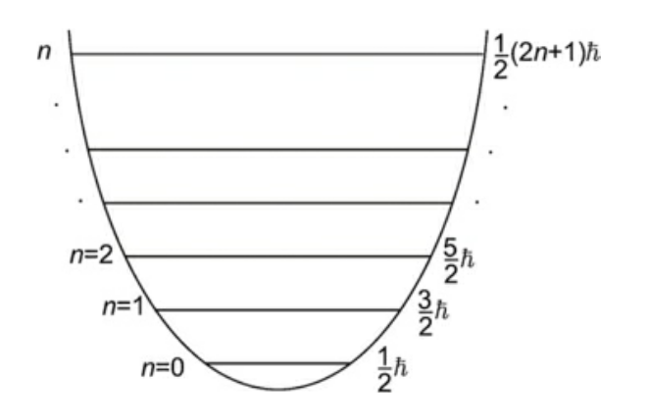
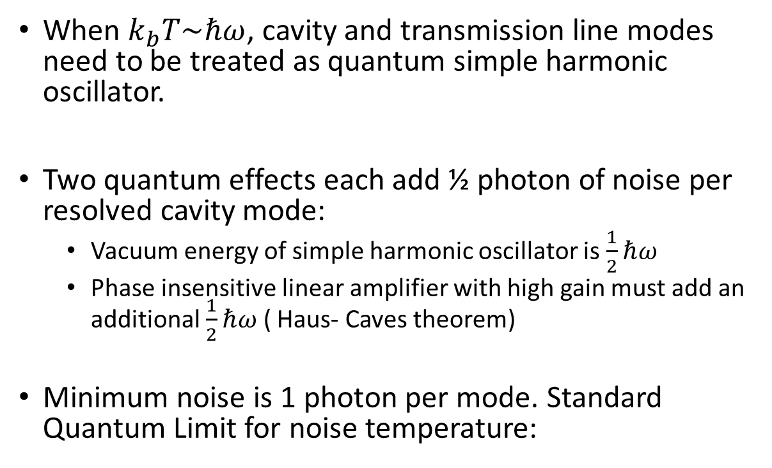

Standard Quantum Limit
Energy Levels of a
harmonic oscillator
When $k_{b}T\sim ℏω$, cavity and transmission line modes need to be treated as quantum simple harmonic oscillator.
Two quantum effects each add ½ photon of noise per resolved cavity mode:
  Vacuum energy of simple harmonic oscillator is $\frac{1}{2}ℏω$
  Phase insensitive linear amplifier with high gain must add an additional $\frac{1}{2}ℏω$ ( Haus- Caves theorem)
Minimum noise is 1 photon per mode. Standard Quantum Limit for noise temperature:
$$T_{Q}=\frac{ℏω}{k_{B}}$$
≈50 mK @ 1 GHz

Slide 29
Noise Performance of Microstrip Squid Amplifiers
Achieved T_{N}= 48 mK at 600 MHz during testing at UC Berkeley
1.7 x quantum limit.
In ADMX operation, system noise temperatures has additional contributions from:
  Black body radiation in cavity
  Attenuation
  Post amplification stages

Slide 30
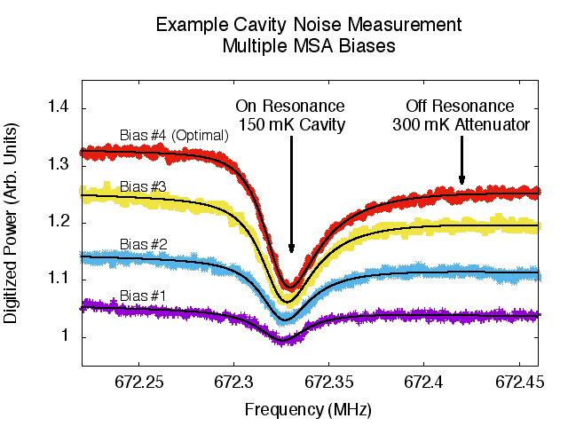
MSA Operation in ADMX 2017/ 2018 Runs
Amplifier package at higher temperature than resonator due to thermal short.
Causes distinctive “dip” in noise power at cavity resonance.
Typical system noise temperature was $\sim$500 mK.
Notes:
Two sources of asymmetry in the signal.
Interference off reflected power of the cavity (off resonance)
Standing wave effects from reflection off the unknown MSA input impedance
Asymmetric because it relies on the complex impedance of the resonator/antenna.
Near resonance it has a positive imaginary part on one side and a negative imaginary part of the other so the interference effects are different on each side.
Different colors are different MSA gain bias (red is highest gain)

Slide 31
Signal to Noise Ratio- Example
$T_{Noise}=\frac{1}{k_{B}}\frac{Noise Power}{Bandwidth}$
Suppose we have $T_{Noise}=0.5 Kelvin$
$P_{noise}=k_{B}T_{Noise}∗Bandwidth=0.5∙1.4×{10}^{−23}W/Hz∙Bandwidth$
Bandwidth of axion is due to halo velocity dispersion ${\frac{∆f}{f}\sim 10}^{−6}$
∼ 1 kHz at 1 GHz axion frequency
So $P_{noise}\sim {10}^{3}Hz∙\frac{{10}^{−23}W}{Hz}={10}^{−20}W$
Still about three orders of magnitude larger than the signal!

Slide 32
Noise reduction by averaging

Slide 33
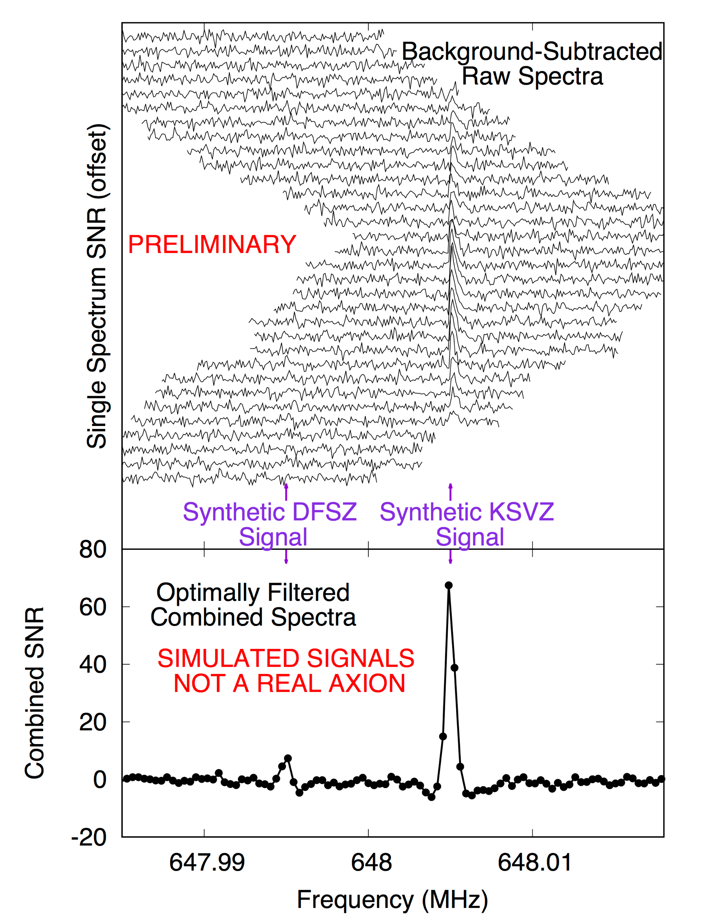
Operating Procedure
The cavity frequency is scanned over a region until the desired SNR is achieved.
Convolution with filter matched to expected axion line shape.
Typically we have ~10⁶ independent measurements on each axion linewidth, averaged to reduce noise by $\sqrt{{10}^{6}}$
We then examine the combined power spectrum for signs of excess
Excess power regions can be statistical fluctuations, synthetically injected signals, RF interference, or axions
Excess power regions are rescanned to see if they persist
Persistent candidates are subjected to a variety of confirmation tests: for example: magnet field changes or probing with other cavity modes.
We do blind signal injection, so we always have candidates

Slide 34
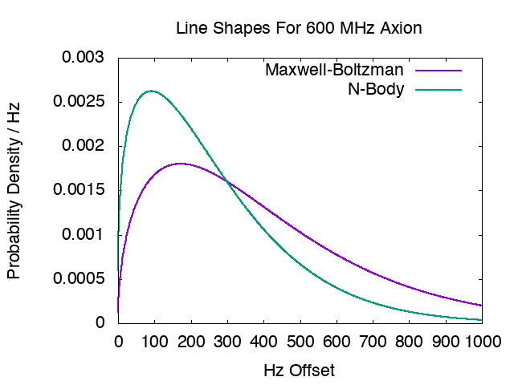
Predicted Axion Signal Shape
Recent N-Body models actually suggest the axion lineshape is narrower than the standard virialized model.
Our analysis searches for both.
Lineshape scaled to current ADMX run
Adapted from: Lentz et al. Ap.J. 845 (2017)

Slide 35
You might have an axion if the signal…
Can’t be seen in the room outside of the magnetic field
Persists all the time
Follows the Lorentzian lineshape of the cavity
Is suppressed in non TM010 modes
Was not a synthetic axion signal injected by the calibration team
Scales with the B² of the magnet
Has an annual frequency modulation
No candidates passed tests in 2017 run.

Slide 36
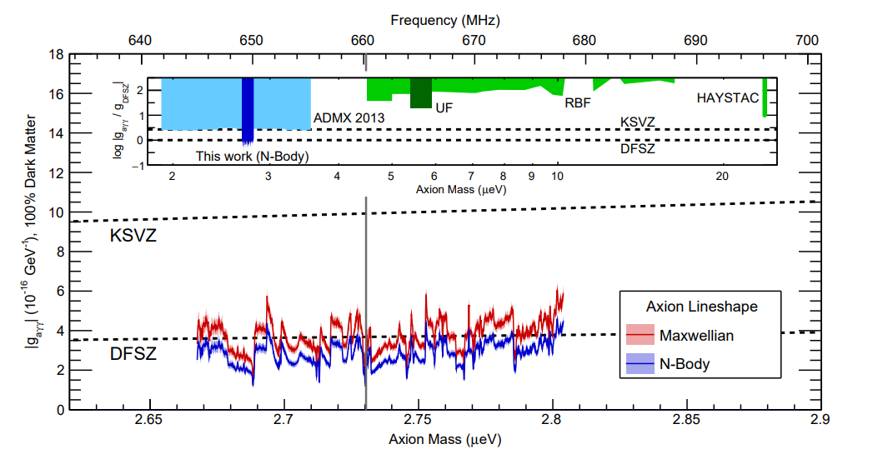
First ADMX-G2 Result (Data from 2017 Run)
Exclude DFSZ models at 90% CL from 2.66-2.82 μeV.
ArXiv 1804.05750 & PRL April 2018

Slide 37
ADMX 2018 Run- Results Coming Soon
Continued DFSZ sensitivity scan in the 680 to 800 MHz range.
Lower physical and noise temperature due to cryogenic improvements.
  T_{noise} -> 350 mK
Scan speed increase by factor of two with higher signal to noise ratio.
Stay tuned for results – paper mid 2019.
2018
In Progress
2017
Excluded

Slide 38


How to Speed up Axion Searches
Effective scan rate of ADMX in 2018 was ≈ 1 MHz/ day
As we move up in frequency,
    Expected axion coupling increases
    Cavity volume decreases, decreasing signal
    Cavity Q decreases, decreasing signal
    Quantum limit increases, increasing noise
Scan Rate Vs Frequency & other parameters
More Detector Volume:
Array of
Resonators
Lower Noise Amplifiers
Higher Q:
Superconducting or Dielectric Resonators
Stronger Magnet

Slide 39



Quantum Sensor R&D for Axion Detection
Axion detection is natural application for quantum sensors.
  Current Microstrip Squid Amplifiers (MSAs) and Josephson Parametric Amplifiers (JPAs) with noise close to standard quantum limit.
  Future: Squeezed states prepared by JPAs, Qubit photon counters.
JPAs used for ADMX-G2
I. Siddiqi, UC Berkeley
Aluminum qubit on a sapphire substrate in a copper resonant cavity. A single photon in the cavity produces a qubit frequency shift (Dave Schuster, Akash Dixit, Aaron Chou)
Qubit sensitivity to Axions (A. Chou, FNAL)

Slide 40





ADMX Cavities up to 4 GHz
2020-2021
4-Cavity Array
8 piezoelectric actuators
1500-2300 MHz
2022-2024
14-Cavity array
2.3- 4 GHz
2019-2020
800-1500 MHz
Large tuning rod
Used in 2016-2018 Runs
580-890 MHz

Slide 41





R&D Towards High Frequency (>4 GHz) Resonators
Challenging to fill a large volume with small tunable structures (“Swiss Watch” problem)
Number of elements goes as $f^{3}$
Explore systems that allow simultaneous tuning of many elements with only a few mechanical motions.
  Photonic bandgap cavity
  “Comb Cavity”
  Electronic fine tuning using nonlinear dielectrics
Comb cavity (FNAL)
“Pizza” Cavity (U. Florida)
Array of posts (LLNL)

Slide 42


Current System for Turning Tuning Rods (~1996-2019)
Driven by stepper motors at room temperature.
19,600:1 gear reduction allows for very small tuning rod motions with high torque.
Not suitable for large numbers of cavities.

Slide 43



Cryogenic Piezoelectric Actuators for Cavity Tuning
Use commercial miniature cryogenic rotary and linear piezoelectric actuators (Attocube)
“Sidecar” 4-6 GHz Cavity
Linear Piezo drive controls antenna depth
Rotary Piezo connected to tuning Rod

Slide 44

Sidecar cavity results 2018
Proof of principle for piezoelectrically tuned cavities.
New exclusion limits at 17, 22, and 30 ueV
High noise temperature (7 Kelvin)– HFET amplifiers.
PRL, January 2019

Slide 45

Assembly of 800-1500 MHz Hardware in February 2019
Improved cryogenic electronics package– goals is to bring electronics temperature below 100 mK & achieve factor of 4 speedup in data taking.
Next run will start in April.
800-1500 MHz Resonator

Slide 46
Timeline For Current and Next Generation Experiments
ADMX- G2 Approved for operation through 2021 at University of Washington, with coverage up to 2 GHz.
We hope to extend running at U Washington to 2024 (4 GHz).
Next generation experiment with a higher field magnet could start as early as 2022.

Slide 47
Summary
ADMX achieved sensitivity to DFSZ axion models, a long standing goal of the field.
Improved sensitivity in current generation of experiments due to lower temperatures and better amplifiers.
Noise temperature reduction and other optimizations will increase scan speed over time.
Exciting times-- a definitive test of most interesting QCD axion dark matter models is possible.

Slide 48
Extra Slides

Slide 49
ADMX Collaboration
Collaborating Institutions:
University of Washington
University of Florida
University of California, Berkeley
Washington University St. Louis
Sheffield University
Pacific Northwest National Lab
Lawrence Livermore National Lab
Los Alamos National Lab
National Radio Astronomy Observatory (NRAO)
Fermilab
The ADMX collaboration gratefully acknowledges support from the US Dept. of Energy, High Energy Physics DE-SC0011665 & DE-SC0010280 & DE-AC52-07NA27344
Also support from LLNL and PNNL LDRD programs and R&D support the Heising-Simons institute
49

Slide 50

Quantum Limit
signal photon rate
*single photon of noise
per resolved mode

Slide 51


Josephson Junction
SQUIDs as microwave amplifiers
Flux Quantization
Josephson Tunneling
insulating
barrier
Φ = nΦ₀
superconductor
superconductor
I
I
~ 20 Å
J
Superconducting state has macroscopic wavefunction.
I and V across the junction are given by the Josephson relations:
$I$= $I0$ sin $δ$ V=${\dot{δ}Φ}_{0}$/2π
Φ = nΦ₀ (n = 0, ±1, ±2, ...)
Φ₀ = h/2e
In presence of Josephson element the quantization condition becomes:
Φ - (δ/2π) Φ₀ = nΦ₀
Courtesy: Sean O’Kelley, UC Berkeley

Slide 52

Josephson Parametric amplifier (JPA)
Parametric amplifier: Oscillator whose resonance frequency is modulated
Oscillating system a λ/4 resonator
Inductance varied with SQUID (flux dependent nonlinear inductor)
Energy transfer from pump to
two normal modes of swing
Noise – Quantum Limit
two normal modes
of swing:
signal + idler
ω_{idler}
ω_{pump}
JPA
Nonlinear L_{J}
modulated
ω_{pump}
ω_{signal}
ω_{signal}
Paramp schematic: L. Zhong et al., “Squeezing with a fluxdriven Josephson parametric amplifier,” New J. Phys. 15, 125013 (2013).

Slide 53


Current data run: JPA operations
Josephson Parameteric Amplifier (JPA) provided by Siddiq Group at UC Berkeley
Current JPA band: 685 MHz – 800 MHz ← limited by circulators.
2nd Channel is an MSA tunable from 800 – 890 MHz
Two amplifiers with complementary tuning ranges!
Minimize number of experimental insertions
Redundancy
As we continue up in frequency we will transition to using entirely JPAs (shown to work up to > 10 GHz)
Prof. Irfan Siddiqi: UC Berkeley
2 mm

Slide 54


Fermilab Initiatives to Surpass The “Standard Quantum Limit”
Fascinating new direction in detector technology well supported by DOE and other agencies
New collaborations with quantum information groups at Chicago, NIST

Slide 55


Beyond the Quantum Limit
Quantum limit comes from trying to measure both amplitude and phase of a harmonic oscillator (mode of E field)
Can we avoid measuring both amplitude and phase?
Various proposals
  “Squeezing the vacuum” using Josephson Parametric Amplifiers (Haystac)
  Qubit single microwave photon detectors (R&D at Lawrence Livermore National Lab and Fermilab)
  Single microwave photon counting using Rydberg atoms (R&D at Yale)
Qubit (FNAL/ Chicago)

Slide 56

Akash Dixit

Slide 57














ADMX: Collaboration
*
Sponsors
ADMX now DOE Gen 2 project
Primary sponsor
R&D support
Notes:
Look at the # of institutions (10) and # of scientist, students (look at the latest MOUs). Count engineers/technicians?
LLNL: 2 scientists / 1 student / 1 technician
LANL: 1: 1 scientist
WU: 3 scientists / 1 student
UFL: 3 scientists / 3 students / 1 engineer
UW: 4 scientists / 3 students
NRAO: 1 scientist
FNAL: 5 scientists, 1 student,
Sheffield:1 scientist
UCB: 4: 2 scientists & 2 students
PNNL: 3 scientists & 2 engineers
Total of ~ 40 people (scientists, postdocs, students and engineers)

Slide 58



The QCD Axion- A Very Predictive Model
Everything depends on just one unknown parameter– the axion decay constant f_{a}
  The axion mass.
  Coupling to gluons and photons.
  The cosmological abundance*
∼ f_{A}
*Vacuum realignment contribution for post inflation scenario, not including cosmic strings & domain walls…

Slide 59
Axion Mass
QCD effects at the time of the QCD phase transition (quark- gluon plasma -> free particles) cause a small tilt in the Peccei Quinn potential producing an axion mass.
Axion mass is determined by curvature of potential around minimum.
∼ f_{A}

Slide 60

CP Violation in QCD
The QCD Lagrangian contains a term that changes sign under Parity or Time reversal
Strong coupling constant
Gluon field strengths
Limits on the neutron electric dipole moment (< 3 x 10⁻²⁶ e cm) constrain the CP violation parameter Θ<10⁻⁹
R.D. Peccei, Hep-ph/0607268

Slide 61
Axion 2d Sensitivity Plot: Photon Coupling vs Mass
Constructed to resemble standard WIMP sensitivity plot.
Allows for a more general parameter space of “axion like particles” or ALPS with independent mass & cross section.
QCD axion appears along diagonal band.
a
g_{aγγ}
Graham, Irastrorza, Lamoreaux, Linder and Van Bibber, arXiv:1602.00039

Slide 62

Production of Dark Matter by Vacuum Realignment
After PQ symmetry breaking the Θ angle is a random number.
Tilting of PQ potential below QCD phase transition causes the field to roll to its minimum, converting vacuum energy to axion particles.
Axion dark matter density today determined by random initial value of Θ.
Can assume different values in causally disconnected regions of space-> domain walls.
Cosmic axion
string
Random $Θi$
1.12
0.01
0.37
1.93
0.63
2.01
0.17
3.14
1.57

Slide 63
Beyond the Quantum Limit
Quantum limit comes from trying to measure both amplitude and phase of a harmonic oscillator (mode of E field)
Can we avoid measuring both amplitude and phase?
Various proposals
  “Squeezing the vacuum” using Josephson Parametric Amplifiers (Haystac)
  Qubit single microwave photon detectors
  Single microwave photon counting using Rydberg atoms.

