Slide 1
Analytical Research Tools for Research the systems that make them whole
Sandra G. Biedron, Ph.D.
Department of Electrical and Computer Engineering
Department of Mechanical Engineering
Accelerator Science Seminar
Enrico Fermi Institute
The University of Chicago
21 October 2019

Slide 2
Thank you
Thank you Young-Kee Kim for the invitation.

Slide 3
Analytical tools for research
Humans are relying evermore on the generation of x-rays, particles, and bright and/or coherent photons as analytical tools for conducting research as well as to transform materials.

Slide 4
Discussion today
A few examples of applications of these tools
What research can be done to transform these tools

Slide 5
A few examples of use of analytical tools for research

Slide 6
Modern Analytical Devices
A few applications with impact to science
450-MeV Chicago Cyclotron
Used to show that particles called "pions" are largely responsible for the force that holds protons together in the nucleus of an atom. Built between 1950-52, this early particle accelerator was one of the most powerful of its time. (U of C archive and Fermilab Today)
X-ray diffraction to understand the physical structure of the DNA molecule.
(Facebook page for Rosiland Franklin)
CERN used in the discovery of the Higgs boson.
(From Nature 564, 46-47 (2018)doi: 10.1038/d41586-018-07405-x)

Slide 7
Not just limited to pure science of course
Security
Materials processing
Archeology
Anthropology
History
Medicine
Industry
Etc.

Slide 8
Security
Example of food security
Courtesy Dr. Christine M. Bruhn, Retired, Director, Center for Consumer Research, UC Davis
Ideas of similar nature discussed at “FOOD AND SCIENCE, 2016 UChicago Joint Speaker Series Program”

Slide 9
Materials
Example of strengthening of materials though cross-linking of polymers
Biedron/Infodelity™ discussions with DuPont

Slide 10
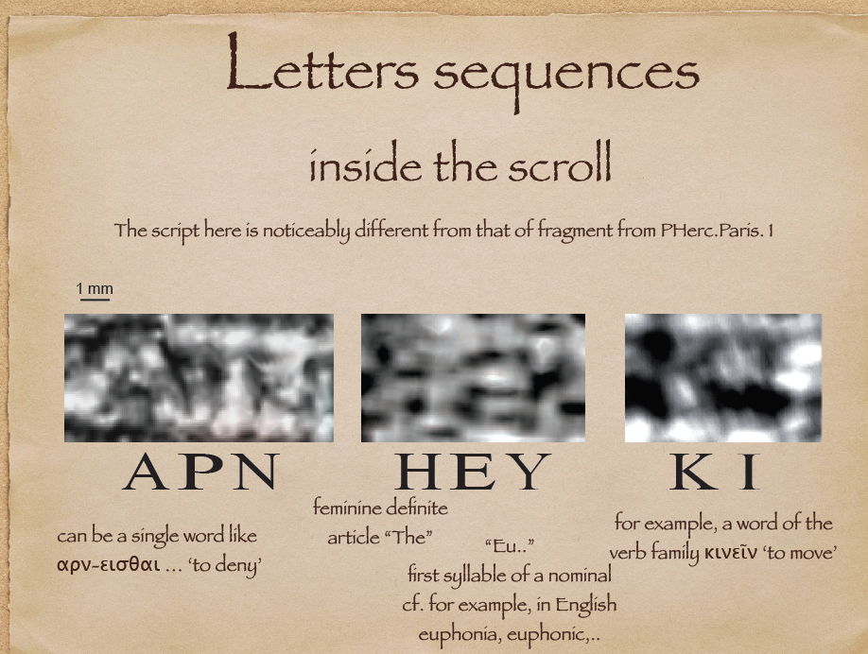
Archeology, History, Art, Anthropology
Example of reading scrolls thought lost to natural disasters
Revealing letters in rolled Herculaneum papyri by X-ray phase-contrast imaging
Slide courtesy of
Vito Mocella
Nature Communications volume 6, Article number: 5895 (2015)

Slide 11
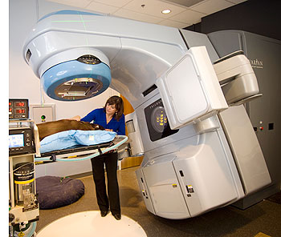
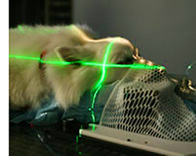
Medicine
Example of Companion Animal Radiotherapy
Need various accelerators co-located with veterinarians to facilitate translational medicine
Advantages of Large vs Small Animal Cancer Models
Naturally occurring tumors
Functional immune systems (combined immuno-radiotherapy)
Similar treatment responses in large animals and humans
Superior tumor imaging
Superior model for surgery, chemo- and radiotherapy
Dogs 85% genetically identical to humans
Breeds offer unique genetic tools
Tissue biopsies can be performed more frequently
Courtesy Jac Nickoloff

Slide 12
Industry
Example of magnetic materials
Courtesy Fulvio Parmigiani
The FERMI@Elettra
Soft X-Ray FEL
helps us understand ultra-fast demagnetization dynamics
Recent progress on all-optical control of ultrafast demagnetization and all-optical switching promises technological advances in magnetic data manipulation. However, both techniques will rely on nm localization of light (i.e. far beyond its diffraction limit) as well as detailed knowledge on how non-local damping leads to a spatial transfer of magnetic information. The unique properties of the free-electron laser FERMI at the scattering endstation DIPROI allowed for the first time to directly visualize the spatial and temporal evolution of magnetic order of a Cobalt based ferromagnet after a deliberately localized optical excitation. The ultrashort, coherent and circular polarized X-ray pulses at the Cobalt M-edge (58.9 eV) met all requirements for implementation of X-ray magnetic circular dichroism (XMCD) based Fourier-Transform-Holography to image the ultrafast changes of a magnetic domain pattern.

Slide 13
Industry
Example for engineering devices such as microelectronics
These measurements were carried out using the four wave mixing. This allowed my colleagues to measure the transition from diffusive heat transfer to the ballistic one happening at the nanoscale. This is fundamental for engineering microelectronic devices**.
**For example, John Kelly of IBM suggests that the quest for AI will
drive a need for advanced microelectronics (new devices, new accelerators,
new interconnects) DOE AI Summit 2019, Chicago.
Courtesy
Claudio Masciovecchio

Slide 14
What’s next?
So many of you probably thought it was an error that the word “research” appeared twice in my title.
  Analytical Research Tools for Research
  What I actually want to point out is that the sources are in themselves interesting tools enabling the research of others but also have their own interesting science questions. (I’ll come to this soon.)
  The tools we build, e.g. accelerator systems, are improved by being studied while being used to for the “end” research.
Many of the examples I gave could have tailored sources for the specific, desired application.
  Question – could we use components developed from the tool research to create these modular devices and if tailored (not so general use) could they be more compact, more efficient, etc.? Use a systems approach. Reflect back to Fermi for a moment on the Chicago Cyclotron.
The examples I chose were for a reason.
  Most of the examples, ranging from high-energy physics, to nuclear physics, materials explorations, to security, to medicine, etc. would benefit from smaller, more efficient, less expensive as well as “tailored” tools to a certain application.
  This means that my job is interesting as there is even more research that will be needed to be carried out.

Slide 15
Compact, efficient, cheaper, etc.
In fact, there is such a push for such compact accelerator sources, that the Office of Science is conducting an assessment - “Basic Research Needs for Compact Accelerators for Security and Medicine” (report expected by end of CY).
Further, the report “Opportunities in Intense Ultrafast Lasers: Reaching for the Brightest Light” (National Academies of Sciences, Engineering, and Medicine. 2018. https://doi.org/10.17226/24939) points to many examples of needs for compact accelerators, new other genres of tools, etc. enabled by a intense lasers.
Further yet, in the 2010 Department of Energy publication “Accelerators for American Future”, the term compact appeared 40+ times.
Plus many other meetings on the subject…..

Slide 16
What research can be done to transform these tools
In (mostly) laser and accelerator science

Slide 17
The Science of the Analytical Tools
The systems that can be used to architect analytical tools prove to us over and over again of their own uniqueness and contribution to science and technology. Further, they can be used contribute to other studies.

Slide 18
The Science of the Analytical Tools
Just looking to particle accelerators for a moment
In just the U.S. for instance - In support of its science mission, the U.S. Department of Energy operates large scientific instruments that support the work of more than 50,000 scientists worldwide. Large particle accelerators are at the core of eleven of the seventeen National User Facilities that DOE operates.
It is estimated that in the post-1938 era, accelerator science has influenced almost 1/3 of physicists and physics studies and on average contributed to physics Nobel Prize-winning research every 2.9 years*.
These machines continue to become more complex and push technology to the limits.
*See for example, E. Haussecker, A. Chao, The Influence of Accelerator Science on Physics Research, Physics in Perspective 13 (2011) 146.

Slide 19
What are some of the building blocks for future analytical tools?
More compact sources (e.g. for security and medicine, see upcoming DOE Office of Science Basic Research Needs Report)
Better control
On device computing
HPCs for design, computing, data analysis
Continuous improvements in lasers and optics (e.g. photocathodes, beam instability control, seed lasers, HHG drivers, pump lasers, timing and synchronization, for laser-driven acceleration schemes, etc…)
Lasers as analytical tools
Laser driven devices as analytical tools (e.g. HHG)
Electron microscopy sources
Better ways to fabricate superconducting RF cavities
Better wall plug efficiencies in all analytical tools
Etc….

Slide 20
Analytical tool toolbox
Physics, Chemistry, Mechanical Engineering, Electrical Engineering, Etc.
Lasers (and derivatives like HHG sources)
Radiation and dosimetry
Pulsed power
Survey and alignment
High performance computing
Edge computing
Data science, including mathematical optimisation and machine learning
Etc…
Materials science
Vacuum science
Collective effects
Electromagnetism
Vacuum electronics/RF to THz sources
Instrumentation
Controls engineering
Computational techniques

Slide 21
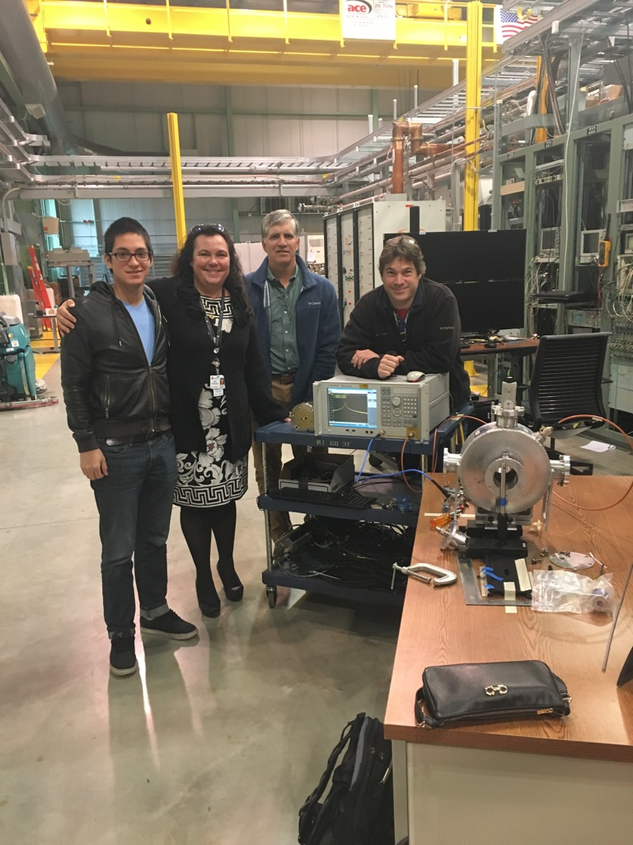
A few of the people working on these systems with us
Aasma Aslam
Sandra Biedron
Trudy Bolin
Dave Caulton
John Cary (Tech-X)
Mark Curtin (ILS)
Jorge Alberto Diaz Cruz
Salvador Isaac Sosa Guitron
Manel Martinez-Ramon
Stephen Milton
John Noonan
Reza Pirayeshshirazinezh
Sam Smith (just finished his Masters) + Many collaborators

Slide 22
A few of our own areas of interest in the research of tools
Collective Effects
Novel RF Devices
LWIR Lasers
HHG sources (not covered today)
Data Science
Control

Slide 23
Computing for design and also needed for control and data analysis
Argonne Leadership Computing Facility (ALCF) and local 20-core cluster
  Our team already has access to THETA at ALCF for highly-parallelized simulations, AI-based model development, and control of large machines and sub-systems.
  Supported by the U.S. Department of Energy’s (DOE) Office of Science, Advanced Scientific Computing Research (ASCR) program, the ALCF is one of two DOE Leadership Computing Facilities in the nation dedicated to open science.
  ALCF is a DOE Office of Science User Facility that helps accelerate the pace of discovery and innovation by providing supercomputing resources that are 10 to 100 times more powerful than systems typically used for scientific research.
  The use of computing centers will only continue to increase for applications of and to particle accelerators
  We recently participated in the AI for Science Town Hall at Argonne and LBL to speak for laser and particle accelerator (and facility) needs.
Slide content courtesy of B. Cerny and M. Papka, ALCF Argonne

Slide 24
Accelerator Science Enabling High Current Energy Recovery Linacs
Applications such as the Electron-Ion Collider, X-rays for NDE, and EUV chip manufacturing
Collective Effects
RF device to help alleviate effects
Electron-Ion Collider – M. Farkhondeh’s at the EIC Accelerator Collaboration Meeting on October 11, 2019, at Argonne National Laboratory.
Electron-Ion Collider – 2020 Office of Nuclear Physics SBIR Topic 33 “Accelerator techniques for an energy recovery linac (ERL) a…novel beam transport methodologies for transporting, merging, injecting, extracting and manipulating…”
NDE – 1. See, for example, Basic Research Needs Workshop on Compact Accelerators for Security and Medicine, May 6 – 8, 2019.
Chip Manufacturing - L. Assoufid et al., 2015, “Compact X-ray and Extreme-Ultraviolet Light Sources,” Optics and Photonics News, July/August 2015, Optical Society of America, 40-47.

Slide 25
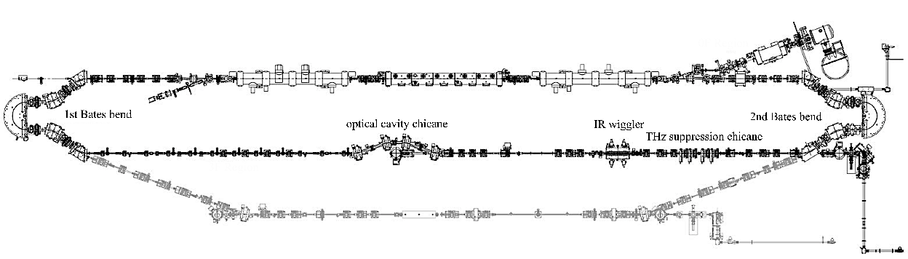
Accelerator Science Enabling future ERLs
Collective effect are rampant in high-current ERLs due to the number of dipoles and the overall ERL architecture – different than in single-pass coherent radiators (e.g. FELs, HGHG) as large
Lack of efficiency and additional effects show themselves in the merge region (red)
Many dipoles
Courtesy S. Benson

Slide 26
Coherent Synchrotron Radiation (CSR)
About those dipoles…
  When deflected by magnetic fields, our electrons will emit radiation
  Radiation is broad spectrum
  Generally assumed all particles are radiating independently, but…..
CSR leads to position-dependent energy loss changes the energy of the different longitudinal slices. In the dipole dispersion leads to different trajectory for each slice. This creates growth of the projected emittance in bending plane.
Incoherent
Coherent

Slide 27
Coherent Synchrotron Radiation (CSR)
Observe 200 W/mA of CSR
In our 2-D modelling we looked at this special case of CSR in an ERL for an FEL but much more work is still needed for the future ERLs as well as in other accelerator architectures
C.C. Hall, et al., Phys. Rev. ST Accel. Beams 18, 030706 (2015).

Slide 28
Coherent Synchrotron Radiation (CSR)
In just the example of an architecture for the EIC, more research required in simulation with 3D codes.
Need to control longitudinal phase space curvature to subsequently control CSR.

Slide 29
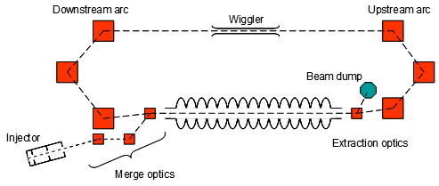
About that merge…
2020 Office of Nuclear Physics SBIR Topic 33 “Accelerator techniques for an energy recovery linac (ERL) a…novel beam transport methodologies for transporting, merging, injecting, extracting …”
Example, an electron beam is accelerated to a nominal 10 MeV, injected into a linac and accelerated to ~100 MeV, transported through two 180 degree arcs, and co-axially merged into the linac for decelerating. This example is based off of the Thomas Jefferson National Accelerator Facility’s ERL free-electron laser (FEL).
Example ERL Architecture
“The Jefferson Lab free electron laser program”, J. Phys. Conf. Ser. 299 012014 (2011).; “The VUV/IR/THz Free Electron Laser Program at Jefferson Lab”, Nucl. Instr. and Meth. A649 9 (2011); Studies for ONR with Lewellen, Milton, and Noonan.

Slide 30
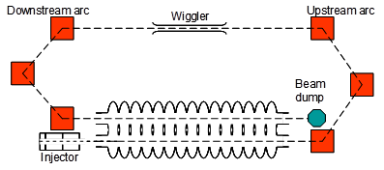
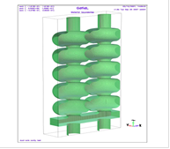
About that Merge
Let’s compare the the 100-MeV electron beam energy ERL example (where the depleted beam would need to be above ~7 MeV. Let’ s for fun say 100-mA beam current, so the external rf power to keep the electron beam at energy is 700 kW). However, if the depleted beam can be reduced to 500 keV, the external rf power required could be reduced to around 50 kW. In addition, the thermal load that must be managed is also reduced - from 700 kW to 50 kW. And no booster is needed.
Need new accelerator devices and new accelerator system architectures
U.S. Patent 9,129,714, Sept 8, 2015; “Dual-Axis Energy Recovery Linac,” 2007 Energy Recovery Linac Workshop, Daresbury, UK; Conceptual design considerations of a 5-cell dual axis SRF cavity for ERLs, proceedings of the SRF 2007 (Peking University, Beijing, China, 2007); 16.; H.K. Park, Superconducting Twin Axis Cavity for ERL Applications, SRF 2017; 2019 Proposal to the DOE as discussed at Argonne EIC meeting 2019.

Slide 31
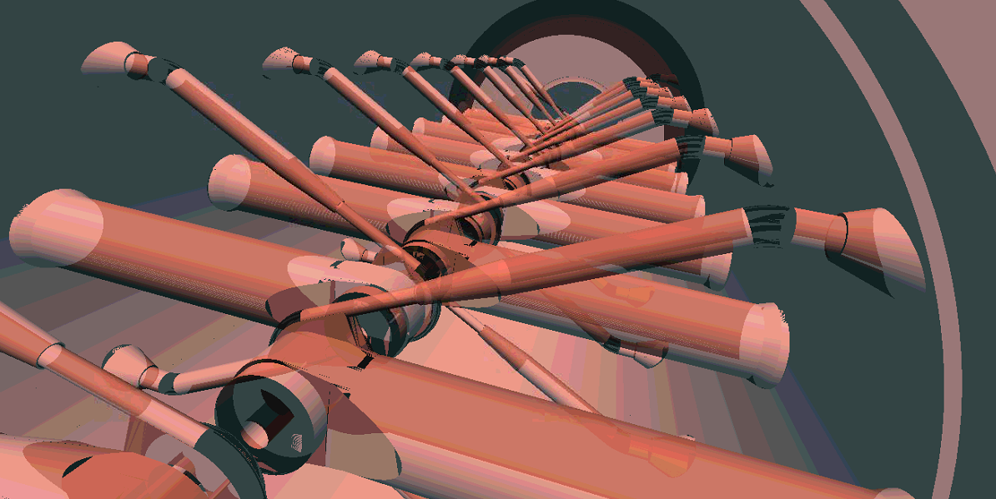
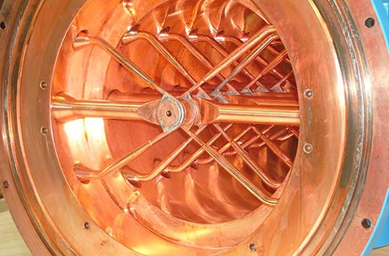
About that Merge
Collaborating with Tech-X and using their code VSim (flexible electromagnetic, particle, and plasma software application.) and using this for the DCC, medical accelerator studies (with Ion Linac Systems) and with LANL on C-band accelerators for future light sources.
VSIM already running on our 20-core and on the ALCF along with our data science tools for activities such as optimization and model building.
Modeling example with Vsim for a different device.
Nieter, Chet, and John R. Cary. "VORPAL: a versatile plasma simulation code." Journal of Computational Physics 196.2 (2004): 448-473; https://www.txcorp.com/vsim

Slide 32
Next steps:
  Planning to finalize the design of the DCC with Vsim and the suite of data science tools
  Fabricate the NCRF version at Meyer Tool and Manufacturing in Oak Lawn, IL (Eileen Cunningham)
  Test at the Argonne Wakefield Accelerator at Argonne (John Power)

Slide 33
Long-Wavelength IR Lasers
Why is research needed?
Areas of research application includes:
  laser-induced plasma interactions,
  atmospheric propagation and filamentation,
  generation and study of collisionless shockwaves,
  particle and photon beam generation,
  Self phase modulation effects,
  surface wave acceleration,
  atmospheric detection of cloud phase, dust and volcanic ash,
  LIDAR,
  inverse free-electron lasers,
  laser wakefield acceleration,
  and high-harmonic generation.

Slide 34
Long-Wavelength IR Lasers
Why needed?
The Accelerator Test Facility has a very successful LWIR program based on their CO2 and other laser expertise. The ATF is the only one user facility and test bed in the U.S. with an LWIR laser development.
Well on their way to a
10+ TW, <1 ps, match to ATF e-beam
Slide content Misha Polyanskiy

Slide 35
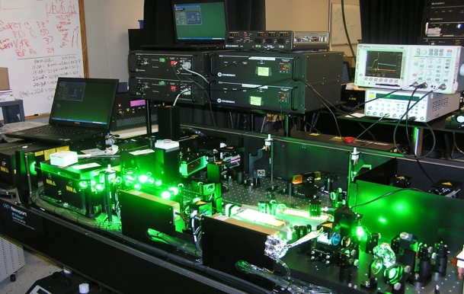
Long-Wavelength IR Lasers
Other approach we are launching
Finalizing the architecture of a novel tunable LWIR laser (8-14 microns) for test
+
Existing fs-Ti:Sapphire laser operating at a 1KHz. The 800-nm, 40-fs, 30-mJ pulse will drive a non-collinear optical parametric amplifier (NOPA)
LWIR pump options using the L1-ALLEGRA (courtesy of B. Rus for ELI)
With our test configuration, we hope to demonstrate the laser architecture concept for tunability 8-14 microns at 1TW peak and 100 W average power with scalability to higher powers. New and improved optical materials will help us push to higher peak and average powers.

Slide 36
Long-Wavelength IR Lasers
Why needed? A couple of examples.
Many discussions over the past few years with “accelerator” folks for laser-driven accelerators and particle generation rand with Bob Rosner for astrophysics in the (smaller) lab possibilities.
This is a delicate balance that we are exploring. LWIR laser sources are interesting due to the very large increase of the ponderomotive forces acting on the electron plasma density: F_{p} ∝ ∇I /mω².
  In comparison with the traditional, 1-μm laser sources, F_{p} increases, assuming a similar intensity gradient, up to a factor of 10² or more due to the wavelength.
  On the other hand, the larger the laser wavelength, the larger the diffraction limited focal spots.

Slide 37
Example of UHI lasers for astrophysics
In Grassi’s recent paper from 2017, for instance, they showed using PIC codes the possibility to efficiently drive the ion Weibel instability in the collisionless regime on UHI laser facilities. They identified the optimal experimental configuration as linear S-polarization at oblique incidence. This would stabilize the surface instability reducing the hot electron production. This configuration, is shown to potentially lead to Weibel-mediated collisionless shocks.
Also Chaojie Zhang presented thoughts on the “Probing Weibel instability in CO₂ ionized plasmas using ultrashort electron beams” at last week’s ATF science planning meeting.
F. Fiuza, R. A. Fonseca, J. Tonge, W. B. Mori, and L. O. Silva, Phys. Rev. Lett. 108, 235004 (2012); A. Grassi, ” Radiation-Pressure-Driven Ion Weibel Instability and Collisionless Shocks,” https://arxiv.org/pdf/1705.05402.pdf and references therin.

Slide 38
More LWIRs

Slide 39
Compact accelerators needed as analytical probes
Ultrafast electron and photon probes for material science as an indirect result of compact advanced accelerator R&D was stressed by Eric Colby at last week’s ATF science planning meeting. (Like the outcomes of the BRN for compact accelerators for security and medicine.)
Along with thinking about future lasers for particle source production, we are also thinking about how to generate smaller coherent light sources.

Slide 40
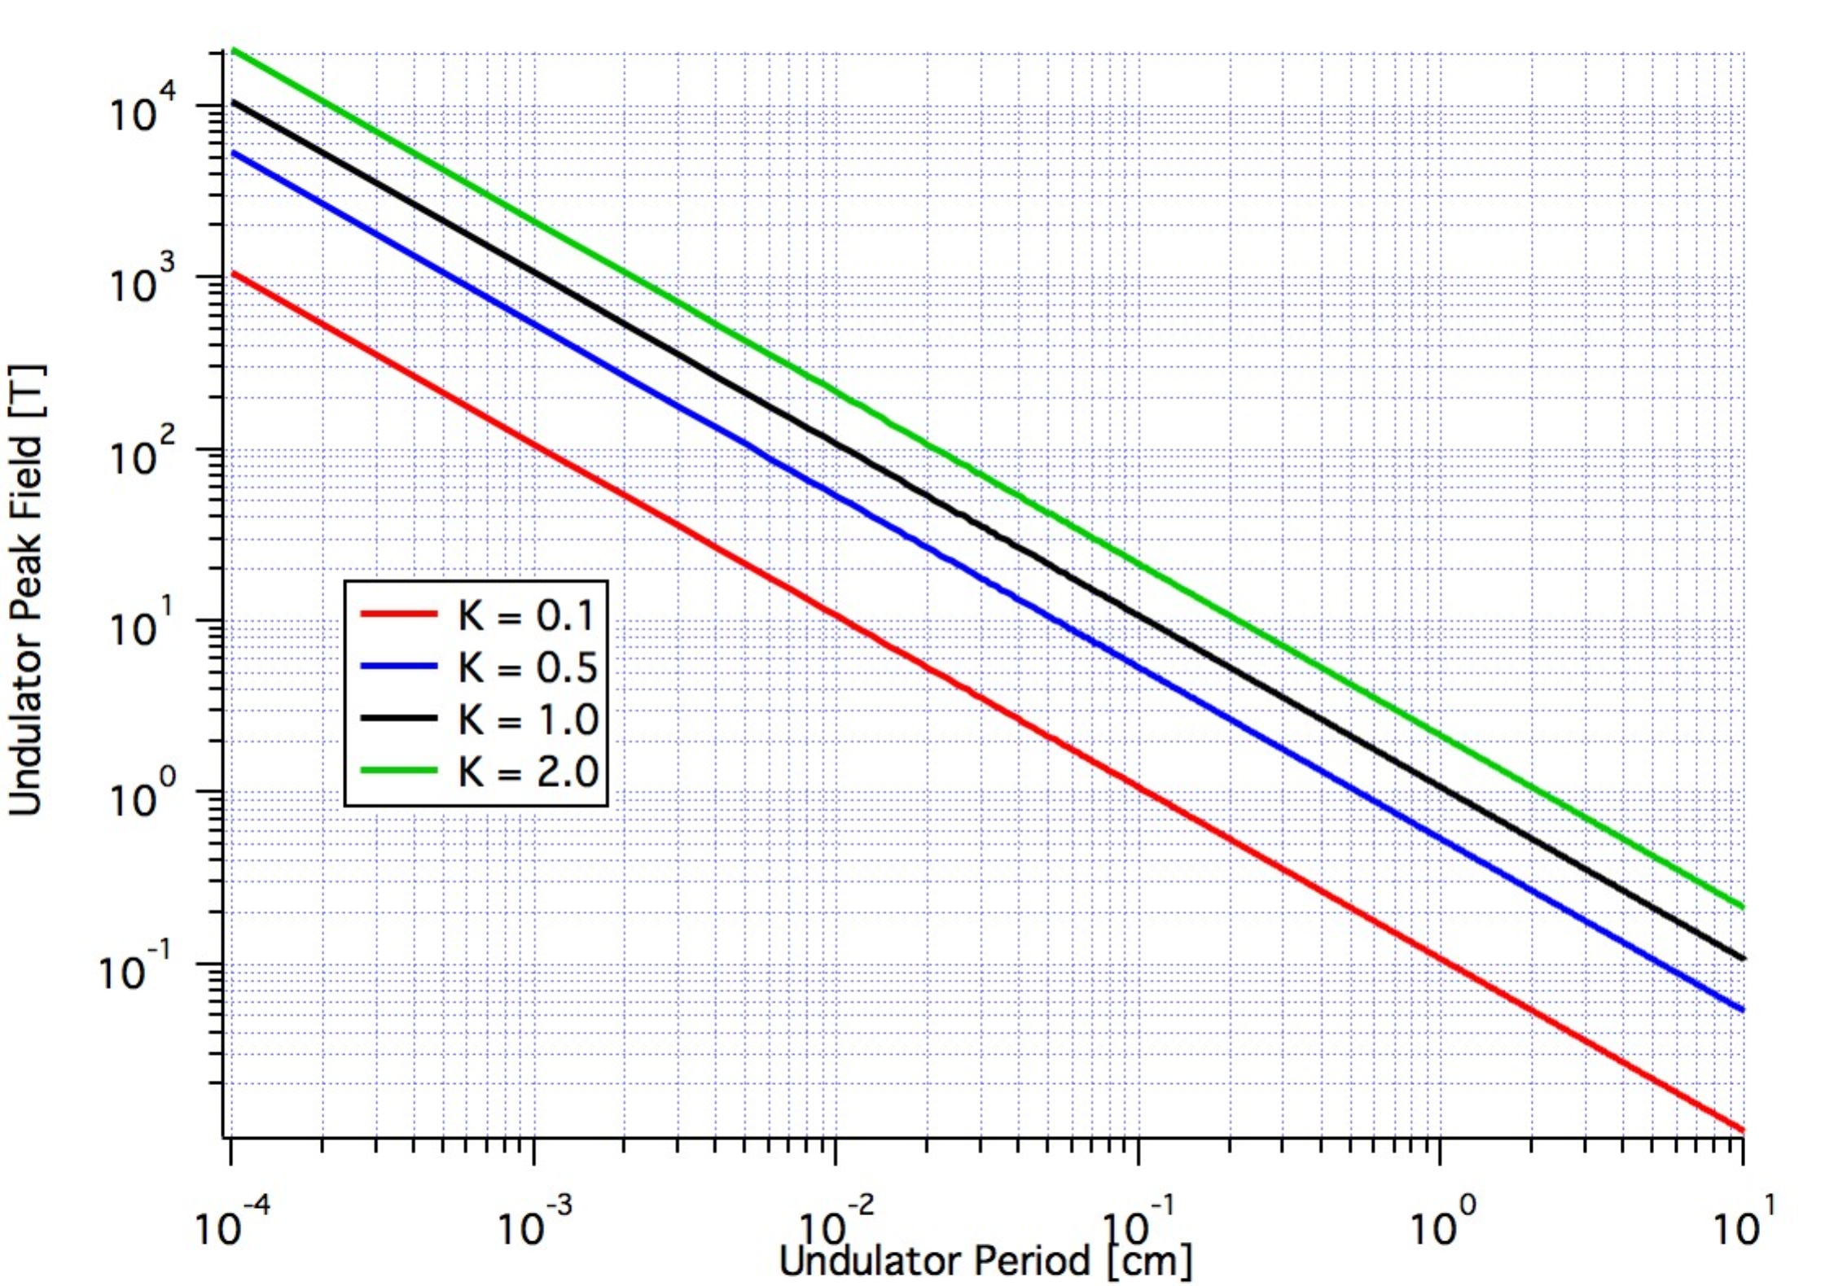
Some Basics
Conventional Undulators

Slide 41
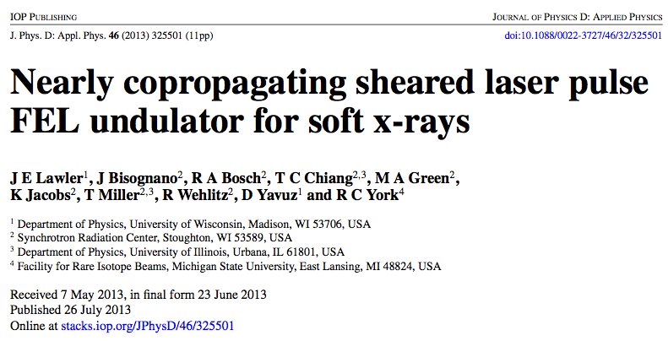
Copact Light Sources
See the following and references contained within

Slide 42
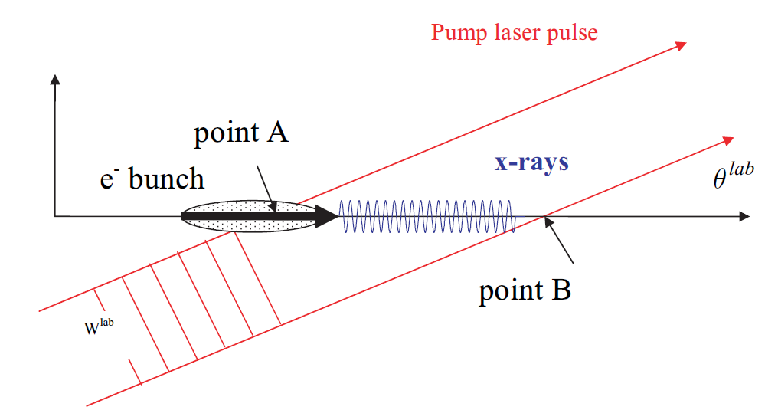
A Laser-Based Undulator
Basic “resonant” equation

Slide 43
A Laser-Based Undulator
The above equation reduces to
Further it can be shown that the K value is Lorentz invariant
  This is merely a statement that the total number of photons in a period does not change when one moves to another moving reference frame

Slide 44
The Problems
Head on collision
  If the goal is soft x-rays, say 1 nm, and the laser wavelength is 800 nm then the energy of the beam is roughly 7 MeV
    This is too low an energy to get good emittance and good peak current, necessary components to achieve FEL gain
  Use instead a crossing angle and subsequent higher beam energies
Laser Pulse Length
  Typical meaningful lasers in the sense that they have sufficient power to generate meaningful K values, i.e. a laser, have very short pulses
    The “Undulator” has very few periods (10 – 20)
    A crossing angle makes matters worse as the beam only “collides” with a few of these

Slide 45
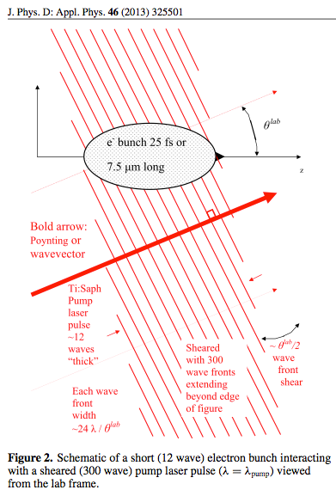
Small coherent light sources
Laser Undulator
“Shear” the laser pulse
This has the effect of making the few period long optical pulse look to the beam like it is composed of many periods.

Slide 46
A compact light source
Use a laser as the undulator, but shear it with a grating in a manner that effectively creates many more wavefronts than there were originally (30 goes to 300 or more)
Cross the beam and “undulator” at an angle that overlaps the many undulator periods with the beam and also increases the effective wavelength of the laser by a factor of 100 or more.
Combined with a very high brightness electron beam this process provides the opportunity to create a functional short wavelength FEL at historically low electron beam energies.

Slide 47
A compact light source
Supposing a 100-MeV beam, a K-value of 1, a standard planar undulator period of 1cm, and an angle of pi/5, radians, we find that a planar undulator has an output frequency of ~783 nm, while the sheared-pulse geometry can achieve output radiation on the order of ~3.3 Å.
3D results expected soon!
S. Milton, J. Einstein, and S. Biedron, 2016, “1D FEL Simulations Utilizing Laser Undulators,” In: High-Brightness Sources and Light-Driven Interactions, Proceedings of the Compact (EUV & X-ray) Light Sources Conference, OSA technical Digest (online), Optical Society of America, paper ET3A.3.

Slide 48
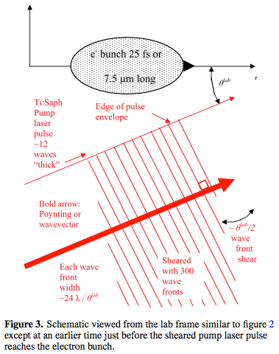
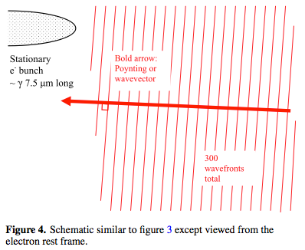
The “Beam’s” View
Lab Frame
Electron Rest Frame

Slide 49
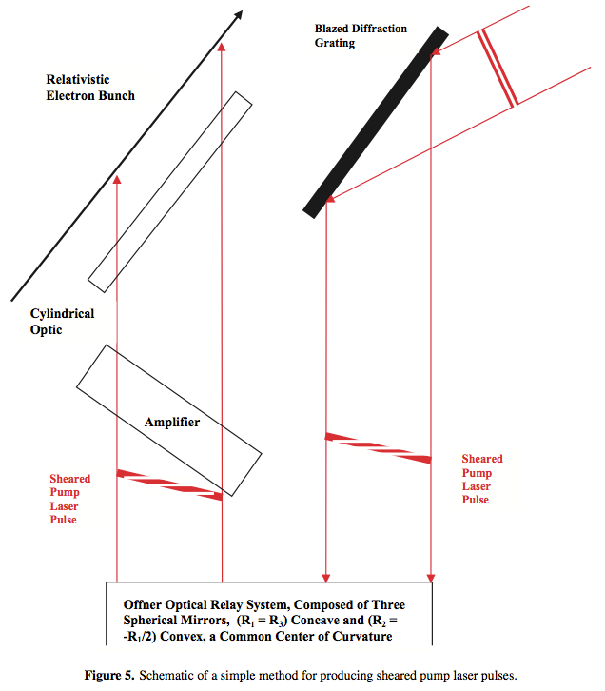
One Possible Way to do This

Slide 50
Another example
Use SPARC and FLAME as an example to discuss
Attempt to get gain
  Even if we do not have the electron beam or laser quality required for gain we should be able to measure an increase in the spontaneous emission due to the sheared beam
Use modest parameters
  75 MeV
  0.014 radian crossing angle (1.4 cm/m)
    Very small so that we are at a relatively long resonant wavelength
  150 nm
    Limit of sapphire transmission

Slide 51
Potential Problems
Electron Beam
  No real foreseeable true problems as the beam quality is already quite good.
Laser
  Achieving a high quality shear
    And being able to verify this
  Near field vs. far field questions about the shear
  The “dilution” of the K value due to the shearing process
  The variation of the K value due to the variation of the laser intensity as a function of time
  The unknown unknowns etc.

Slide 52
Compact Light Source
This is an untried concept to achieve FEL operations at significantly lower electron beam energies for a given desired output wavelength.
One might be able to reach soft x-ray and possibly even hard x-ray wavelengths with systems that could potentially be 1/10 the size of existing system and comparably lower in costs.
We are trying implement this new concept of using a sheared laser pulse co-propagating with the electron beam an an existing system at a wavelength that would be simple enough to characterize yet be significant enough to truly show the power of the method.

Slide 53
References
Chang, et al. “High-Gain Thompson-Scattering X-Ray Free-Electron Laser by Time-Synchronic Laterally Tilted Optical Wave.” PRL 110, 064802 (2013)
Lawler, et al. “Nearly copropagating sehared laser pulse FEL undulator for soft x-rays.” J. Phys. D: Appl. Phys. 46 (2013) 325501 (11pp)
Li, et al. “Phase retrieval using a modified Shack-Hartmann wavefront sensor with defocus.” Applied Optics Vol 53, No 4. 1 February 2014.
Meshulach, et al. “Adaptive ultrashort pulse compression and shaping.” Optics Communications 138 (1997) 345-348
Peng, et al. “Adaptive control of wavefront and phase of beam in a Ti:sapphire femtosecond laser.” Adaptive Optics and Applications III. Proceedings of SPIE Col. 5639
Xu, et al. “Pulse shaping of octave spanning femtosecond laser pulses.” Optics Express Vol 14 No 22 20 October 2006

Slide 54
Harnessing data science for better understanding of analytical tools
Design of entire experiment, control, and data analysis
Knowledge of where the data originates (in data science terms “its domain”)
Exploratory data analysis
Mathematics
Statistics
Visualization
High performance computing
Specialized computer hardware – FPGAs, application-specific integrated circuit (ASIC), including tensor processing units (TPUs), neural engines
Etc…

Slide 55
Simple view of data science

Slide 56
Models
GOAL
is to make identical
DEVICE (SYSTEM)
Operation, controls, maintenance records, etc.
DATA SCIENCE
HPC
There can be a data exchange process that begins from the first principles simulations and eventual model of a device with the behaviour and control of the device if well monitored can improve the model continuously through data science.
Tech-X’s VSim engineering and physics models courtesy of Salvador Sosa

Slide 57
High Energy physics
Employing AI/ML algorithms has demonstrably sped up calculations (e.g. one million times for analysis of strong lenses) and produced clear cost-savings (30% increase in effective detector volume for neutrino flavor tagging with neural networks).
These faster algorithms enable accelerated science, and in some cases they lead to paradigm shifts: in situations where it once required one day for a human to analyze a single object.
Also see a recent talk/work by Gabriel Perdue (FNAL) -> next chart
Y. D. Hezaveh, L. P. Levasseur, and P. J. Marshall, “Fast automated analysis of strong gravitational lenses with convolutional neural networks,” Nature, vol. 548, pp. 555–557, Aug. 2017; P. Adamson et al., “Constraints on oscillation parameters from ne appearance and nμ disappearance in nova,” Phys. Rev. Lett., vol. 118, p. 231801, Jun 2017. [Online]. Available: https://link.aps.org/doi/10.1103/PhysRevLett. 118.231801; M. A. Acero et al., “New constraints on oscillation parameters from ne appearance and nμ disappearance in the nova experiment,” Phys. Rev. D, vol. 98, p. 032012, Aug 2018. [Online]. Available: https://link.aps.org/doi/10.1103/PhysRevD.98.032012
Courtesy Jim Amundson

Slide 58
Courtesy Jim Amundson

Slide 59
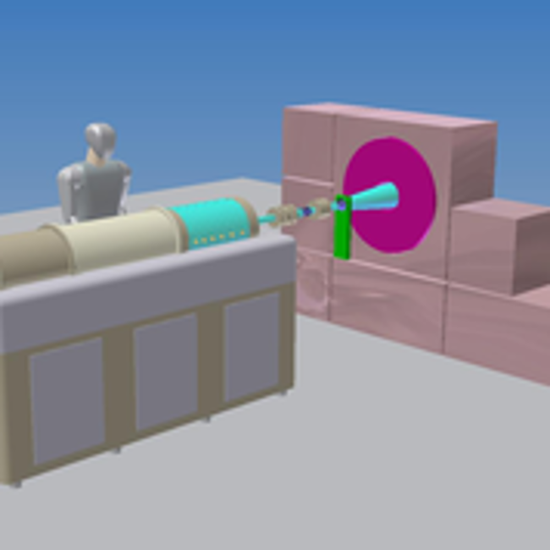

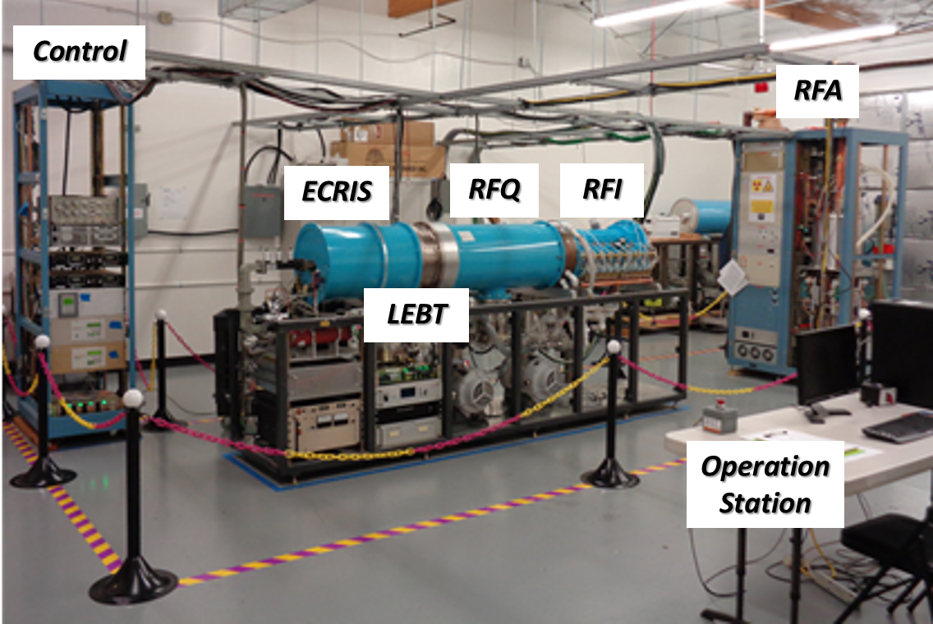
Intelligent Controls for Medical Accelerators
ILS has developed a medical linac for cancer therapy based on the Neutron Capture nuclear interaction:
  Cancerous cells are tagged and then radiated with a beam of (slow) epithermal neutrons.
The NC process releases a large radiation dose within a micrometer range, i.e. no radiation damage to healthy cells.
NC has a small cross section. A high-flux of neutrons is then required to maximize the number of NC interactions
  The linac needs to be controlled to produce and hold steady a high-current proton beam for producing neutrons.
Scheme for BNCT cancer therapy with ILS accelerator.

Slide 60






Intelligent Controls for Medical Accelerators
AI controllers can help the linac operate in an optimal configuration that, as one example, maximizes beam current.
A Neural Network (NN) can help find the a very good suite of set-points for a set of requirements based on the available diagnostic instrumentation readouts.
The NN can adjust the machine online provided (e.g. pre-trained offline).
The NN can be trained with large amounts of data from two sources:
  Recorded data from operations and experiments.
  Generated data from first principles simulations.
$$x_{1}$$
$$x_{2}$$
Input the readouts from instruments
$$y_{1}$$
Output the optimal setpoints
$$x_{3}$$
…
…
…
…
$$y_{2}$$
$$x_{n}$$
Hidden layers
This technology has the potential of making medical accelerators more affordable and efficient.

Slide 61
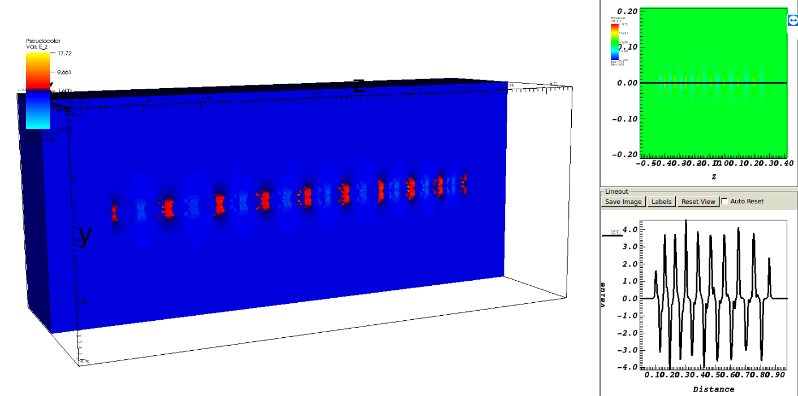
Intelligent controls for Medical Accelerators
Production of training data using electromagnetic and PIC simulation software VSim10.
Scanning the parameter space assuming numerous injected beams, which depend on ion source and LEBT configurations:
  Hydrogen flow
  Power supplies
  Water temperature
  RGA data
  Vacuum levels, etc.
  Target material, condition etc.
Propagate numerous beams and determine optimal machine states being used as training data for the NN controller.
Use of HPC (THETA at the Argonne Leadership Computing Facility) in order to generate thousands of training points.
VSim10 model and actual picture of the ILS linac accelerating RF structure.
VSim10 simulation of the longitudinal E-field along the axis of the RF structure.
Tech-X’s VSim engineering and physics models courtesy of Salvador Sosa

Slide 62
for LLRF and Resonance Control Systems
LLRF and Resonance control is an important element to achieve desired beam quality.
Phenomena affecting the field stability include:
  Microphonics
  Lorentz force detuning
  Thermal acoustic oscillations
  …
  All need to be compensated by the LLRF!
Effects are both non-linear and difficult to characterize, making Neural Networks one of several promising methods to improve existing control.
O. Kononenko, 3D multiphysics modeling of superconducting cavities with a massively parallel simulation suite. PRAB, 2017
Courtesy Jorge Alberto Diaz Cruz
Active Resonance Control developed at Fermilab for TESLA cavities

Slide 63
for LLRF and Resonance Control Systems
We are exploring intelligent techniques as a tool to improve performance of existing LLRF and resonance control systems.
Simulations are performed to create data for training of Neural Networks. (Eventually to merge with experimental data.)
Gaussian processes, genetic algorithms and Neural networks are all part of the artificial intelligence framework under test.
Courtesy Jorge Alberto Diaz Cruz; NAPAC2019, LLRF, ICALEPS

Slide 64
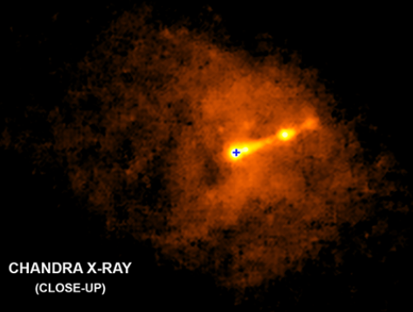
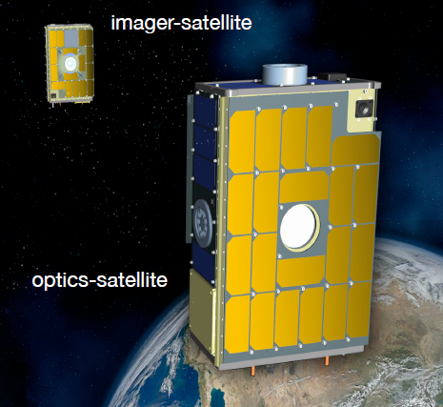
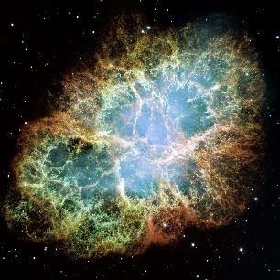
Virtual Telescope for X-Ray Observations (VTXO)
A telescope made up of 2 separate satellites in 2 different orbits
Accuracy requirements are sub-arcsecond relative attitude accuracy and 1 mm relative position accuracy
Approximately 1 hour observing the Crab Nebula
Applications
1) Investigating the nature of space (Like dark matter)
2) Covering the Sun (To see planets and stars behind it)
3) Understanding more about black holes
4) Detecting space phenomena like star collisions
5) Finding other life forms
An example of X-Ray observation
Imager
Virtual Telescope
Optics
Optics
Imager
Earth
Pirayesh, Reza, et al. "Deep learning and Gaussian process approach for optimal attitude control of a Two-CubeSat Virtual Telescope." SmallSat 2019).
Courtesy Reza Pirayesh

Slide 65
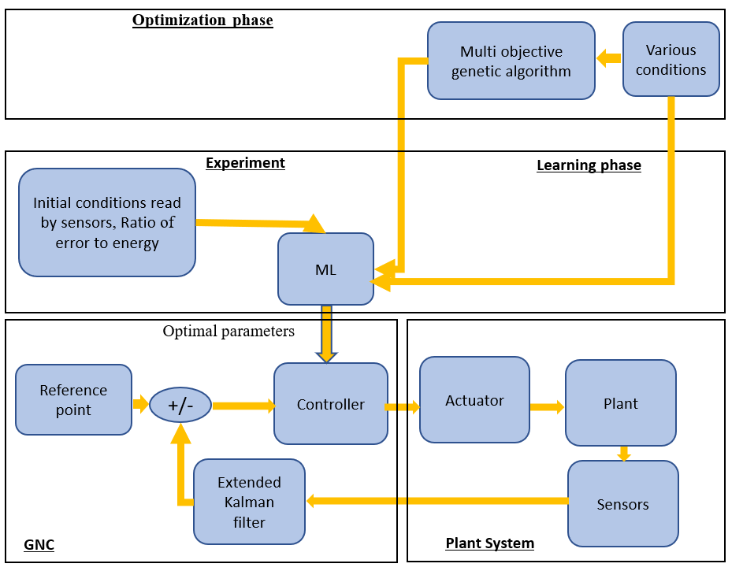
Virtual Telescope for X-Ray Observations(VTXO)
Applying more sensors and sensor fusion algorithm
Develop artificial intelligence algorithms to decrease the error in pointing to the targets in space
Combining relative position control and attitude control algorithms to increase the performance of the formation flying control system
Energy
Gaussian processes
Confidence interval
Initial conditions, Error
Performance
Deep learning
Optimal parameters
Courtesy Reza Pirayesh; Small Sat, ICALEPS

Slide 66
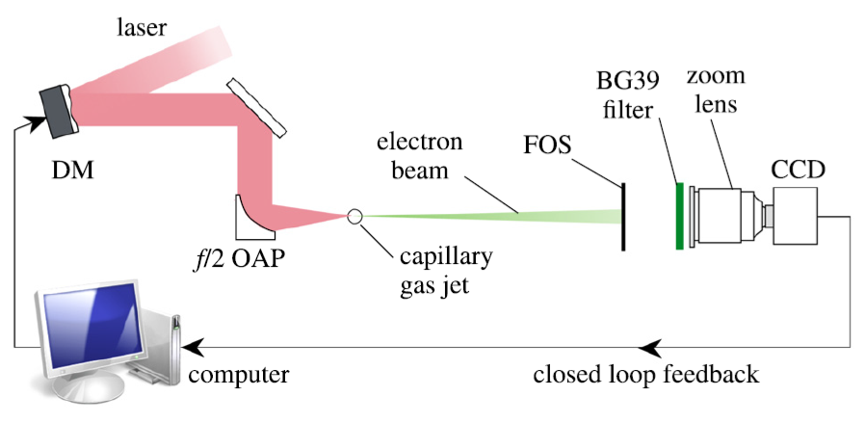
Coherent control of plasma dynamics in a laser wakefield electron acceleration experiment
The first input of the genetic algorithm under open-loop conditions and the corresponding final output of the genetic algorithm will be used as input and relevant output respectively to train the neural network.
Output for training
Input for training
CNN Architecture
Convolutional Neural Networks take advantage of local spatial coherence in the input (often images), which allow them to have fewer weights as some parameters are shared.
This process, taking the form of convolutions, makes them especially well suited to extract relevant information at a low computational cost.
Courtesy A. Aslam, research with the University of Michigan (Thomas, Krushelnick)

Slide 67
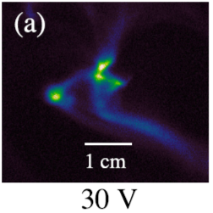

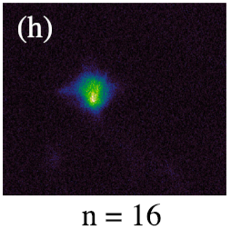
Coherent control of plasma dynamics in a laser wakefield electron acceleration experiment
V1
V2
:
V37
CNNTraining
Deformable Mirror
The first input of the genetic algorithm under open-loop conditions and the corresponding final output of the genetic algorithm will be used as input and relevant output respectively to train the neural network.
Courtesy A. Aslam, research with the University of Michigan (Thomas, Krushelnick)

Slide 68
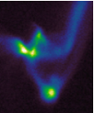

Coherent control of plasma dynamics in a laser wakefield electron acceleration experiment
Input Layer
Fully Connected Layer
Convolutional Layers
Output Layer
Once trained successfully, much faster, and easy to implement.
Can be improved evolutionary while being used as a feed-forward control.
Most of the real-world problems have non-linear and complex relationship between input and output and NNs have ability to learn and model such relationship.
32
1
1
V1
V2
:
:
V37
2
2
32
n
n
Courtesy A. Aslam, research with the University of Michigan (Thomas, Krushelnick)

Slide 69

Optimal formation flying control of a Virtual Telescope for X-Ray Observations
- A telescope made up of 2 separate satellites in 2 different orbits
- Sub-arcsecond relative attitude accuracy with1-mm relative position accuracy
- Approximately 1 hour observing the Crab Nebula
- We ae designing the control system to do formation control on the 2 satellites to provide the given accuracy
- Various machine learning algorithms, sensor data fusion algorithms, and control algorithms are used to provide the high accuracy with the lowest energy.
An example of an X-Ray observation
Virtual Telescope
Optics
Optics
Imager
Pirayesh, Reza, et al. "Deep learning and Gaussian process approach for optimal attitude control of a Two-CubeSat Virtual Telescope." SmallSat 2019).
Imager
Earth
Reza Pirayeshshirazinezh, UNM Lead

Slide 70
Lots of applications of analytical tools
Many of the individuals involved with the applications examples I outlined have long-term wishes for more efficient, more compact analytical tools.
The science within the tools must be researched to help us design the the next generation research tools.
Collective effects, novel RF structures, lasers that themselves enable science as well as the generation of other anlaytical tools, and data science (HPC, AI, hardware) are pathways there.

Slide 71
One medical application before I wrap up
The second is serious example of the present impact of the analytical tools we have developed (and why we need to keep pushing on the research of the tools themselves).

Slide 72
Michigan Story Two
The video you are about to see speaks for itself
https://drive.google.com/file/d/0BzwnSZnaqjRZWUQ4V1BVcFcyeUU/view
Video courtesy of Fermilab
Again, never underestimate the impact that your work can have in ways that you might now have imagined.
Cheaper, more compact devices with great controls can enable more people to be treated.

Slide 73
Just a bit of background on the Loma Linda machine
Lee Teng designed the Loma Linda machine.
Lee Teng worked with Enrico Fermi and other UChicago colleagues with the design and operation of the Chicago Cyclotron.
Lee Teng was at one time my supervisor and mentor at Argonne.
My cousin was able to thank Lee and others at Fermilab personally for

Slide 74
Closing thoughts
Much exciting research still lies in the systems required to architect and operate analytical tools for discovery and many applications.
All of us in this room are people who use their unique and diverse skill sets to develop analytical research tools. Maybe we need to think even harder together of these tools as a (research) system to make transformational leaps. The architecture of these tools and their applications has history in Fermi’s teams in which multi-disciplinary involvement is necessary for doing science and applications.
Use the bui
Thanks again for the invite to visit today.

Slide 75
Accelerator encompasing Earth
Maybe Enrico Fermi actually just meant by his accelerator encompassing the Earth idea that accelerators (and other analytical research tools) would in a figurative way encompass the Earth.
Figure courtesy University of Chicago

Slide 76
Questions?
Thanks for your attention!
biedron@unm.edu

Slide 77
Backup charts

Slide 79
Energy Loss: Critical-Compression

Slide 80
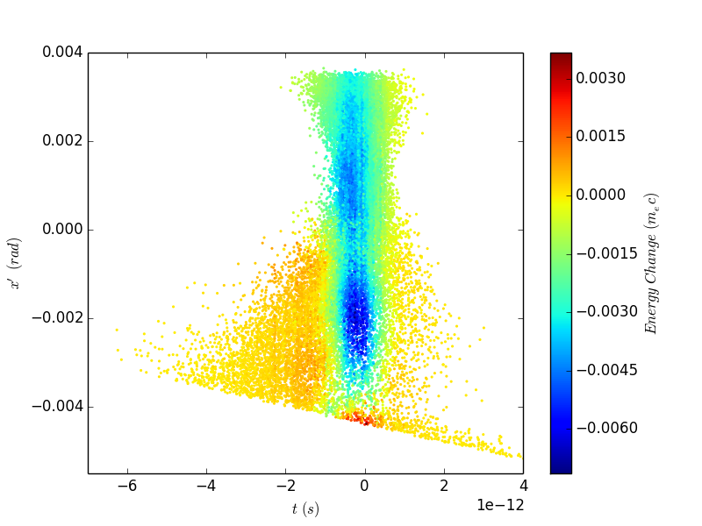
Energy Change in x’-t
i
i+1
(x’,t)
Particle coordinates
plotted for the i’th simulation step
Energy change calculated from E_{i+1}-E_{i}

Slide 81
Energy Loss: Over-Compression

Slide 82
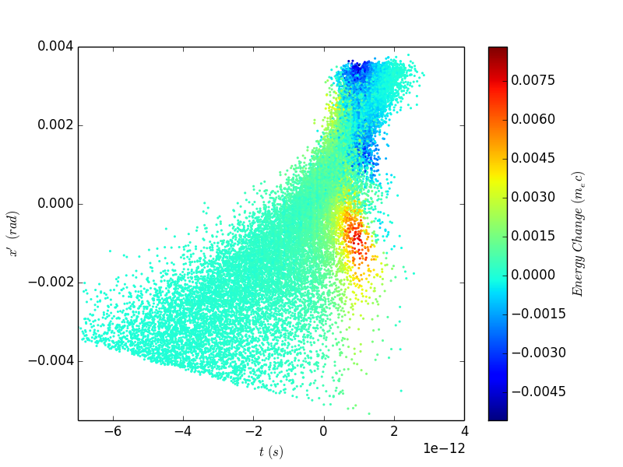
Energy Change in x’-t
i
i+1
(x’,t)
Particle coordinates
plotted for the i’th simulation step
Energy change calculated from E_{i+1}-E_{i}

Slide 83
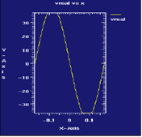
About that merge
The calculated fields of the side-coupled cavity show good coupling between cavities, small distortion of fields at the inner cavity wall, and a flat peak field, which should minimize the beam-beam instability.

Slide 84
Modern Analytical Devices, cont.
Nonlinear optics experiments at FERMI@Elettra.
Here we see an observation of second harmonicgeneration from a graphite film. Since the SHG signal can come only from non-centro-symmetric materials, the intensity is produced only by the surface’ss layers. Doingabsorption (XAS) measurements can reveal the information on the electronic and geometric structure with single atomic layer sensitivity. This is the same for interfaces.
Courtesy
Claudio Masciovecchio

Slide 85
Modern Analytical Devices, cont.
Courtesy Carl Willis

