Slide 1
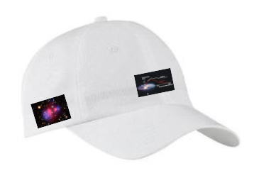
Center for Axion and Precision Physics
9 May 2014
AKPA meeting, University of Chicago
Yannis K. Semertzidis
CAPP: a completely new IBS center at the KAIST campus
Strong CP-problem
Axion dark-matter experiment; solar axions
Proton Electric Dipole Moment experiment
Muon g-2 experiment, …

Slide 2
CAPP’s mission is to seek answers in two of the most important physics questions today:
What is the dark matter that holds the stars together within the galaxies, and the galaxies together within clusters of galaxies? Are axions part of the dark matter?
What is the answer to the matter-antimatter asymmetry mystery of our universe?

Slide 3
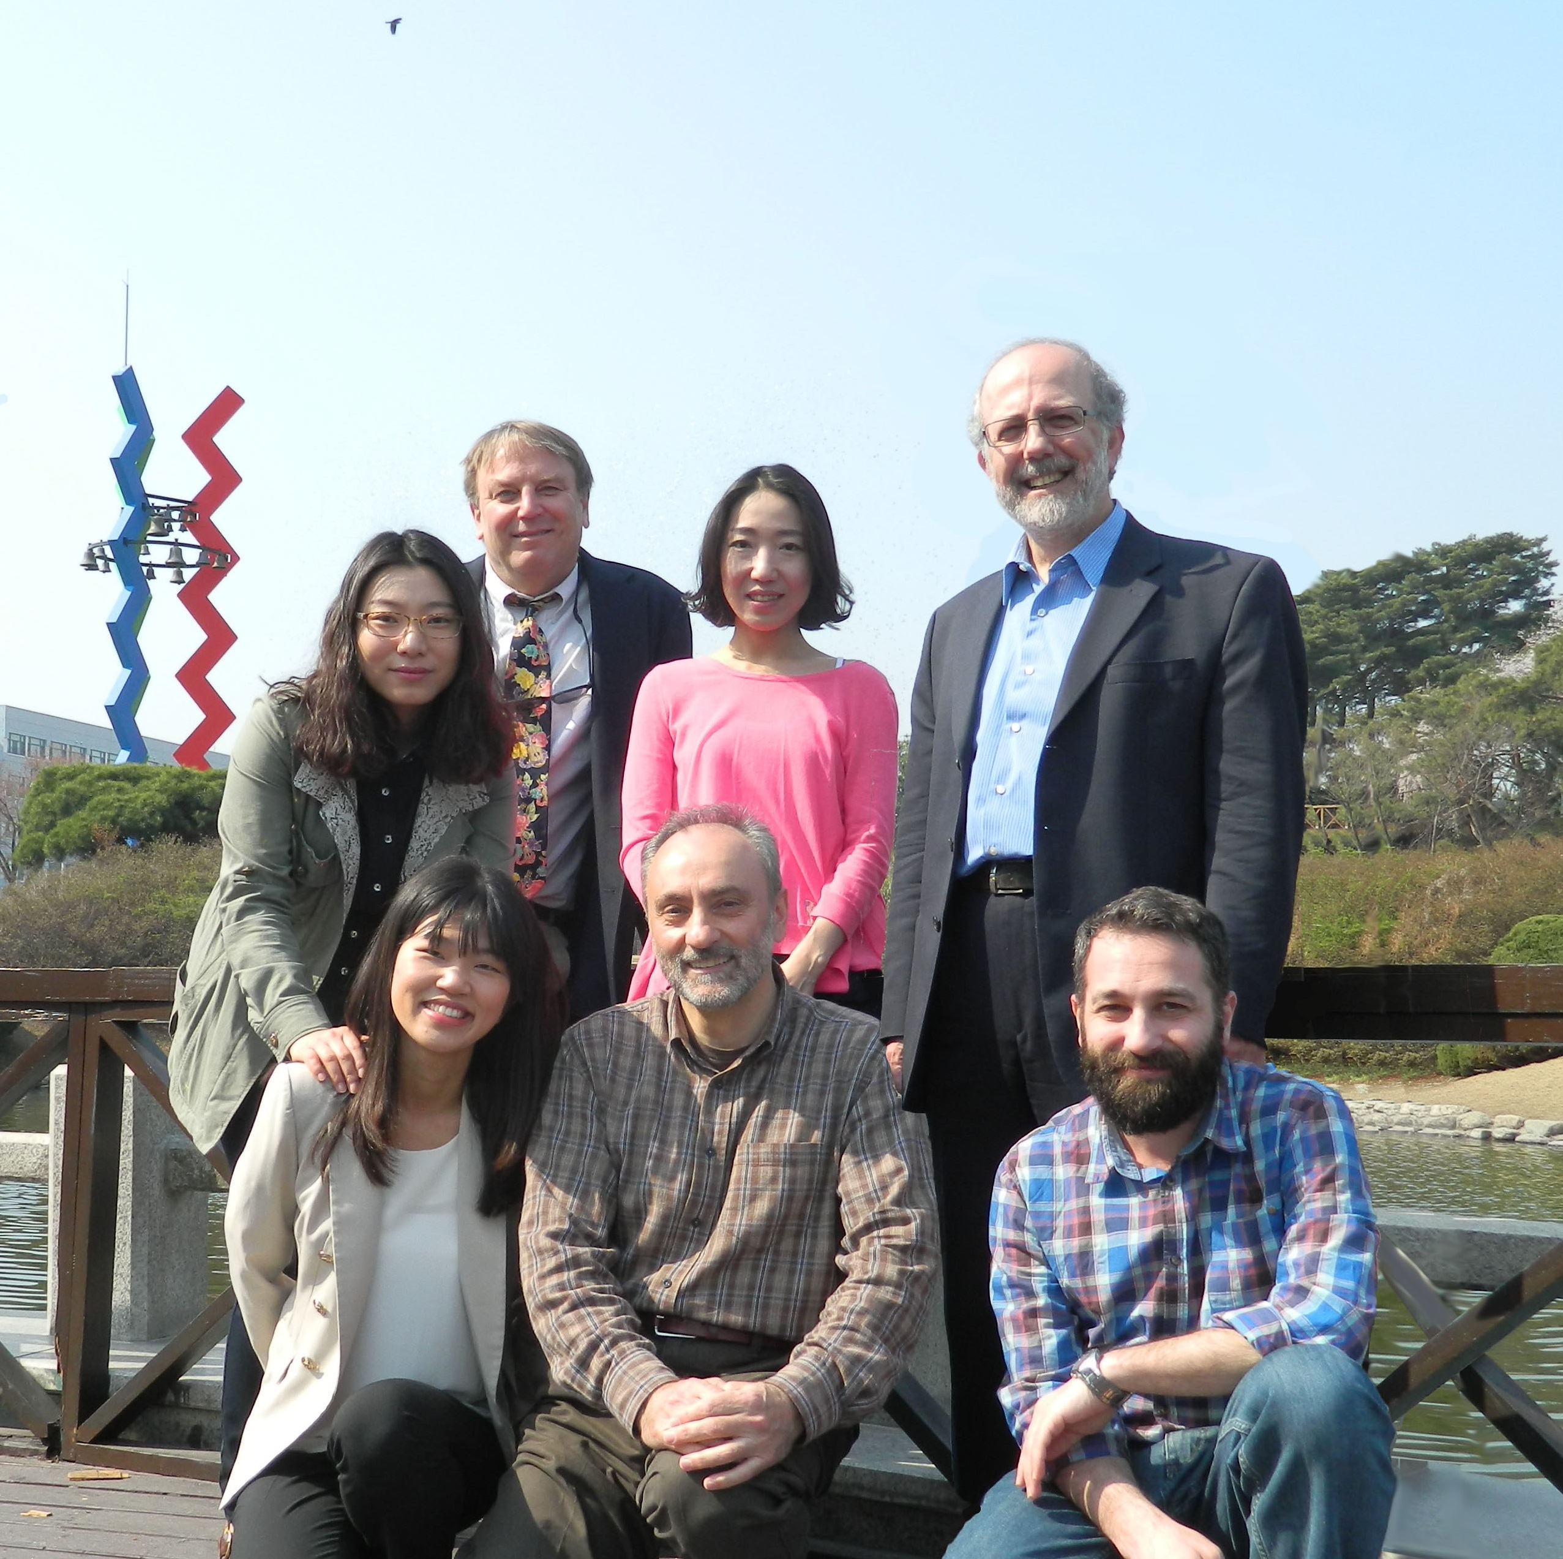
Axion dark matter hunters
Recent (CAPP axion-dark matter group, 2014)
Hired two more Research
Fellows and more are
joining soon…
Our ambition: Two theory
positions plus post docs
in cosmology/dark matter

Slide 4
CAPP’s lab space at KAIST (CAPP is a “green-field” center)

Slide 5
Fundamental Symmetries
P-parity: Symmetry over mirror reflection
C-charge: Symmetry of particles/anti-particles
T-time: Symmetry over direction of time
Fundamental symmetries guide the theories describing the
particle interactions and our world.

Slide 6
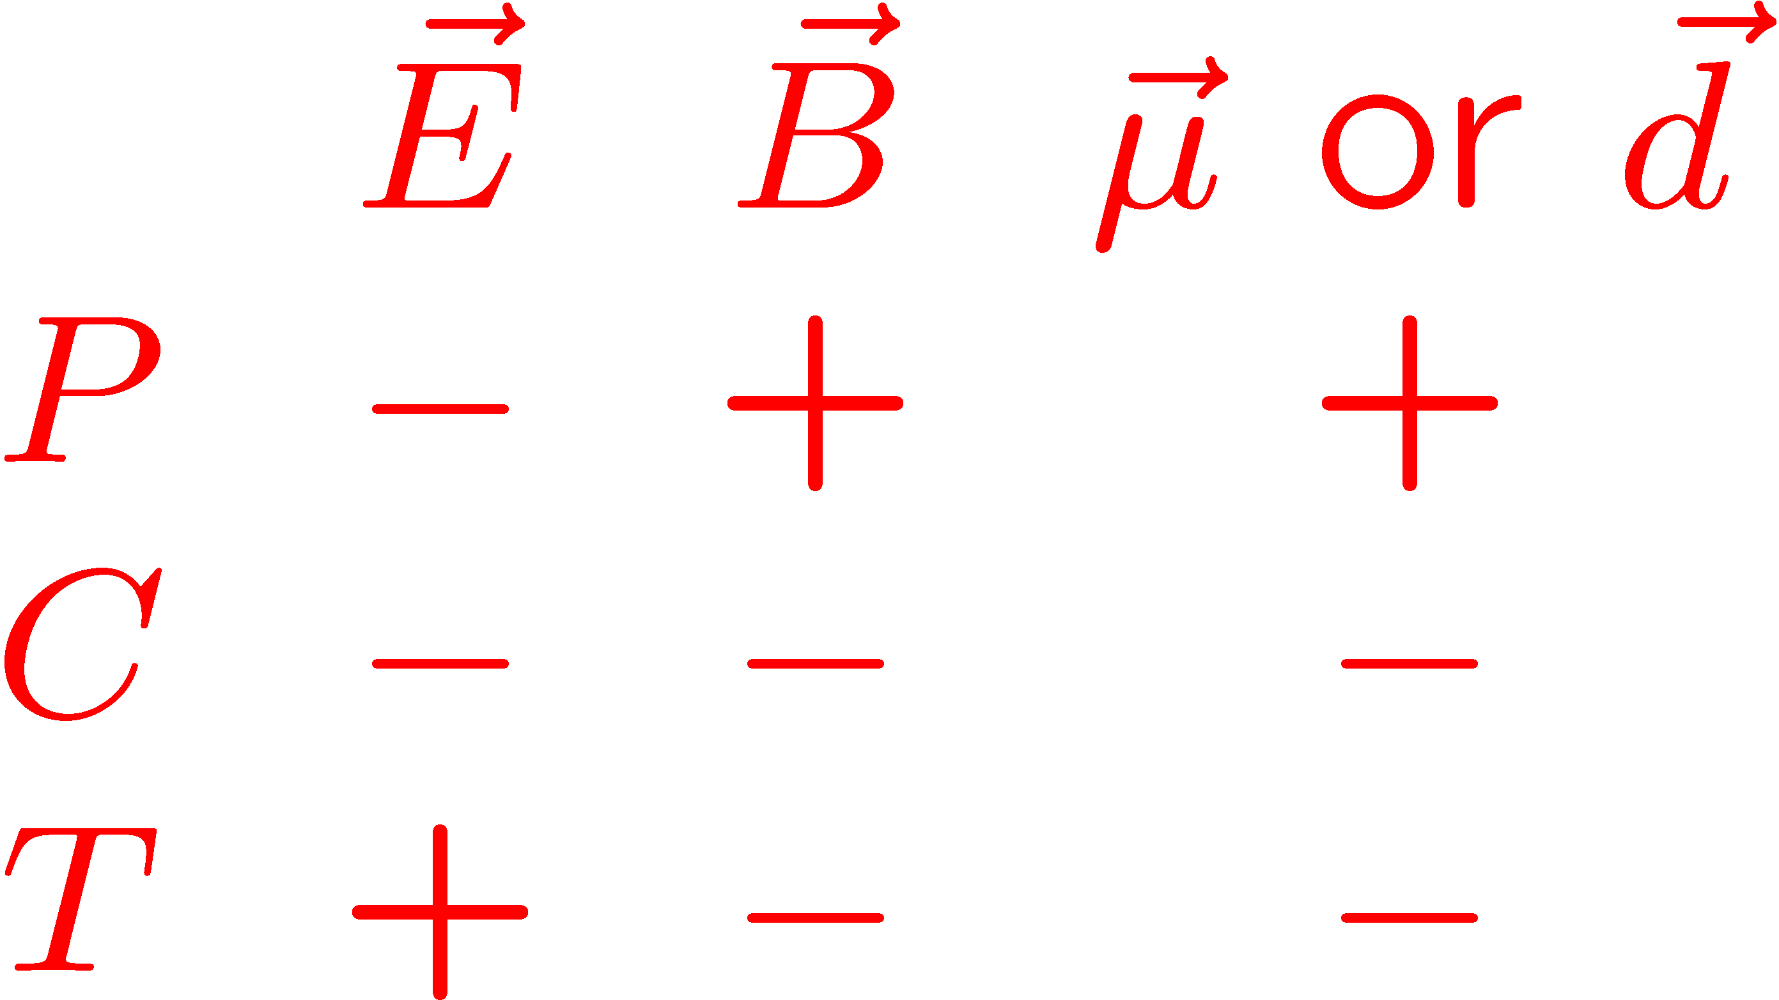
Electric Dipole Moments ( ): P and T-violating when is parallel to spin .
The Magnetic Dipole Moments of particles with spin are allowed in physics and are observed to be large. The EDMs violate both P and T-symmetries and are found, so far, to be compatible with zero. From CPT symmetry conservation, T-violation means CP-violation as well.

Slide 7
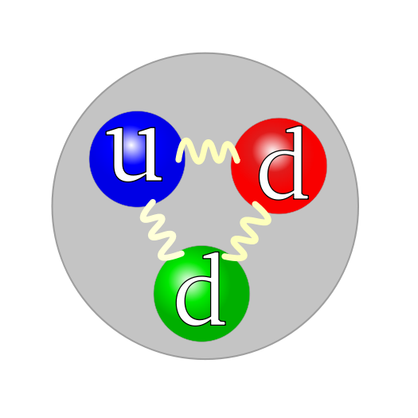
Strong CP-problem and neutron EDM
~
~1fm
Dimensional analysis (naïve) estimation of the neutron EDM:
M. Pospelov,
A. Ritz, Ann. Phys.
318 (2005) 119.
In simple terms: the theory of strong interactions demands a large neutron EDM. Experiments show it is ~9-10 orders of magnitude less! WHY?
Notes:
From dimensional analysis

Slide 8
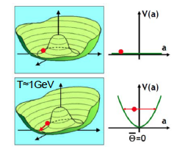
Solution to Strong CP-problem
Peccei-Quinn: θ_{QCD} is a dynamical variable (1977), a(x)/f_{a}. It roles to zero naturally
Wilczek and Weinberg: axion particle (1977)
J.E. Kim: Hadronic axions (1979)
Axions: pseudoscalars,
permeating all space

Slide 9
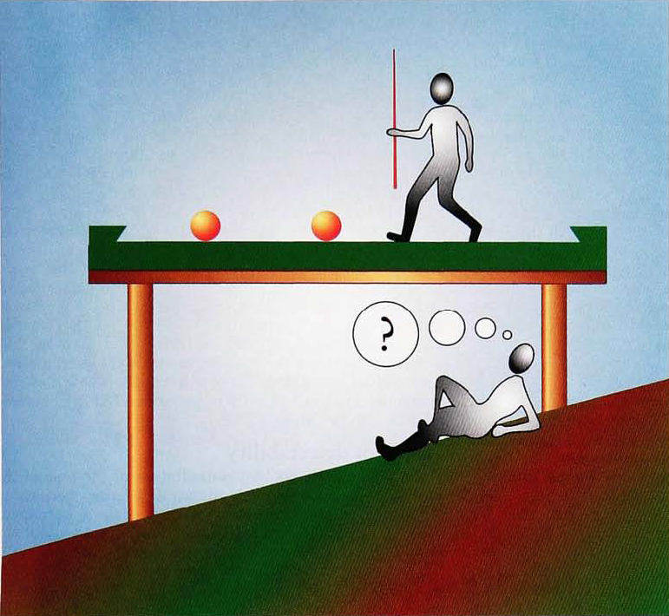
Strong CP-problem: level of pool table to <1 nrad!
Pool table is too carefully aligned!
The Pool-Table Analogy with Axion
Physics, Pierre Sikivie
Physics Today 49(12), 22 (1996);
http://dx.doi.org/10.1063/1.881573

Slide 10
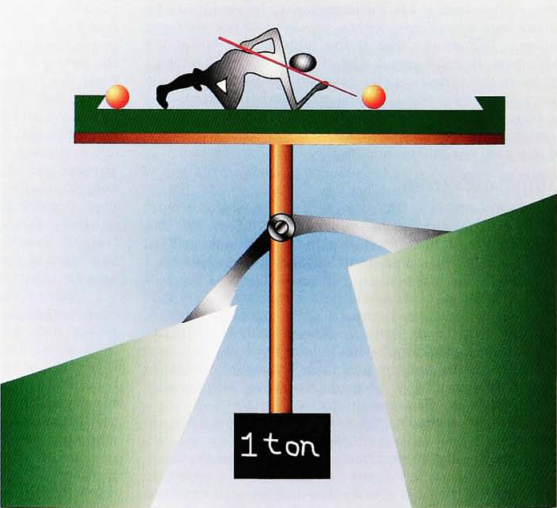
Peccei-Quinn solution of Strong CP-problem
Dynamic alignment mechanism!

Slide 11
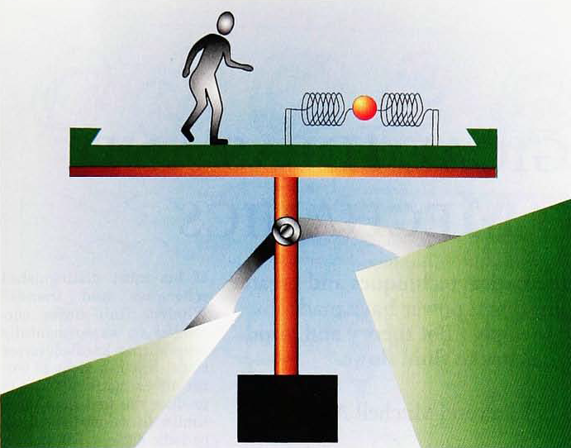
Peccei-Quinn solution of Strong CP-problem
Axions: oscillation of the system. Frequency of oscillation = axion mass.

Slide 12
Dark matter: The glue that’s holding the stars together within the galaxies.
It prevents galaxies from breaking apart. What is it?

Slide 13
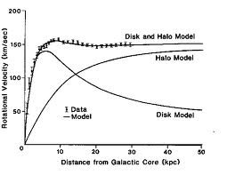
Dark matter halo model
The dark matter density near earth:
about half a proton mass per cm³.

Slide 14
P. Sikivie’s method: Axions convert into microwave photons in the presence of a DC magnetic field (Primakov effect)
a
X
Detector

Slide 15
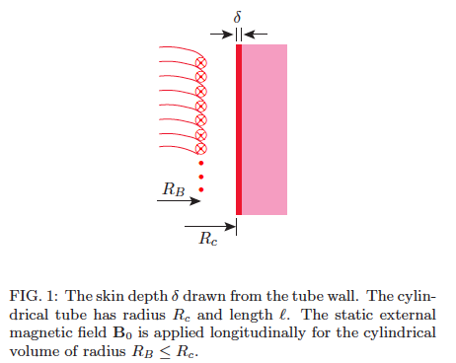
The axion field fills all space (similar to Higgs). In the presence of a magnetic field (B₀) in vacuum, we get an oscillating E-field due to the axion field along B₀. Using a microwave cavity with same resonance frequency enhances the conversion rate by the cavity Quality factor.
J. H., J.E. Kim, S. Nam, YkS
hep-ph: 1403.1576

Slide 16
The conversion power on resonance
The axion to photon conversion power is very small, a great challenge to experimentalists.

Slide 17
(CAPP) Axion dark matter plan, 1
Important parameters in the Sikivie method:
B², V, Q, Noise Temperature
We have started an R&D program for new magnets: goal 25T, 10cm diameter; then 35T, 5cm diameter. Currently all axion experiments are using <10T.
Based on high T_{c} cables (involving a Korean cable company). Program length is ~5 year.

Slide 19
Axion dark matter plan, 2
We have started an R&D program to achieve large Q in the presence of large B-fields.
Presently: Q~10⁵ copper cavities. Aiming for >10⁷.

Slide 20
Improving the quality factor Q
Superconducting vertical walls (ADMX). Parallel magnetic field B_{r} < 100Gauss.
Top and bottom walls perp. to magnetic field. R&D at KAIST to bypass the problem.
Do we need top/bottom cavity walls? A) open cavity, B) High Q dielectric. R&D at KAIST.
Toroidal cavity (no end walls!); work at KAIST.

Slide 21
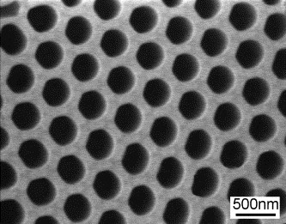
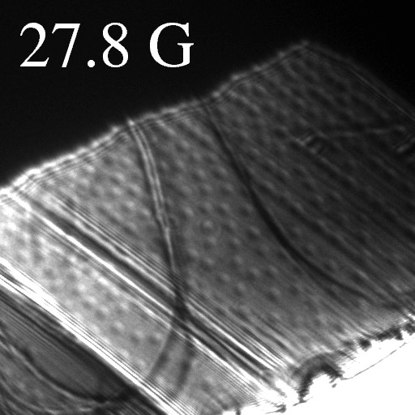
Proposal of Cryogenic STM Research Group (Jhinhwan Lee/KAIST and YkS, Patent pending) Enhancement of the High Tc Superconductors by Novel Vortex Engineering
Our Idea: Each Ion Implantation Site Designed to Hold Multiple Vortices for High Field Applications
Special Anodized Alumina Masks are to be used for Ion Implantation
Lorentz Microscopy Visualization of Distributed Vortices on BSCCO
Notes:
이 동영상에서는 각각의 에너지에서 왼쪽에 전자 파동의 공간적인 분포를, 오른쪽에는 이를 FT하여 밴드 구조 정보로 보여드리고 있습니다.

Slide 22
Axion dark matter plan, 3
We have started a development program with KRISS to provide us with (near) quantum noise limited SQUID amplifiers in the 1-10 GHz range. Evaluate method for higher frequency. 5 year program.
Physical temperature: aiming for 30mK (Q.L.: 50mK at 1GHz).

Slide 23
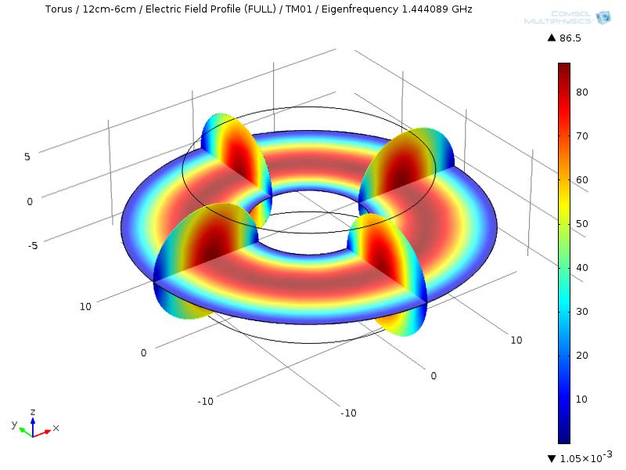
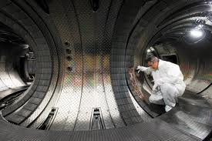
Axion dark matter plan, 4
Large volume for low frequencies (e.g., Tokamaks). Critical issue is temperature. Very expensive. Opportunity for large collaborations.
Electric field simulation of a TM010 mode in a toroidal cavity

Slide 24
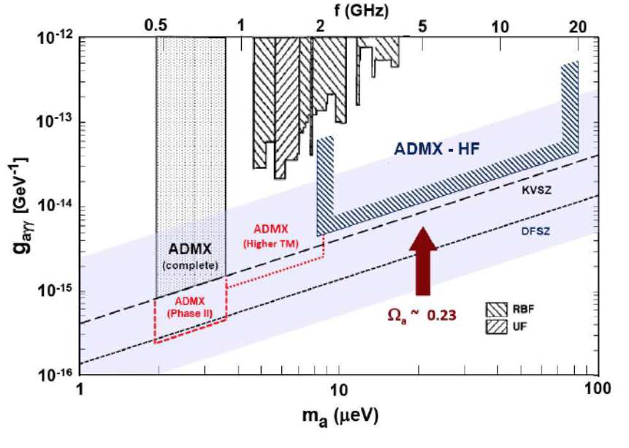
ADMX goals and CAPP plan
Current
plan,
low T
B-field
High-Q
B-field

Slide 25
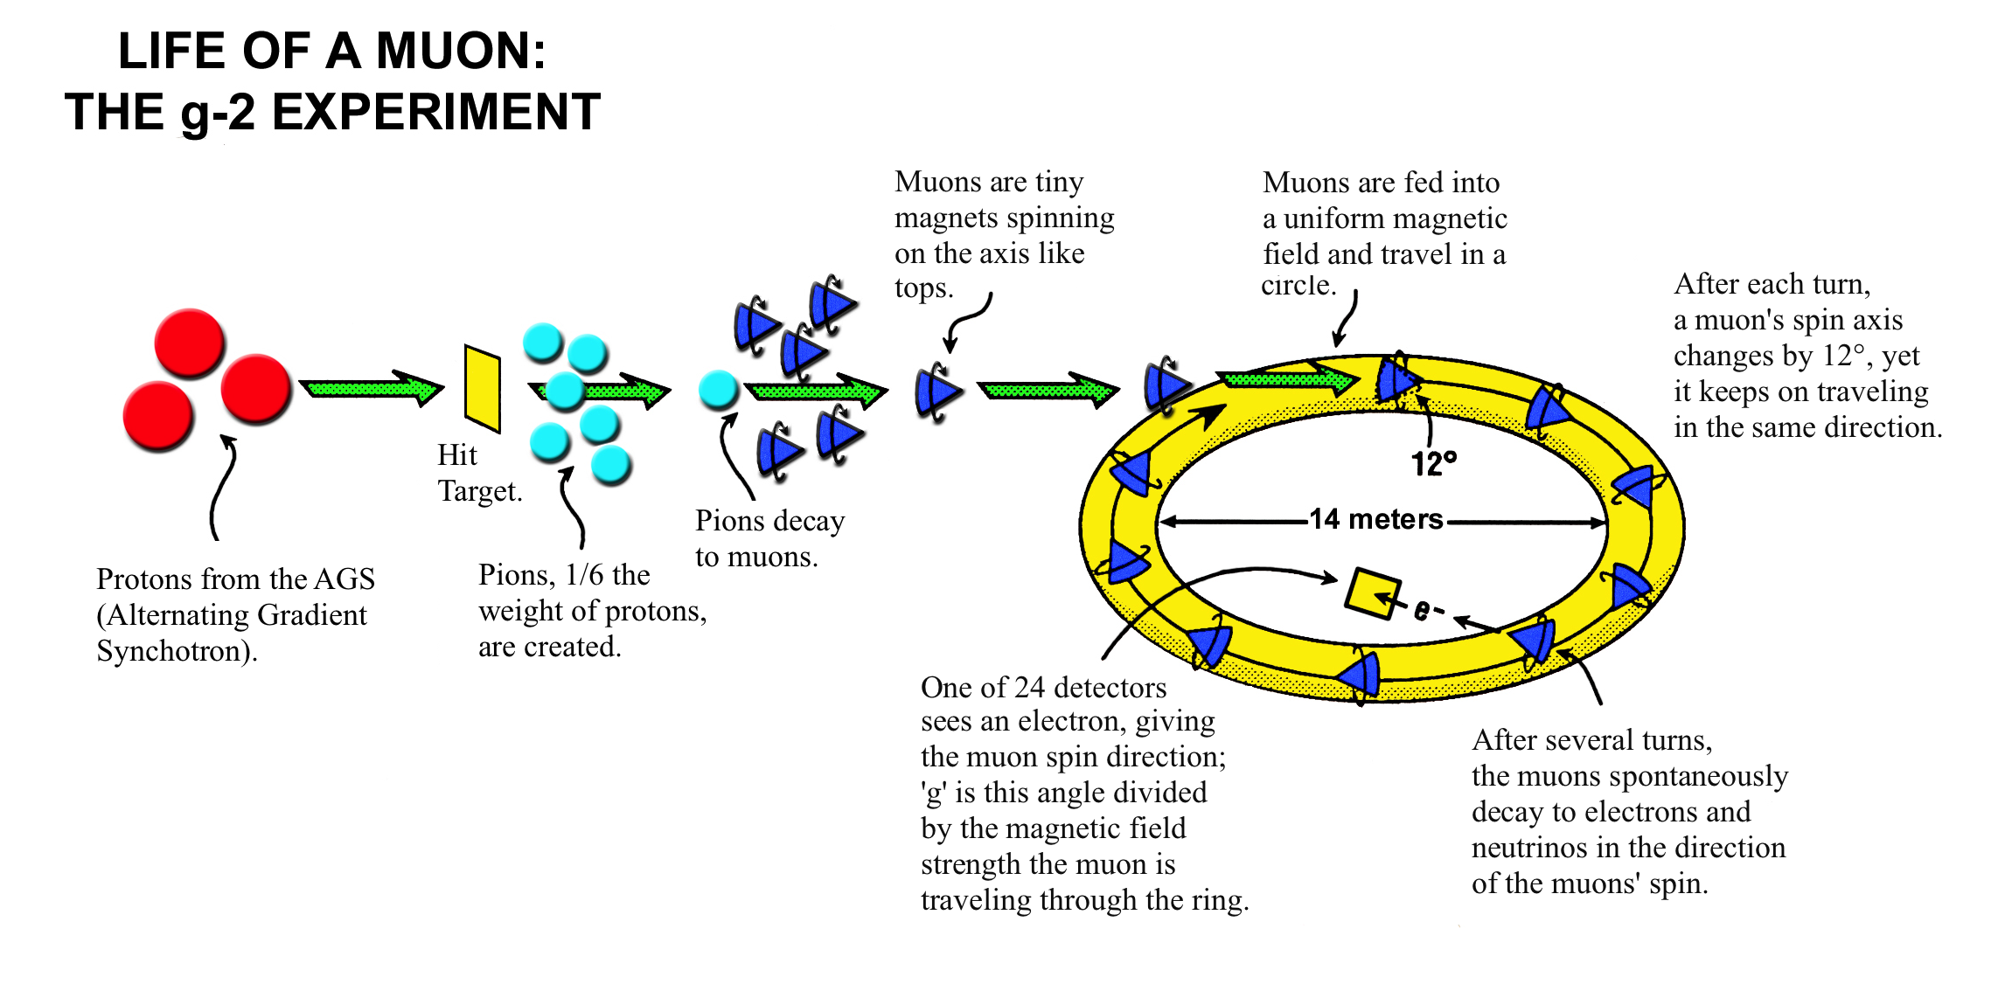
Muon g-2 experiment: Best challenge to the Standard Model
E821 at BNL: 1997-2004
E969 at FNAL: first data in 2017

Slide 26
Proton EDM experiment in storage rings: Best hadronic EDM method
First goal: 10⁻²⁹ e-cm.
Breakthrough:
Statistics!

Slide 27
Visit Korea with your Physics Ideas
Send us an email when you want to visit
Write down what you want to work on
Develop your ideas
Come and do your experiment (you as PI)
(Leading to eventual publishable results)
Incentives for teaching Nuclear/Particle Physics/Cosmology at KAIST (need at least six months warning to setup course).
Need large collaboration for toroidal cavity…

Slide 28
Summary
Axion dark matter experiments are closing in. CAPP can have a significant role in probing the axion mass range 1-100 μeV.
Proton EDM: Probe EW-Baryogenesis, high-mass scale New Physics up to ~10³ TeV.
Two of the most important physics questions today:
1) What is the Dark Matter? 2) Probe the matter-antimatter asymmetry mystery

Slide 29
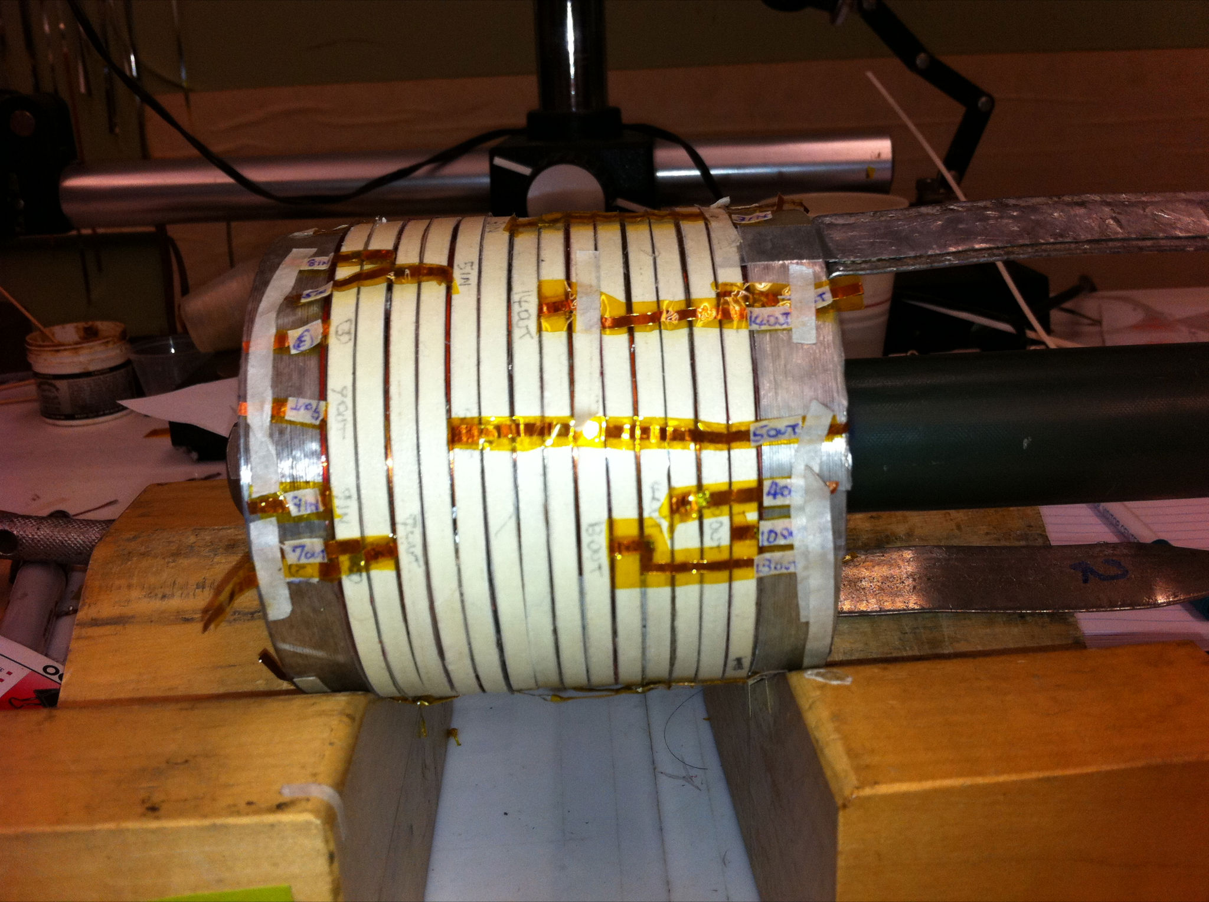
New record field, 16 T, for solenoid wound with YBCO High Field Superconductor
High Field Superconductor =
High Temperature Superconductor at 4 K (not 77 K)
Previous record: 10 T
YBCO tape: 0.1 mm x 4-12 mm
OHEP SBIR with Particle Beam Lasers, BNL as subcontractor (2 Phase IIs, 1 Phase I) – YBCO vendor: SuperPower
Full program: 3 nested coils, can test full set to ~ 40 T
I = 285 A
id = 25 mm, od 91 mm
700 m tape
Did not quench
R&D program at BNL, from P. Wanderer

